Slide 1
Quality engineer
Hao Zhong
Shanghai Jiao Tong University

Slide 2
Last class
Programmer
  How to program with others
Code style
  variable, …, class
Design pattern
  Good vs Evil

Slide 3
Design patterns
Structure Patterns
  Composite
Creation Patterns
  Factory
Behavioral Patterns
  Visitor

Slide 4
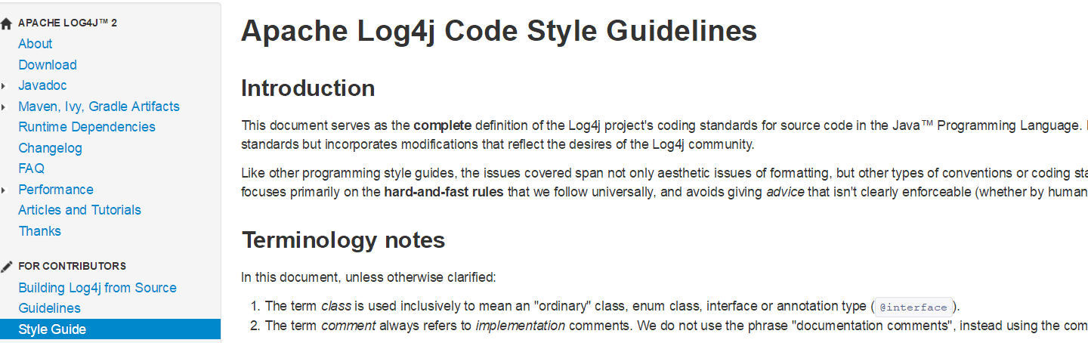
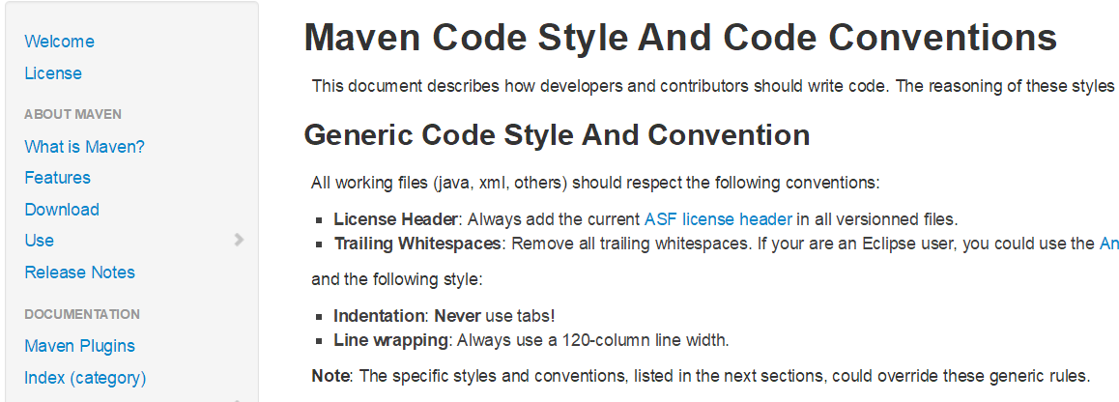
Code style

Slide 5
Software process models
Requirements
engineering
Design
Implementation
Integration
The waterfall model

Slide 6

Role
A software quality analyst is responsible for applying the principles and practices of software quality assurance throughout the software development life cycle.
A software bug is an error, flaw, failure or fault in a computer program or system that causes it to produce an incorrect or unexpected result, or to behave in unintended ways.

Slide 7
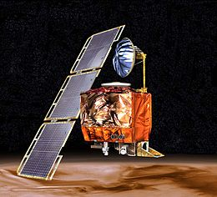


Software bug
Errors can happen in any engineering discipline
  Software is one of the most error-prone products of all engineering areas
  Software can be really complex, undecidable problems are everywhere
  Most product are put into the market with no or very few errors
Mars Climate Orbiter ($165M, 1998)
  Smashed to the planet: failing to convert between English measure to metric values
Shooting down of Airbus A300 (290 death, 1988)
  Misleading output of the tracking software
THERAC-25 Radiation Therapy (1985)
  2 cancer patients at East Texas Cancer center received fatal overdoses
Boeing 737 max (2019)
  Flight control

Slide 8
Software bug
On average, 1-5 bugs per KLOC (thousand lines of code)
  In mature software
  More than 10 bugs in prototypes
Windows2000
  35MLOC
  63K known bugs at the time of release
  2 bugs per KLOC
$59.5B loss due to bugs in US 2002 (estimation by NIST)
It is not feasible to remove all bugs
  But try to reduce critical bugs

Slide 9
Approach to reduce bugs
Testing
  Feed input to software and run it to see whether its behavior is as expected
  Limitations
    Impossible to cover all cases
    Test oracles (what is expected)
Static checking
  Identify specific problems (e.g., memory leak) in the software by scanning the code or all possible paths
  Limitations
    Limited problem types (oracles)
    False positives

Slide 10
Approach to reduce bugs
Formal Proof
  Formally prove that the program implements the specification
  Limitations
    Difficult to have a formal specification (oracle)
    The proof does not guarantee the correctness of implementation
Inspection
  Manually review the code to detect faults
  Limitations:
    Hard to evaluate (oracle)
    Huge manual effort

Slide 11
Answer is testing, why?
“50% of my employees are testers, and the rest spends 50% of their time testing”
---- Bill Gates, 1995
More reliable than inspection, relatively cheap
  Actually in the old days, when testing is expensive, inspection was the major answer
You get what you pay (linear rewards)
  Compared to other 3 approaches
    Inspection, static checking, formal proof

Slide 12
Testing: Concepts
Test case
Test oracle
Test suite
Test script
Test driver
Test result
Test coverage

Slide 13
Testing: Concepts
Test case
  An execution of the software with a given list of input values
  Include:
    Input values, sometimes fed in different steps
    Output values
Test oracle
  The expected outputs of software by feeding in a list of input values
  A part of test cases
  Hardest problem in auto-testing: test oracle problem

Slide 14
Testing: Concepts
Test suite
  A collection of test cases
  Usually these test cases share similar pre-requisites and configuration
  Usually can be run together in sequence
  Different test suites for different purposes
    Smoke test, Certain platforms, Certain feature, performance, …
Test script
  A script to run a sequence of test cases or a test suite automatically

Slide 15
Testing: Concepts
Test driver
  A software framework that can load a collection of test cases or a test suite
  It can usually handle the configuration and comparison between expected outputs and actual outputs
Test coverage
  A measurement to evaluate how well the testing is done
  The measure can be based on multiple elements
    Line
    Branch
    …

Slide 16
Granularity of testing: V-model

Slide 17
Granularity of testing
Unit Testing
  Test of a single module
Integration Testing
  Test the interaction between modules
System Testing
  Test the system as a whole, by developers on test cases

Slide 18
Unit testing
Testing of an basic module of the software
  A function, a class
Typical problems revealed
  Local data structures
  Algorithms
  Boundary conditions
  Error handling

Slide 19
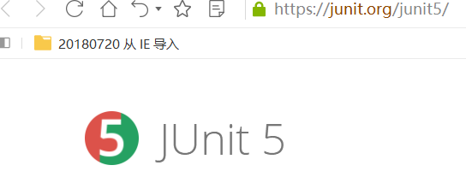
Unit test framework
xUnit
  Created by Kent Beck in 1989
    This is the same guy we mentioned in XP, design patterns
  The first one was sUnit (for smalltalk)
  Junit - The most popular xUnit framework
  There are about 70 xUnit frameworks for corresponding languages

Slide 20
Unit Test Framework
System under test: the system/module/component we are testing
Test Method: The actual code of the test
Test Case: A collection of tests with common purpose/setup

Slide 21
Writing a Test Case
public class VectorTest extends TestCase { // extending Junit TestCase
protected Vector fEmpty;
protected Vector fFull;
protected void setUp() { // executed before every test
fEmpty= new Vector(); // Generate SUTs
fFull= new Vector();
}
@Test // annotation: tell Junit a test method
public void testCapacity() { // a test method
int size= fFull.size();
for (int i= 0; i < 100; i++){
fFull.addElement(new Integer(i));
}
assertTrue(fFull.size() == 100+size); //assertion, compare output with expected
}
}

Slide 22
Assertions
public void testCapacity() { // a test method
….
assertTrue(fFull.size() == 100+size); //assertion
}
If assertion fails:
Assertion failed: myTest.java:150 (expected true but was false)
Not so good!
Try: assertEquals(100+size, fFull.size()); //expected value first
Assertion failed: myTest.java:150 (expected 102 but was 103)
Better!
Try: assertEquals(“list length”, 100+size, fFull.size());
Assertion failed: myTest.java:150 (list length expected 102 but was 103)

Slide 23
Assertions
Extend TestCase and write your own assertions
  AssertStringContains, AssertArrayEquals, …
  Use fail(String) to fail a test with certain message
Junit creates one instance of TestCase per test method
public void testRemoveAll() {
fFull.removeAllElements();
fEmpty.removeAllElements();
assertTrue(fFull.isEmpty());
assertTrue(fEmpty.isEmpty());
}

Slide 24
Test failures
Fail assertion or unhandled exception
  In JUnit, each test case is executed in a try-catch
  Why?
  Avoid one fail test to affect the following tests
Test methods are independent in JUnit
  The order of executing test methods should not affect the test results
  JUnit achieve this by setup and tear down

Slide 25
Tear down
void setUp() {
File f = open(“foo”);
File b = open(“bar”);
}
void testAAA() {
try {
use f and b
} finally {
clean&close f, b
}
}
void testBBB() {
try {
use f and b
} finally {
clean&close f, b
}
}
Consider the following test code
void setUp() {
File f = open(“foo”);
File b = open(“bar”);
}
void testAAA() {
use f and b
}
void testBBB(){
use f and b
}
Better?
Problems?

Slide 26
Tear down
Consider the following test code
void setUp() {
File f = open(“foo”);
File b = open(“bar”);
}
void testAAA() {
use f and b
}
void testBBB(){
use f and b
}
void tearDown{
clean&close f, b
}
void setUp() {
File f = open(“foo”);
File b = open(“bar”);
}
…
void tearDown{
try{
clean&close f
}catch{
…
}
the same for b
}
Even better

Slide 27
Tear down
If tear down is not complete, a test failure may affect the following test cases
Recover the changes done to global data that are not well handled by the setup
  Database, files, network, global variables
Clean resources
Caution of exceptions in tear down itself

Slide 28
Integration Testing
Big Bang
Top down
Bottom Up

Slide 29
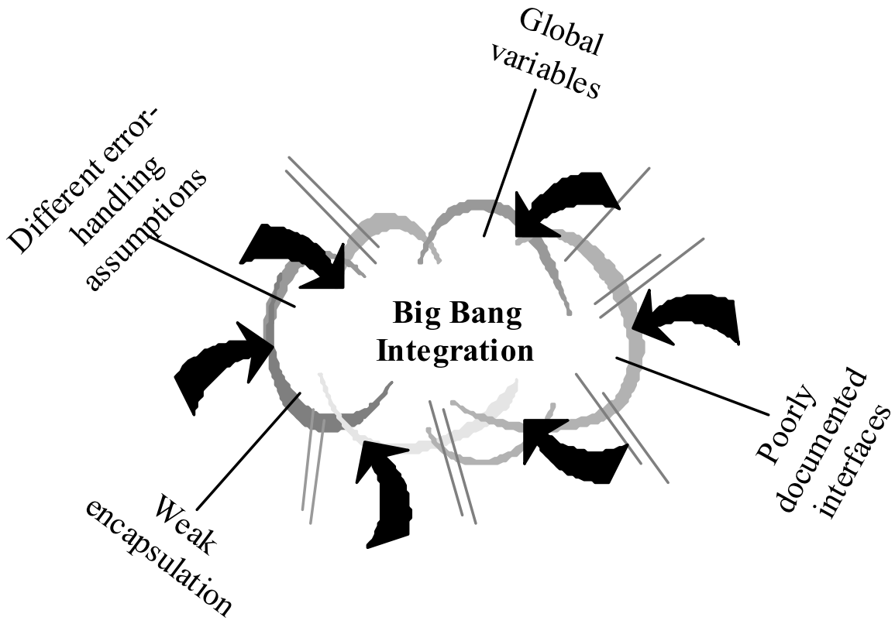
Big Bang!
Prepare all relevant components
  Data, Global variables…
  Pray!
Usage Scenario
  Quite common in small projects
  Requires no extra effort for integration
Difficult to locate a fault

Slide 30
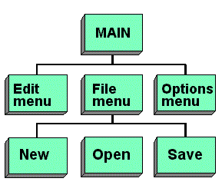
Top down strategy
Feature decomposition
  A hierarchical structure of all software features

Slide 31
Top down strategy
Focus on the validation of the whole system first
  Test an empty system with no components at first
  All components are replaced with test doubles, e.g., stubs
  Gradually add components
  Until all components are added

Slide 32
Top down strategy
Advantages
  Easier to understand the process of the integration
  May have a working system earlier (or always have a working system): important for modern development, such as XP
Disadvantages
  Requires to write test stubs
  Centralized, and the integration cannot be done in parallel

Slide 33
Bottom-up strategy
Focus on the integration of lowest units at first
  Start from an unit depending nothing else
  When all sub-unit of a component are integrated, integrate the component
  Until the whole system is built
33

Slide 34
Bottom-up strategy
Advantages
  No test stub is required
  Requires test driver but may re-use unit test cases (view the whole component as a unit)
  Support parallel integration
Issues
  No working system is available until the end
  Some issues emerge at the end

Slide 35
System testing - functional
Test the system as a whole
Usually test against requirements (specifications)
For each item in the specification
  Work out a test case and a test oracle
  Test boundary values
  Test with invalid inputs
  Test with environment errors

Slide 36
GUI testing
Testing Graphics User Interface is easier
  But harder to automate
  And harder to compare results with oracles
Manual testing is still widely performed for GUI testing
  Manually explore the user interface
  Record the steps in the test for future testing
  Observe the GUI for errors

Slide 37
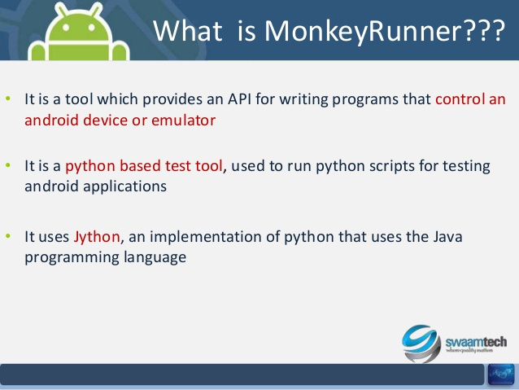
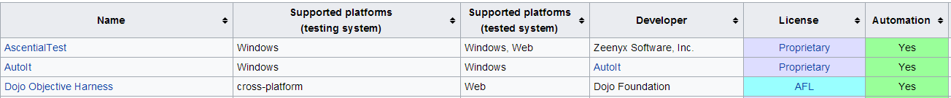
GUI testing
Record and Replay
  Screen record and replay
    Record click on the screen and keyboard inputs
    Replay all the clicks and inputs
    Not robust, affected by screen size, resolution, resize, …
  Event record and replay
    Record all the UI events in the UI framework (swing, MFC, android etc.), and outputs (texts) in the UI
    Re-trigger all the events and compare the UI texts
    More robust, but requires more preparation and overhead
https://en.wikipedia.org/wiki/Comparison_of_GUI_testing_tools

Slide 38
System testing - nonfunctional
Platforms
  OS, database, application server, browser
  Compatibility is a huge problem
Performance
  Response time
Overload
…

Slide 39
Test Coverage
After we have done some testing, how do we know the testing is enough?
The most straightforward: input coverage
# of inputs tested / # of possible inputs
Unfortunately, # of possible inputs is typically infinite
Not feasible, so we need approximations…

Slide 40
Code Coverage
Basic idea:
  Bugs in the code that has never been executed will not be exposed
  So the test suite is definitely not sufficient
Definition:
  Divide the code to elements
  Calculate the proportion of elements that are executed by the test suite
Criteria
  Statement (basic block) coverage, are they the same?
  Branch coverage (cover all edges in a control flow graph), same with basic block coverage?
  Data flow coverage

Slide 41
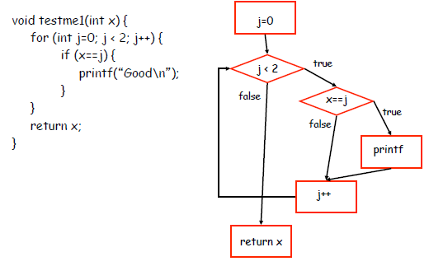
Example
branch coverage vs statement coverage

Slide 42
Example
branch coverage vs statement coverage
  0, 1 vs 1

Slide 43
Statement coverage in practice
Microsoft reports 80-90% statement coverage
Safely-critical software must achieve 100% statement coverage
Usually about 85% coverage, 100% for large systems is usually very hard
Coverage is used to build the confidence on test suites
Coverage does not guarantee correctness

Slide 44
More metrics to measure test cases
Academy
  Mutation test
Industry
  Requirement coverage
program
mutated programs
test suite
requirement
test suite

Slide 45
This class
Quality engineer
Faults and their detection approaches
Test
  Unit test
  Integration test
  System test
Test coverage

Slide 46
Next class
Quality engineer

