Slide 1
Introduction to SE300
Hao Zhong
Shanghai Jiao Tong University

Slide 2
About Me
Name
  Hao Zhong
Experience
  PhD, Peking University, 2009
  Assistant Professor, IOS, Chinese Academy of Sciences, 2009-2011
  Associate Professor, IOS, Chinese Academy of Sciences, 2011-2013
  Associate Professor, Shanghai Jiao Tong University, 2013-
Research Interest
  Empirical software engineering, program analysis, software maintenance, and mining software engineering data
Email
  zhonghao@sjtu.edu.cn
Website
  http://www.cs.sjtu.edu.cn/~zhonghao

Slide 3
Grading Schema
Exam: 40%

Slide 4
Textbook
One of the following Software Engineering books
  Pressman, “Software Engineering: A Practitioner’s approach”, 7th Edition, McGraw Hill, 2011.
  软件工程：实践者的研究方法（原书第7版·本科教学版）作者:（美）普雷斯曼 著，郑人杰 等译出版社:机械工业出版社出版时间:2011年08月
  Ian Sommerville, “Software Engineering”, 8th Edition, Addison-Wesley, 2006. (Or 9th Edition, Or 7th Edition)
  Pfleeger and Atlee, “Software Engineering: Theory and Practice”, 4th Edition, 2010, Prentice Hall, 2006.

Slide 5
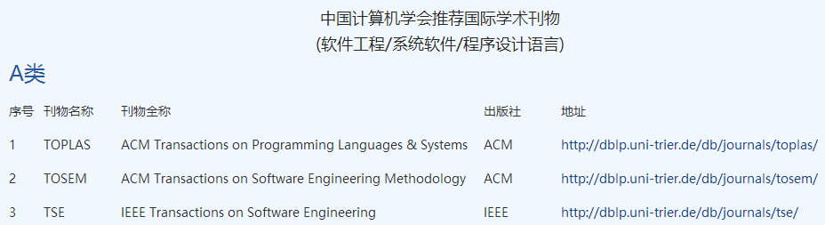
Grading Schema
Exam: 40%
Paper reading 10%
http://www.ccf.org.cn/xspj/rjgc/xtrj/cxsjyy/

Slide 6
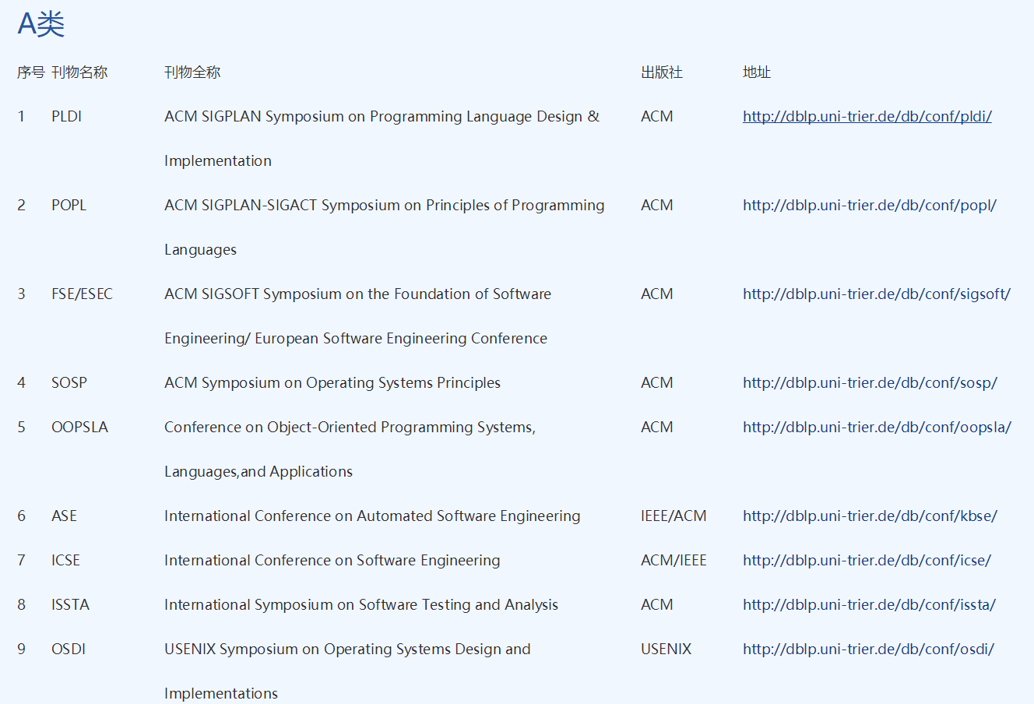
Grading Schema

Slide 7
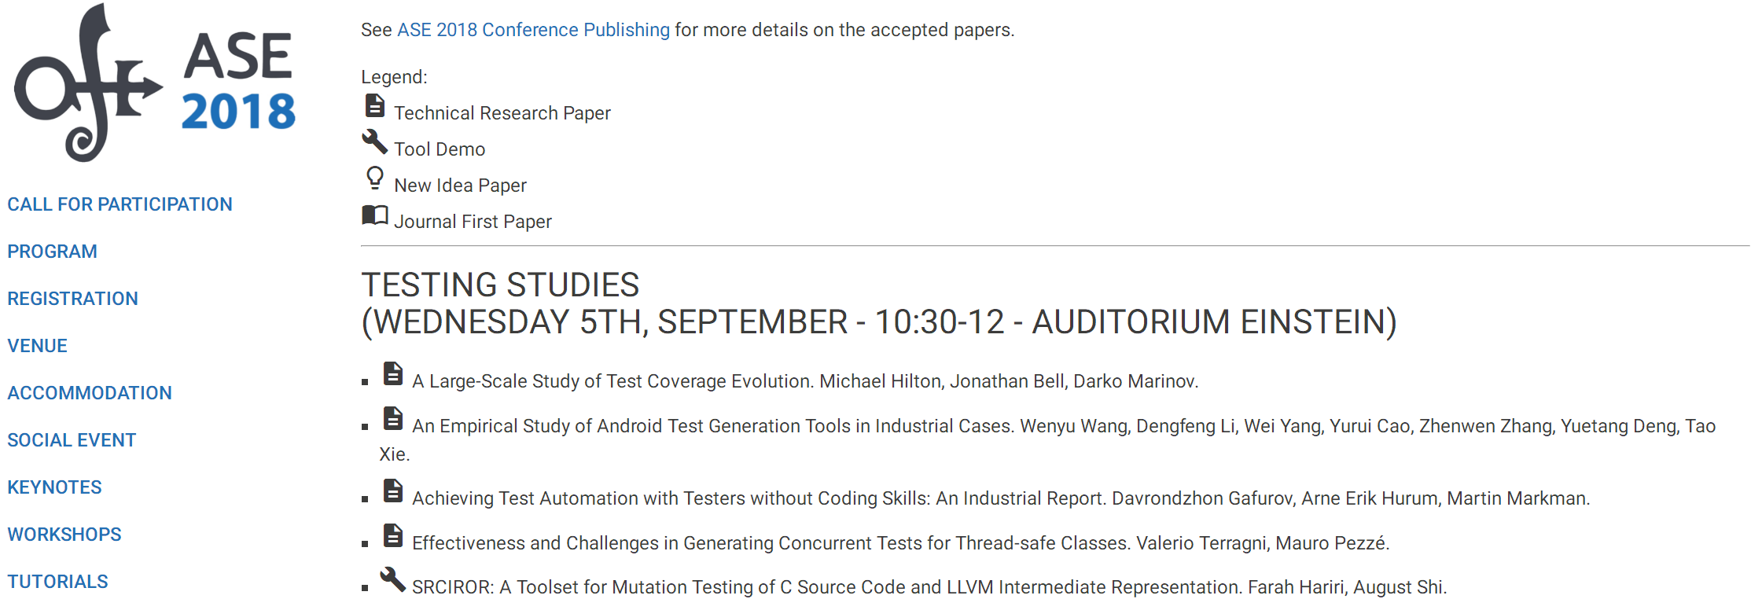
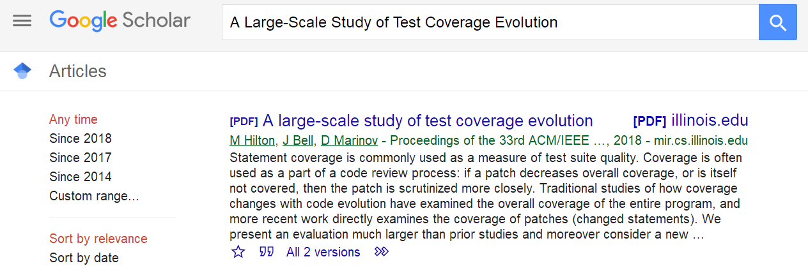
Grading Schema

Slide 8
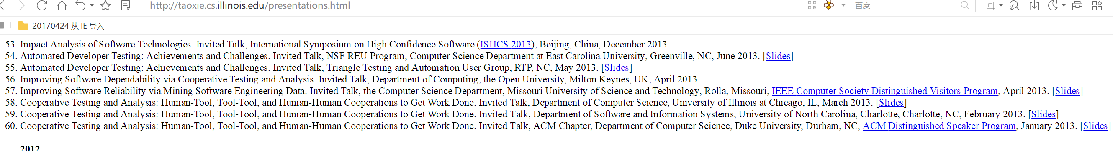
How to present a paper
Learn from others
Title, authors, conference/journal, your name, and your student number
What is the target problem? Why is it important? How do the author solve the problem? How do they evaluate their approach?
Your comments
Answer questions from me and other students

Slide 9
Grading Schema
Exam: 40%
Paper reading 10%
Project: 50%
  Midterm presentation 10%
  Final term presentation 10%
  Technical report 30%

Slide 10
Grading Schema
Exam: 40%
Paper reading 10%
Project: 50%
  Implement a tool that is useful to any roles in software engineering.
  The tool must be novel.
  Present your early results at midterm.
  Present your tool at final
  Write a technical report
  A research topic on software engineering.
  Each group consists of no more than four students.
    https://github.com/
    drhaozhong

Slide 11
What is Software (engineering)?
Software is a collection of artifacts
  Computer programs
  Data
  Documents
Characteristics of software
  Software is complex
  Software evolves
Software engineering is the establishment and use of sound engineering principles in order to obtain economically software that is reliable and works efficiently on real machines
  by Prof. Fritz Bauer at the 1968 NATO conference on software technology, in Garmisch, Germany.
In short, software engineering is about developing quality software in a productive way.

Slide 12
Software Process Models
Requirements
engineering
Design
Implementation
Integration
The waterfall model

Slide 13
Roles in software engineering
Requirements
engineering
Architecture
Designer
Domain expert
Design
Programmer
Implementation
Quality engineer
Team manager
Integration
The waterfall model

Slide 14
Software Process Models
Requirements
engineering
Design + build
prototype
Validate
prototype
Formalize
requirements
Design and
implementation
Integration
UTSA CS5103
The prototype model

Slide 15
What is a good research topic?
Novel or significantly better
Available inputs
Importance
Relevant
Implementation effort
…

Slide 16
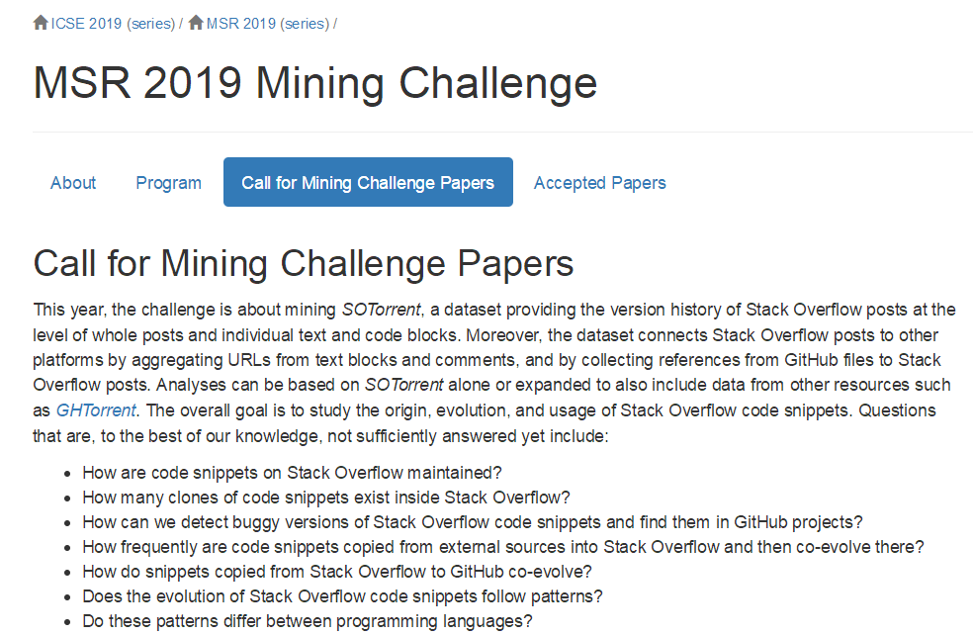
MSR 2019 Challenge
Mining StackOverflow for program repair
Xuliang Liu and Hao Zhong
In Proc. International Conference on Software Analysis, Evolution, and Reengineering (SANER), pages 118-129, 2018.
[pdf] [BibTeX]

Slide 17
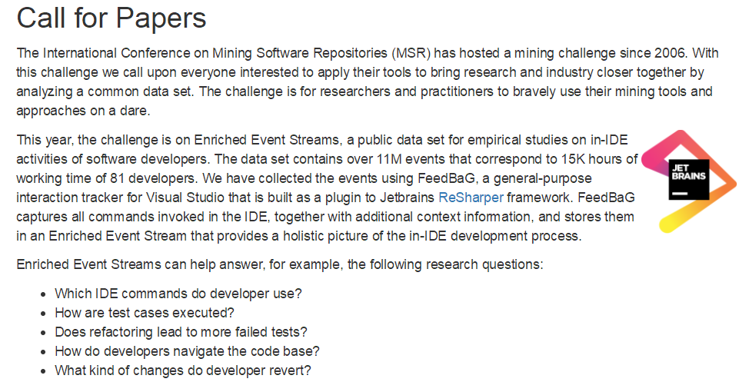
MSR 2018 Challenge

Slide 18
MSR 2017 challenge
This year, the challenge is on TravisTorrent, a freely available data set synthesized from Travis CI and GitHub. TravisTorrent provides easy access to hundreds of thousands of analyzed builds from more than 1,000 projects.
Data format https://travistorrent.testroots.org/page_dataformat/
API https://github.com/travis-ci/travis.rb
Dump https://travistorrent.testroots.org/page_access/
Column | Description
tr_build_id | The analyzed build id, as reported from Travis CI.
tr_job_id | The job id of the build job under analysis.
tr_build_number | The serial build number of the build under analysis for this project.
…

Slide 19
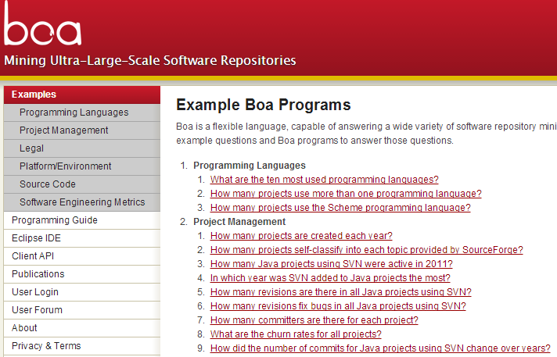
MSR 2016 challenge
We provide the data including the metadata for all projects/repositories and development histories for Java projects/repositories from SourceForge and GitHub up to September 2013.

Slide 20
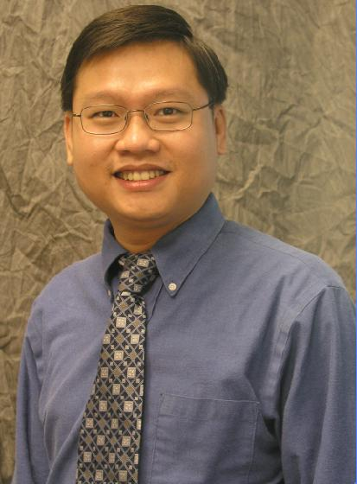
MSR 2016 challenge
Dyer, Robert, Hridesh Rajan, Hoan Anh Nguyen, and Tien N. Nguyen. "Mining billions of AST nodes to study actual and potential usage of Java language features." In Proc. ICSE, pp. 779-790. 2014.
  RQ1: Do Projects Use New Language Features Before Their Release?
  RQ2: How Frequently Is Each Language Feature Used?
  RQ3: How Did Committers Adopt and Use Language Features?
  RQ4: Were There Missed Opportunities to Use Language Features?
  RQ5: Was Old Code Converted to Use New Language Features?
Tien N. Nguyen

Slide 21

MSR 2015 and 2013 challenges
This year's challenge is on comparing and combining different information sources, on theStack Overflow data set.
http://2015.msrconf.org/challenge_data/
http://data.stackexchange.com/ (Latest)

Slide 22
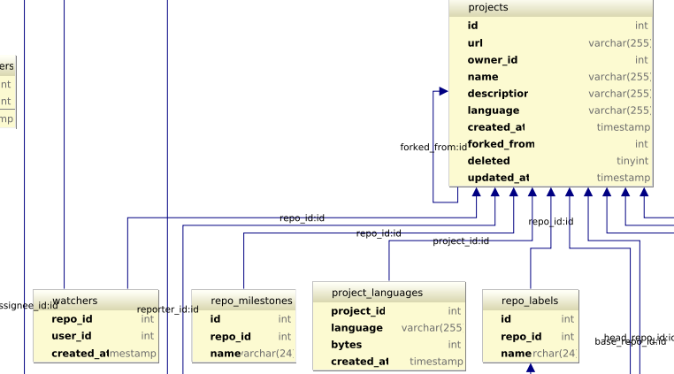
MSR 2014 challenge
This year, the challenge is on the GitHub data. We provide the data for the GitHub repository and you should use your brain, tools, computational power, and magic to uncover interesting findings related to it.
http://www.ghtorrent.org/ (Updated!!!)
http://www.ghtorrent.org/downloads.html

Slide 23
MSR 2012 and 2011 challenges
The focus of the challenge is the Android platform. We provide two sources of data: the Android changes (updated Dec. 6) and Android bug reports (updated Dec. 6).
This year the main theme of the challenge is on comparison of projects. We selected four open source projects, and you should use your brain, tools, computational power, and magic to compare them and uncover interesting similarities and differences. The projects are Eclipse and Netbeans, two popular IDEs written in Java (Group 1) and Firefox and Chrome,
  Bug reports
  SVN

Slide 24
Other data sources
FLOSSmole
  http://flossmole.org/
PROMISE
  http://openscience.us/repo/
Software-artifact Infrastructure Repository
  http://sir.unl.edu/portal/index.php
Socorro
  https://wiki.mozilla.org/Socorro
Mame (requirements)
  http://softwareprocess.es/static/What's_in_a_Name.html
SeCold
  https://sites.google.com/site/asegsecold/

Slide 25





What is open source
Open-source software (OSS) is computer software with its source code made available with a license in which the copyright holder provides the rights to study, change, and distribute the software to anyone and for any purpose.

Slide 26

Why open source
Individuals
  learn about new tools, techniques, skills, etc.
  have fun building software
  exercise their technical skill
  try out new kinds of systems to develop
  interconnect multiple FOSSD projects

Slide 27


Why open source
Company and organizations
  Free Software (GPL)
  Free sample
    Community versions (Mysql)
  Business model
    Corporate-Sponsored (IBM-Eclipse)

Slide 28
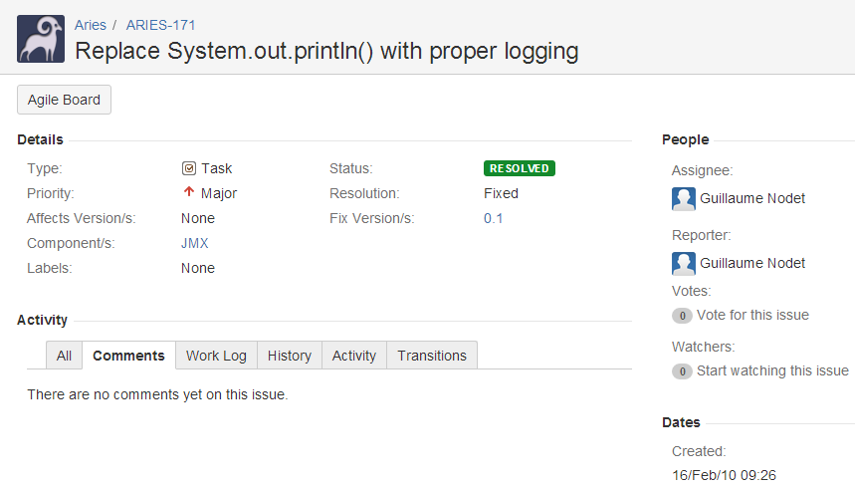
Characteristics
People come and go
Roles, but different from commercial software
No explicit requirements and no design
  Refined incrementally
People locate in different places
  SVN, GIT (Will introduce later)
Issue tracker

Slide 29
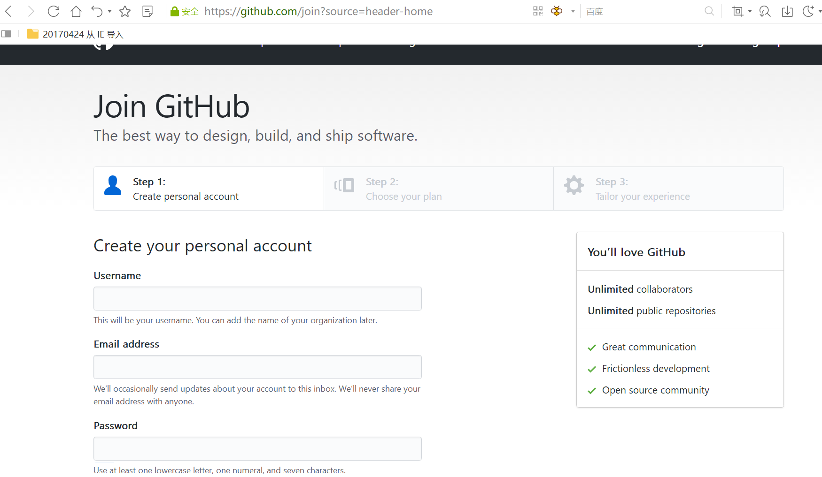
Development Environment
Java
  https://blog.csdn.net/u012934325/article/details/73441617/
Eclipse
  http://www.runoob.com/eclipse/eclipse-install.html
Github
  https://blog.csdn.net/earl_yuan/article/details/60476938

Slide 30
Code analysis
Compiler
Partial program analysis
More advanced analysis

Slide 31
Java model
Eclipse JDT
  An open source compiler that is integrated with Eclipse
  APIs to access, create, and manipulate Java projects’ source code

Slide 32
How do we use Java model?
https://www.programcreek.com/2011/01/best-java-development-tooling-jdt-and-astparser-tutorials/

Slide 33
Create New Java Elements

Slide 34
Abstract syntax tree
More details: http://www.vogella.com/tutorials/EclipseJDT/article.html

Slide 35
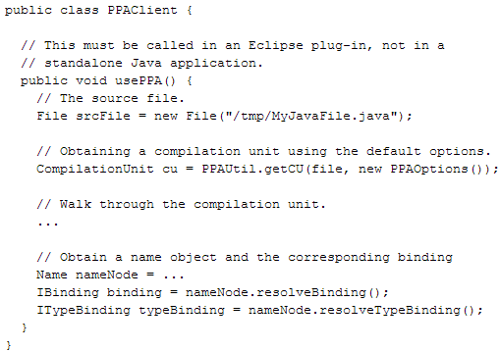
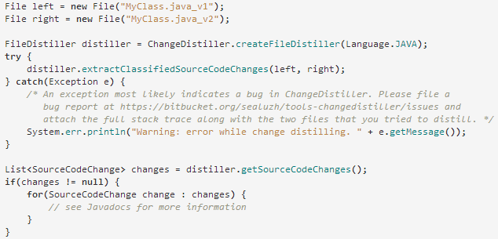
Partial program analysis
A partial program is a subset of a complete program.
PPA
  http://www.sable.mcgill.ca/ppa/ppa_eclipse.html
Changedistiller
  http://www.ifi.uzh.ch/en/seal/research/tools/changeDistiller.html

Slide 36
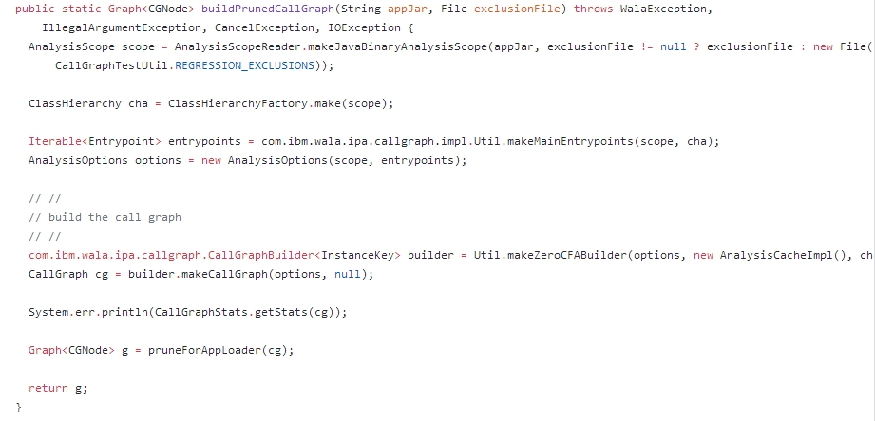
More advanced analysis
WALA
  http://wala.sourceforge.net/wiki/index.php/Main_Page
Soot
  https://sable.github.io/soot/

Slide 37





Mining software engineering data
Tao Xie, UIUC
  Software Mining and Software Datasets. Invited Tutorial. 2015 NSF Interdisciplinary Workshop on Statistical NLP and Software Engineering, Seattle, WA, October 2015. [Slides]
  Towards Mining Software Repositories Research that Matters. Next Generation of Mining Software Repositories '14 (Pre-FSE 2014 Event), November 2014. [Slides]
  Improving Software Reliability via Mining Software Engineering Data. Invited Talk, the Computer Science Department, Missouri University of Science and Technology, Rolla, Missouri, IEEE Computer Society Distinguished Visitors Program, April 2013. [Slides]

Slide 38
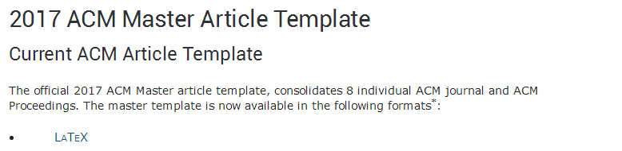
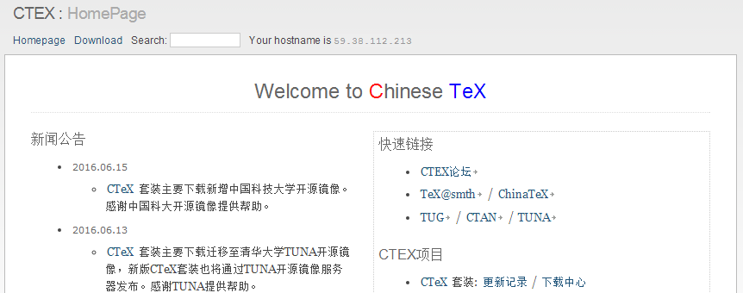
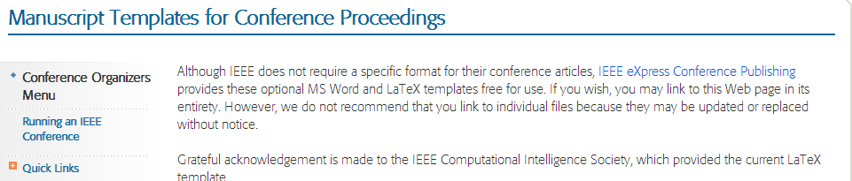
Grading Schema
Exam: 40%
Paper reading 10%
Project: 50%
  A research topic on software engineering.
  Working towards a published paper.
http://www.acm.org/publications/proceedings-template
http://www.ctex.org/HomePage
https://www.ieee.org/conferences_events/conferences/publishing/templates.html

Slide 39
Grading Schema
Exam: 40%
Paper reading 10%
Project: 50%
  Midterm presentation 10%
  Final term presentation 10%
  Technical report 30%

Slide 40
The structure of a technical report
Role
Motivation
Related work
Contribution
Technical issues
Evaluation

Slide 41
This class
Introduction
Grading Schema
Open source
  Software engineering data
Code analysis
  Compiler
  Partial program analysis
  WALA, SOOT

Slide 42

Next class
Domain Expert

