Slide 1
UI designer
Hao Zhong
Shanghai Jiao Tong University

Slide 2
Last class
Project manager
  Responsibility
  Cost estimation
  Planning
  Risk
  CVS
  Issue tracker

Slide 3
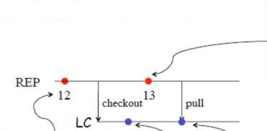
Concurrent Development

Slide 4
Merge Conflict

Slide 5
Merge is textual
Code may not work after merge
  Developer A makes the change:
    f (int x, int y) -> f(int x, int y, int z)
  Developer B makes the change:
    insert f(a, b)
Merge problems
  Code will not compile
  It is lucky that it does not compile!
  Communication: notify the people who may be affected
  Auto test suite and Regression testing!!
M. Tufano, F. Palomba, G. Bavota, M. Di Penta, R. Oliveto, A. De Lucia,
and D. Poshyvanyk. There and back again: Can you compile that
snapshot? Journal of Software: Evolution and Process, 2016.

Slide 6
Branch
Users report bugs for a released version
  Bug fixes are applied on this specific version
Programmers are developing to next version (branch)
Need to merge before the next release

Slide 7
Other reasons for branches?
Temporary versions
  Implement new features (tentative)
  Isolate changes to have a stable trunk
  Eventually merge back to the trunk
Snapshot for testing
  Development continues
  Fixes eventually merge back to the trunk
Separate branch for different release
  Different OS, …

Slide 8
Software process models
Requirements
engineering
Design
Implementation
Integration
The waterfall model

Slide 9
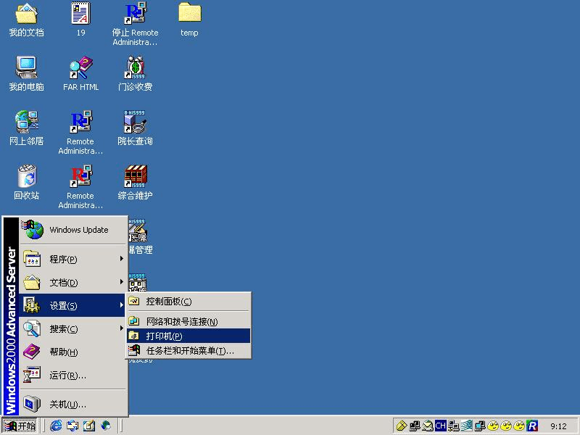
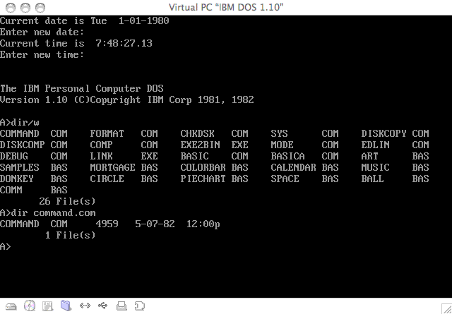
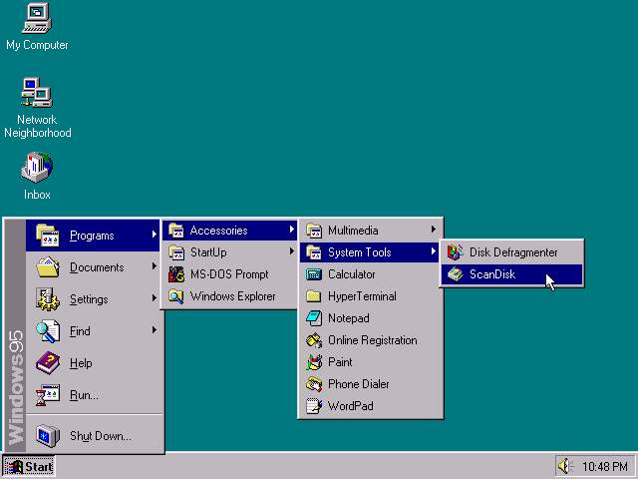
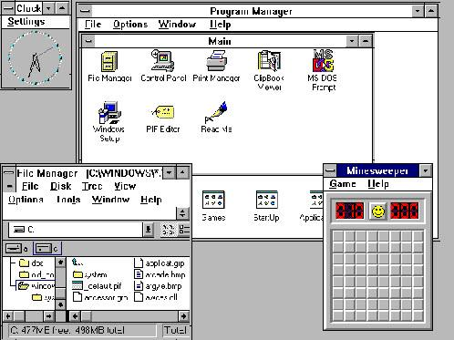
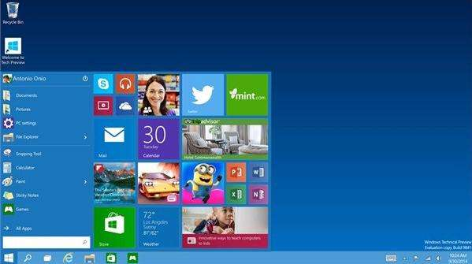
Role
User interface design (UI) or user interface engineering is the design of user interfaces for machines and software, such as computers, home appliances, mobile devices, and other electronic devices, with the focus on maximizing usability and the user experience.

Slide 10
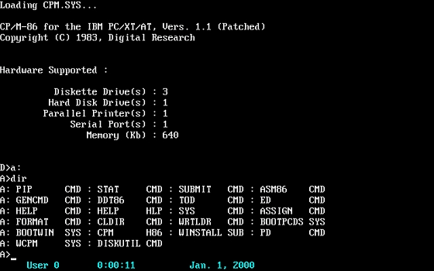
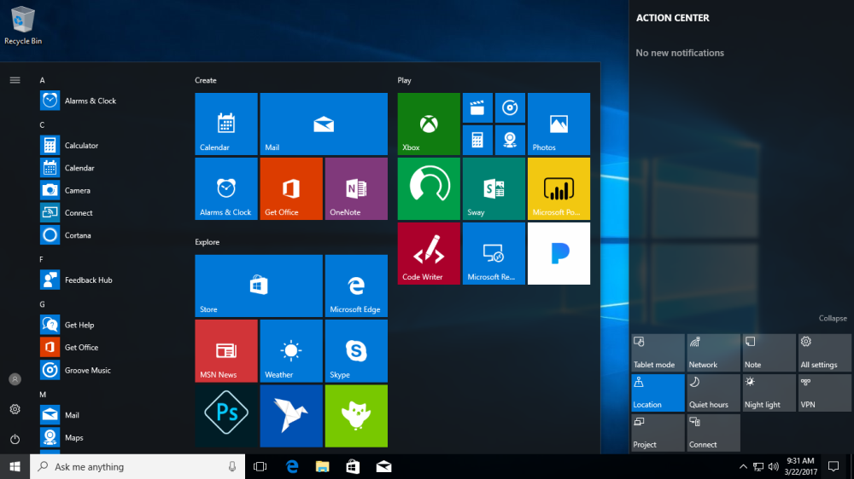
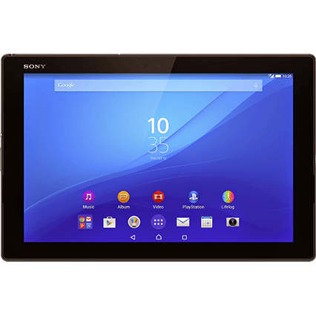

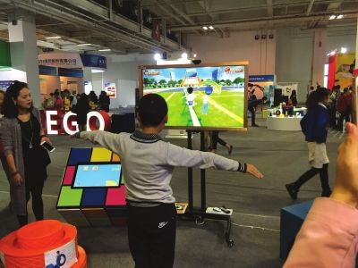
The history of UI
?

Slide 11
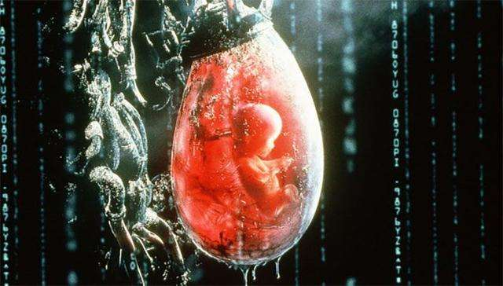
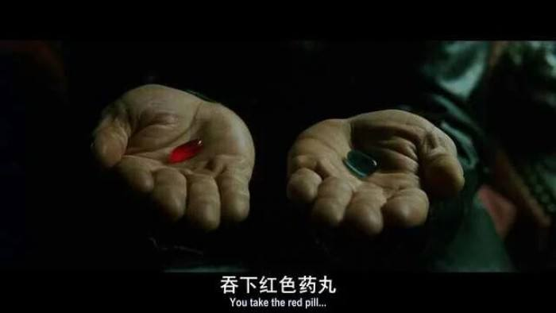
The future of UI

Slide 12

Why it matter
System users often judge a system by its interface rather than its functionality
A poorly designed interface can cause a user to make catastrophic errors
Poor user interface design is the reason why so many software systems are never used

Slide 13
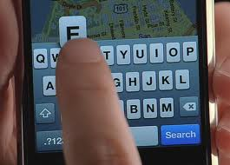
User-system interaction
Two problems must be addressed in interactive systems design
  How should information from the user be provided to the computer system?
  How should information from the computer system be presented to the user?
User interaction and information presentation may be integrated through a coherent framework such as a user interface metaphor

Slide 14
Software Process Models
Requirements
engineering
Design + build
prototype
Validate
prototype
Formalize
requirements
Design and
implementation
Integration
UTSA CS5103
The prototype model

Slide 15
User interface design process

Slide 16
Some methods to achieve good usability:
Paper prototyping
  Show users various UI menus and ask them to group the ones that are similar, to see what UI tasks are seen as being related by users.
Code prototyping
User testing / field studies
  having users use the product and gathering data
  Evaluations and reviews by UI experts

Slide 17
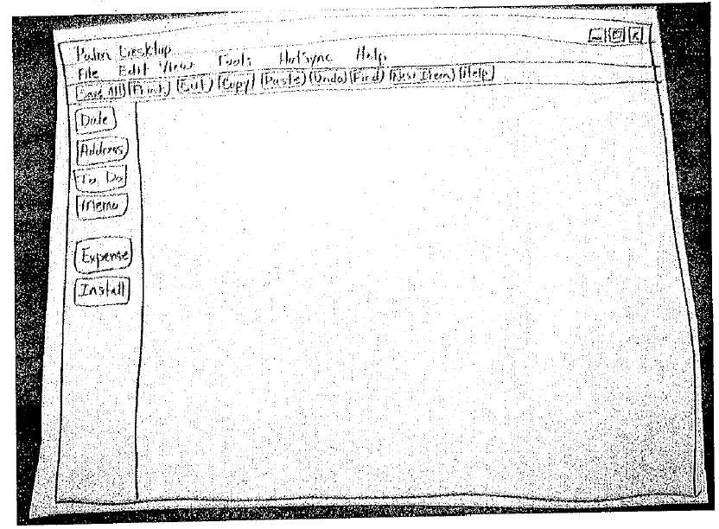
Creating a paper prototype
Your requirements and designs?
Identify the screens in your UI
  consider use cases, inputs and outputs to user
Think about how to get from one screen to next this will help choose between tabs, dialogs, etc.
Drawing the background

Slide 18
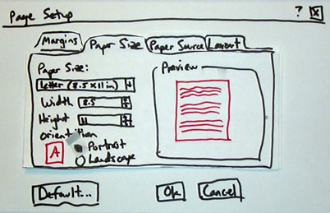
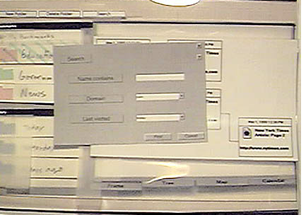
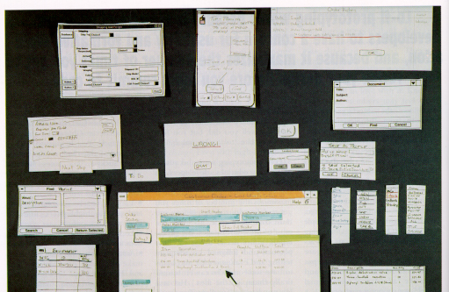
Representing a changing UI

Slide 19
Code prototype
UI builders (Visual Studio, ...)
  Draw a GUI visually by dragging/dropping UI controls on screen
  No real implementation
The logic chain, with faked data
Depth of menu
Determine whether the underlying framework supports the paper prototype
  Implement a customized UI is difficult
  APIs
  Need art designers

Slide 20
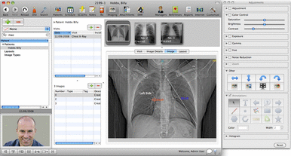
UI design principles
User familiarity
  The interface should be based on user-oriented terms and concepts rather than computer concepts
  E.g., an office system should use concepts such as letters, documents, folders etc. rather than directories, file identifiers, etc.

Slide 21
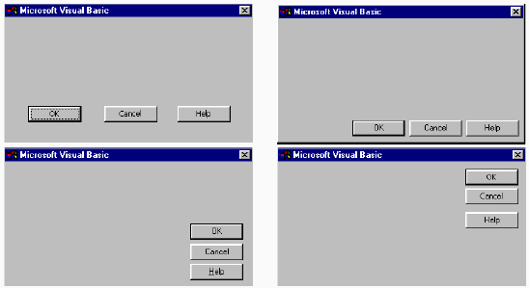
UI design principles
Consistency
  The system should display an appropriate level of consistency
  Commands and menus should have the same format, command punctuation should be similar, etc.

Slide 22
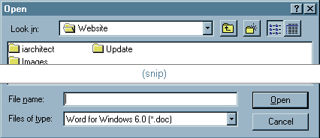
UI design principles
Minimal surprise
  If a command operates in a known way, the user shall not diagnose abnormal behaviors

Slide 23
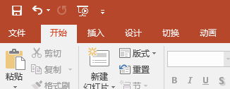
UI design principles
Recoverability
  The system should provide some resilience to user errors and allow the user to recover from errors
  This might include an undo facility, confirmation of destructive actions, 'soft' deletes, etc.

Slide 24
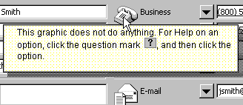
UI design principles
User guidance
  Some user guidance such as help systems, on-line manuals, etc. should be supplied

Slide 25

UI design principles
User diversity
  Interaction facilities for different types of user should be supported
  E.g., some users have seeing difficulties and so larger text should be available

Slide 26
UI design principles
Meaningful feedback
  Programmers often use UI to debug

Slide 27
Usability attributes
Learnability
  How easy is it for users to accomplish basic tasks the first time they encounter the design?
Efficiency
  Once users have learned the design, how quickly can they perform tasks?
Memorability
  When users return to the design after a period of not using it, how easily can they reestablish proficiency?
Errors
  How many errors do users make, how severe are these errors, and how easily can they recover from the errors?
Satisfaction
  How pleasant is it to use the design?

Slide 28
Simple evaluation techniques
Questionnaires for user feedback
Video recording of system use and subsequent tape evaluation.
Instrumentation of code to collect information about facility use and user errors.
  Analyze help desk logs
  Analyze access logs for web apps

Slide 29

Internationalization
Why should a team want to internationalize / localize its app?
  reach a wider audience
  make more money
Is it worth it to localize?
  May need to evaluate cost/benefit:
    What fraction of our users speak that language?
    Development effort
Open-source software is often translated for free by community
  Maybe you can post your code and let them do it ...

Slide 30
Locales
locale: A geographic/cultural location targeted for localization.
  A locale consists of:
    a language (e.g. English)
      often expressed as an ISO-639-1 code: de, en, fr, ja
    a location or variant (e.g. United States, UK)
      often expressed as an ISO-3166-1 code: CA, US, GB, DE, ES, JP
Why isn't it enough to specify just the language?
  Different locations may use different conventions, spelling, etc.
    "color" (US) vs. "colour" (UK)
    "localize" (US) vs. "localise" (UK)
  Other differences (dates, currency, numbers, time zone, etc.)

Slide 31
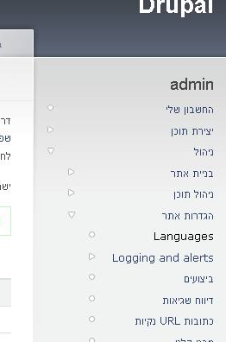
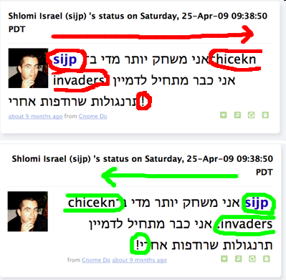
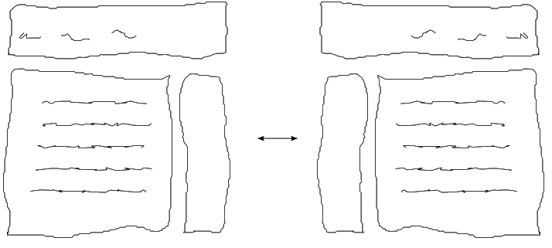
Right-to-Left (RTL)
Some languages begin lines on the right side and go left
  Arabic, Farsi/Persian, Hebrew, Kurdish, Punjabi, Somali, ...
Often handled by supplying separate .css files for RTL locales
Can lead to lots of subtle UI bugs
based on coders' LTR assumptions

Slide 32
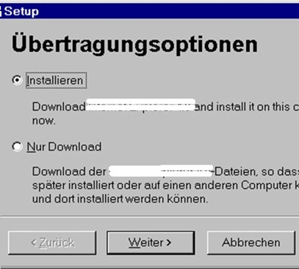
Localization gotchas
Some languages (e.g. German) use long words
  buttons/labels get too wide for space provided
Some Unicode characters look like ASCII ones
  U+00A0 "non-breaking space" character
  "-" vs. U+2014 "em-dash" —, U+2013 "en-dash" –
Some fonts don't have all characters
  but a smart OS can use font substitution
Regular expressions / text searches may not match i18n input
  ex. \w "word boundary" doesn't match Unicode word delimiters
Web server might return text that has not been localized (Ajax)

Slide 33
Differences between locales
language English vs. German
spelling "color" vs. "colour"
slang "line" vs. "queue"
number formatting
  telephone number format (206) 949-0504 vs. +1.206.949.0504
  decimal separator, digit groups
currency units/formatting $123.45 vs. 123,45€
date formatting 3/14/10 vs. 2010/Mar/14
keyboard shortcuts
text direction hello vs. שָׁלוֹם
  left-to-right ("LTR") vs. right-to-left ("RTL"), AKA "bidi" issues
multimedia: spoken audio; video subtitles

Slide 34
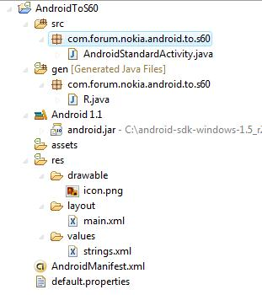
Android localization
Android apps store resources in res/ folder
  text strings go in strings.xml files:
  res/values/strings.xml (defaults)
  res/values-en/strings.xml (English)
  res/values-fr/strings.xml (French)
Testing locales:
  (on a real Android device)
  Home → Menu → Settings →
  Locale & text → Select locale

Slide 35
strings.xml example
  <!-- res/values/strings.xml -->
  <?xml version="1.0" encoding="utf-8"?>
  <resources>
  <string name="greeting">Hello!</string>
  <string name="login">User %1 logged in.</string>
  </resources>
  <!-- layout XML file that uses string in View -->
  <TextView
  android:layout_width="fill_parent"
  android:layout_height="wrap_content"
  android:text="@string/greeting" />
  // in-app Java code that grabs a resource string
  Resources res = getResources();
  String greet = res.getString(R.string.greeting);
  String msg = String.format(
  res.getString(R.string.login), userName);

Slide 36


Other resources
Images are in res/drawable
  res/drawable/company-logo.png (English)
  res/drawable-fr/company-logo.png (French)
  <!-- layout XML file that uses image in View -->
  <ImageView
  android:layout_height="wrap_content"
  android:layout_width="wrap_content"
  android:src="@drawable/company-logo" />
Layouts are in res/layout
Menus are in res/menu
Colors are in res/values/colors.xml

Slide 37
Formatting dates
Differences in how to display dates across locales:
  names of the months/days (Monday vs. Lundi)
  ordering of days (what day does a week start/end)
  relative order of y/m/d (3/14/2010 vs. 2010/Mar/14)
  time zone (usually offset from UTC/GMT)
  12 vs. 24 hour time (5:00 PM vs. 17:00)
java.text.DateFormat formats dates
  styles: DateFormat.DEFAULT, FULL, LONG, MEDIUM, SHORT
  DateFormat fmt = DateFormat.getDateTimeInstance(
  DateFormat.LONG, DateFormat.SHORT, locale);
  String s = fmt.format(new Date());
  Date d = fmt.parse(dateText.trim()); // parse a date

Slide 38
This class
UI designer
  Responsibility
UI design
  Principle
  Process
  Evaluation
Internationalization
  Language
  Locale

