Slide 1
COMP 110-001
Loop Statements
Yi Hong
May 21, 2015

Slide 2
Announcements
Grades of Lab 0 were posted

Slide 3
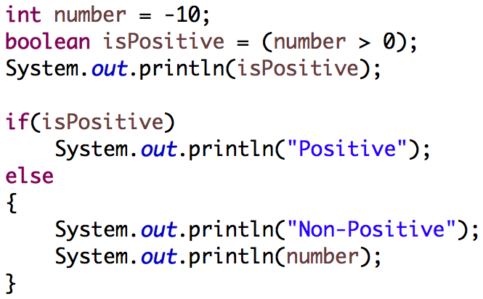
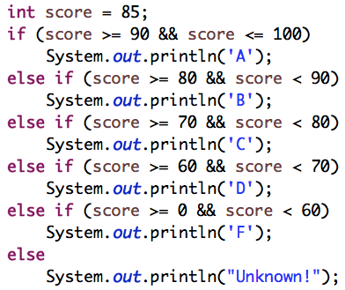
Review
Q1: What’s the outputs of following statements?
Q2: Write a program that assigns grade based on an input score
  A: 90 ~ 100
  B: 80 ~ 89
  C: 70 ~ 79
  D: 60 ~ 69
  F: 0 ~ 59

Slide 4
If-Else or Switch Statement
Use a switch statement when you have more than 2 conditions on a single variable
  Example: Weekdays – if you have a different action to perform for each day of the week, use a switch statement
Use an if-else for all other scenarios:
  More than one variable you’re testing (multiple conditions)
  Testing for a range of values
  Variable is not an int, char, or enum
  Example: Grades – each grade (A, B, C, D, E) has a range of values that reflect each grade letter

Slide 5
Today
Loop statements
Warm-up so far in this course
Loop is where it starts to get harder
I suggest you to spend more time on examples given in this and future lectures

Slide 6
Flow of Control
Alter the order in which a program’s statements are executed
Typically, two kinds
  Conditionals (if-else and switch)
    Execute a set of statements by choosing among two or more paths
  Loops
    Repeat a group of instructions numerous times

Slide 7
Types of Loops
while loop
  Repeats its body while a boolean expression is true
do while loop
  Loop iterates at least ONCE
for loop
  Numeric computation changes by equal amount

Slide 8
The While Loop
Syntax
  while (Boolean_Expression)
  Body
  The Body may be either a
  simple statement or, a list of
  statements enclosed in braces {}
A while statement repeats while a controlling boolean expression remains true
The loop body typically contains an action that ultimately causes the controlling boolean expression to become false

Slide 9
An Example of a While Loop

Slide 10
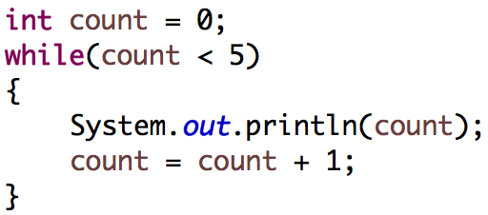
While in Practice
What’s the output?
  Iteration 1: count = 0, < 5? true, print 0, +1
  Iteration 2: count = 1, < 5? true, print 1, +1
  …
  Iteration 5: count = 4, < 5? true, print 4, +1
  Iteration 6: count = 5, < 5? false, stop

Slide 11
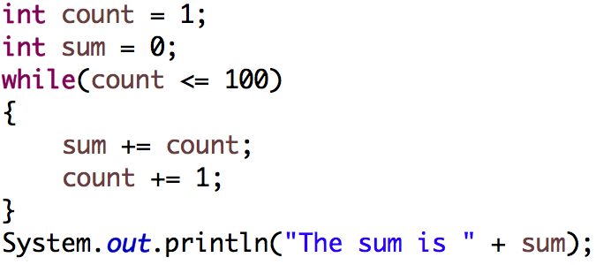
Calculate the Sum of 1…100

Slide 12
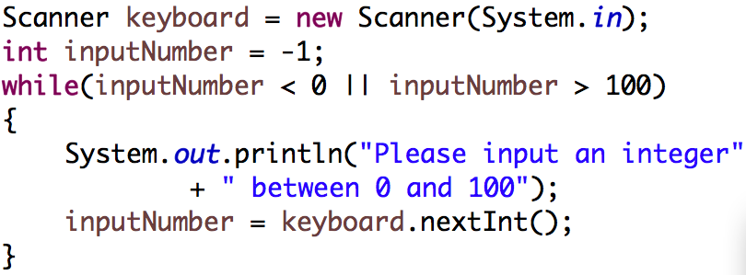
Input Checking
Ask user to input an integer between 0 and 100, keep reading until we get the correct input

Slide 13
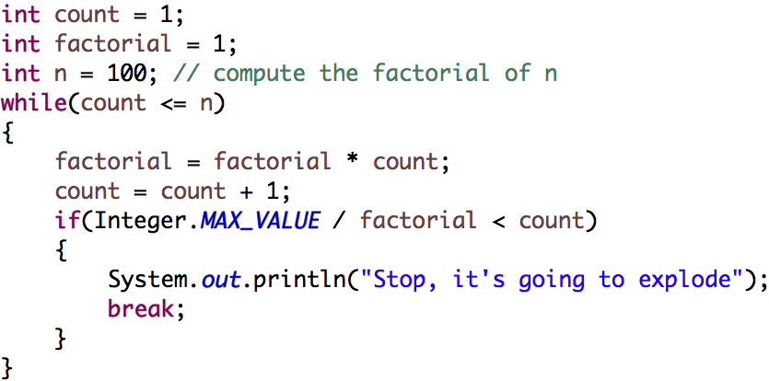
Early Exit
break;
Exit a loop and continue to execute the statement after the loop
Example: Compute factorial

Slide 14
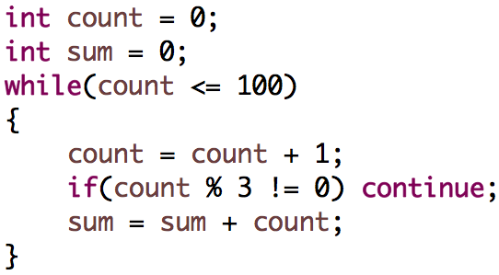
Go To Next Iteration
continue;
Skip next part of a loop, and start the next iteration upon invocation
Example: Calculate the sum of multiples of 3 within [1, 100]

Slide 15
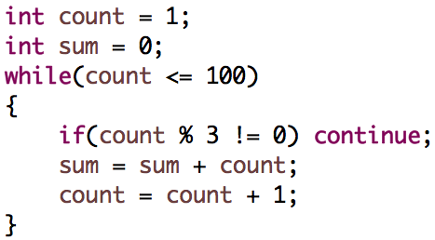
Compute the Sum of Multiples of 3
What’s wrong with the following implementation?

Slide 16
The do-while Loop
Similar to a while loop, except that the loop body is executed at least once
Syntax
  do
    Body
  while (Boolean_Expression);
  Don’t forget the semicolon

Slide 17
The do-while Loop
First, the loop body is executed
Then, the boolean expression is checked
  As long as it is true, the loop is executed again
  If it is false, the loop is exited
Equivalent while statement
  Statements
  while (Boolean_Expression)
  Statements

Slide 18
An Example of the do-while Loop

Slide 19
Loop Practice
Write a while loop or a do-while loop that will compute the sum of the first n positive odd numbers. For example, if n is 5, you should compute 1 + 3 + 5 + 7 + 9.

Slide 20
Some short-forms
Nested expression, used a lot in a loop
  n = n + 1; → n++; or ++n;
  n = n – 1; → n--; or --n;
  n = n + m; → n += m;
  n = n – m; → n -= m;

Slide 21
The for Loop
Syntax
  Example
  int count;
  for (count = 1; count < 3; count++)
  System.out.println(count);

Slide 22
An Example of the for Loop

Slide 23
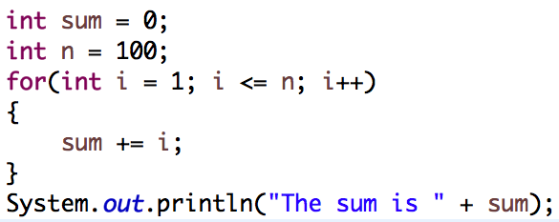
Another Example: The Sum of 1…n
  Possible to declare variables within a for loop
  Note that variable i is local to the loop

Slide 24
Loop Practice
Write a for loop that will compute the sum of the first n positive even numbers. For example, if n is 5, you should compute 2 + 4 + 6 + 8 + 10

Slide 25
Summary of Loops
Three types:
The while loop
The do-while loop
The for loop

Slide 26
Next Class
More about Loops

