Slide 1
COMP 110-001
Review of Chapter 1 & 2
Yi Hong
May 18, 2015

Slide 2
Today
Review of Chapter 1 & 2
Review programs in lectures & labs

Slide 3
Hardware vs. Software
Hardware - physical machine
  CPU, Memory
Software - programs that give instructions to the computer
  Windows XP, Games, Eclipse
3

Slide 4
Measuring Data
1 bit (binary digit): 0 or 1
1 byte: 8 bits
  00000000 ~ 11111111
  2^8 = 256 possible states
An example of a byte
  0 1 0 1 0 0 1 0
  As decimal number: 82 = 2^1 + 2^4 + 2^6

Slide 5
Measuring Data
4 bytes: 4 * 8 = 32 bits
  2^32 possible states
Size of int type in Java
If we use 4 bytes to represent an integer, what is the range?
  Unsigned: 0 ~ 2^32-1 ( starts from 0 )
  Signed: -2^31 ~ 2^31-1

Slide 6
Primitive Types
Examples (For a full list, check p. 52)
Type | Size | Example | Remarks
int | 4 bytes | 3443, -1024 | Integer only Smaller range +, - , * , / , %
double | 8 bytes | -0.4, 3.2, 3.343*10^100 | Much larger range Limited precision +, - , * , / , %
boolean | 1 bit | true, false | And or negation && || !
char | 2 bytes | ‘a’, ‘0’, ‘-’, ‘%’ | Single quotes

Slide 7
Variables
Container of Data
  Data can be of Class type or Primitive type
Declaration of Variable:
type variable_name;
type variable_name = initial_value;
e.g.:
int i = 1;
boolean passedTest = true;
Polygon triangle = new Polygon();
int age;
double length;
char letter;
main memory

Slide 8
Using Variables
Specify the type only once at declaration
In assignment operation, the right side is evaluated first. The value is then stored into the left side
E.g.: Swap values of two integer variables
  int a = 10; int b = 5;
  Method 1: Method 2:
  int c = a; a = a + b;
  a = b; b = a – b;
  b = c; a = a – b;

Slide 9
Defined constants
public static final Type Variable = Constant;
Named in ALL_CAPS
public class DefinedConstant
{
public static final double PI = 3.14159;
public static void main(String[] args){
… }
}
9

Slide 10
Compatibility and Type Casting
Variable of “Bigger” type can hold values of “Smaller” type
  int a = 5;
  double b = a;
One can cast one type into another type (at the risk of losing information)
  double a = 10.0 / 3.0; // a = 3.333333333…
  int b = (int)a; // b = 3

Slide 11
Object Oriented Programming (OOP)
Object: Attributes + Methods
Class: the blueprint of objects of the same type
Person
name, contact
Superclass
Student
student ID, program, year
Teacher
employee ID, department, rank
Subclass
Class
Objects
S1
name=“Alan”, contact=“919-…..”,
program = biostat,
year = 1st
S2
name=“Anna”, contact=“919-…..”,
program = CS,
year = 1st
T1
name=“Yi”, contact=“919-…..”,
dept = CS,
rank = no rank
T2
name=“Marc”, contact=“919-…..”,
program = biostat,
rank = assoc prof

Slide 12
Java is an OOP language
Encapsulation
  “Information hiding”: putting things in a capsule
Polymorphism
  “Many forms”: the same instruction to mean the same thing in different contexts
Inheritance
  Organizing classes, so properties only have to be defined once

Slide 13
OOP in Practice
Import class if necessary
  E.g.: import java.util.*;
Create object
  Class_Type variable_name = new ClassType(…);
  E.g.: Scanner keyboard = new Scanner(System.in);
  Polygon treeTop = new Polygon();
Access object members (attribute or method)
  int inputNumber = keyboard.nextInt();
  treeTop.setColor(Color.green);

Slide 14
String
A Class Type
Objects of String class can be defined as:
  String myString = “UNC is Great!”;
Each String object consists of
  A sequence of characters (char)
  A set of methods that can process the sequence of characters
String
Indices:
U | N | C |  | i | s |  | G | r | e | a | t | !
0 | 1 | 2 | 3 | 4 | 5 | 6 | 7 | 8 | 9 | 10 | 11 | 12

Slide 15
String
Concatenation by “+”
  “My name is ” + “Yi” → “My name is Yi”
Mixed operations
  “The sum is ” + 5 + 6 → “The sum is 56”
  “The sum is ” + (5+6) → “The sum is 11”
More methods, see Java API for reference
  length(), subString(), charAt(), toLowerCase() …

Slide 16
Console I/O
Two built-in Java objects
  System.in
  System.out
Console input: use Scanner class
  Scanner keyboard = new Scanner(System.in);
  int inputNumber = keyboard.nextInt();
  String name = keyboard.next();
Console output
  System.out.print(…);
  System.out.println(…);

Slide 17
Review Programs in Previous Lectures & Labs

Slide 18
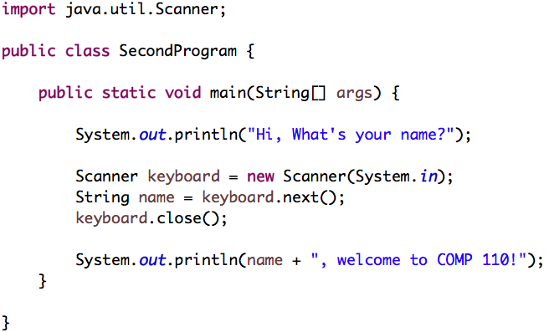
SecondProgram.java in Lecture 2

Slide 19
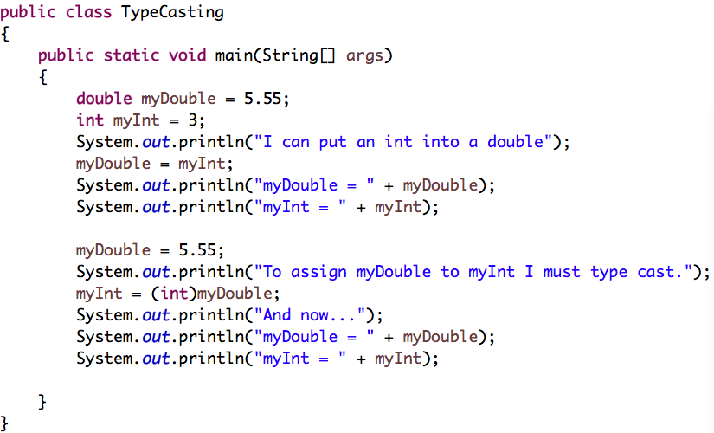
TypeCasting.java in Lecture 4

Slide 20
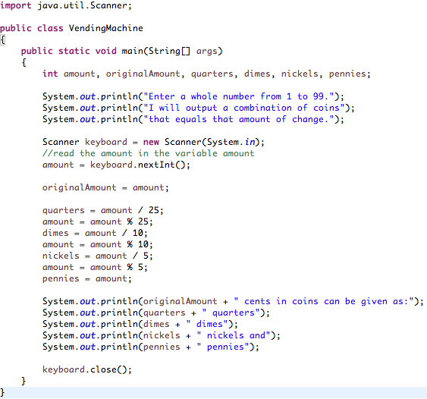
VendingMachine.java in Lab1

Slide 21
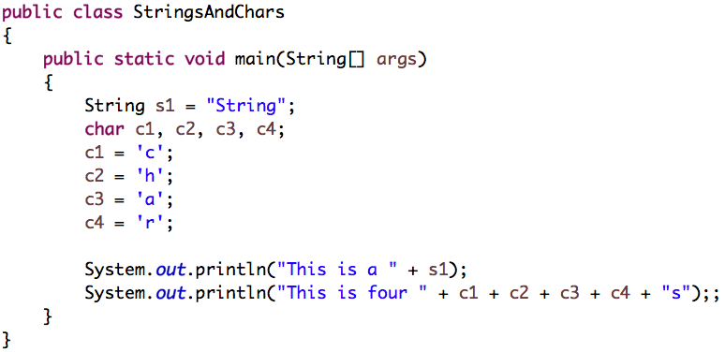
StringsAndChars.java in Lecture 5

Slide 22
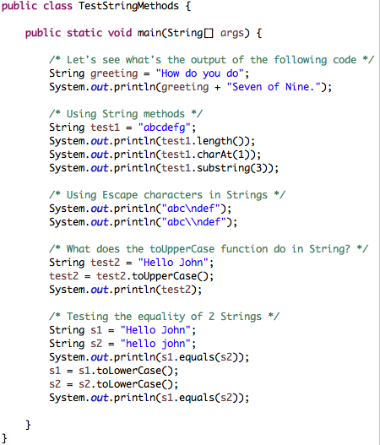
TestStringMethods.java in Lecture 5

Slide 23
Next Class
Flow of control: Branching
Reading assignments: Chapter 3.1-3.3

