Slide 1
COMP 110-001 Computer Basics
Yi Hong
May 13, 2015

Slide 2
Today
Hardware and memory
Programs and compiling
Your first program

Slide 3
Before Programming
Need to know basics of a computer
Understand what your program is doing
Talk intelligently about computers

Slide 4
Computer System
Hardware: Physical components for computation
CPU, Memory, Keyboard ….
Software: Programs that give instructions to the computer
Windows, Office, Games, Eclipse …

Slide 5
Hardware
Main components of a computer
CPU (Central Processing Unit): Performs the instructions in a program
Memory: Holds programs and data
Input devices: Provide data to a computer
Output devices: Display data carried out by a computer

Slide 6
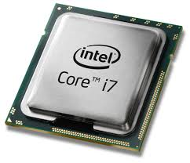
CPU – the “Brain”
Central processing unit
Clock speed: GHz, how many clock cycles a CPU can perform per second
(1GHz = 1 billion CPU cycles per second)
Dual core: Multiple processing units per CPU

Slide 7
Memory – the Brain
Holds data for the computer
Main memory
Holds the current program and much of the data that the program is manipulating
Volatile, disappears when shutting down the computer
Auxiliary memory (secondary memory)
Hard disk drives, CDs, flash drives …
Exists even when the computer’s power is off

Slide 8
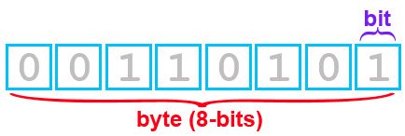
RAM (Random Access Memory)
The main memory
4 gigabytes of RAM
A bit: the basic unit of information in computing (binary digit, 0 or 1)
A byte: A quantity of memory, 8 bits
2^0 + 2^2 + 2^4 + 2^5 = 53

Slide 9
Measuring Memory
Both main memory and auxiliary memory are measured in bytes
1 byte = 8 bits
1 Kilobyte (KB) = 1024 bytes
1 Megabyte (MB) = 1024 KB = 1024*1024 bytes
1 Gigabyte (GB) = 1024 MB
Terabyte (TB), Petabyte (PB) …
Notes:
In decimal system, kilo stands for 1000, but in binary systems, a kilo is 1024 (2^10)

Slide 10
Software
Program: A set of computer instructions
Program
Data (input for the program)
Computer
Output

Slide 11
Programming Languages
Different levels
Java / C++ Program
High-Level Languages
(Human readable)
Compiler
Assembly languages
Machine Language
Low-Level Languages
(Computer readable)

Slide 12
Translation
A high-level language →? a low-level language
Compiler: translate once, run forever
Interpreter: translation alternates with execution, directly executes instructions
Java: combines a compiler and an interpreter

Slide 13
Java Bytecode
Java Code (.java)
A compiler translates Java code into bytecode
JAVAC
compiler
Java Bytecode (.class)
The Java Virtual Machine (JVM) is an interpreter that translates and executes bytecode
JVM
JVM
JVM
Windows
Linux
Mac

Slide 14
Why Using Java Bytecode?
The bytecode is not the machine language for any particular computers
Can be easily translated into the machine language of a given computer
Portability
Java bytecode runs on any computer has a JVM
No need to recompile the Java code

Slide 15
Objects, Methods, and Classes
Object: a combination of attributes (data) and methods (actions)
Yi’s Car (has wheels, can start, stop, …)
Class: defines a type or kind of object
Car (blueprint for defining the objects, e.g., Yi’s car, Bob’s car …)
Methods: actions performed by objects
start(), stop(), forward(), back() …
Notes:
Oop is a programming methodology that views a program as similary consisting of objects that can act alone or interact with one another.

Slide 16
Invoking a Method
A Java program uses objects to perform actions that are defined by methods
Yi’s car.forward ();
System.out.println(“Welcome to COMP 110”);
Print the string in quotes to screen
Semicolon at the end of each statement
Object to
perform actions
Method of the object System.out
Argument

Slide 17
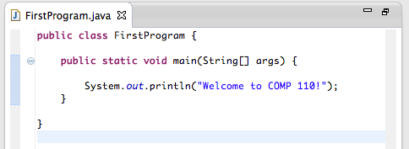
First Java Program
A simple task
Print a message: “Welcome to COMP 110”
Each class is in *.java
A class contains methods
Every application has a main method
The body of the method
Notes:
The class FirstProgram must be in a file named FirstProgram.java

Slide 18
Begin the Program
Begin a program named “FirstProgram”
Program names should make sense
Capitalize the first letter of each word in the program name

Slide 19
Run the First Program
Compile: javac FirstProgram.java
Bytecode is in the file, FirstProgram.class
Execute: java FirstProgram
Or use IDE (integrated develoment environment)

Slide 20
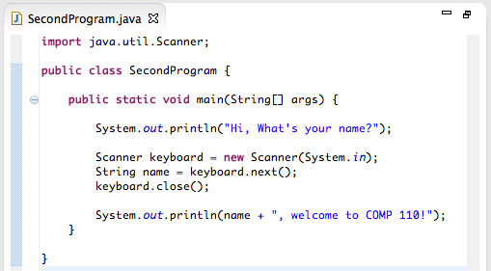
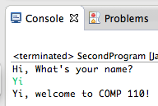
Second Java Program
Ask the user to input his/her name, and print a welcome message

Slide 21
What’s New (1): Java Package
import java.util.Scanner
Gets the Scanner class from the package java.util
Package = Library of classes
Different libraries provide different functionalities
Math library: math equations
Network library: send / receive packages
java.util : allows you to read data from keyboard

Slide 22
What’s New (2): Create Objects
Scanner keyboard = new Scanner(System.in)
Create an object (i.e., keyboard) of the Scanner class
Then the object performs actions:
String name = keyboard.next();
Read a string from the keyboard
Keyboard.close();
Close the keyboard, stop getting data from a user

Slide 23
First & Second Java Programs
Import a package / class
Define a class
A main method
Create an objects
Invoke methods

Slide 24
Next Class
Object-Oriented Programming (OOP)
Primitive data types and variables
Reading and coding assignments
Chapter 1.3, 2.1
Try the two sample programs in class

