Slide 1
COMP 110-001 Introduction to Sorting
Yi Hong
June 12, 2015

Slide 2
Today
Introduction to Sorting
Bubble sort
Selection sort
Merge sort
You should understand the idea behind bubble sort & selection sort
You should be able to understand the code given in slides (and know how to use the code in similar problems by making slight modifications).

Slide 3
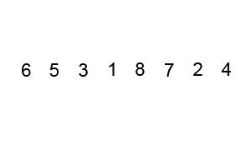
Bubble Sort (or Sinking Sort)
Basic idea (Wikipedia)
Start from the beginning of the list
Compare every adjacent pair, swap their positions if they are not in the right order
After each iteration, one less element (the last one) is needed to be compared until there is no more elements left to be compared
Animation from Wikipedia:

Slide 4
Bubble Sort
Step-by-step example of "5 1 4 2 8“
First Pass: ( 5 1 4 2 8 ) ( 1 5 4 2 8 ), Compares the first two elements, and swaps because 5 > 1. ( 1 5 4 2 8 ) ( 1 4 5 2 8 ), Swaps because 5 > 4 ( 1 4 5 2 8 ) ( 1 4 2 5 8 ), Swaps because 5 > 2 ( 1 4 2 5 8 ) ( 1 4 2 5 8 ), In order (8 > 5), no need to swap
Second Pass: ( 1 4 2 5 8 ) ( 1 4 2 5 8 ) ( 1 4 2 5 8 ) ( 1 2 4 5 8 ), Swap since 4 > 2 ( 1 2 4 5 8 ) ( 1 2 4 5 8 ) ( 1 2 4 5 8 ) ( 1 2 4 5 8 ) Now, the array is already sorted, but our algorithm does not know if it is completed. The algorithm needs one whole pass without any swap to know it is sorted.
Third Pass: ( 1 2 4 5 8 ) ( 1 2 4 5 8 ) No swap ( 1 2 4 5 8 ) ( 1 2 4 5 8 ) No swap ( 1 2 4 5 8 ) ( 1 2 4 5 8 ) No swap ( 1 2 4 5 8 ) ( 1 2 4 5 8 ) No swap, done.

Slide 5
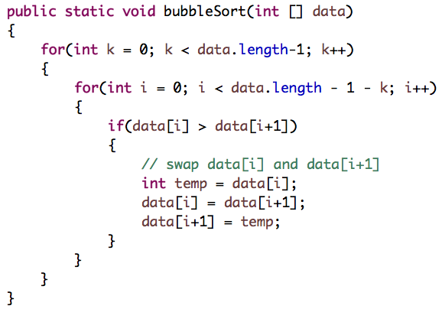
Bubble Sort (I)

Slide 6
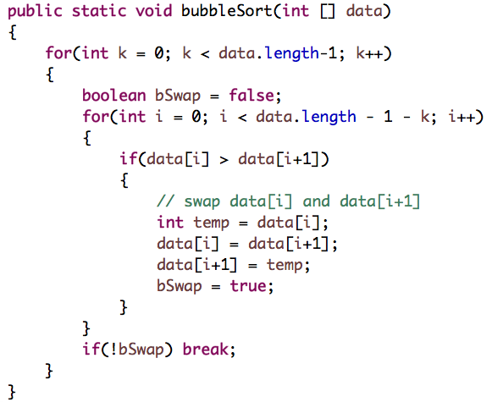
Bubble Sort (II)

Slide 7
Selection Sort
Animation from Wikipedia:
Given an array of length n, each time select the smallest one among the rest elements:
Search elements 0 through n-1 and select the smallest
Swap it with the element at location 0
Search elements 1 through n-1 and select the smallest
Swap it with the element at location 1
Search elements 2 through n-1 and select the smallest
Swap it with the element at location 2
Search elements 3 through n-1 and select the smallest
Swap it with the element at location 3
Continue until there’s no element left

Slide 8
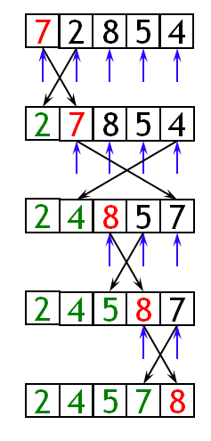
An Example of Selection Sort
Step by step example: 7 2 8 5
Iteration 1: found 2, swap it with 7
Iteration 2: found 4, swap it with 7
Iteration 3: found 5, swap it with 8
Iteration 4: found 7, swap it with 7
The selection sort might swap an array element with itself--this is harmless, and not worth checking

Slide 9
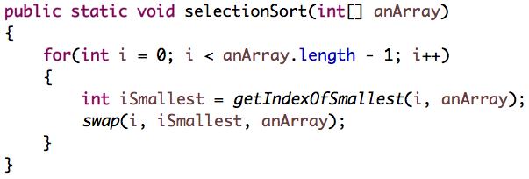
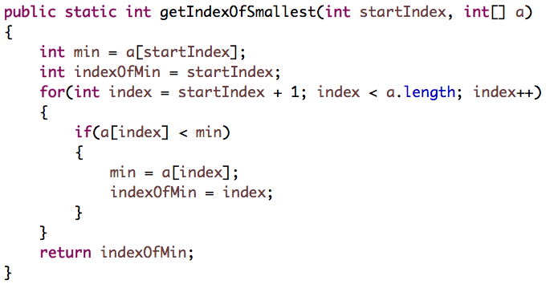
Selection Sort

Slide 10
Merge Sort
Bubble Sort and Selection Sort:
Intuitive and easy to implement
Help build basic abstract sorting concepts
Requires ~n^2 * c operations in worst case
n : number of items to sort
c : some constant factor
Not commonly used in practice
Two commonly used sorting algorithms in practice:
Quick Sort & Merge Sort

Slide 11
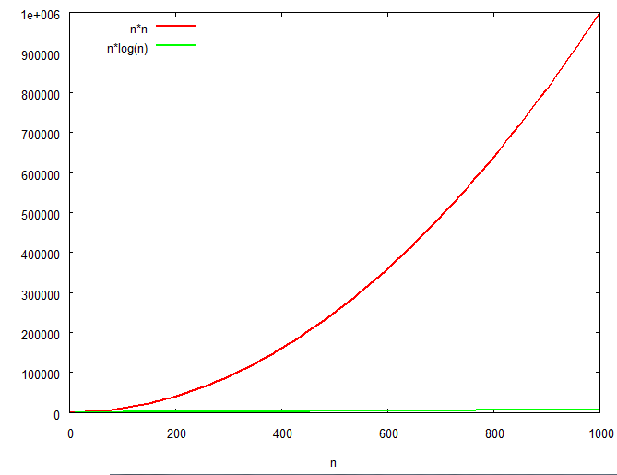
Merge Sort
Strategy: Recursively split the list in half and merge the two returned segments
Java’s built-in sort function is a variant of merge sort: Collections.sort( .. );
Quick sort: Arrays.sort(..);
~ n*log(n) * c operations in worst case
Check the difference between n*log(n) and n^2 when n is large

Slide 12
Merge Sort
30
24
7
12
14
4
20
21
33
38
10
55
9
23
28
16
Split the array into two or more parts
30
24
7
12
14
4
20
21
33
38
10
55
9
23
28
16
Sort each part individually
4
7
12
14
20
21
24
30
9
10
16
23
28
33
38
55
Merge
4
7
9
10
12
14
16
20
21
23
24
28
30
33
38
55

Slide 13
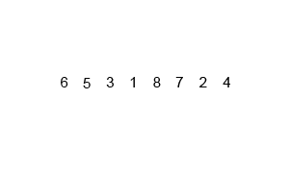
Merge Sort
Animation from Wikipedia:

Slide 14
Merge Sort
Not easy to implement Merge sort correctly
No Java code here (beyond the level of COMP110)
Just understand the high-level idea

Slide 15
Next Class
Review of final exam

