Slide 1
COMP 110-001
Recursion, Searching, and Selection
Yi Hong
June 12, 2015

Slide 2
Announcements
Homework 4 deadline extended to June 13th, by 11:59pm
Final exam, comprehensive
  Wednesday, June 17th, 8am – 11am
  Review on Monday

Slide 3
Today
Introduction to Recursion
Introduction to Search & Selection
  Not the focus of the final exam
  But, you should be able to understand the code in the slides (and know how to use the code in similar problems by making slight modifications).

Slide 4
Recursion
Whenever an algorithm has one subtask that is a smaller version of the entire algorithm’s task, it is said to be recursive
Recursion: you write a method to solve a big task, and the method invokes itself to solve a smaller subtask
  E.g., I want to eat 5 apples now. My subtask can be eating 4 apples, eating 3 apples, eating 2 apples, et…..
  To eat 5 apples, I can do:
    Eat 3 apples + Eat 2 apples
    Eat 1 apple + Eat 4 apples
Eat 1 apple
Eat 1 apple
Notes:
What about 4 apples?

Slide 5
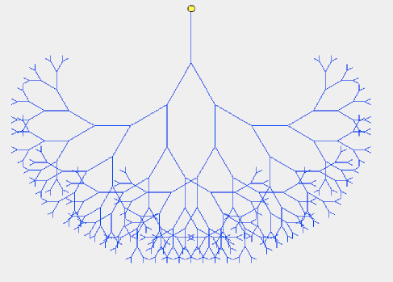
Recursion
Eating 1 apple is the smallest task that I can have. I cannot divide it anymore.
This is the base case in recursion.
Recursion is to divide a big task into smaller tasks. Smaller tasks are then divided further. Until we reach base case.

Slide 6
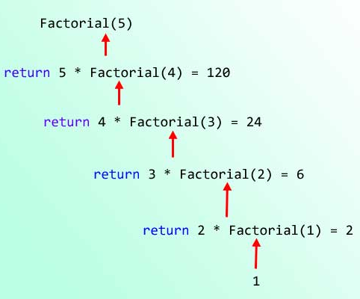
Recursion
Let’s start with a simple example: calculating factorial
  Factorial(n) = n * (n-1) * (n-2) * ….. * 3 * 2 * 1
How do you solve a task with smaller task(s)?
  Factorial(n) = n * Factorial(n-1)

Slide 7
Recursion
Translate this into Java code
  public static int factorial( int n )
  {
  if (n==1) return 1; // base case
  else
  return n * factorial(n-1);
  }

Slide 8
Recursion
The recursion form can be more natural in many problems (than using loops)
Some problems can be hard to formulate using naïve looping (but such problems are beyond the scope of this course)
Let’s see more recursion examples:
  Digits to Words from textbook

Slide 9
Recursion: Digits to Words
Define a method that takes a single integer as an argument and displays the digits of that integer as words.
  For example, if the argument is the number 223, the method should display:
two two three
Base case?
Recursive rule?

Slide 10
Recursion: Digits to Words
Base case: only 1 digit
  print word for 1 digit
Recursive rule:
  Print words for n digits -->
  (print words for first n-1 digits) + (print word for last digit)

Slide 11
Recursion: Digits to Words
public static void displayAsWords( int number )
{
  if (number < 10) // base case
  System.out.print(getWordFromDigit(number) + " ");
  else //number has two or more digits
  {
    displayAsWords(number / 10);
    System.out.print(getWordFromDigit(number % 10) + " ");
  }
}
You should be able to write out: getWordFromDigit(int num)

Slide 12
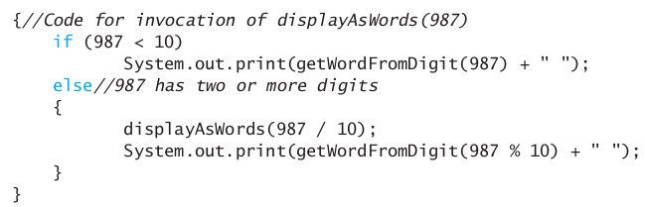
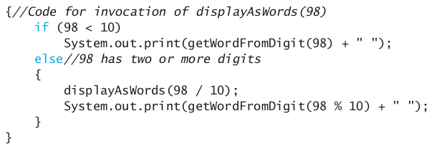
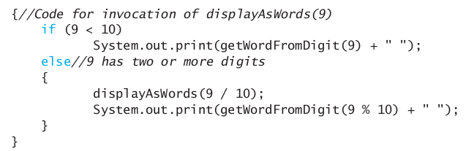
Recursion: Digits to Words
displayAsWords(987);

Slide 13
Search
Given a list of numbers (in an array), how do you search for a number?
  Return index if the number is found in the array
  Return -1 if the number is not found

Slide 14
Sequential (Linear) Search
Basic idea
  For each item in the list:
    if that item has the desired value, stop the search and return the item's location.
  Return Not Found.
Can you do better than this (by making it faster)?
The general answer is no
  No assumptions made on array (unsorted)
  In worst case, have to examine each array element at least once

Slide 15
Search
How about sorted array? ( numbers are in ascending or descending order )
Can you make the linear search faster?

Slide 16
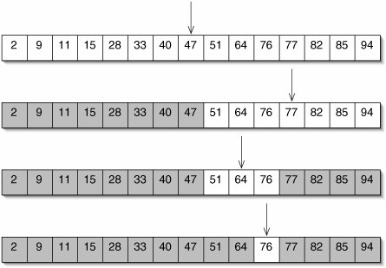
Search
Let’s see an example: searching for 76

Slide 17
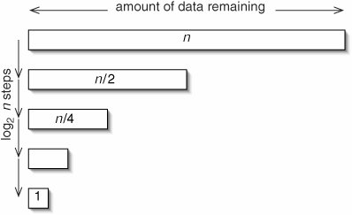
Search
Given n numbers:
  In linear search, you need to explore one possible choice in each iteration
    Worst case, n comparisons needed
  With the new search algorithm (which only works for sorted array), we can reduce half of the search space in each iteration!
    How many comparisons
    do I need in the worst case?

Slide 18
Binary Search
int binary_search(int A[], int key, int imin, int imax) {
  // test if search range is empty
  if (imax < imin) {
    return KEY_NOT_FOUND; // set is empty
  } else {
    // calculate midpoint to cut set in half
    int imid = midpoint(imin, imax);
    // three-way comparison
    if (A[imid] > key) // key is in lower subset
    return binary_search(A, key, imin, imid-1);
    else if (A[imid] < key) // key is in upper subset
    return binary_search(A, key, imid+1, imax);
    else // key has been found
    return imid;
}
}

Slide 19
Search Algorithms
A lot of search algorithms, here we just covered two simplest cases:
  Linear search in a list (array) of numbers
  Binary search in sorted array
More with different data structures:
  Search in graphs and trees (computer science concepts, not the usual graph/tree)
    E.g., search for a move in chess game
    Search for relations/patterns in social network communication graph

Slide 20
Selection
One selection problem:
  Find the smallest / largest number in a given list (array)
  No assumption made on the list ( so it is not sorted )
We have solved this in lab 4
  Loop through each element, keep the largest/smallest
Let’s relax the problem a bit

Slide 21
Selection
Find the k-th smallest (or largest) element in a list of numbers
How to solve this problem?
  Go through each element, for each element, check its position in list
    How many operations in the worst case?
  Sort array first. Then get the k-th element
    How many operations in the worst case

Slide 22
Selection
Quickselect (quick in practice, but not in the worst case)
To find k-th smallest number in n numbers:
  Randomly pick a number from the list, call it p
  Partition the array into two parts:
    Numbers that are < p (m numbers)
    Numbers that are > p (n – m – 1 numbers)
  If m==k-1, p is the k-th smallest
  If m > k, find the k-th smallest in the m numbers
  If m < k, find the (k-m-1)-th smallest in the (n-m-1) numbers
On average, this requires ~n*constant operations
But in the worst case, it is ~n^2*constant

Slide 23
Next Class
Introduction to sorting

