Slide 1
COMP 110-001
Exception Handling
Yi Hong
June 10, 2015

Slide 2
Announcement
Lab 7 is due today

Slide 3
Today
Exception Handling
  Important in developing Java code. But not a major focus of this course

Slide 4
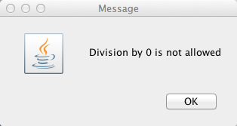
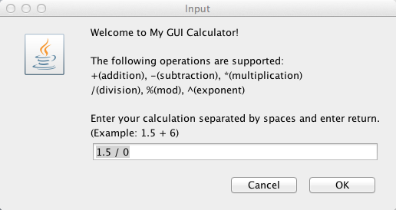
Recall Homework 2
Homework 2: GUI Calculator
If the user try to divide by 0, prints out a message

Slide 5
Recall Homework 2
Homework 2: GUI Calculator
  Each of you used an if-else statement to test whether it is a division and the second operand is 0
  If it is divided by 0, did you still do the division after you print out the message?

Slide 6
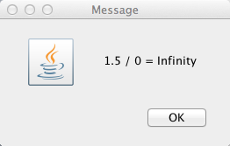
Recall Homework 2
If you choose not to do, you have handled this case by skipping the result calculation part
If you still calculates the result, you will probably get the output like this:
for floating-point number
If two numbers are integers, the program terminated due to the error.

Slide 7
What Is The Right Thing To Do…
When your code detects a problem?
In program 2, we printed out a message to indicate a problem. And may choose to skip result calculation
Not so many problems for a small program. We have control of everything involved
But things quickly become messy when we want to write something slightly bigger

Slide 8
What If….
What if you are writing some classes for others to use…
What do you plan to do when your code detects some problem?
Do you print out a message?
  What if the program that uses your class runs in graphical mode?
  Does the program really want some “uncontrolled” print-outs?
Do you just let resulting errors terminate the program?
  Sounds like a terrible idea in most cases
  But if your class should do something and it is not performed properly, how to inform the program that uses the class?
  E.g., a method in your class is called and is supposed to return some value. When your code sees error, should it still return any value?
    If yes, what value?

Slide 9
What If….
You are using someone’s class for your program.
E.g., you use the classes provided by Java to read from or write to a file.
If some problems happens in reading / writing ( file not found, cannot read/write), how does your program get notified?

Slide 10
The Need of a Formal Mechanism
A formal mechanism is needed to handle “problems”
“Problems” in one class should be reported and handled differently in different programs.
This mechanism is different from return values in method-calling

Slide 11


Try-Throw-Catch
In Java, the mechanism is called “Exception Handling”
  Try to execute some actions
  Throw an exception: report a problem and asks for some code to handle it properly
  Catch an exception: a piece of code dedicated to handle one or more specific types of problem

Slide 12
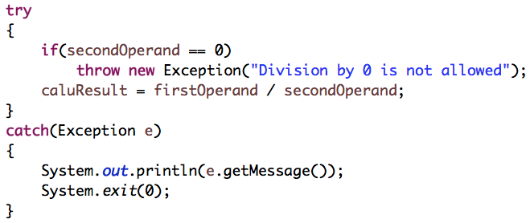
Another Implementation Using Exception Handling
Try
block
Catch
block
An exception’s getMessage method returns a description of the exception
A try bock detects an exception
A throw statement throws an exception
A catch block deals with a particular exception

Slide 13
More About Exception
If an exception occurs within a try block, the rest of the block is ignored
If no exception occurs within a try block, the catch blocks are ignored
An exception is an object of the class Exception

Slide 14
Handling Exceptions
Syntax for the try and catch statements
Syntax for the throw statement

Slide 15
Another Example

Slide 16
Another Example

Slide 17
Predefined Exception Classes
Java provides several exception classes
  The names are designed to be self-explanatory
    E.g.: BadStringOperationException,
    ClassNotFoundException,
    IOException,
    NoSuchMethodException,
    InputMismatchException
  Use the try and catch statements

Slide 18
An Example
If you think that continuing with program execution is infeasible after the exception occurs, use System.exit(0) to end the program in the catch block

Slide 19
Declaring Exceptions
When we want to delay handling of an exception
A method might not catch an exception that its code throws

Slide 20
Throwing Exceptions Example
/** Set a new radius */
public void setRadius(double newRadius)
throws IllegalArgumentException {
if (newRadius >= 0)
radius = newRadius;
else
throw new IllegalArgumentException(
"Radius cannot be negative");
}
Step 1: add throws clause, “throws ExceptionType”, in the method’s heading
Step 2: when problem occurs, use a throw statement throws an exception, “throw new ExceptionType( …. ); ”

Slide 21
The Java Exception Hierarchy
Unchecked exception.

Slide 22
Checked Exceptions vs. Unchecked Exceptions
RuntimeException, Error and their subclasses are known as unchecked exceptions
  no need to be caught or declared in a throws clause of a method’s heading
All other exceptions are known as checked exceptions
  must be either caught or declared in a throws clause

Slide 23
Unchecked Exceptions
In most cases, unchecked exceptions reflect programming logic errors that are not recoverable
  E.g., a NullPointerException is thrown if you access an object through a reference variable before an object is assigned to it
  an ArrayIndexOutOfBoundsException is thrown if you access an element outside the bounds of the array
Logic errors that should be corrected in the program, Java does not mandate you to write code to catch unchecked exceptions

Slide 24
The finally Bolck
try {
statements;
}
catch(TheException ex) {
handling ex;
}
finally {
finalStatements;
}
A finally block always executes
Put cleanup code in a finally block, e.g., closing a file

Slide 25
Trace a Program Execution
Suppose no exceptions in the statements
try {
statements;
}
catch(TheException ex) {
handling ex;
}
finally {
finalStatements;
}
Next statement;

Slide 26
Trace a Program Execution
The final block is always executed
try {
statements;
}
catch(TheException ex) {
handling ex;
}
finally {
finalStatements;
}
Next statement;

Slide 27
Trace a Program Execution
Next statement in the method is executed
try {
statements;
}
catch(TheException ex) {
handling ex;
}
finally {
finalStatements;
}
Next statement;

Slide 28
Trace a Program Execution
try {
statement1;
statement2;
statement3;
}
catch(Exception1 ex) {
handling ex;
}
finally {
finalStatements;
}
Next statement;
Suppose an exception of type Exception1 is thrown in statement2

Slide 29
Trace a Program Execution
try {
statement1;
statement2;
statement3;
}
catch(Exception1 ex) {
handling ex;
}
finally {
finalStatements;
}
Next statement;
The exception is handled.

Slide 30
Trace a Program Execution
try {
statement1;
statement2;
statement3;
}
catch(Exception1 ex) {
handling ex;
}
finally {
finalStatements;
}
Next statement;
The final block is always executed.

Slide 31
Trace a Program Execution
try {
statement1;
statement2;
statement3;
}
catch(Exception1 ex) {
handling ex;
}
finally {
finalStatements;
}
Next statement;
The next statement in the method is now executed.

Slide 32
Trace a Program Execution
try {
statement1;
statement2;
statement3;
}
catch(Exception1 ex) {
handling ex;
}
catch(Exception2 ex) {
handling ex;
throw ex;
}
finally {
finalStatements;
}
Next statement;
statement2 throws an exception of type Exception2.

Slide 33
Trace a Program Execution
try {
statement1;
statement2;
statement3;
}
catch(Exception1 ex) {
handling ex;
}
catch(Exception2 ex) {
handling ex;
throw ex;
}
finally {
finalStatements;
}
Next statement;
Handling exception

Slide 34
Trace a Program Execution
try {
statement1;
statement2;
statement3;
}
catch(Exception1 ex) {
handling ex;
}
catch(Exception2 ex) {
handling ex;
throw ex;
}
finally {
finalStatements;
}
Next statement;
Execute the final block

Slide 35
Trace a Program Execution
try {
statement1;
statement2;
statement3;
}
catch(Exception1 ex) {
handling ex;
}
catch(Exception2 ex) {
handling ex;
throw ex;
}
finally {
finalStatements;
}
Next statement;
Rethrow the exception and control is transferred to the caller

Slide 36
Next Class
Streams and File I/O

