Slide 1
COMP 110-001
Mid-Term Review
Yi Hong
May 27, 2015

Slide 2
Announcement
Midterm on Friday, May 29
  Closed books, no notes, no computer

Slide 3
Today
A whirlwind tour of almost everything we have covered so far
You should start preparing for mid-term if you haven’t
Finish the mid-term practice before Thursday
Review slides and textbook
Review your lab / assignment code

Slide 4

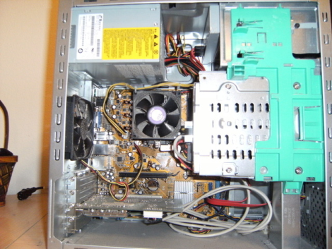



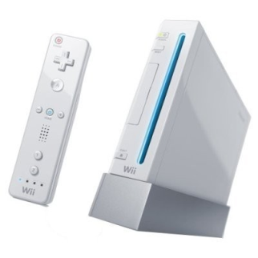
Hardware vs. Software
Hardware - physical machine
  CPU, Memory
Software - programs that give instructions to the computer
  Windows XP, Games, Eclipse

Slide 5
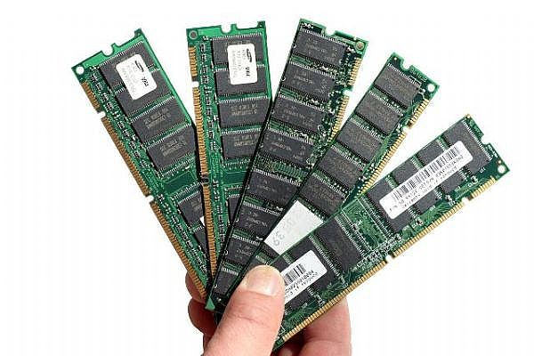
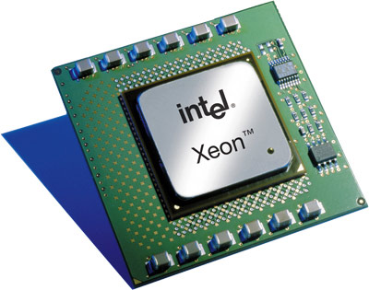

Hardware
CPU – the “brain” of your computer
Memory – stores data for the computer
  How much the “brain” can remember
  Main memory: RAM
  Auxiliary memory: Hard Drive

Slide 6
Memory
Measured in bytes
1 byte = 8 bits
Bit is either 0 or 1
Language of the computer is in bits

Slide 7
Programming Languages
Your Program
High-level language
(human readable)
Compiler
Low-level language
(computer readable)
Machine Language (Bits)

Slide 8
Algorithms and Pseudocode
Algorithm – a set of instructions for solving a problem
Pseudocode – combination of code and English used to express an algorithm before writing algorithm into code
  We can also use flow-chat to write pseudocode

Slide 9
Variables
Used to store data in a program
The data currently in a variable is its value
Name of variable is an identifier
  Letters, digits, underscore
  Cannot start with digits
Can change value throughout program
Choose variable names that are meaningful!

Slide 10
How to Use Variables
Declare a variable
  int number;
Assign a value to the variable
  number = 37;
Change the value of the variable
  number = 513;

Slide 11
Keywords
Reserved words with predefined meanings
You cannot name your variables keywords
if, else, return, new

Slide 12
Data Type
What kind of value the variable can hold
Two kinds of types.
  Primitive type - indecomposable values
    Names begin with lowercase letters
    int, double, char, float, byte, boolean, and others
  Class type - objects with both data and methods
    Names by convention begin with uppercase letter
    Scanner, String, Student
Notes:
We have seen these class types in the FirstProgram code

Slide 13
Assignment Statements
Change a variable’s value
Syntax
  variable = expression;
Example
  sleepNeeded = 8;
  sleepDesired = sleepNeeded * 2;

Slide 14
Assignment Compatibilities
int x = 5;
double y = 12.7;
y = x; → =
x = y; → =
byte → short → int
→ Long → float → double
OK
Not OK

Slide 15
Type Casting
x = (int) y; → =
(int)
OK

Slide 16
Arithmetic Operators
Unary operators
  +, -, ++, --, !
Binary arithmetic operators
  *, /, %, +, -
    rate*rate + delta
    1/(time + 3*mass)
    (a - 7)/(t + 9*v)

Slide 17
Modular Arithmetic: %
Remainder
7 % 3 = 1 (7 / 3 = 2, remainder 1)
8 % 3 = 2 (8 / 3 = 2, remainder 2)
9 % 3 = 0 (9 / 3 = 3, remainder 0)

Slide 18
Parentheses and Precedence
Expressions inside parentheses evaluated first
  (cost + tax) * discount
  cost + (tax * discount)
Precedence rules
  Highest Precedence
  First: the unary operators +, -, !, ++, and --
  Second: the binary arithmetic operators *, /, %
  Third: the binary arithmetic operators + and –
  Lowest Precedence

Slide 19
Errors
Syntax error – grammatical mistake in your program
  Java will not compile programs with syntax error
Run-time error – an error that is detected during program execution
  E.g., exceptions during execution
Logic error – a mistake in a program caused by the underlying algorithm

Slide 20
Strings
A string (lowercase) is a sequence of characters
  “Hello world!”
  “Enter a whole number from 1 to 99.”
String (capital S) is a class in Java, not a primitive type

Slide 21
String
String animal = “aardvark”;
System.out.println(animal);
aardvark

Slide 22
String Concatenation
String animal = “aardvark”;
String sentence;
sentence = “My favorite animal is the ” + animal;
My favorite animal is the aardvark
Notes:
Concatenate many strings
They can be as long as you want (assuming you have enough memory)

Slide 23
String’s Methods
myString.length();
myString.equals(“a string”);
myString.toLowerCase();
MyString.indexOf(‘ ’);
myString.trim();
…
For other methods, check Java API

Slide 24
String Indices
U | N | C |  | i | s |  | G | r | e | a | t
0 | 1 | 2 | 3 | 4 | 5 | 6 | 7 | 8 | 9 | 10 | 11
String output = myString.substring(1, 8);
Notes:
output = “NC is G”

Slide 25
String Indices
U | N | C |  | i | s |  | G | r | e | a | t
0 | 1 | 2 | 3 | 4 | 5 | 6 | 7 | 8 | 9 | 10 | 11
String output = myString.substring(1, 8);
Notes:
output = “NC is G”

Slide 26
Escape Characters
\” | Double quote
\’ | Single quote
\\ | Backslash
\n | New line
\r | Carriage return
\t | Tab

Slide 27
Keyboard Input
Scanner keyboard = new Scanner(System.in);
int num = keyboard.nextInt();

Slide 28
Comments
// this is a comment
/* This is also
a comment.
it ends
here --->*/

Slide 29
Boolean Expressions
An expression that is either true or false
Examples:
  It is sunny today (true)
  10 is larger than 5 (true)
  Today is Saturday (false)

Slide 30
if/else Statements
import java.util.*;
public class FlowChart
{
public static void main(String[] args)
{
System.out.println("Give me an integer:");
Scanner keyboard = new Scanner(System.in);
int inputInt = keyboard.nextInt();
if (inputInt > 10)
{
System.out.println("big number");
}
else
{
System.out.println("small number");
}
}
}
Prompt user for integer
Is input greater than 10?
Yes
No
Print: “big number”
Print: “small number”

Slide 31
If-else-if for Multi-Branch Selections
if (year==1) {
System.out.println(“Freshman”);
} else if (year==2) {
System.out.println(“Sophomore”);
} else if (year==3) {
System.out.println(“Junior”);
} else {
System.out.println(“Senior”);
}
if ( case1 ) {
// branch 1
} else if ( case2) {
// branch 2
} else if ( case3 ) {
  …
  …
} else {
…
}

Slide 32
Java Comparison Operators for Primitive Values
== | Equal to
!= | Not equal to
> | Greater than
>= | Greater than or equal to
< | Less than
<= | Less than or equal to
Example expressions:
variable <= 6
myInt > 5
5 == 3
The result is a boolean value (true/false)

Slide 33
Boolean Type
Can be either true or false
  boolean sunny = true;
  boolean cloudy = false;
  if (sunny || cloudy)
  {
  // walk to school
  }

Slide 34
&&, || operators
AND
  if ((temperature > 50) && (temperature < 75))
  {
  // walk to school
  }
OR
  if (sunny || cloudy)
  {
  // walk to school
  }

Slide 35
The ! (NOT) operator
!true is false
!false is true
Example: walk to school if it is NOT cloudy
  if (!cloudy)
  {
  // walk to school
  }

Slide 36
Loops
Loop: part of a program that repeats
Body: statements being repeated
Iteration: each repetition of body
Stopping condition
Start
Enough sandwiches?
Yes
Make sandwich
No
Distribute sandwiches

Slide 37
Types of Loops
while
  Safest choice
  Not always the best
do-while
  Loop iterates AT LEAST once
for
  Similar to while, but often more convenient syntax
  Most useful when you have a known number of iterations you need to do

Slide 38
Using a while Loop
int n = 1;
while (n <= 10)
{
System.out.println(n);
n = n + 1;
}

Slide 39
Using a for Loop
int n;
for (n = 1; n <= 10; n++)
{
System.out.println(n);
}

Slide 40
Infinite Loop Example
int n;
for (n = 1; n <= 10; n = 0)
{
System.out.println(n);
}

Slide 41
The break statement
for (int item = 1; item <= 5; item++)
{
System.out.print(“Enter cost of item #” + item + “: $”);
amount = keyboard.nextDouble();
total = total + amount;
if (total >= 100)
{
System.out.println(“You spent all your money.”);
break;
}
System.out.println(“Your total so far is $” + total);
}
System.out.println(“You spent $” + total);

Slide 42
Ending a Loop
Count-controlled loops
  If you know the number of loop iterations
  for (count = 0; count < iterations; count++)
User-controlled loops
  Change the value of control variable
    E.g., Ask-before-iterating, or sentinel value ( if user input is smaller than 0)
    E.g., booleans, matching is found

Slide 43
Nested Loops Example
for (int i = 1; i<10; i++) {
for (int j = 1; j<=i; j++) {
System.out.print( i + ”*” + j + “=“ + (i * j) + “\t“);
}
System.out.println();
}
Inner loop
Outer loop

Slide 44
Classes, Objects, and Methods
Class: a definition of a kind of object
Object: an instance of a class
  Contains instance variables (data) and methods
Methods
  Methods that return a value
  Methods that return nothing

Slide 45
Class
A class is the definition of a kind of object
  A blueprint for constructing specific objects

Slide 46
Objects, Instantiation
Object Name: patsCar
amount of fuel: 10 gallons
speed: 55 miles per hour
license plate: “135 XJK”
Object Name: ronsCar
amount of fuel: 2 gallons
speed: 75 miles per hour
license plate: “351 WLF”
Object Name: suesCar
amount of fuel: 14 gallons
speed: 0 miles per hour
license plate: “SUES CAR”
Instantiations, or instances, of the class Automobile

Slide 47
Creating an Object
Create an object jack of class Student
Student jack = new Student();
Scanner keyboard = new Scanner(System.in);
Create an object keyboard of class Scanner
Assign memory address of object to variable
Return memory address of object
Create an object

Slide 48
Instance Variables
Data defined in the class are called instance variables
public String name;
public int classYear;
public double gpa;
public String major;
variables
public: no restrictions on how these instance variables are used (more details later – public is actually a bad idea here)
Data type: int, double, String…

Slide 49
Methods
Two kinds of methods
  Methods that return a value
    Examples: String’s substring() method,
    String’s indexOf() method, etc.
  Methods that return nothing
    Perform some action other than returning an item
    Example: System.out.println()

Slide 50
Methods
returns a String
  public String getMajor()
  {
  return major;
  }
  public void increaseYear()
  {
  classYear++;
  }
return type
returns nothing

Slide 51
Calling Methods That Return Nothing
Object, followed by dot, then method name, then ()
  Order, type, and number of arguments must match parameters specified in method heading
Use them as Java statements
  Student jack = new Student();
  jack.classYear = 1;
  jack.increaseYear();
  System.out.println(“Jack’s class year is ” + jack.classYear);

Slide 52
Calling Methods That Return a Value
Object, followed by dot, then method name, then () (the same as before)
Use them as a value of the type specified by the method’s return type
  Student jack = new Student();
  jack.major = “Computer Science”;
  String major = jack.getMajor();
  System.out.println(“Jack’s full name is ” + jack.getName());
  System.out.println(“Jack’s major is ” + major);

Slide 53
Local / Instance Variables
Instance variables
  Declared in a class
  Confined to the class
  Can be used in any method in this class
Local variables
  Declared in a method
  Confined to the method
  Can only be used inside the method
public class Student
{
public String name;
public int classYear;
public String major;
public void printInfo(){
String info = name + “:”
+ major + “:” + classYear;
System.out.println(info);
}
public void increaseYear(int inc)
{
classYear += inc;
}
}

Slide 54
An Example
public class Student
{
public String name;
public int classYear;
public String major;
public void printInfo()
{
String info = name + “: ” + major + “: ” + classYear ;
System.out.println(info);
}
public void increaseYear(int inc)
{
classYear += inc;
}
}
info is a local variable declared inside method printInfo()
can only be used inside method printInfo()
classYear and name are instance variables
can be used in any method in this class

Slide 55
An Example
public class Student
{
public String name;
public int classYear;
public String major;
public void printInfo()
{
String info = name + “: ” + major + “: ” + classYear ;
System.out.println(info);
}
public void increaseYear(int inc)
{
classYear += inc;
info = “info changed a bit”; }
}
Java will not recognize info
✗

Slide 56
Methods with Parameters
Parameters are used to hold the value that you pass to the method
Parameters can be used as (local) variables inside the method
  public int square(int number)
  {
  return number * number;
  }
Parameters go inside parentheses of method header

Slide 57
Methods with Multiple Parameters
Multiple parameters separated by commas
  public double getTotal(double price, double tax)
  {
  return price + price * tax;
  }

Slide 58
Method Parameters and Arguments
public class SalesComputer
{
public double getTotal(double price, double tax)
{
return price + price * tax;
}
// ...
}
SalesComputer sc = new SalesComputer();
double total = sc.getTotal(“19.99”, Color.RED);
double total = sc.getTotal(19.99);
double total = sc.getTotal(19.99, 0.065);
int price = 50;
total = sc.getTotal(price, 0.065);
✗
✗
✓
✓
Automatic typecasting

Slide 59
Calling Methods from Methods
In a method’s body, we can call another method
  receiving_object.method();
If calling a method in the same class, we do not need receiving_object:
  method();
Alternatively, use the this keyword
  this.method();

Slide 60
Several Common Mistakes
Unwanted semicolon after if / for statements
if (a>b); // this semicolon causes an empty if-branch
c++; // this line is always executed
for(int i = 0; i<10; i++); // this semicolon indicates an empty loop body
c++; // this is executed only once
Unpaired brackets
  Use indentation to help checking
  Use Eclipse’s auto format function

Slide 61
Indentation
Indentation
  Makes code easier to read
  Helps with finding syntax and logic errors
  Indent code that goes between { and }
Be consistent!

Slide 62
Next Class
Go through questions from mid-term practice worksheet
Q&A

