Slide 1
COMP 110-001
More About Loops
Yi Hong
May 21, 2015

Slide 2
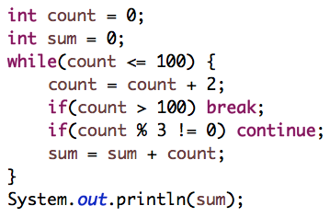
Review
Q1: What is the output of the following statements?
  The sum of multiples of 6 within [0, 100]

Slide 3
Review
Q2: How many iterations?
  for (count = 1; count < 10; count++)
  for (count = 1; count <= 10; count++)
for (count = 0; count <= 10; count++)
for (count = 0; count < 10; count++)
for (count = 1; count < 10; count+=2)
9 times
10 times
11 times
10 times
5 times

Slide 4
Today
How to write loops
Bugs in loops

Slide 5
Loop Body
count = 1;
while (count <= num)
{
System.out.print(count + “, “);
count++;
}
  Repeated code
  Write pseudocode and turn repeated statements into loops

Slide 6
Pseudocode for a Loop
Get user input
sum = sum + input
Get user input
sum = sum + input
Get user input
sum = sum + input
Average sum
Repeated statements in pseudocode become your loop
6

Slide 7
Body of The Loop
Get user input
sum = sum + input

Slide 8
Initializing Statements
sum = sum + input
Variables in a loop must be initialized (set to a value) before the loop
What is initialization of sum?
What if we want to compute the product?
  sum = sum * input
8

Slide 9
Ending a Loop
If you know number of loop iterations
  Count-controlled loops (the for loop)
User controlled ending
  Ask-before-iterating
  Sentinel value
Booleans

Slide 10
Count-Controlled Loops
for(count = 0; count < iterations; count++)
{
System.out.print(“I have iterated ” + (count + 1) + “times\n”);
}

Slide 11
Ask-Before-Iterating
do
{
//do stuff in your code here
System.out.print(“Continue? yes/no”);
answer = keyboard.next();
} while(answer.equalsIgnoreCase(“yes”));
11

Slide 12
Sentinel Value
Signal end of input
  System.out.println(“enter a negative number to end the loop”);
  int next = keyboard.nextInt();
  sum = 0;
  while (next >= 0)
  {
  sum = sum + next;
  System.out.println(“enter a number”);
  next = keyboard.nextInt();
  }

Slide 13
Booleans
int next, sum = 0;
boolean numbersLeft = true;
Scanner keyboard = new Scanner(System.in);
while (numbersLeft)
{
next = keyboard.nextInt();
if (next < 0)
numbersLeft = false;
else
sum = sum + next;
}
System.out.println(“The sum is ” + sum);
13

Slide 14
Write Code
Give a Java loop statement that will set the variable result equal to 2⁵
Write a program that maintains the balance of an account
  Ask for a balance-update from user in each iteration
    Positive value: deposit
    Negative value: withdraw
  If the balance-update is 0 or the balance goes below 0, exit from loop and print out the remaining balance
14

Slide 15
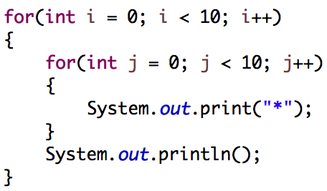

Nested Loop
What does the following statements do?

Slide 16
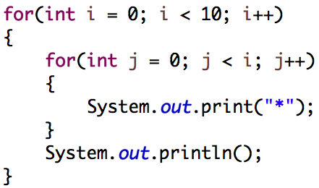

Nested Loop
What does the following statements do?

Slide 17
Bugs
Problems in a program that prevent correct execution
Two most common mistakes in loops
  Off-by-one errors
  Infinite Loops!!!!!!
17
Notes:
Grace Hopper
1947
Moth found in program
Debugging!

Slide 18
Off-by-one errors
Loop repeats one more or less time
  E.g.: If you want a program to repeat 10 times
    for (count = 1; count < 10; count++);
      Loop 9 times
    for (count = 1; count <= 10; count++);
      Loop 10 times
    for (count = 0; count < 11; count++);
      Loop 11 times
    for (count = 0; count < 10; count++);
      Loop 10 times
18
Notes:
Do this on board

Slide 19
Infinite Loops
A loop which repeats without ever ending is called an infinite loop
If the controlling boolean expression never becomes false, a loop will repeat without ending

Slide 20
Infinite Loops
count = 1;
while (count <= num)
{
System.out.print(count + “, “);
//count++;
}
20
Notes:
Do this on board

Slide 21
Infinite Loops
count = 1;
while (count <= num);
{
System.out.print(count + “, “);
count++;
}
21
Notes:
Do this on board

Slide 22
Infinite Loops
int count;
int num = 1;
// initializing action; boolean expression; update action
for (count = 1; count >= num; count++)
{
System.out.print(count + “, “);
num = count;
num++;
}
22
Notes:
Do this on board

Slide 23
Finding Errors
Error checking
  System.out.print(variable);
  Run on simple input
Debug (Required only for CS students or who are interested in debugging)
  Eclipse: breakpoint + variable watch
23
Notes:
Do this on board

Slide 24
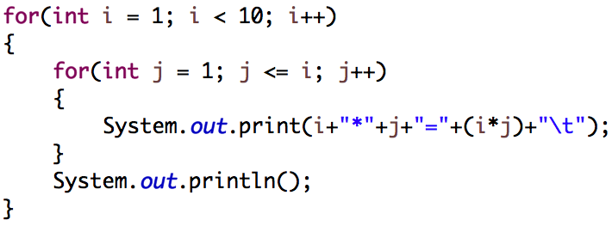
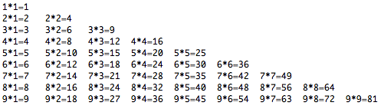
Try It Yourself
Let’s print out a Multiplication Table
  Output

Slide 25
Next Class
Classes
Reading assignment: Chapter 5.1

