Slide 1
Experience: Practical Problems for Acoustic Sensing
MobiCom 2022
Notes:
这类文章比较少讲。马萨诸塞大学阿默斯特分校，2021QS世界大学排名270位。

Slide 2
Challenges
There exists annoying audible sound leakage caused by acoustic sensing
Acoustic sensing actually affects music play and voice call;
Acoustic sensing consumes a significant amount of power, degrading the battery life;
Real-world device mobility can fail acoustic sensing.

Slide 3
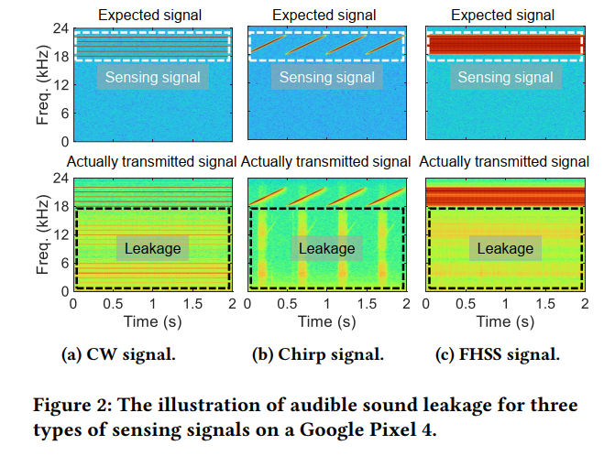
1. Audible Leakage
For some devices, the intensity level of the audible sound leakage can be higher than 65 𝑑𝐵, which is close to the noise generated by a vacuum cleaner.
Notes:
吸尘器的声音大小
CW 为Continue Wave: 频率振幅固定
FHSS：跳频扩频：一种数据传输技术，它利用一个在宽范围内改变频率(即“跳频”)的窄带载波信号调制数据信号。

Slide 4
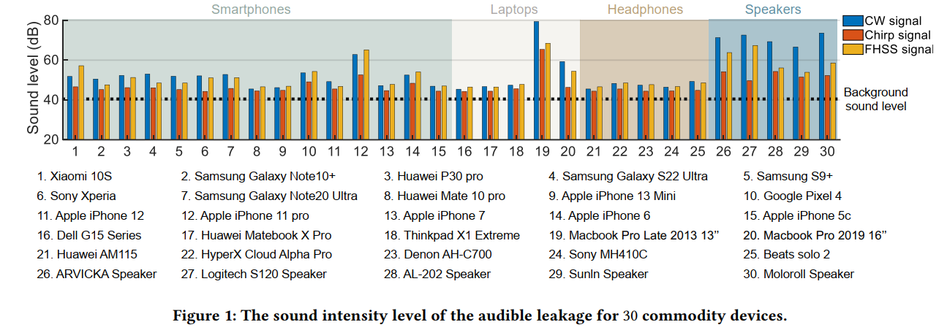
发送信号水平均超出noise强度；即便噪音较低情况下，由于噪音的刺耳特性，用户同样会感觉不舒服

Slide 5
Why the leakage exists
Notes:
通过对结构进行分析，结论是非线性效应。

Slide 6
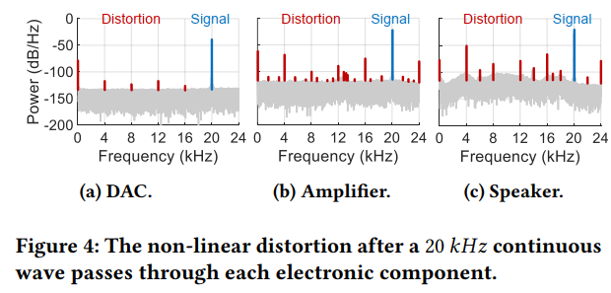
Findings
1. The non-linear distortion of the audio amplifier is the chief culprit of the audible sound leakage.
实验表明，只用DAC模块没有产生
泄露；加放大器才有
Notes:
放大器的非线性失真，是导致泄露音频的主要原因。

Slide 7
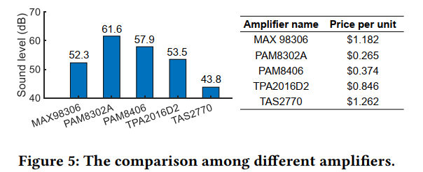
Fingdings
1. 看起来是贵的泄露更少(实验中保证输出相同)

Slide 8
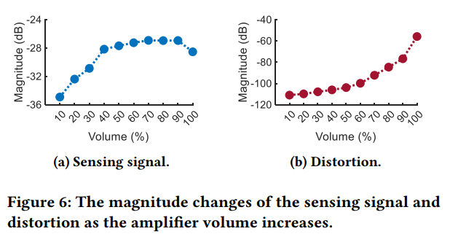
Fingdings
3. 由于泄露，并不是音量越大sensing信号越强

Slide 9
Fingdings
3. The severity of the audible sound leakage is dependent on the signal type.
the chirp signal produces the least amount of audible sound leakage because there is just one single frequency at each timestamp
同一时间多个频率信号，则产生更多aliasing,干扰更严重。

Slide 10
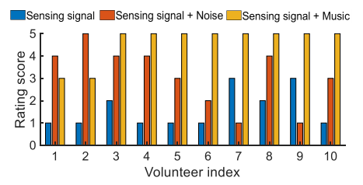
Findings
4. The audible sound leakage issue can be mitigated by masking it with white noise or music
with the two masks, i.e., white noise and soft music
解释是声音更柔和；同时对sensing影响较小
Notes:
he maximum volume does not necessarily bring the maximum sensing range due to the audible sound leakage.

Slide 11
2. Influence on usage
user expects sensing and other applications such as music play to co-exist
the quality of music play gets degraded if sensing and music play happen simultaneously

Slide 12
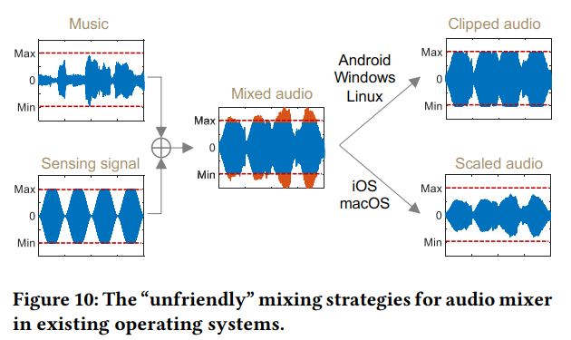
2. IMPACT OF SENSING ON MUSIC PLAY/VOICE CALL

Slide 13
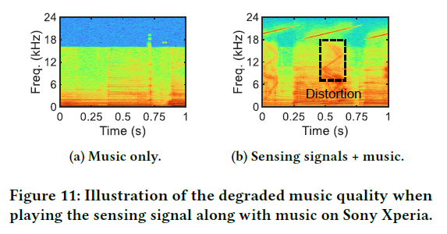
Findings
5. Although existing operating systems support simultaneous playing of sensing signal and music/voice, the quality of music/voice does get affected
由于sensing声音一般设置大于音量的80%；而DAC会对mixed信号做cut-off
Notes:
For example, if the music is using 60% of the maximum
volume, we limit the volume of the sensing signal below 40% of
the maximum volume.

Slide 14
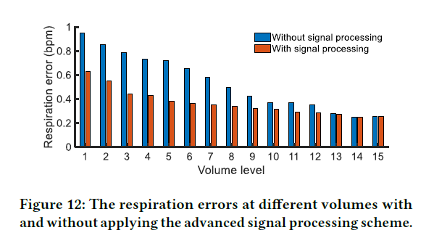
Findings
方案：对sensing音量做动态限制
方案：使用信号处理提升sensing音量以提升sensing距离(LASENSE,使用一对麦克风扬声器做信号增强)
Advanced signal processing schemes
Notes:
LASense: Pushing
the Limits of Fine-grained Activity Sensing Using Acoustic Signals

Slide 15
3. Power
When acoustic sensing is enabled for 2 hours, there is a 22% battery drop on a smartphone, a 78% battery drop on a smartwatch, and a 66% battery drop on a wireless earphone, respectively

Slide 16
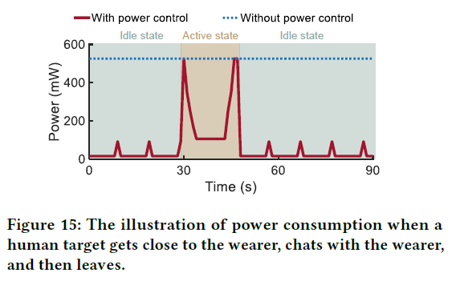
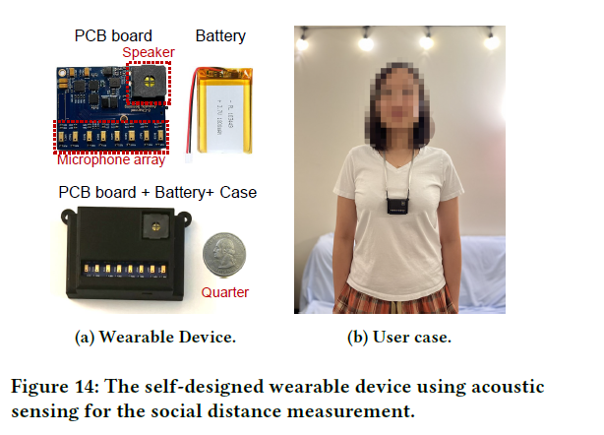
Findings
there is no human target in front of the wearer for more than 80% of the time： Once a target is detected, the
device enters into the active state
The signal power required for sensing a close target is much smaller
The power consumption of acoustic sensing can be significantly reduced if we introduce power control schemes

Slide 17
4. Device mobility
when the device is moving, differentiation between human target and static objects becomes challenging because even signals reflected from static objects exhibit non-zero Doppler values.

Slide 18
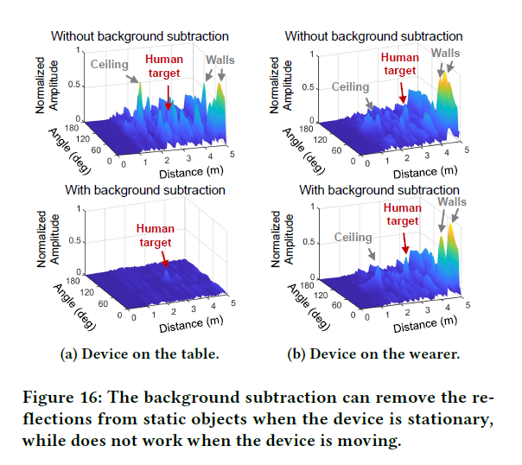
Findings
The movements of sensing device significantly degrade the performance of acoustic sensing
消减背景方法只对静止device有效

Slide 19
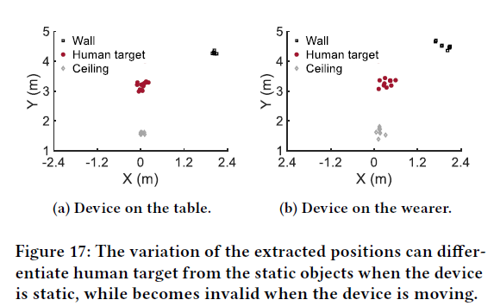
基于位置预测的方法
Notes:
When the device is worn by a user, even if the wearer just stands still, the involuntary
movement of the body [40] changes the position of the device,
resulting in large distance changes for both the human target and
the static objects, as shown in Figure 17b.

Slide 20
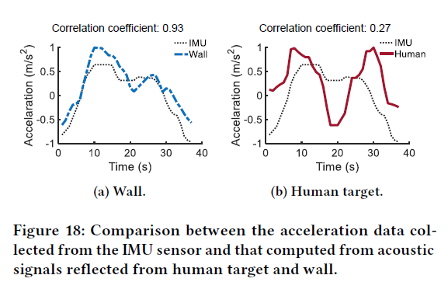
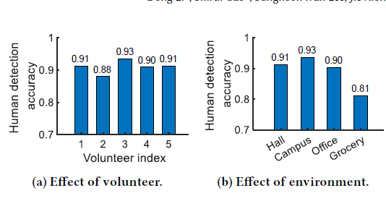
Method
We involve the inertial measurement unit (IMU) sensor to address the device movement issue.
IMU 和声音计算出的物体位置的差分，可以用来抵消不同的移动影响 。

Slide 21
Conclusion
实际项目
Audible leakage: 选用信号；增加white noise; 非线性效应
Music Play Influence: 音量控制
功耗：根据有无物体/物体距离调整功耗
Device移动：IMU等方式弥补

