Slide 1
Your Microphone Array Retains Your Identity:
A Robust Voice Liveness Detection System for Smart Speakers
USENIX SECURITY 2022
Yan Meng¹, Jiachun Li¹, Matthew Pillari², Arjun Deopujari², Liam Brennan², Hafsah Shamsie², Haojin Zhu¹, and Yuan Tian²
¹Shanghai Jiao Tong University
²University of Virginia
August, 2022
1
Notes:
活跃度检测； 基于语音系统。
和之前文章的相似度；

Slide 2
OUTLINE
Background
Motivation System Design
Evaluations
Discussions Conclusion
2

Slide 3
1
Background
3

Slide 4
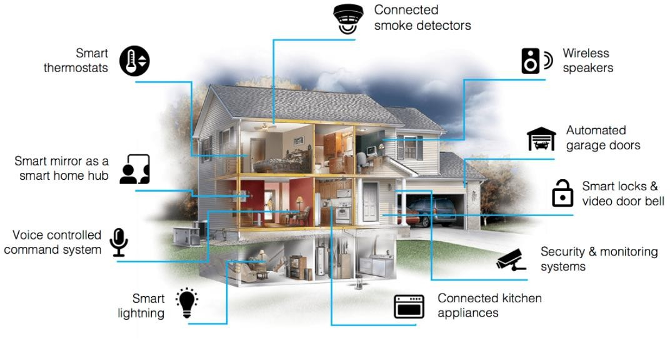
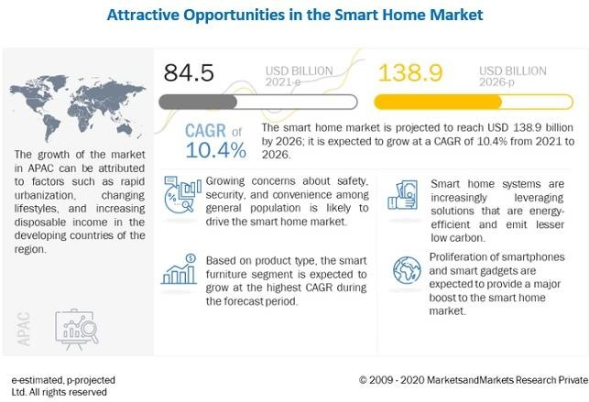
Smart Home
A typical application of cyber physical system (CPS)
Undergoing rapid growth of market size
A typical example of smart home
Global Market¹
$84.5 Billion（2021）→ $138.9 Billion（2026）
1. Markets and Markets Research, Smart Home Market with COVID-19 Impact Analysis by Product.
4

Slide 5
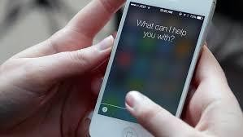
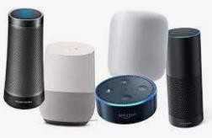
Voice Interface
The primary user interface in smart home
Smart speakers with multiple microphones
Standalone microphone
Smart speakers
Siri
Alexa
Cortana Google Now
Typical applications
Voice Interface Hardware
5
Notes:
语言接口

Slide 6
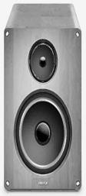
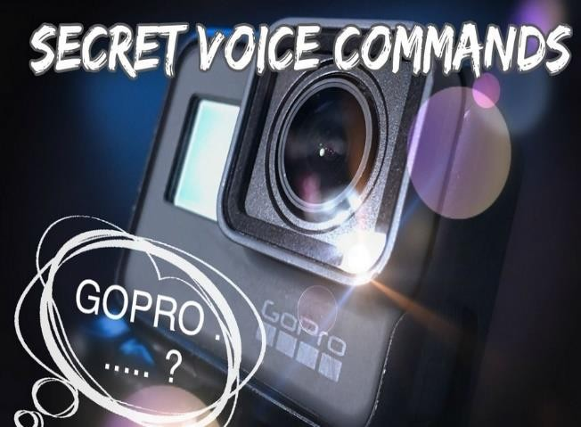
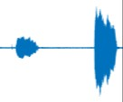
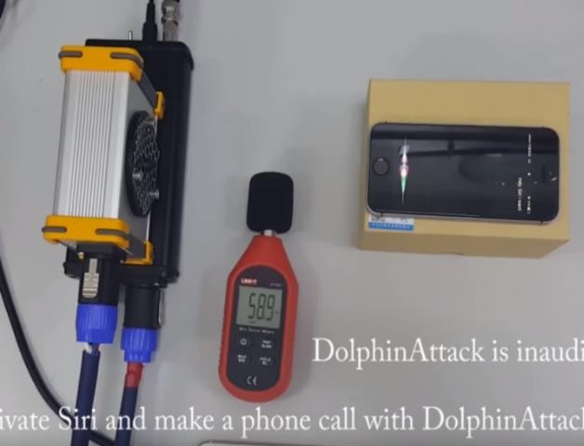
Threats Faced by Voice Interface
Suffering from voice spoofing due to its broadcast nature
Typical attacks: replay attack, hidden voice, inaudible attack
Attacker Machine Replay
Classical replay attack
Hidden voice attack
（Carlini et al, Security’16）
Dolphin attack
（Zhang et al, CCS’17）
Hidden voice:人类听众无法理解但被设备解释为命令的隐藏语音命令
6
Notes:
智能音箱等具有广播的性质(任何人可以接入)，容易遭受攻击
重放攻击、

Slide 7
Thwart Voice Spoofing: Liveness Detection
Detection Principle: Authentic and spoofing voice commands are generated by real human and electrical device respectively.
Liveness detection: detecting factors related to human
User
Voice Command
活体检测是提升智能音箱等安全的主要方法
Authentic
Openness nature
VCS
Spoofing
7
Notes:
阻止语音欺骗:活体检测。 Spoof: 电子欺骗

Slide 8
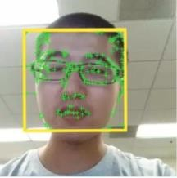
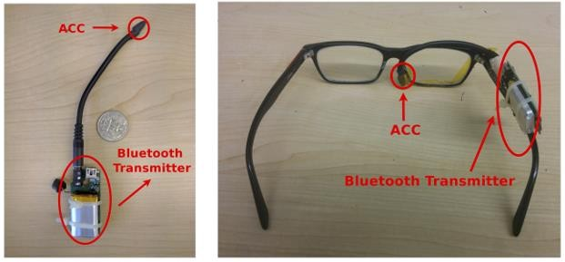
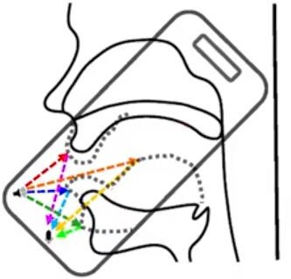
Existing Liveness Detection Schemes
Two-factor Authentication
Passive Liveness Detection
Leveraging image, accelerator, or ultrasonic as the second factor.
Limitations: requiring carrying device, incurring user’s burden
Image
Chen et al INFOCOM’17
Acceleration
Feng et al MobiCom’17
Ultrasound
Zhang et al
CCS’17
Notes:
已有的活体检测方法：双因子认证。
已有方法都需要额外设备。

Slide 9
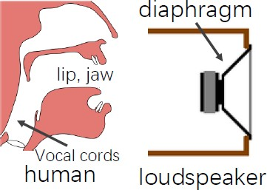
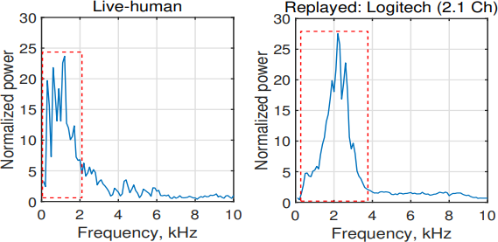
Existing Liveness Detection Schemes
Two-factor Authentication
Passive Liveness Detection
Passive detection: only utilizing collected voice samples
The voice spectrums from authentic user and spoofing are different
Features: spectrum (mono); Fieldprint (dual-channel)
𝑀₁
𝑀₂
Different sound
generation models
Ahmed et al.,（0~10kHz） USENIX Security’20
Yan et al., fieldprint
CCS’19
9
Notes:
其他被动检测的方法，尝试去分辨构造模型、低频特性、

Slide 10
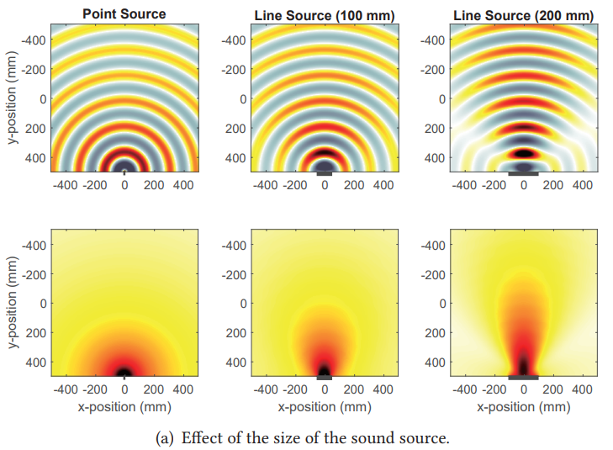
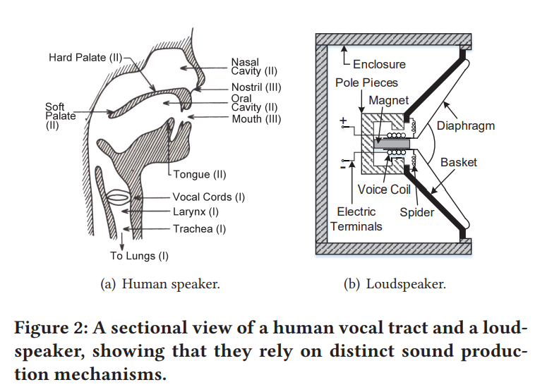
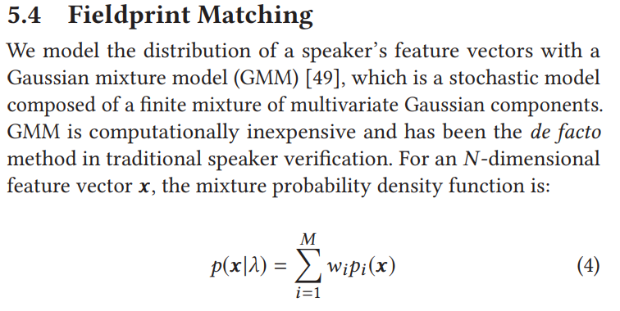
Yan et al., fieldprint
CCS’19
Notes:
利用声场的概念

Slide 11
Existing Liveness Detection Schemes
Limitations Faced by Passive Detection
Unstable spectrum characteristics (mono channel)
Required fixed gestures (dual channel)
Fixed gestures
Can we design an effective and robust passive liveness detection scheme?
Location A
Location B
Unstable spectrums

Slide 12
2
Motivation

Slide 13
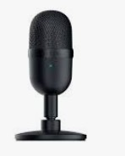
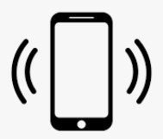
Microphone Array Based Solution
Smart speakers usually have the microphone array
Multi-channel audios have more diversity
𝑀₁
𝑀₂
Smart phone: pair
𝑦 _{𝑀2}
Single microphone
2𝜋/𝑁
𝑀₁
𝑑
2
𝑆₀ (𝐿, 0)
𝜃
𝑑₁
𝑥
𝑂
𝑟
𝑀_{𝑁}
^{𝑀}𝑁−1
Microphone array
Smart speaker: array
Notes:
具体来讲，可以利用麦克风阵列的特性

Slide 14
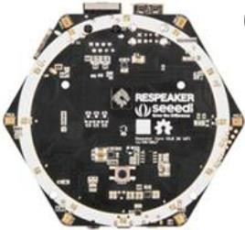
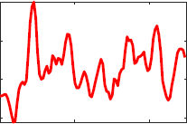
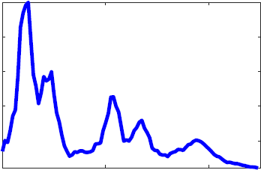
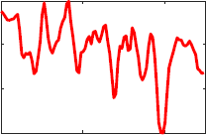
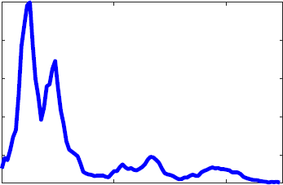
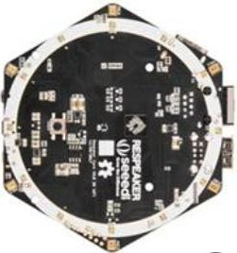
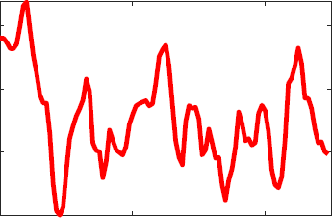
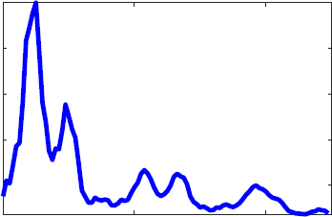
Array Fingerprint
麦克风阵列特征具有旋转不变等更稳定的特性
Extracting feature from multiple channel audios
Better robustness
Dual channel Feature
Array Fingerprint
Rotate 𝟗𝟎∘
Rotate 𝟏𝟖𝟎∘

Slide 15
Validation of Array Fingerprint
Effective to distinguish authentic user and spoofing devices
Preliminary实验：发现不同设备上，特征均比较稳定。

Slide 16
3
System Design

Slide 17
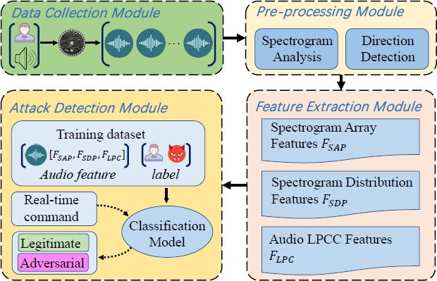
System Overflow of ArrayID
ArrayID consists of four modules:
Data Collection
Pre-processing
Feature Extraction
Attack Detection

Slide 18
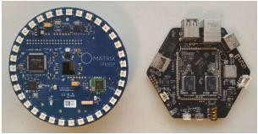
Data Collection and Preprocessing
Data collection module
Preprocessing module
Feature extraction
Attack detection
Microphone array
Matrix Creator
Seeed ReSpeaker Core V2
Preprocessing
STFT
Direction Detection
Spectrograms from first, third and fifth microphones

Slide 19
Feature Extraction
Data collection module
Preprocessing module
Feature extraction
Attack detection
Calculating array fingerprint
Meshing
Calculating

Slide 20
Feature Extraction
Data collection module
Preprocessing module
Feature extraction
Attack detection
Calculating array fingerprint
Extracting more features
Spectrogram distributions
LPCC
Array fingerprint
Distributions from whole audio channels

Slide 21
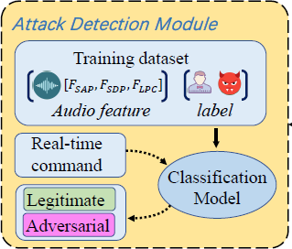
Attack Detection
Data collection module
Preprocessing module
Feature extraction
Attack detection
Classification model:
lightweight feed-forward back- propagation neural network
Network, 3 layers, Size 64/32/16

Slide 22
4
Evaluations

Slide 23
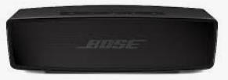
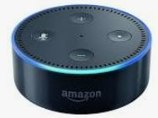
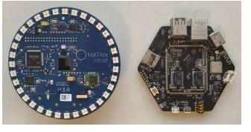
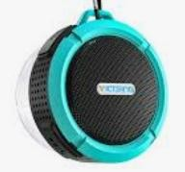
Dataset Collection
Hardware setup
Data collection device: Matrix Creator, Seeed ReSpeaker Core v2
Spoofing devices: 14 different devices
Microphone array
Part of employed spoofing devices

Slide 25
Dataset Collection
20 types of voice commands from 20 users
10241 authentic commands，22529 spoofing samples
Metrics：Accuracy；FAR；FRR；EER
Turn on Bluetooth.
Remind me to buy coffee at 7 am.
Open music player.
Voice command samples

Slide 26
Performance
Performance on our collected dataset
Two-fold cross-validation
Accuracy: 99.84%, EER: 0.17%.
FAR: 0.05%; FRR: 0.39%
ReMasc dataset, Accuracy is 97.78%
Time overhead
6-channel: 0.12 seconds; 8-channel: 0.38 seconds
Desktop with Intel i7-7700T CPU and 16 GB RAM

Slide 27
Impact of Various Factors
ArrayID is robust to the following factors:
Distance
Direction
Spoofing devices
Environment
User movement
Training Distance (m) | 1.2 | 1.8 | 2.4
Accuracy (%) | 99.41 | 99.53 | 99.66
EER (%) | 1.11 | 0.93 | 0.69
Impact of distance
EER (%)
Accuracy (%)
100
99.5
99
98.5
1.5
1
0.5
0
Front
Left
Right Back Front
Left
Right
Back
Impact of direction

Slide 28
5
Discussions

Slide 29
Impact of Noise
Performance degrades when the noise increases.
Experiment setup
Accuracy (%)
EER (%)
100
90
80
70
98.8
100
30
20
10
0
91.36
92.1
86.3
45
50
55
60
65
45
50
55
60
65
Performance
27

Slide 30
Impact of Modulated Attack
Effective but unstable when handling modulated attack.
Processing via Inverse Filter
Similar with Authentic
Still an open problem
Still robust
Spoofing Device | Echo | iPad | Mi
Accuracy (%) | 100 | 92.74 | 97.29
Notes:
调制以后的信号，效果不好。

Slide 31
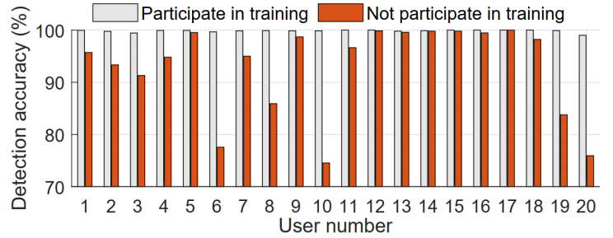
Training Requirements
Training Requirements
ArrayID requires audio samples for training classifier
Performance degrades when no training samples
No Training Hurdles remains an open problem

Slide 32
6
Conclusions

Slide 33
Conclusion
Summary:
Propose ARRAYID for thwarting voice spoofing attacks without any extra devices.
Propose a robust liveness feature array fingerprint.
Proved to be effective and robust to various factors.
Future Work
Improve the performance under strong noises.
Thwart more advanced attacks.
Achieving no training hurdles.
Notes:
消除/阻止

Slide 34
Discussion
Mic Array for sensing, e.g., AudioSense
Smart Speaker Array for, e.g., fall detection

Slide 35
Conclusion
Thank you!
Yan Meng: yan_meng@sjtu.edu.cn Haojin Zhu: zhu-hj@sjtu.edu.cn

