Slide 1
Transformer for Time Series Prediction
Newest work
Same dataset
SOTA idea

Slide 2
2. EEG Comforter
Network Structure
Y. Song, Q. Zheng, B. Liu and X. Gao, "EEG Conformer: Convolutional Transformer for EEG Decoding and Visualization," in IEEE Transactions on Neural Systems and Rehabilitation Engineering, vol. 31, pp. 710-719, 2023, doi: 10.1109/TNSRE.2022.3230250.

Slide 3
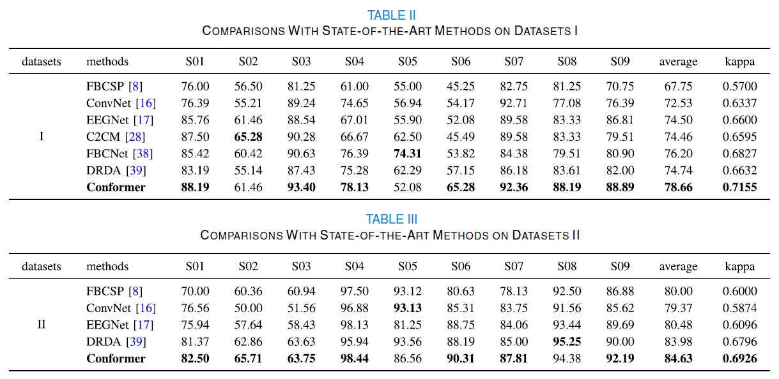

Slide 4
Compare: EEG Transformer
arxiv.org/abs/2106.11170

Slide 5
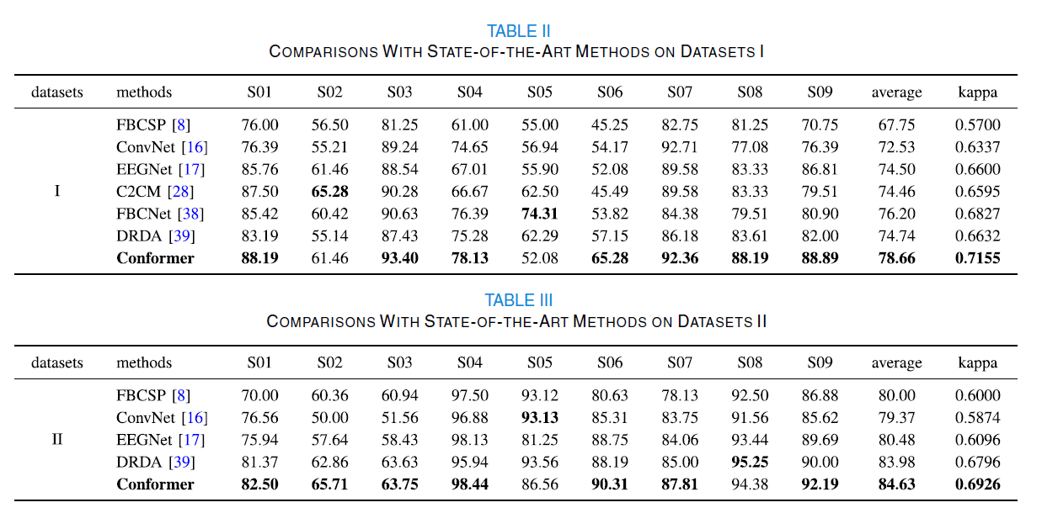

Slide 6
启发
时间序列等数据集上使用CNN+Transformer的可能性

