Slide 1
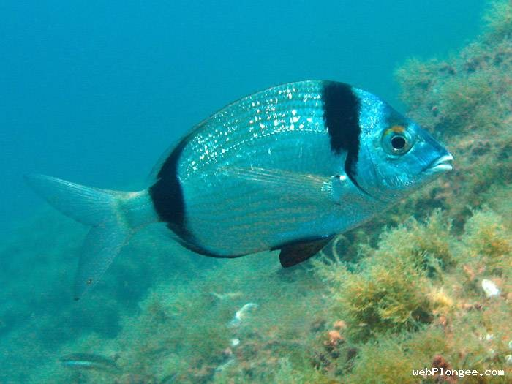
SAR principles
Introduction to SAR Understanding SAR: different points of view Example of a SAR algorithm: the RMA
E. Colin Koeniguer
E. Colin Koeniguer, elise.koeniguer@onera.fr
SAR principles

Slide 2
Outline
Introduction to SAR Understanding SAR: different points of view Example of a SAR algorithm: the RMA
1
Introduction to SAR Introductions Resolutions
2
Understanding SAR: different points of view Geometric point of view
The PSF point of view
The signal processing point of view Why different SAR algorithms?
3 Example of a SAR algorithm: the RMA
Modelling of the mathematical problem to solve The different steps of the algorithm
E. Colin Koeniguer, elise.koeniguer@onera.fr
SAR principles

Slide 3
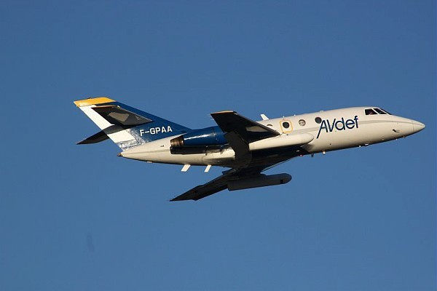
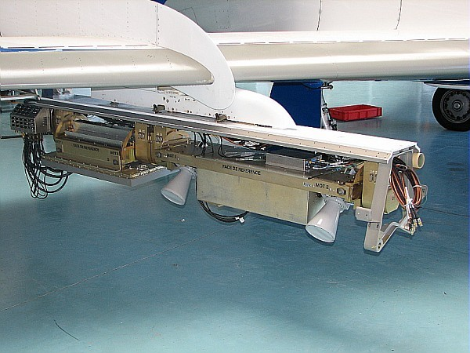
Introduction to SAR Understanding SAR: different points of view Example of a SAR algorithm: the RMA
Introductions Introductions
What is SAR?
Definition
Synthetic Aperture Radar (SAR) is an active remote sensing technology
that uses microwave energy to illuminate the surface.
The system records the elapsed time and energy of the return pulse
received by the antenna.
These instruments can collect data about the Earth’s surface day or night,
regardless of cloud cover.
Example of airborne system
E. Colin Koeniguer, elise.koeniguer@onera.fr
SAR principles

Slide 4
Introduction to SAR Understanding SAR: different points of view Example of a SAR algorithm: the RMA
Introductions Introductions
Why doing SAR?
Specificities
Because Radars opperate at relatively long wavelengths, they are not (or only very little) affected by scattering in the atmosphere, thus they can ”see” through clouds.
The reflected signal depends (among other factors) on the surface roughness, which provides important additional information not directly available from other observations.
Radar waves used to visualize objects because of their ability to penetrate a range of materials
E. Colin Koeniguer, elise.koeniguer@onera.fr
SAR principles

Slide 5
Introduction to SAR Understanding SAR: different points of view Example of a SAR algorithm: the RMA
Introductions Introductions
SAR concept
Principle
The Radar is an active remote sensing system. Short pulses of EM radiation are sent out and the reflected signal is detected.
Range resolution
travel time t given by τ = ^{2x} , x is the distance travelled The range
c
resolution is then given by the length of pulse ∆τ :
∆τ c 2
δ_{x} =
If frequency modulation is used with a bandwidth B then
c
δ_{x} = _{2B}
E. Colin Koeniguer, elise.koeniguer@onera.fr
SAR principles

Slide 6
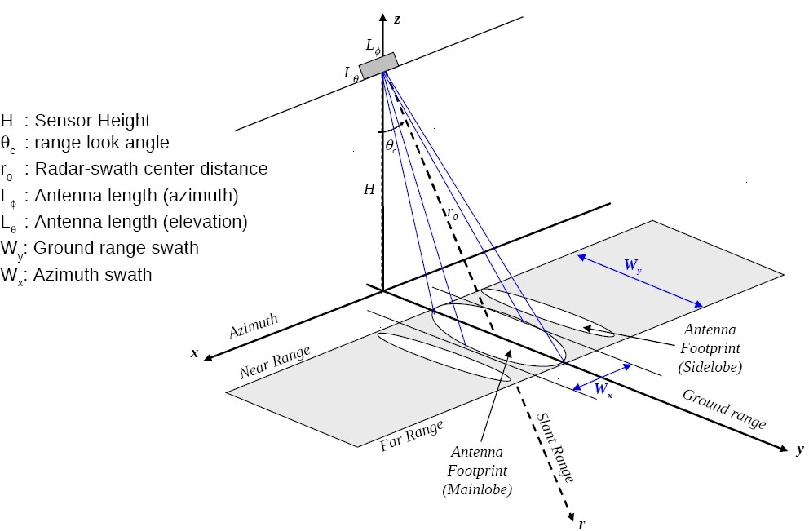
Introduction to SAR Understanding SAR: different points of view Example of a SAR algorithm: the RMA
Introductions Introductions
SAR concept
Azimuth resolution
Azimuth Resolution of image improves as aperture size increases.
Unfortunately, increasing aperture size (antenna length) may simply be impractical (antenna lengths in kilometers)
beam resolution
Example
Uniform aperture antenna has a lobe
with an aperture angle φ = ^{λ} where
L
L is the antenna dimension.
L = 10m, λ = 20cm
=⇒ φ = 0.02rad = 1.145◦ for H=800km, θ₀ = 20◦ =⇒ R = 900km
φ
δ = 2R tan ≈ Rφ = 18km !!
y
2
E. Colin Koeniguer, elise.koeniguer@onera.fr
SAR principles

Slide 7
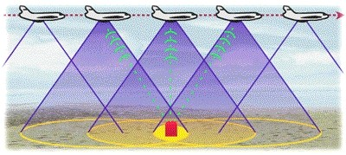
Introduction to SAR Understanding SAR: different points of view Example of a SAR algorithm: the RMA
Introductions Introductions
SAR concept
Goal
gain the advantages of a large aperture radar by using a smaller, traveling aperture
Azimuth processing
E. Colin Koeniguer, elise.koeniguer@onera.fr
SAR principles

Slide 8
Introduction to SAR Understanding SAR: different points of view Example of a SAR algorithm: the RMA
Geometric point of view The PSF point of view
The signal processing point of view Why different SAR algorithms?
Geometric properties of a SAR acquisition
SAR geometric principles
Points of the ground are differentiated by their distance Points of the ground are differentiated by their doppler
Separation according to distance
What are the set of points located at a given distance of the antenna ?
What are the intersection of this set with the ground if it is assumed to be an horizontal plane ?
E. Colin Koeniguer, elise.koeniguer@onera.fr
SAR principles

Slide 9
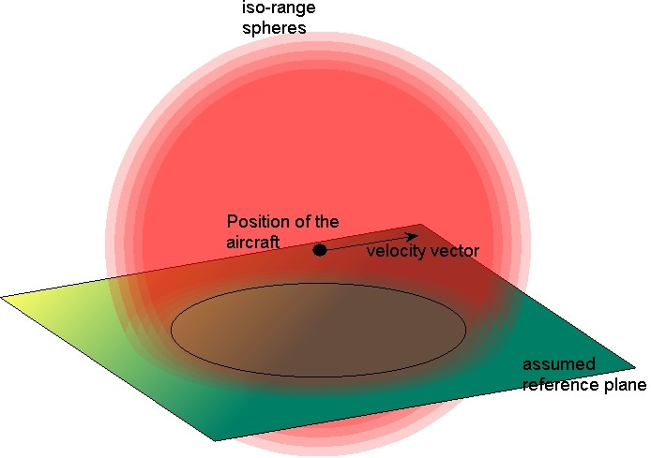
Introduction to SAR Understanding SAR: different points of view Example of a SAR algorithm: the RMA
Geometric point of view The PSF point of view
The signal processing point of view Why different SAR algorithms?
Isorange
Geometric considerations
Iso range surfaces are spheres
Intersection of a sphere with a plane : circles
E. Colin Koeniguer, elise.koeniguer@onera.fr
SAR principles

Slide 10
Introduction to SAR Understanding SAR: different points of view Example of a SAR algorithm: the RMA
Geometric point of view The PSF point of view
The signal processing point of view Why different SAR algorithms?
Geometric properties of a SAR acquisition
Separation according to doppler
What are the set of points seen by a given velocity relative to the antenna ?
What are the intersection of this set with the ground if it is assumed to be an horizontal plane ?
E. Colin Koeniguer, elise.koeniguer@onera.fr
SAR principles

Slide 11
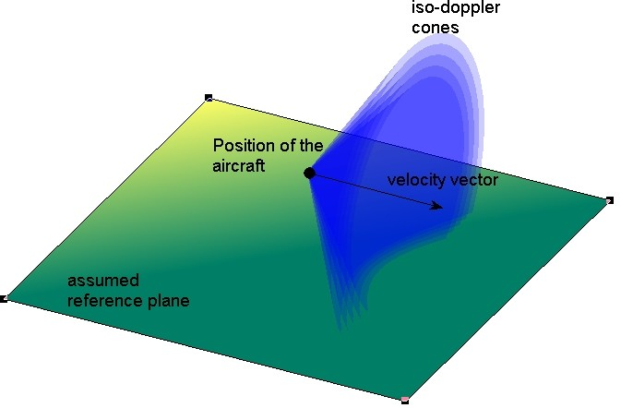
Introduction to SAR Understanding SAR: different points of view Example of a SAR algorithm: the RMA
Geometric point of view The PSF point of view
The signal processing point of view Why different SAR algorithms?
Isodoppler
Geometric considerations
Iso doppler surfaces are cones
Intersection of a cone with a plane: quadric curve
E. Colin Koeniguer, elise.koeniguer@onera.fr
SAR principles

Slide 12
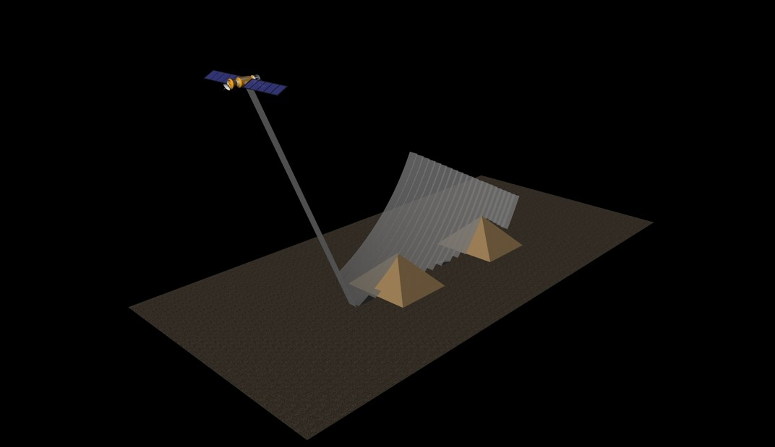
Introduction to SAR Understanding SAR: different points of view Example of a SAR algorithm: the RMA
Geometric point of view The PSF point of view
The signal processing point of view Why different SAR algorithms?
Geometric properties of a SAR acquisition
2D projection of 3D data
The range cell is the projection of a range voxel on the ground
E. Colin Koeniguer, elise.koeniguer@onera.fr
SAR principles

Slide 13
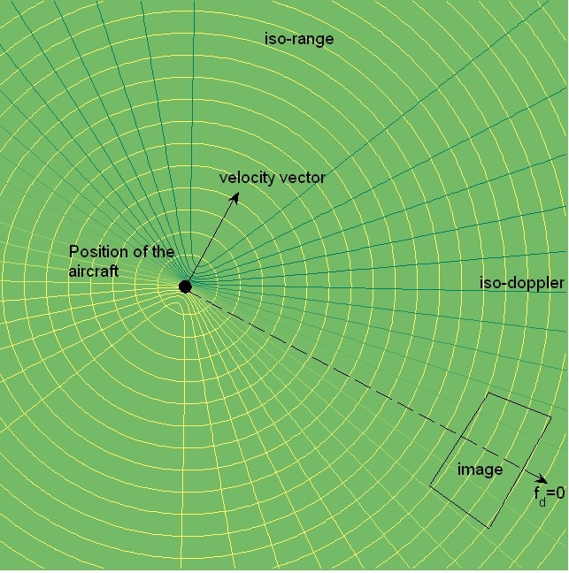
Introduction to SAR Understanding SAR: different points of view Example of a SAR algorithm: the RMA
Geometric point of view The PSF point of view
The signal processing point of view Why different SAR algorithms?
Exemple of Mapping on the ground
On a horizontal plane
E. Colin Koeniguer, elise.koeniguer@onera.fr
SAR principles

Slide 14
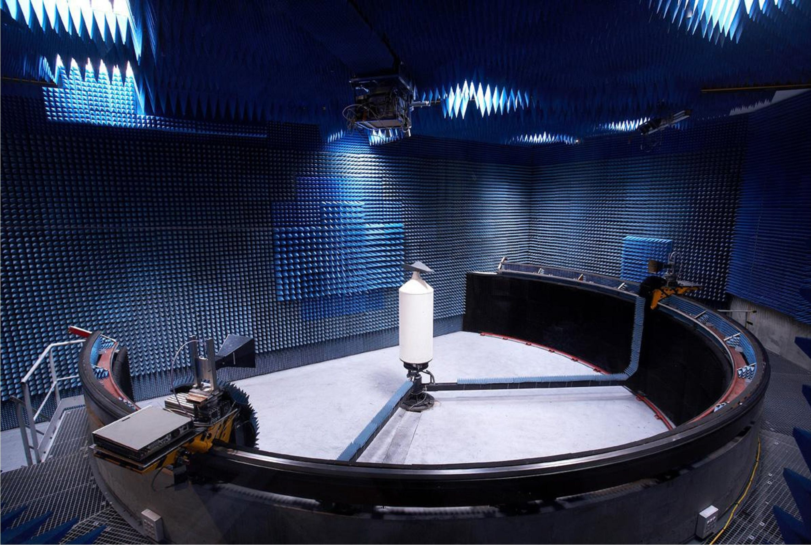
Introduction to SAR Understanding SAR: different points of view Example of a SAR algorithm: the RMA
Geometric point of view The PSF point of view
The signal processing point of view Why different SAR algorithms?
Exemple of Indoor measurement
BABI, a anechoic chamber allowing imaging
Antennas can moove on a circular rail.
E. Colin Koeniguer, elise.koeniguer@onera.fr
SAR principles

Slide 15
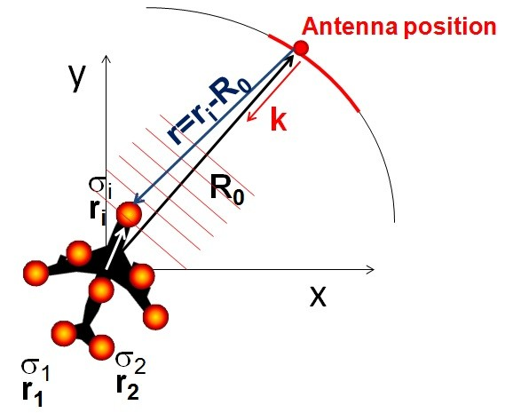
Introduction to SAR Understanding SAR: different points of view Example of a SAR algorithm: the RMA
Geometric point of view The PSF point of view
The signal processing point of view Why different SAR algorithms?
Imaging from indoor measurement (1/2)
Modelling of the signal
Modelling of the signal
H(k) = ∫ exp(jkr)σ_{i} dS_{i} exp(jkr)
H(k) = ∫ σ_{i} dS_{i} exp(j2kr_{i})exp(−j2kR₀)
H(k)exp(j2kR₀) = ∫ σ_{i} dS_{i} exp(j2kr_{i})
E. Colin Koeniguer, elise.koeniguer@onera.fr
SAR principles

Slide 16
Introduction to SAR Understanding SAR: different points of view Example of a SAR algorithm: the RMA
Geometric point of view The PSF point of view
The signal processing point of view Why different SAR algorithms?
Imaging from indoor measurement (2/2)
Modelling of the signal
H(k)exp(j2kR₀) = ∫ dS_{i} σ_{i} exp(j2kr_{i})
. Σ
. Σ
k cos θ
k sin θ y
x
with k =
and r = , σ = σ(x , y ) et dS = dx dy
i i i
H(k)exp(j2kR₀) = ∫ dxdy σ(x , y )exp(j2k_{x} cos θx )exp(j2k_{y} sin θy )
Let K_{x} = 2k cos θ and K_{y} = 2k sin θ
Final signal
exp(j2kR₀)H(k) = ∫ dxdy σ(x , y )exp(j(K_{x} x + K_{y} y ))
σ(x , y ) = TF ⁻¹(exp(j2kR₀)H(k))
E. Colin Koeniguer, elise.koeniguer@onera.fr
SAR principles

Slide 17
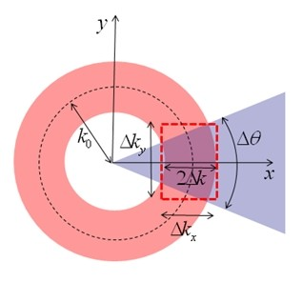
Introduction to SAR Understanding SAR: different points of view Example of a SAR algorithm: the RMA
Geometric point of view The PSF point of view
The signal processing point of view Why different SAR algorithms?
Computation
Methods
Approximate the frequency support by a rectangular box.
Resolutions
Resolutions
∆f
∆k_{x} = 2∆k = 4π _{c}
∆k_{y} = 2k₀∆θ
2π
2π
∆K
δ = , δy =
x
∆K
x
y
c
c 1
δ = , δy =
x
2∆f
2f ∆θ
0
E. Colin Koeniguer, elise.koeniguer@onera.fr
SAR principles

Slide 18
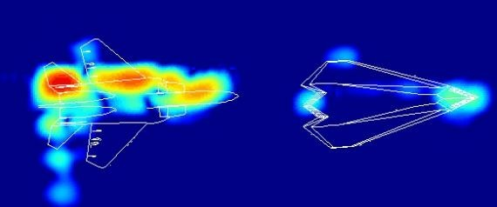
Introduction to SAR Understanding SAR: different points of view Example of a SAR algorithm: the RMA
Geometric point of view The PSF point of view
The signal processing point of view Why different SAR algorithms?
Examples of images from indoor measurement
Questions
Where is the stealth aircraft?
On which parameters depends the resulting image?
E. Colin Koeniguer, elise.koeniguer@onera.fr
SAR principles

Slide 19
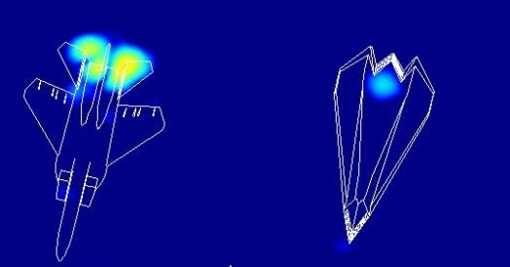
Introduction to SAR Understanding SAR: different points of view Example of a SAR algorithm: the RMA
Geometric point of view The PSF point of view
The signal processing point of view Why different SAR algorithms?
Examples of images from indoor measurement
Questions
Where is the radar?
Order of magnitude of the resolutions?
E. Colin Koeniguer, elise.koeniguer@onera.fr
SAR principles

Slide 20
Introduction to SAR Understanding SAR: different points of view Example of a SAR algorithm: the RMA
Geometric point of view The PSF point of view
The signal processing point of view Why different SAR algorithms?
The case of SAR acquisition
Goal
Determine σ(x , y ) for each target
How?
Range imaging
Cross Range imaging
E. Colin Koeniguer, elise.koeniguer@onera.fr
SAR principles

Slide 21
Introduction to SAR Understanding SAR: different points of view Example of a SAR algorithm: the RMA
Geometric point of view The PSF point of view
The signal processing point of view Why different SAR algorithms?
Computation
Why different SAR algorithms?
Computational cost
Adaptability to large bandwidths or large swath Motion compensation
Which different SAR algorithms?
Backprojection or temporal correlation
RDA Range Doppler algorithms or Polar Algorithm RMA Range Migration Algorithm or (ω, k) Algorithm
E. Colin Koeniguer, elise.koeniguer@onera.fr
SAR principles

Slide 22
Introduction to SAR Understanding SAR: different points of view Example of a SAR algorithm: the RMA
Geometric point of view The PSF point of view
The signal processing point of view Why different SAR algorithms?
Comparisons of different SAR algorithms
Temporal correlation, backprojection exact geometry
time consuming −→ backprojection: one interpolation
RDA or PFA, CSA : frequential domain the most used on satellite platforms only one interpolation
not adapted to very large bandwidths CSA version adapted the the chirp signal
RMA : dual frequential domain adapted to very large bandwidths
Motion compensation not adapted to circular trajectories
E. Colin Koeniguer, elise.koeniguer@onera.fr
SAR principles

Slide 23
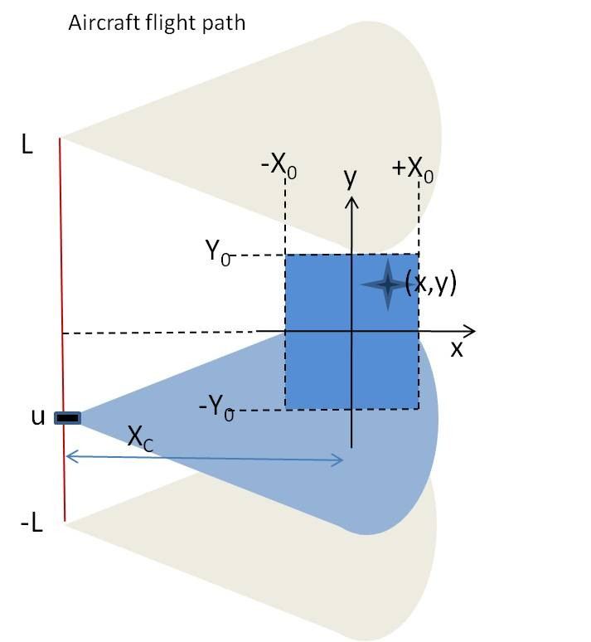
Introduction to SAR Understanding SAR: different points of view Example of a SAR algorithm: the RMA
Modelling of the mathematical problem to solve The different steps of the algorithm
The initial problem to solve
Modelling of the signal
∫ ∫
2
s(t, u) =
dxdyf (x , y )s (t − d (x , y ))
0
c
The goal
Geometric parameters
How to deduce f (x , y ) ?
A particular case
linear trajectory, non squinted, stripmap mode
d (x , y ) = √(X_{c} + x )² + (u − y )²)
E. Colin Koeniguer, elise.koeniguer@onera.fr
SAR principles

Slide 24
Introduction to SAR Understanding SAR: different points of view Example of a SAR algorithm: the RMA
Modelling of the mathematical problem to solve The different steps of the algorithm
First Step
Notations
Let X = (X_{c} − x ) and Y = (u − y ). Note that X > 0
Fourier transform along t
∫ ∫
. .
√
ΣΣ
2
f (f , u) = dxdyf (x , y )TF
s t − X + Y
+ t .
s
t›→ω 0
2 2
0
c
s(t − a) _{FF}−_{T}→_{t›→ω} S (ω)exp(−i ωa)
∫ ∫ . Σ
2
√
2
f (f , u) = dxdyf (x , y )S (f ) exp −j2πf X + Y exp (j2πf _{c} X_{c} ).
s 0
2 2
c
E. Colin Koeniguer, elise.koeniguer@onera.fr
SAR principles

Slide 25
Introduction to SAR Understanding SAR: different points of view Example of a SAR algorithm: the RMA
Modelling of the mathematical problem to solve The different steps of the algorithm
Second Step
Matched filtering
We want simply ^{fs (f ,u)} but S₀(f ) can have zero values. We do instead
S0 (f )
match filtering:
f_{sm} (f , u) = f_{s} (f , u)S₀(f )∗
Result
∫ ∫ .
√
Σ
2
2
2
f (f , u) = |S (f )| dx dy f (x , y ) exp −j2πf X + Y e
j2πf X
.
sm 0
2 2
c
c
c
2
if |S₀(f )| = 1 over the bandwidth:
∫ ∫ .
√
Σ
2
2
f (f , u) = dx dy f (x , y ) exp −j2πf X + Y e
j2πf X
.
sm
2 2
c
c
c
E. Colin Koeniguer, elise.koeniguer@onera.fr
SAR principles

Slide 26
Introduction to SAR Understanding SAR: different points of view Example of a SAR algorithm: the RMA
Modelling of the mathematical problem to solve The different steps of the algorithm
Third Step
Fourier transform along u
FFT transform along u axis
F_{s} (f , k_{u} ) = ∫ f_{sm} (f , u) exp(−jk_{u} u)du
∫ ∫ ∫
√
(−j2πf X +Y
) j2πf X −jk u
F (f , k ) =
dx dy du f (x , y ) e
2 2
2
e
2
e .
s u
c
c
c u
Stationary method for integral over u
∫ ∫
,
√
,
−j 4k −k (X +x )−jk y )
F (k, k ) =
−j
π
2 2
u j2kX
dx dy f (x , y )e e
u ^{c}
e .
s u
4
c
E. Colin Koeniguer, elise.koeniguer@onera.fr
SAR principles

Slide 27
Introduction to SAR Understanding SAR: different points of view Example of a SAR algorithm: the RMA
Modelling of the mathematical problem to solve The different steps of the algorithm
Fourth Step
frequence centering
√
2 2
by multiplying our function by e e
jπ/4 j 4k −k X −j2kX
e , we obtain:
u ^{c}
c
∫ ∫
. Σ
√
F (k, k ) = dx dyf (x , y ) exp −j 4k − k x − jk y .
2 2
sm u u u
E. Colin Koeniguer, elise.koeniguer@onera.fr
SAR principles

Slide 28
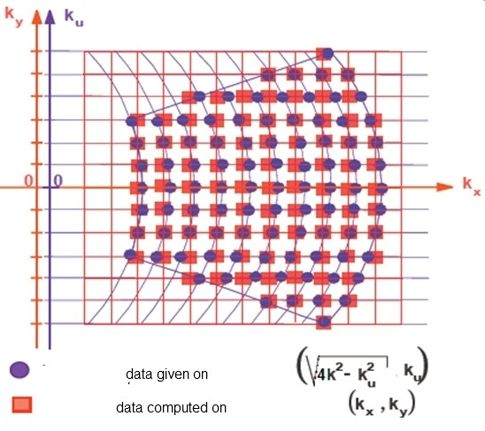
Introduction to SAR Understanding SAR: different points of view Example of a SAR algorithm: the RMA
Modelling of the mathematical problem to solve The different steps of the algorithm
Fifth Step
Stolt interpolation
√
let k = 4k − k and k = k . Then
2 2
x u y u
F_{sm} (k_{x} , k_{y} ) = ∫ ∫ dx dy f (x , y ) exp (−jk_{x} x − jk_{y} y ).
Schematic representation F_{sm} (k, k_{u} ) −→ F_{sm} (k_{x} , k_{y} )
E. Colin Koeniguer, elise.koeniguer@onera.fr
SAR principles

Slide 29
Introduction to SAR Understanding SAR: different points of view Example of a SAR algorithm: the RMA
Modelling of the mathematical problem to solve The different steps of the algorithm
Sixth and last step
2D FFT
f (x , y ) = ∫ ∫ F_{sm} (k_{x} , k_{y} )dxdy exp (+jk_{x} x + jk_{y} y ).
E. Colin Koeniguer, elise.koeniguer@onera.fr
SAR principles

Slide 30
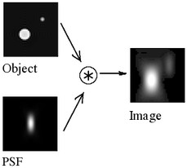
Introduction to SAR Understanding SAR: different points of view Example of a SAR algorithm: the RMA
Modelling of the mathematical problem to solve The different steps of the algorithm
The Point Spread Function
Definition
describes the response of an imaging system to a point source or point object.
E. Colin Koeniguer, elise.koeniguer@onera.fr
SAR principles

Slide 31
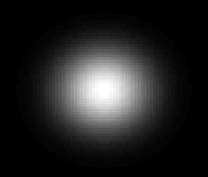
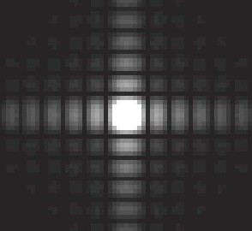

Introduction to SAR Understanding SAR: different points of view Example of a SAR algorithm: the RMA
Modelling of the mathematical problem to solve The different steps of the algorithm
The Point Spread Function
Question
What is the Point Spread Function for a SAR image ? Why?
E. Colin Koeniguer, elise.koeniguer@onera.fr
SAR principles

Slide 32
Introduction to SAR Understanding SAR: different points of view Example of a SAR algorithm: the RMA
Modelling of the mathematical problem to solve The different steps of the algorithm
Why is it far more complex?
Geometry is more complex
squinted modes (middle of trajectory does not correspond to middle of the scene
3D mode: the antenna has an elevation
motion compensation: the trajectory is not exactly linear
Towards more sophisticated configurations
towards ultra high resolution: very sensible to trajectory towards other trajectories: circular
towards bistatic configurations
E. Colin Koeniguer, elise.koeniguer@onera.fr
SAR principles

Slide 33
Introduction to SAR Understanding SAR: different points of view Example of a SAR algorithm: the RMA
Modelling of the mathematical problem to solve The different steps of the algorithm
To conclude
The only things to keep in mind SAR is a 2D image process
Points are differentiated by their distance and doppler
Range resolution is obtained like with a classical radar: using compression with a frequency bandwith.
Azimuth resolution is obtained with the movement of the antenna. (”Synthetic antenna”). It depends also on the central frequency.
E. Colin Koeniguer, elise.koeniguer@onera.fr
SAR principles

