Slide 1
RIO: A Pervasive RFID-based Touch Gesture Interface
Reporter: 胡航

Slide 2
Lots of Connected Devices by 2020
~30 Billion

Slide 3
Can we effectively transform everyday object into a touch Interface？
Notes:
The traditional ways are WIFI, Capacitive, Vision, IMU and so on

Slide 5
Issues with these modalities
Not easy to customize
Not low cost
Extensive training phase
Need to be recharged frequently
…

Slide 6
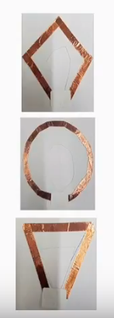
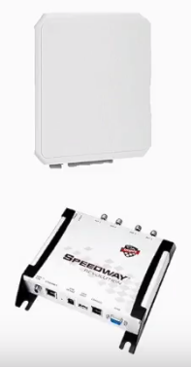
Passive RFID tags as touch interface
COTS Tags
Custom Tags
COTS Reader/Antenna
Notes:
COTS: commercial off-the-shelf (现成的)

Slide 7
And that interface
Customizable and less costly
Battery-free
Supports fine-grained tracking
Multi interface support

Slide 8
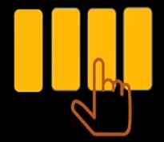
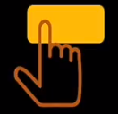
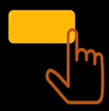
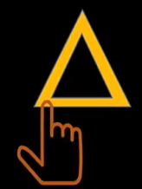
Keyboard
Button
Slider
Multiple Sliders
Dial
Shapes

Slide 9
Key Idea and Reasoning
Tracking within Multiple Tags
Evaluation
Touch and Single Tag Tracking

Slide 10
Key Idea and Reasoning
Tracking within Multiple Tags
Evaluation
Touch and Single Tag Tracking

Slide 11
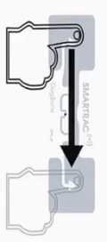
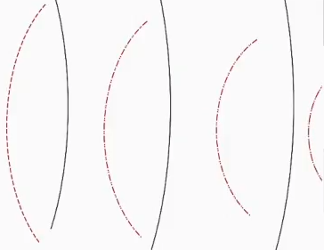
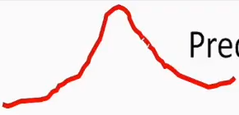
Key Idea and Reasoning
Antenna
Tag
Finger Swipe on Tag
Predictable phase change at reader side
Reader

Slide 12
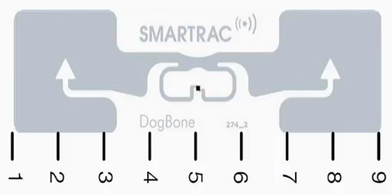
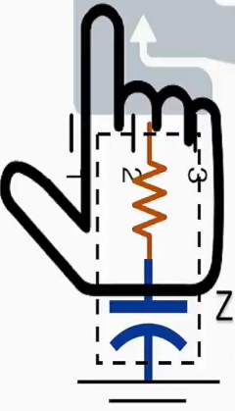
Why dose it happen?
ZAntenna
Backscattered Electric field and Phase
ZChip
$$Induced Current ∝ \frac{Incident Electric Field}{Z_{chip}+Z_{Antenna}}$$
Body

Slide 13
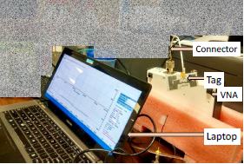
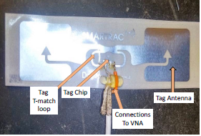
VNA based measurements
Notes:
应用范围：1.5 m，商用RFID Tag：2.4 m

Slide 14
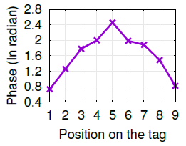
VNA based measurements

Slide 15
Key Idea and Reasoning
Tracking within Multiple Tags
Evaluation
Touch and Single Tag Tracking

Slide 16
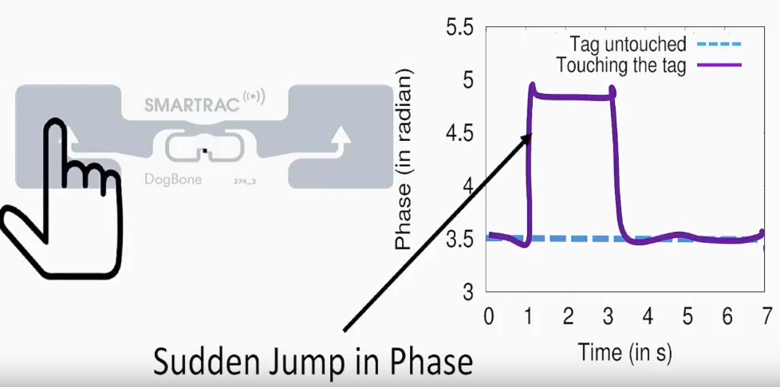
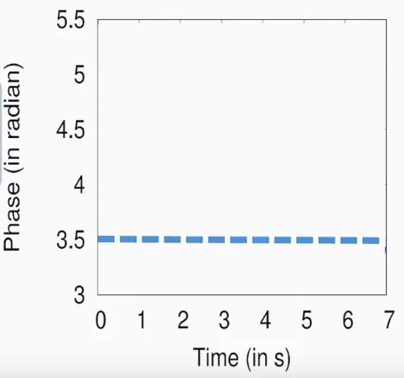
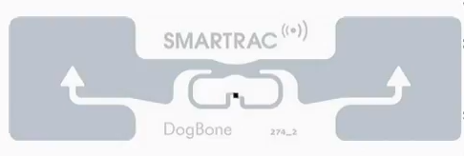
How to detect touch?

Slide 17
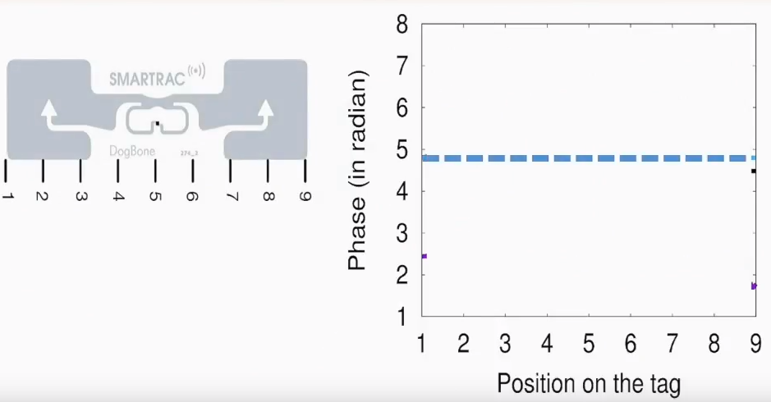
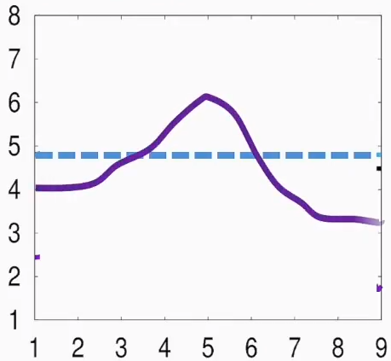
How to detect tracking?
Predictable Phase Pattern
Notes:
相位变化超过阈值C即认为接触。C=0.9，100% detect accuracy

Slide 18
This Change is also present in NLoS
Remains Similar
Notes:
NLoS: non-line-of-sight (视线之外)

Slide 19
Single tag tracking algorithm sketch
Notes:
DTW：动态时间分割弯曲, T=0.5s,可调节，对应精度和速度

Slide 20
Key Idea and Reasoning
Tracking within Multiple Tags
Evaluation
Touch and Single Tag Tracking

Slide 21
Tracking within Multiple Tags

Slide 22
Mutual coupling phenomenon
Neighboring tags show reverse phase pattern

Slide 23
Multi tag tracking algorithm sketch
Apply joint DTW matching

Slide 24
Key Idea and Reasoning
Tracking within Multiple Tags
Evaluation
Touch and Single Tag Tracking

Slide 25
Experimental Setup
Notes:
Tag: 1.5 x 10 cm; 天线：下方50cm处; read 速度：200次/s

Slide 26
Single Tag Tracking Accuracy
Error ~10 mm

Slide 27
Multi Tag Tracking Accuracy
Error ~18 mm

Slide 28
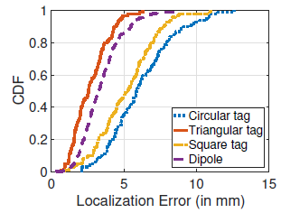
Custom Tag Tracking Accuracy
Error < 10 mm
Custom Tags
Notes:
Human touch 100% accuracy, swipe location accuracy less 3mm (less than 4% of tag length)

Slide 29
Thanks!

