Slide 2
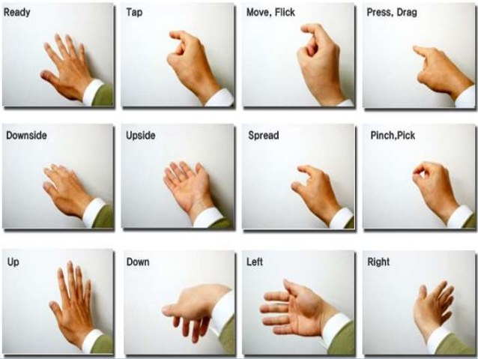
WiFi is a powerful sensing medium
Gait Identification
Gesture Recognition

Slide 3
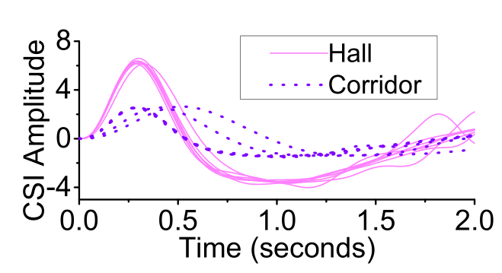
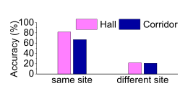
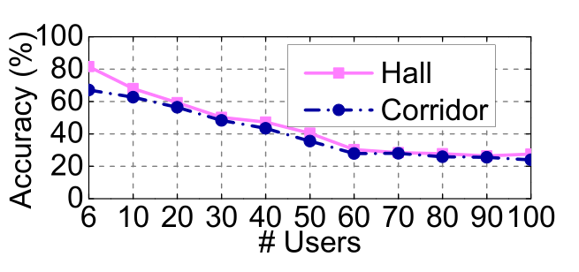
Limitations
Require collecting training data in all sites
Only support for a handful of users
Notes:
同一个人、同一手势在不同地方的特征表现非常不同（原因：multipath effect）。图为同一个人的手势在两个不同地点的特征。收集数据需要耗费大量时间
User数目增多时，准确率下降明显。

Slide 4
Goals
Scaling to new environments
Consistent performance for larger problem sizes
Notes:
仅在一个地点收集数据，但是通过一些方法得到多个环境下的模型，达到跨站点的效果
分类的类别数增加依然能保持很好的效果（步态识别中的用户数目，手势识别中的手势数目）

Slide 5
Roaming WiFi metrics
Learning how does the environment affect the WiFi signal
Translated signal metrics for site B
Input signal metrics
for site A
y = f(x)
Roaming model
Notes:
不同地点的数据扩展

Slide 6
Using multiple sensing models
Dynamically choose which sensing model (expert) to use
Sensing model to use
Input WiFi signal
y = g(x)
Expert selector
Notes:
问题规模增大时的解决方案：采用expert selector选择不同的模型

Slide 7
How do the two parts work together?
Roaming model
WiFi training data for new sites
WiFi data
Notes:
1. 训练一个roaming model，offline

Slide 8
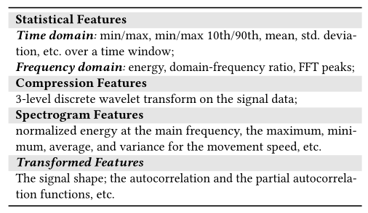
Model Input
Noise Removal
Feature Selection
WiFi data

Slide 9
Artificial neural network based data roaming
Roaming model
WiFi training data for new sites
WiFi data

Slide 10
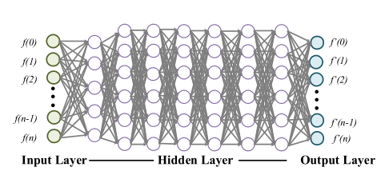
Roaming model
7-layer MLP
Training data
data collection site → deployment site
Data collection time cost ~14 hrs
Transfer learning
Shared params (first few layers) between Model_{A_B} and Model_{A_C}
Reducing data collection cost largely

Slide 11
Classification based model selection
Roaming model
WiFi training data for new sites
WiFi data

Slide 12
Sensing model chosen based on input signal characteristics
Sensing model 1
Sensing model 2
kNN classifier
Sensing model i
Translated WiFi signals
…
Sensing model N

Slide 13
Prior art
Gait Identification
Gesture Recognition
WiWHO
WiFiU
WiG
WiAG
Tens of participants
Handful of gestures

Slide 14
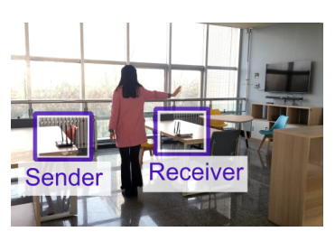
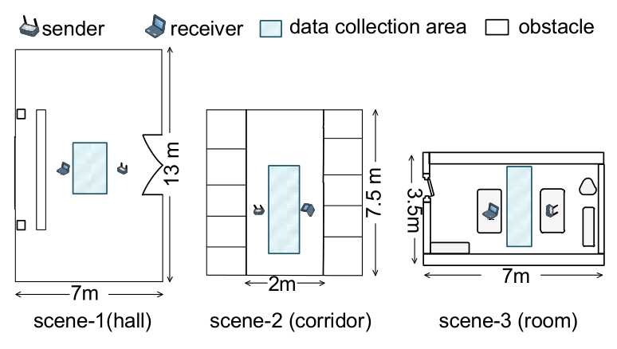
Evaluation Setup
Environments: 3x sites: low, medium and high multipath
Activities: Gait identification (100 users) and gesture recognition (40 gestures)
Wireless channel metrics: CSI and RSSI

Slide 15
Consistently good performance

Slide 16
Roaming WiFi data improves the performance

Slide 17
Conclusion
Problem: Wifi sensing is great, but limited to small-scale deployments
Solutions: Machine learning for roaming training data and scalable performance
Results:
4x improvements on accuracy
much larger problem sizes

Slide 18
Thank you

