Slide 1
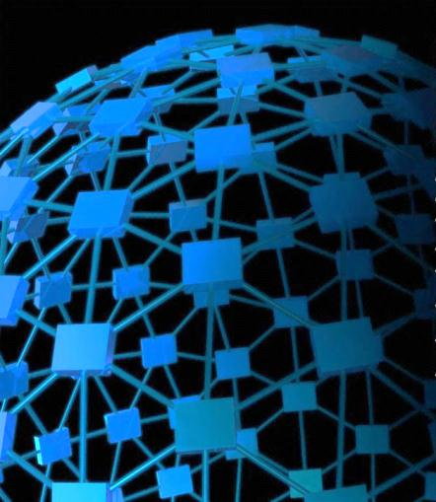
Some Tentative Exploration In Crowdsourcing And Indoor localization
Yan Huang
（黄琰）
Department of Electronic Engineering
Shanghai Jiao Tong University

Slide 2
Overview
Introduction
Previous Work
My Work
My Simulation
Conclusion

Slide 3
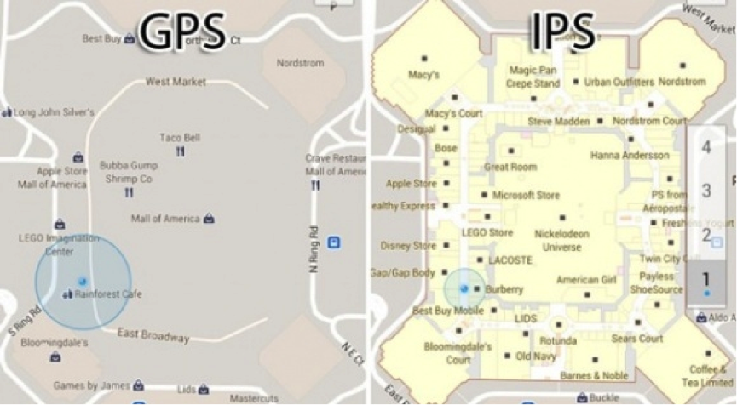
Introduction
Basic Concepts for Crowdsourcing and indoor localization

Slide 4
Brief Description
To make up for the deficiency of GPS
Two
Solutions:
Signal modeling
localization
Fingerprint modeling localization

Slide 5
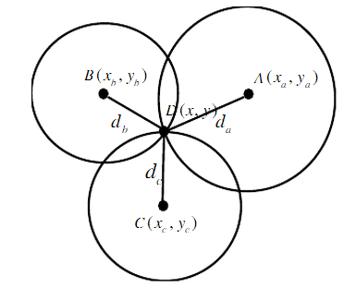
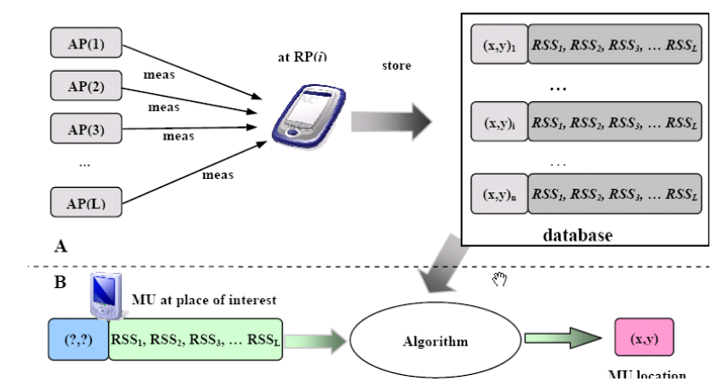
Comparison
The weakness of each method?
Signal modeling
localization
Based on pass loss model
Cannot be commonly used
Fingerprint modeling localization
Should build up a database at first
The time delay when matching with database

Slide 6
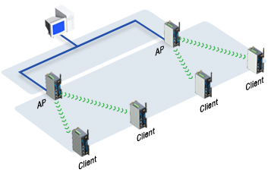
Previous work
Crowdsourcing and indoor localization

Slide 7
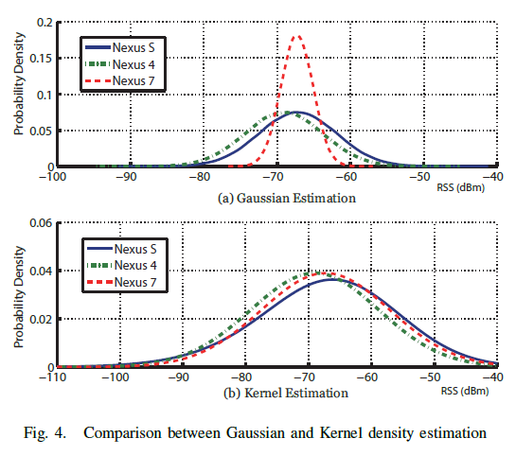
senior fellow apprentice’s work
1.Kernel Density Estimate to deal with heterogeneous devices

Slide 8
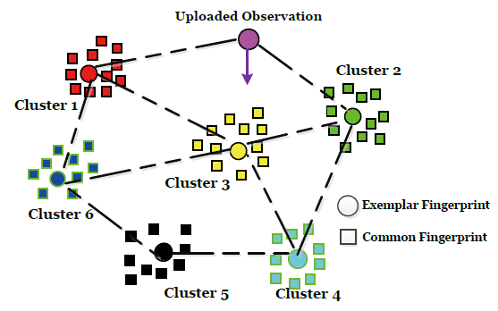
senior fellow apprentice’s work
2.Design an algorithm to shorten searching time
MMC-KNN algorithm

Slide 9
Other works
Probability distribution method
Use SNR to localization(UCLA)
Use sensors in devices and combine it with rectifying system(DUKE)
…

Slide 10
MY work & My SIMULATION
Crowdsourcing and indoor localization

Slide 11
Two main problems
1.unsteady RSS at the fixed location may affect accuracy
2.Matching the location needs long time

Slide 12
For more accuracy…
1.Take RSS change into consideration
In some paper, the RSS change at a fixed location is neglected, however…-60dbm~-94dbm on my computer!

Slide 13
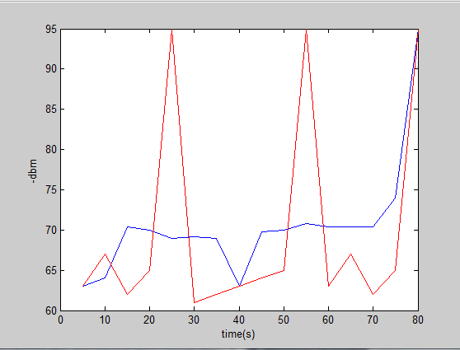
Little suggestion
1.Take RSS change into consideration
My solution: overlapping average to decrease fluctuation
$$AVG_RSS(t)=\frac{1}{n}\sum_{i=0}^{n−1}{RSS(t−i)}$$

Slide 14
For less time…
2.A New Algorithm based on matrix operation
Sampling data
Different APs
Signal strength | Signal strength | …
Signal strength | …
…
Location1_data
Location2_data
Location3_data
…
M*N 1*MN
The data from one location
Fold them together to get the matrix like this, we call it matrix D

Slide 15
2.A New Algorithm based on matrix operation
++++++ +
$$\frac{1}{n}$$
Location1_data
Location2_data
Location3_data
…Location n
Covariance matrix
+
Y=$X^{T}$
$$×$$
-
Average location data
Note: The locations are in same cluster divided in Zhengyong Huang’s project

Slide 16
2.A New Algorithm based on matrix operation
Eigenvalue
We call the Eigen value series Li
Covariance matrix
SVD
Eigenvector
We call the
Eigenvector Vi
Ui is our mapping function

Slide 17
2.A New Algorithm based on matrix operation
$samples in database×u_{i}$
$real time samples×u_{i}$
Ui is our mapping function
Compare and find the top n matched nodes in one cluster
Note:This is also called PCA(Principle component algorithm), we use this method to find the most matched point in a cluster.

Slide 18
conclusion
Conclusion of Crowdsourcing and indoor localization

Slide 19
My work in a word
Find an algorithm to match the RSS to the database consuming less time
Future work
Write an android program to test my work
Use a continuous series of samples(a cycle) instead of a point in the database.

Slide 20
Thank you!
References:
[1] Indoor Localization with a Crowdsourcing based Fingerprints Collecting-Zhengyong Huang
[2] Real time f ingerprint positioning algorithm based on spatial diversity and trajectory continuity-LIU Xingchuan, ZHANGSheng, XU Liqiang, LIN Xiaokang
[3] WLAN定位技术-中国移动通信有限公司研究院业务所

