Slide 1
On the Design and Analysis of Wireless Deadline-aware SWCube for Data Center Networking
Senhong Huang
Department of Electronic Engineering
Shanghai Jiao Tong University
Notes:
Good morning, ladies and gentlemen! I’m Huang Senhong. I am going to talk today about a novel topology for data center: wireless deadline-aware SWCube.

Slide 2
Outline
1. Introduction & motivation
2. Topology of Wireless SWCube
3. Deadline-aware data center TCP
4. Conclusion & future work
Notes:
To start with I'll mention the motivation and related work of my project.

Slide 3
Introduction & motivation
Cloud Service: X as a Service(XaaS)
Basic infrastructure: Data Center
Large, Larger, Larger~er
Notes:
The latest concept of cloud service is “X as a service”, which means all is service;
Do you know what infrastructure support those services? Data Center!
To meet the demand of variety of service you guy enjoying every day, the data center is becoming larger and larger!
Problem 1:How to connect a larger number of servers?

Slide 4
Introduction & motivation
12306: You are buying the train ticket!
Are you kidding me?
Burst of query traffic!
Notes:
assume that you are buying the train ticket----what the hell?
Do you know what happen? Because so many people send their request to buy the ticket, causing the burst of query traffic.
Some of the request had to be dropped.
Problem 2:How to relieve hotspots in DCN?

Slide 5
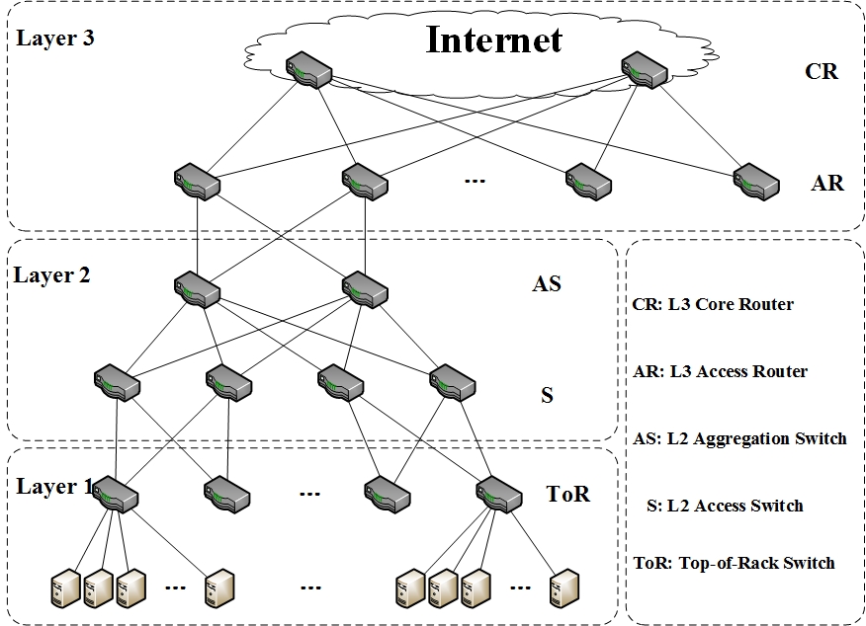
Introduction & motivation
Traditional tree-based topology of data center
Bandwidth limited
High
bandwidth
Low scalability
Server expansive
Low reliability
Burst
tolerance
High cost
Low cost
Notes:
Then we will have a look at the traditional tree-based topology. Unfortunately, for the bottleneck of core switch in the layer 3,
performance is very bad.
What I want to do is to build a data center with those requirements: high bandwidth, server expansive, burst tolerance and low cost.

Slide 6
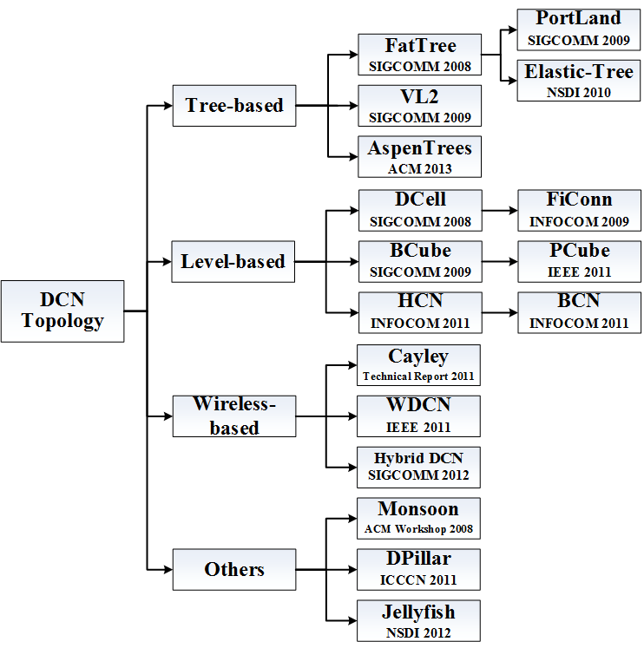
Introduction & motivation
Topologies proposed for DCN
Notes:
Before moving on, have a look at related work on such project.
Topologies proposed for DCN from 2008 to 2013 is shown on this slide, which can be classified as tree-based, level-based, wireless based and other kind of structure.

Slide 7
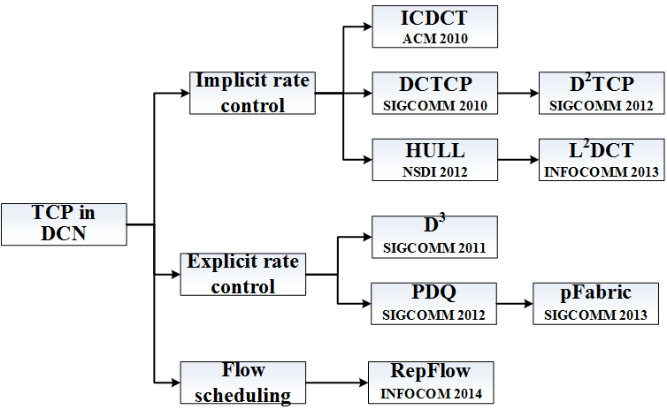
Introduction & motivation
Transmission Control Protocol proposed for DCN
Notes:
And the improved version of TCP for the DCN is shown on this slide.

Slide 8
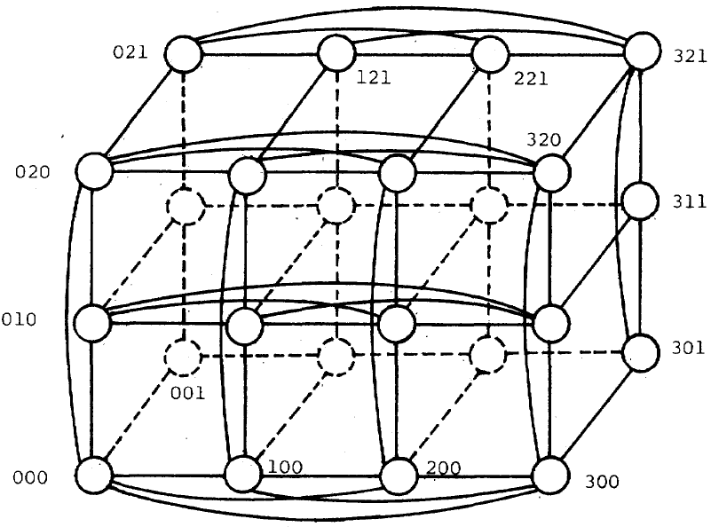
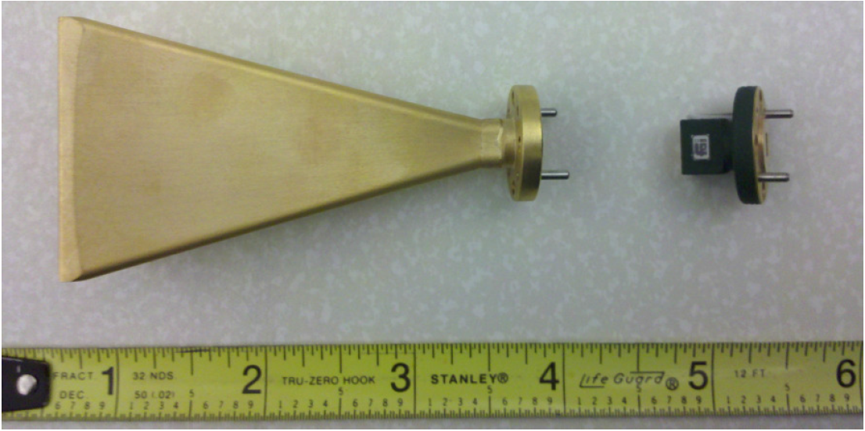
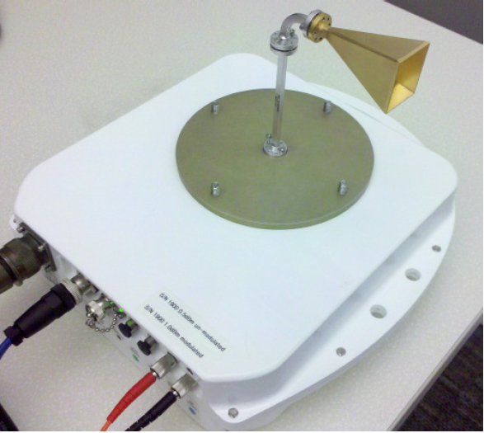
Introduction & motivation
Hypercube : IEEE Transactions on Computers,
1984
60GHz technology：ACM SIGCOMM, 2011
Wireless Deadline-aware SWCube
Notes:
There is another interesting structure named Hypercube, with nodes in different dimension.
60GHz technology is available in DCN.
Based on those works above, I proposed my design: Wireless Deadline aware SWCube.

Slide 9
Outline
1. Introduction & motivation
2. Topology of Wireless SWCube
3. Deadline-aware data center TCP
4. Conclusion & future work
Notes:
Then I'll describe the topology of Wireless SWCube.

Slide 10
Topology of Wireless SWCube
Construction of Wireless SWCube
Wireless SWCube($r,k$)
$k$-dimensional hypercube
$r$ nodes in the $i\text{−}th$ dimension
ID of node: $W=w_{1}w_{2}⋯w_{k}$,where $0<w_{i}≤r$
$n$ port commodity switches
dual port servers
ID of server: $V=\left(V^{1},V^{2}\right)=(v_{1}^{1}v_{2}^{1}{⋯v}_{k}^{1},v_{1}^{2}v_{2}^{2}{⋯v}_{k}^{2})$
Notes:
There are two parameters in SWCube(r,k)
N port commodity switches and dual port servers are used in the construction.

Slide 11
Topology of Wireless SWCube
Construction of Wireless SWCube($r,k$)
Step 1: Constructing Hypercube($r,k$)
Step 2: Replace all the nodes with switches
Step 3: Insert one server into each link
Step 4: Place one antenna on the top of switch
Notes:
The new architecture can be constructed by 4 steps. Of course, I will show you how to generalize SWCube(4,2)to help you understand that.

Slide 12
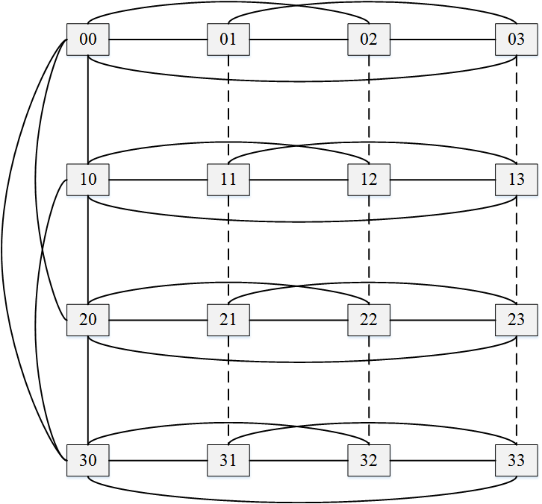
Topology of Wireless SWCube(4,2)
Step 1: Constructing Hypercube(4$,$2)
Notes:
Note that, the interconnections of nodes along the 2nd,3rd,and 4th columns are represented by dotted lines

Slide 13
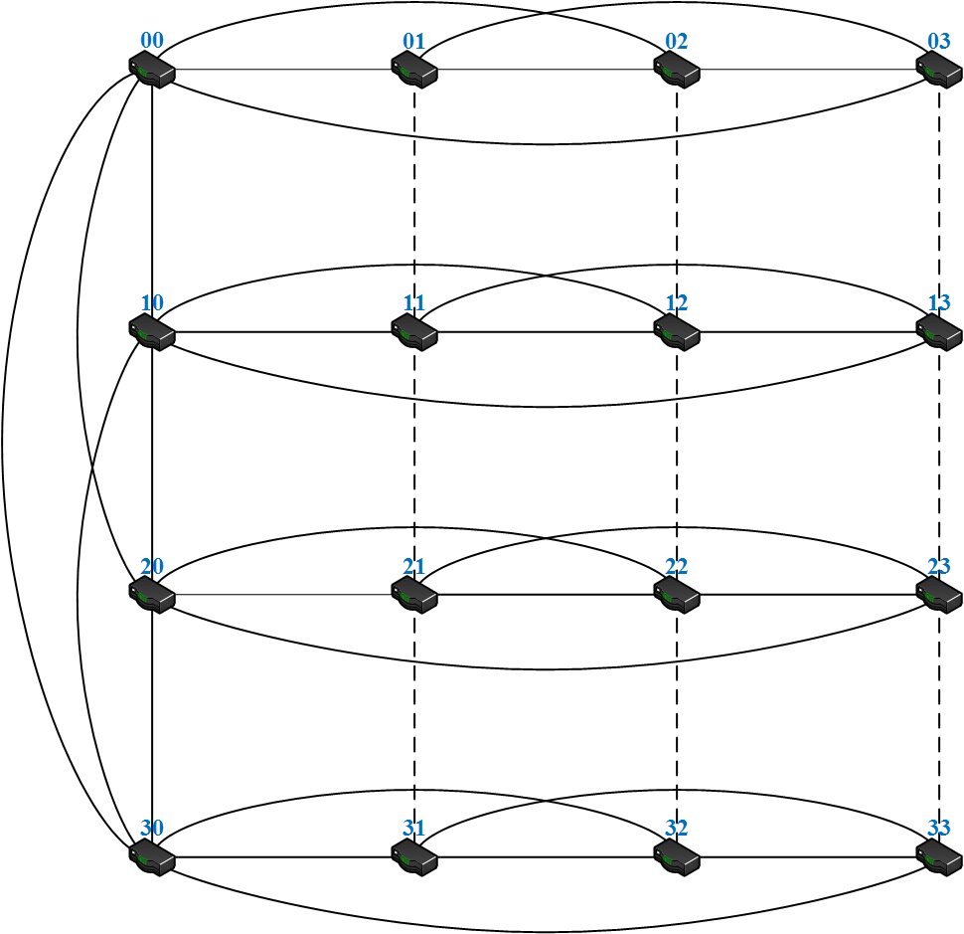
Topology of Wireless SWCube(4,2)
Step 2: Replace all the nodes with switches

Slide 14
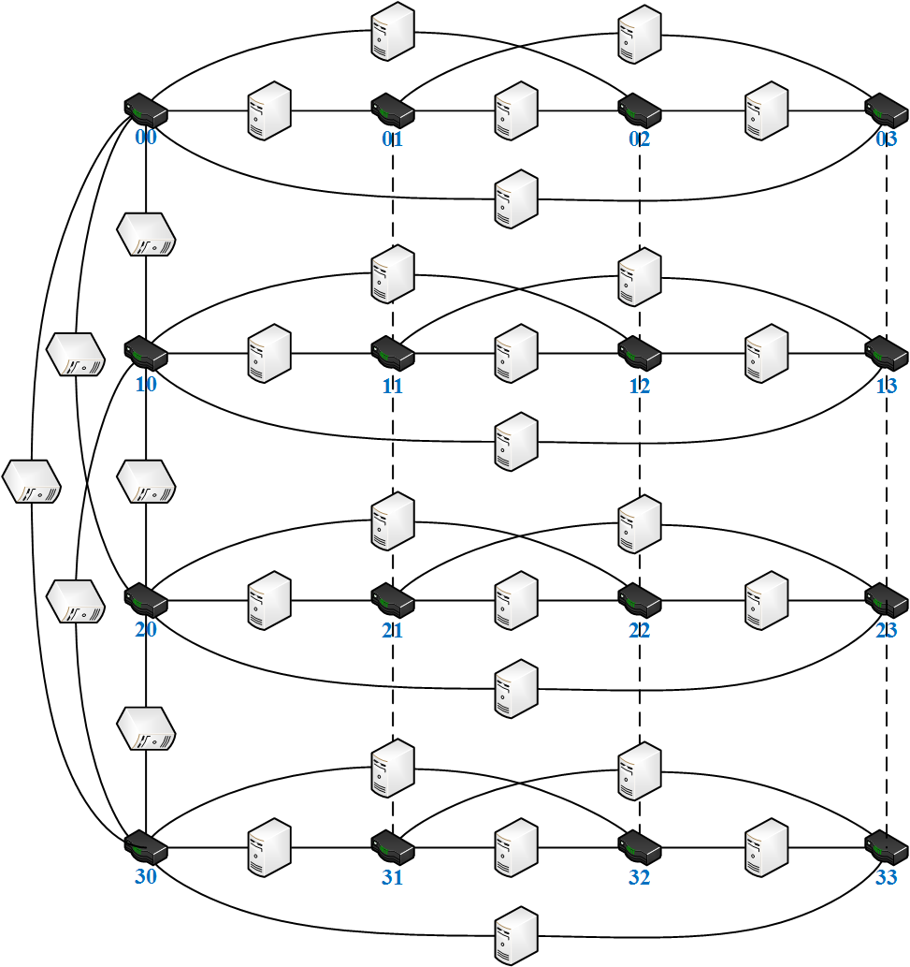
Topology of Wireless SWCube(4,2)
Step 3: Insert one server into each link

Slide 15
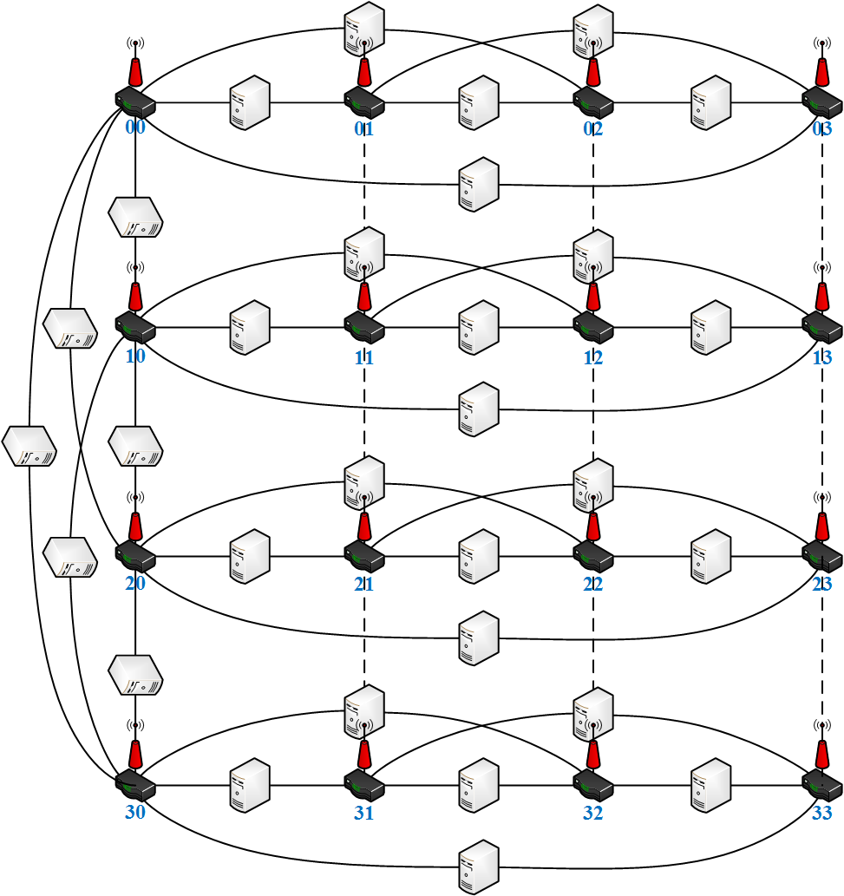
Topology of Wireless SWCube(4,2)
Step 4: Place one antenna on the top of switch

Slide 16
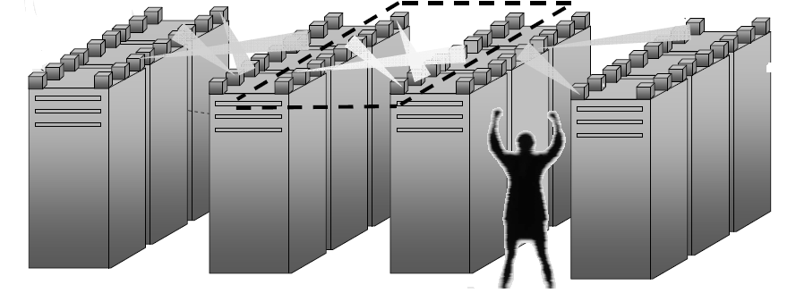
Topology of Wireless SWCube
Placement of Wireless SWCube in DCN
Notes:
After that, the progress is finished.

Slide 17
Topology of Wireless SWCube
Properties of Wireless SWCube($r,k$)
Number of switches：$N_{w}=r^{k}$
Number of servers: $N_{v}= N_{w}×n=r^{k}k\left(r−1\right)$
Number of antenna: ${ N}_{a}=N_{w}=r^{k}$
Diameter: $d=k+1$
distance of two servers:
$$\left\{\begin{aligned}same dimension d≤2 \\ different dimension d≤k+1\end{aligned}\right.$$
Notes:
Some properties will show in this slide.
R power k
加：plus 减：minus 乘：times 除:divide by
The distance of two servers that are along the same dimension is at most 2
The distance of two servers that are along the different dimension is at most k+1

Slide 18
Outline
1. Introduction & motivation
2. Topology of Wireless SWCube
3. Deadline-aware data center TCP
4. Conclusion & future work
Notes:
After that I'll show you the algorithm of the deadline aware TCP.

Slide 19
Deadline-aware data center TCP
Algorithm of Deadline-aware TCP
Step 1: Flow scheduling at the switch
Step 2: Simple marking at the switch
Step 3: ECN-Echo at the Receiver
Step 4: Controller at the Sender
Step 5: Deadline priority scheduling
Notes:
Which is divided into 5 steps

Slide 20
Deadline-aware data center TCP
Step 1: Flow scheduling at the switch
Threshold: $K=(\sqrt{C×RTT})/7$
$C$ : capacity of single wire link
RTT: round-trip time
Queue occupancy
$$\left\{\begin{aligned}Q≤K \text{transport} \text{by} \text{wire} \text{link} \\ Q>K \text{both} \text{by} \text{wire} \text{and} \text{wireless}\end{aligned}\right.$$
Notes:
If queue occupancy is less than K, packets are only transported by wire link;
If not, packets are transported by wire and wireless link;

Slide 21
Deadline-aware data center TCP
Step 2: Simple marking at the switch
Marking threshold: $W=\left(1+θ\right)K$
$θ=\frac{Capacity of wireless link}{Capacity of wire link}$
Marking with CE code-point
Queue occupancy
$$\left\{\begin{aligned}Q≤W packet is not marked \\ Q>W packet is marked \end{aligned}\right.$$
Notes:
If queue occupancy is larger than W, packets are marked with CE code point

Slide 22
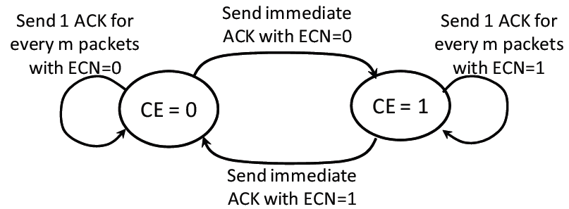
Deadline-aware data center TCP
Step 3: ECN-Echo at the Receiver
Explicit Congestion Notification state machine
Notes:
The receiver tries to convey the exact sequence of marked packets back to the sender;

Slide 23
Deadline-aware data center TCP
Step 4: Controller at the Sender
$α$: estimate of fraction of marked packets
$α←\left(1−g\right)×α+g×F$
$F$: fraction of marked packets last window
$g$: weight given to new samples of $α$
Congestion window size
$cwnd←cwnd×(1−α/2)$
Notes:
Congestion window size is calculated according to the estimate of fraction of marked packets $α$,

Slide 24
Deadline-aware data center TCP
Step 5: Deadline priority scheduling
Deadline :$d=\frac{T_{C}}{D}$
$T_{C}$: time needed to complete transmitting
$D$: time remaining until deadline expires
Deadline priority
$\left\{\begin{aligned}d>1 near deadline flow \\ d=1 deadline meeting flow \\ d<1 far deadline flow \end{aligned}\right.$
Priority dropping: lowest priority packet dropped
Notes:
If the buffer is full in the switch, the far deadline packet is dropped.

Slide 25
Outline
1. Introduction & motivation
2. Topology of Wireless SWCube
3. Deadline-aware data center TCP
4. Conclusion & future work
Notes:
Finally, I'll summarize my presentation

Slide 26
Conclusion & future work
Two contributions:
Design Wireless SWCube($n,k$)
high bandwidth: ECMP
Server expansive: ${ N}_{v}=r^{k}k\left(r−1\right)$
Burst tolerance: deadline-aware TCP
Low cost: dual port servers and commodity switches
Deadline-aware TCP for wireless network
Future work
Simulation on NS2
Compare with Fat-tree
Notes:
I made two contribution in my project, designing a novel structure: Wireless SWCube and
proposing deadline aware TCP algorithm for my topology.

Slide 27
Thank you Q&A
Notes:
That’s all, thank you

