Slide 1






Capacity and delay analysis for multicast
Xing Gao

Slide 2
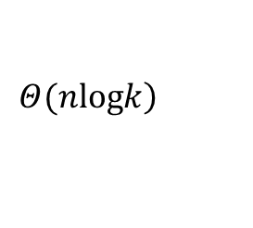
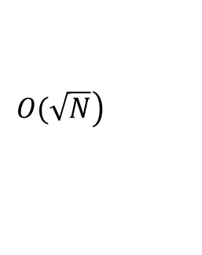
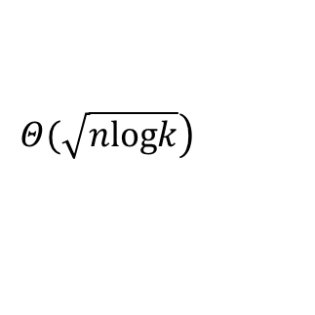
Previous work
  In [1],Michael J and Eytan Modiano focus on the unicast under two-hop algorithm ,demonstrating that it can achieve the delay of O(N) without redundancy and the delay of with redundancy.
  In [2],Xinbing Wang and his cooperators extend the unicast to multicast(Motioncast) and find out that we can achieve the delay , respectively without and with redundancy.Howerever, is also limited in two-hop.
$$\left.Ο(\sqrt{N}\right)$$
$$\left.Θ(nlogk\right)$$
$$\left.Θ(\sqrt{nlogk}\right)$$
  [1] M. J. Neely, and E. Modiano, ‘’Capacity and delay tradeoffs for ad hoc mobile networks,'' IEEE Transactions on Information Theory, vol. 51, no. 6, pp. 1917-1937, Jun. 2005.
  [2]Xinbing Wang,Wentao Huang, ShangXing Wang,Jinbei Zhang ,and Chenhui Hu”Delay and Capacity tradeoff analysis for motioncast” IEEE Transactions on Information Theory, vol. 19, no. 5, pp. 1354-1366, Oct. 2011.

Slide 3
Objectives
In this presentation,we focus on the multicast under multi-hop and answer the following questions:
  What is the upper bound and lower bound of the delay?
  What is the maximum per-node Multicast capacity?
  Is it better than two-hop?

Slide 4
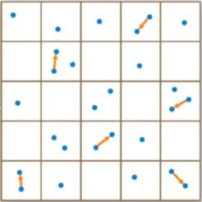

Network model and definition
Cell partitioned Network:
  The network is a unit square and there are N mobile nodes in it.
  Divide it into cells with equal size.
Mobility Model:
  Divide time into constant duration slots.
  I.I.D. mobility model.
    The initial position of each node is equally likely to be any of the C cells independent of others. And at the beginning of each time slot, nodes randomly choose and move to a new cell i.i.d. over all cells in the network.
  The cell-partitioned network model restricts communication to one transmission per cell per timeslot
  This model captures the characteristic of the infinite mobility. With the help of mobility, packets can be carried by the nodes until they reach the destinations

Slide 5
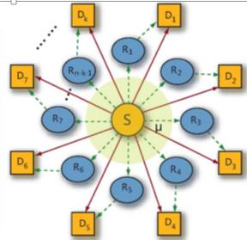
Network model and definition
the source–destination relationships :
In particular, we assume the number of users is divisible by k+1 and number all the nodes from 1 to N .
We uniformly and randomly divide the network into different groups with each of them having k+1 nodes.
Assume packets from each node in a specific group must be delivered to all the other nodes within the group. Nodes not belonging to the group can serve as relays.
The relationships do not change as nodes move around.

Slide 6

Network model and definition
Definition of Capacity:
  For a fixed , the network is stable if there exists a scheduling algorithm so that the queue in each node does not grow to infinity as time goes to infinity.
  The per-node capacity of the network is the maximum rate that it can stably support.
Definition of Delay:
The delay for a packet is defined as the time it takes the packet to reach all its k destinations after it arrives at the source.

Slide 7
Multihop Relay Algorithm for Multicast
Every timeslot and for each cell containing at least two users.
1) If there exists a source–destination pair within the cell,randomly choose such a pair (uniformly over all such pairs in the cell). If the source contains a new packet intended for that destination, transmit. But when the receiver has received it before, ignore it . Else remain idle.
2) If there is no source–destination pair in the cell, designate a random user within the cell as sender. Independently choose another user as receiver among the remaining users within the cell. With equal probability, randomly choose one of the two options.

Slide 8
Multihop Relay Algorithm for Multicast
• Send a Relay packet to its Destination: If the designated transmitter has a packet destined for the designated receiver, send that packet to the receiver. But when the receiver has received it before, ignore it .Else remain idle.
• Send a New Relay Packet: If the designated transmitter has a packet, relay that packet to the designated receiver. But when the receiver has received it before, ignore it .Else remain idle.
When the packet has transmitted to all of the k destinations, delete it.

Slide 9
Multihop Relay Algorithm for Multicast
Case 1:
Send a packet to its Destination

Slide 10
Multihop Relay Algorithm for Multicast
Case 2:
Send a New Relay Packet

Slide 11
Multihop Relay Algorithm for Multicast
Case 3:
Send a Relay packet to its Destination

Slide 12
Multihop Relay Algorithm for Multicast
Case 4:
Send a New Relay Packet

Slide 13
Capacity and Delay
• Theorem 1: Algorithms permitting at most one transmission in a cell at each time slot cannot achieve an average delay better than .In particular,
If ,the min delay is .
  Hint: In order to achieve the best delay,consider an ideal situation where the network is empty and only node 1 sends a single packet to k destinations. At timeslot T ,there are no more than 2^T nodes have the packet.

Slide 14



Capacity and Delay
Lemma 1^{[1]:}Under the above algorithm ,for any network size , the expected time for the packet to reach all destinations satisfy :
where:
:the total time to reach all destinations
:represent the time required to send the packet to at least N/2 users
:the time required to deliver the packet to the destination users given that at least N/2 users initially hold the packet.
$$T_{N}$$
$$S_{1}$$
$$S_{2}$$

Slide 15
Capacity and Delay
• Theorem 2:Under the multi-hop relay algorithms for multicast,we can achieve the delay Θ(logN) and achieve the capacity
.
  Hint: Theorem1 and Lemma 1 is the special case where there is only one packet transmitting in the network.If we consider each source node as a Geo/Geo/1 queue, the delay we achieved in Th1 and Le1 can be seen as service time. According to the property of Geo/Geo/1 queue(talked in Lemma 2,omit it because of time limmitted),we can achieve the above delay and capacity.

Slide 16
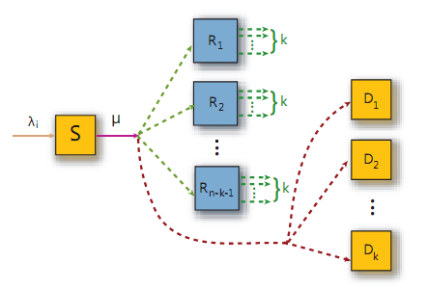
Capacity and Delay
Consider it as a Queue
Arriving process J~B(λ)
Service process S~Geo(μ)

Slide 17
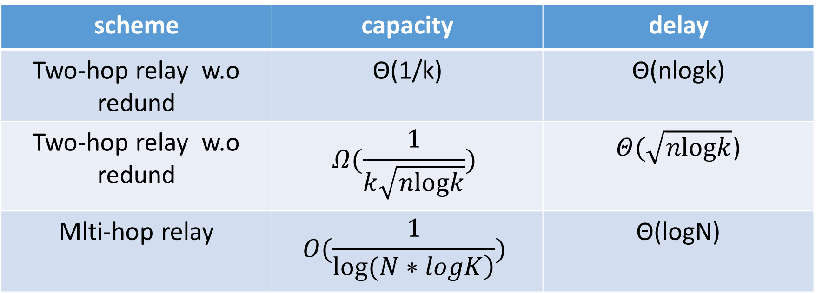
Comparison
scheme | capacity | delay
Two-hop relay w.o redund | Θ(1/k) | Θ(nlogk)
Two-hop relay w.o redund | $$Ω(\frac{1}{k\sqrt{nlogk}})$$ | $Θ(\sqrt{nlogk}$)
Mlti-hop relay | $$Ο(\frac{1}{\left.log⁡(N∗logK\right)})$$ | Θ(logN)
Compared to two-hop,the delay is far better than It while the capacity is worse than it.

Slide 18
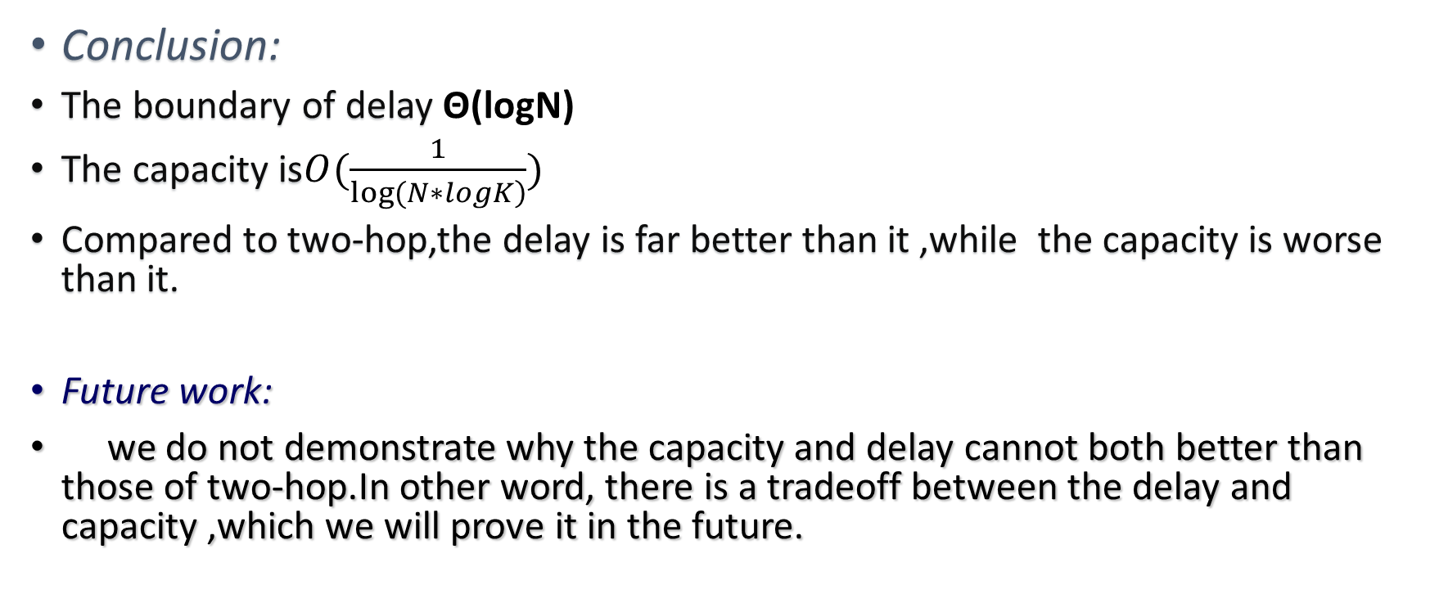
Conclusion and future work
Conclusion:
The boundary of delay Θ(logN)
The capacity is$Ο(\frac{1}{\left.log⁡(N∗logK\right)})$
Compared to two-hop,the delay is far better than it ,while the capacity is worse than it.
Future work:
we do not demonstrate why the capacity and delay cannot both better than those of two-hop.In other word, there is a tradeoff between the delay and capacity ,which we will prove it in the future.

Slide 19
Thank You

