Slide 1
Inferring the Hidden Structure of Information Propagation Using Probabilistic Model
马海蔚

Slide 2
Outline
Background and motivation
Problem statement
Probabilistic model
Solve the problem
Other improvements
Summary for my contribution
Future work

Slide 3
Background and Motivation
In most cases, we observe where and when but not how or why information propagates through a population of individuals. E.g. buy product, get cold
In information propagation, we can observe when a blog mentions a piece of information, but we often do not know where she acquired the information(from external source or internal source), or how long it took her to post it.
Understanding diffusion is necessary for stopping infections, predicting information propagation or maximizing sales of a product. And the probabilistic model is the natural choice.

Slide 4
Problem Statement
Use a directed graph G=(V,E) to model the network, each node in V represents a user, each edge has a weight $w_{i,j}$ to represent the strength of the relationship between node i and node j and describes how frequently information spreads from node i to node j. G is a cluster.
As the information spreads from infected nodes to uninfected nodes, it creates a cascade represented by an N-dimensional vector $t^{c}=\left(t_{1}^{c},…,t_{N}^{c}\right)$, recording when each of N nodes gets infected by the information.
We add another node x to V to represent the external source outside the social network. $t_{x}$ is the time the information first appears in the mass media.
Now we have the mathematical interpretation of networks and information diffusion.

Slide 5
Probabilistic Model
We use probability model and maximum likelihood estimation to solve the problem.
Define $f_{in}\left({∆t}_{i,j};w_{i,j}\right)$as the likelihood of node i infecting node j ${∆t}_{i,j}$ time after node i was infected. ${∆t}_{i,j}=t_{j}−t_{i}$. The parameter $w_{i,j}$ controls the transmission rate.
Define $f_{ex}\left({∆t}_{x,j};w_{x,j}\right)$as the likelihood of node j get infected by the external source ${∆t}_{x,j}$time after the information first appears at mass media. ${∆t}_{x,j}=t_{j}−t_{x}$. The paramete${\text{r} w}_{x,j}$ controls the transmission rate.

Slide 6
Probabilistic Model
Note that node j cannot be infected by node i if node i is infected after node j. ${(t}_{j}>t_{i})$
Define $F_{in}\left({∆t}_{i,j};w_{i,j}\right)$ as the cumulative probability function of${ f}_{in}\left({∆t}_{i,j};w_{i,j}\right)$. Define $S_{in}\left({∆t}_{i,j};w_{i,j}\right)$=1-$F_{in}\left({∆t}_{i,j};w_{i,j}\right)$ which means node j is not infected by node i ${∆t}_{i,j}$ time after node i was infected. Similarly for $F_{ex}\left({∆t}_{x,j};w_{x,j}\right)$ and $S_{ex}\left({∆t}_{x,j};w_{x,j}\right)$.
Define $f_{j}(t_{j})$ as the probability density of node j getting infected at moment $t_{j}$.

Slide 7
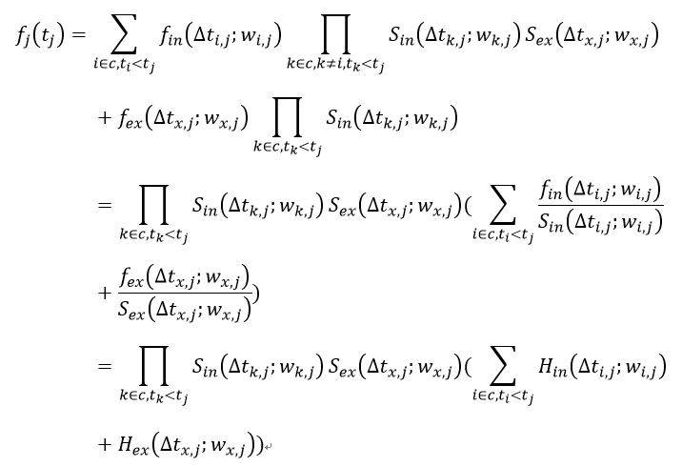
Probabilistic Model
Suppose the set c includes all infected nodes in the vector $t^{c}$, then:

Slide 8
Probabilistic Model
$H_{in}\left({∆t}_{i,j};w_{i,j}\right)=\frac{f_{in}\left({∆t}_{i,j};w_{i,j}\right)}{S_{in}\left({∆t}_{i,j};w_{i,j}\right)}=−\frac{{S^{′}}_{in}\left({∆t}_{i,j};w_{i,j}\right)}{S_{in}\left({∆t}_{i,j};w_{i,j}\right)}$is the hazard function(instantaneous infection rate), which means the event rate after time ${∆t}_{i,j}$ conditional on survival for time${ ∆t}_{i,j}$. Similarly for $H_{ex}\left({∆t}_{x,j};w_{x,j}\right)$
The infection of nodes are independent with each other, so the joint distribution of infection events happening in the cascade $t^{c}$ is${ f}_{c}\left(t^{c}\right)=\prod_{j∈c}{f_{j}(t_{j}^{c})}$
If we observe several cascades of different information, then the likelihood of all cascades is the product of the likelihoods of each individual cascade: $\prod_{c∈Q}{f_{c}(t^{c})}$

Slide 9
Solve the Problem
The problem turns into maximum log-likelihood estimation: $\min{−\sum_{c∈Q}{{log⁡(f}_{c}(t^{c})}}) subject to$ $w_{i,j}≥0 for each pair of (i,j)$
This is a convex problem that can be solved by stochastic gradient descent.
If node i or j are not in any cascade, set $w_{j,i}=0$. Set $w_{j,x}=0$
Otherwise iterate the following formula until convergence or $w_{j,i}=0$:
The optimization problem can split into many several subproblems and thus we can solve for $w_{j,i}$ parallelly.

Slide 10
Other Improvements
Previously we assume $w_{j,i}$ is same for different cascades.
$w_{j,i}$ should vary according to the time and content of the cascade. So ${ w}_{j,i}$ relies on the certain cascade c and turns into ${ w}_{j,i,c}$
We can classify different spreading information into different groups according to the content. Then we try to learn different parameter matrix W for different groups.
Also we can give more weights to the parameter ${ w}_{j,i,c}$ inferred by the latest cascade and then take weighted average on all ${ w}_{j,i,c}$ to get the final${ w}_{j,i}$

Slide 11
Dynamic Network
Some relationships may become strong, some may become weak. A transform matrix M to represent this change.
Infer parameter matrix $W_{t}$ for a certain period of time, say, a month, using cascades happening in that month.
Infer parameter matrix $W_{t+1}$ for another same time interval, say, next month.
Assuming there are only similar slowly changes, then $W_{t}M=W_{t+1}$, $M=W_{t}^{−1}W_{t+1}$
Repeat the work and take average to get an accurate M
Then we can infer the dynamic network at any time using M. For example, a year’s change happening in the network can be calculated by: $M_{year}=M_{month}^{12}$

Slide 12
My Contribution
Based on the previous probabilistic model on information propagation, I do several modifications:
The original model only considers the network diffusion and ignores external influences while I consider the external influences.
The original work does not consider the effects of difference of content between different cascades on the parameters while I consider that.
The original model assumes all relationships($w_{j,i}$) decay and decay to the same extent when time passes by while I consider the more general case.
The original sets a window size T which increases the model complexity but I think it does not make much sense so I remove it.

Slide 13
Future work
Realization and Test
Further research on dynamic networks, such as abrupt changes(burst) in networks

Slide 14
References
RODRIGUEZ M G, LESKOVEC J, BALDUZZI D, et al. Uncovering the structure and temporal dynamics of information propagation[J]. Network Science, 2014, 2(01): 26-65.
Rodriguez M G, Balduzzi D, Schölkopf B. Uncovering the temporal dynamics of diffusion networks[J]. arXiv preprint arXiv:1105.0697, 2011.
Myers S A, Zhu C, Leskovec J. Information diffusion and external influence in networks[C]//Proceedings of the 18th ACM SIGKDD international conference on Knowledge discovery and data mining. ACM, 2012: 33-41.
Gomez Rodriguez M, Leskovec J, Krause A. Inferring networks of diffusion and influence[C]//Proceedings of the 16th ACM SIGKDD international conference on Knowledge discovery and data mining. ACM, 2010: 1019-1028.
Wang D, Park H, Xie G, et al. A genealogy of information spreading on microblogs: A Galton-Watson-based explicative model[C]//INFOCOM, 2013 Proceedings IEEE. IEEE, 2013: 2391-2399.

Slide 15
Thank you!

