Slide 1
Implementation of SISO part in MIMO relays
Presenter: Xushen Han
1
Notes:
Hello everyone! It is great honor here for me to do my presentation about my work in the MIMO relay group. And my work is an implementation of SISO part in MIMO relay system.

Slide 2
Outline
Background
SISO OFDM system
Simulation results
Future work
2
2
Notes:
I will introduce our work with 4 parts: the first one is the background, that is the relationship between kongchao’s idea and our work.
The Second one is our work’s description.
And then I will show you the result we get in our Mayday holidays.
And the last part is our future work.

Slide 3
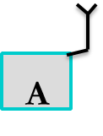
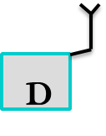
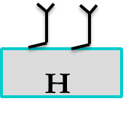
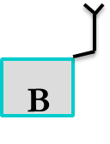
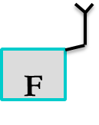
_{Background}
The SISO ODFM transmission is an essential part in each time slot in our MIMO system.
[1,3,4]
_{[3,4]}
[3]
[3]
[4]
[1]
[4]
[1]
[2]
[2,3]
[2]
[1,2]
[2,4]
Notes:
Ok, let’s come to the introduction part.
As you see, in the each time slot in MIMO relay system, It has an SISO(that means single input single output) part. For instance, in time slot 1, the node A should transmit the data to the node B, that is an SISO, and A should transmit data to H at the same time in a different channel. The implementation of this part is what I will focus on in this presentation today.

Slide 4
Outline
Background
SISO OFDM system
Simulation results
Future work
2
2
Notes:
I will firstly introduce some basic theory of our implementation.

Slide 5
_{SISO OFDM system}
The algorithm of OFDM: IFFT
T_{b}
1/T_{b}
Serial to parallel
_{2/T}b
1/8Tb=fΔ
8T_{b}
9_{/(8T}b)
1/8T_{b}=f_{Δ}
8T_{b}
1/8T_{b}=f_{Δ}
8T_{b}
F
1/8T_{b}=f_{Δ}
8T_{b}
1/8T_{b}=f_{Δ}
8T_{b}
1/8T_{b}=f_{Δ}
8T_{b}
1/8T_{b}=f_{Δ}
8T_{b}
1/8T_{b}=f_{Δ}
8T_{b}
Thanks to Su Zhang. Fundamentals and
Implementation of OFDM Modulator
Notes:
So firstly I want to introduce the OFDM theory briefly.
So you can see: in the TDMA, If I want to transmit 8bits in 8Tb, for 1 bits this is the frequency spectrum, it’s bandwidth is 2 over Tb. But here I want to transmit all the data in 8 Tb at the same time, so you can see that the frequency resource will only need 2 over 8Tb. But If I transmit all the data in 1 central frequency. What it would be? Every bits will disturb the others, just like many people in the classroom speak to the others so no one can hear what he want to know. In order to solve the aliasing in frequency domain, we modulate the central frequency to the zero point. Just as many people speak in different languages.
Ok, now we have the modulate waveform in frequency domain, It’s bandwidth is 9/8Tb, so we save about half of the frequency resources.
So for this good modulation, in the frequency domain, the waveform will be sinc function frequency shift and sigma, right? So in the time domain, It will be the x(t) times e j 2pi/N k n, right? The relationship between them is the Fouler transform.
As for the computer can’t access the continuous data, we use the IDFT to describe this relationship, that is: if you want to do an OFDM modulation, you only need to do an IFFT, that would be ok.

Slide 6
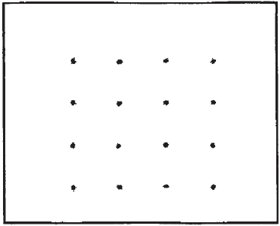
_{SISO OFDM system}
Disadvantage of OFDM : the transmission delay will have bad influence on the FFT in receiver
Solution: cyclic prefix
Notes:
But it still have many drawbacks, for example the transmission delay will have so bad influence on the demodulation part in this system. You can see that the graph 2‘s result is not so good. So in order to avoid this situation, we add a cyclic prefix before the data. The cyclic prefix is a copy of last a few points. For example the data is an 128-bit sequence. And the cyclic prefix is the last 32 points in this sequence, So now our package length is 128+32=160. and at each package I calculate the last 128 points. So as long as the delay is shorter than 32, I can get all the data I need. So this is the cyclic prefix.
Now we can establish our communication system.

Slide 7
_{SISO OFDM system}
OFDM transmitter block diagram
_{Bits generation}
4QAM
Add pilot tones
Make Serial to Parallel
The receiver part will be an inverse process
Add
Cyclic
Prefix
IFFT
Add synchronous
Sequence
Make Parallel
to Serial
Notes:
So the bit flow will go through the 4QAM modulation, add pilot tones, and do the OFDM modulation, add some prefix and synchronous sequence. The receiver part will be an inverse process. So for the D-OFDM system, it has some difference.

Slide 8
_{SISO OFDM system}
D-OFDM and filter in MIMO relay
_{Sequences we want}
_{IFFT}
_{S}
_{Transmitting sequence}
_{FFT}
_{S}
_{filter}
_{Transmitting sequence}
_{We need to focus on it}
Notes:
That is, in the receiver part we need a filter to choose the data we want to get. You can see the relationship between them is the IFFT so use the filter to the Transmitting sequence will get the data piece, I mean a block data we want.

Slide 9
Outline
Background
SISO OFDM system
Simulation results
Future work
2
2
Notes:
So next step is the Simulation part.

Slide 10
_{Simulation result}
It is great honor for me to show our SISO OFDM simulation in face of all of you.

Slide 11
Outline
Background
SISO OFDM system
Simulation results
Future work
2
2

Slide 12
_{Future work}
There are still some challenges for my colleagues and me
[1,3,4]
[3]
[1]
_{MIMO relay}
[1]
[2]
[2,3]
filter
[1,2]

Slide 13
Q & A

Slide 14
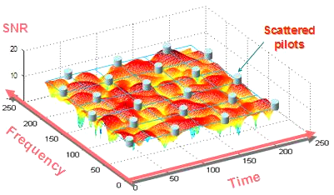
_{Pilot}
Use the Pilot to calculate the channel characteristics

Slide 15
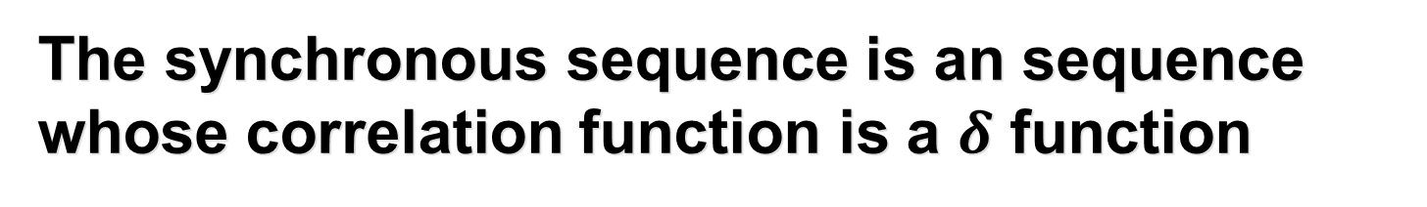
_{add synchronous sequence}
The synchronous sequence is an sequence whose correlation function is a $δ$ function
If the value of the correlation function is so big, then the start point has been spotted

Slide 16
_{Q} & _{A}
What kinds of filter would you use?
square-root raised cosine roll off filter

Slide 17
Thank you!

