Slide 1
Wireless Content
Distribution Network
Zheng Ziqi 5110309274

Slide 2
Background
Rapid development of internet
Huge number of traffics over the network
Congestion in the peak-hour
Page 2

Slide 3

What do we solve ?
Eliminate the issue
Reduce traffics in
Smarter ways
Page 3

Slide 4


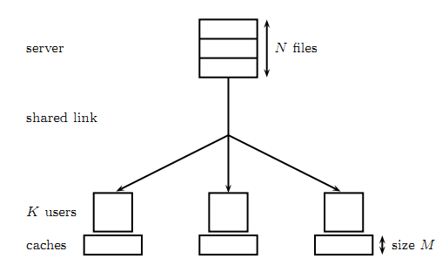
Channel Model
Page 4

Slide 5



Four Steps
Coded caching
Decentralized caching
Dynamic caching
Non-uniform caching
Page 5

Slide 6


Decrease rate uncoded : A2 & B1 codede : A2 xor B1
coded caching
Page 6

Slide 7

server
user1
user2
A1
B1
empty
A2
B2
empty
Page 7

Slide 8
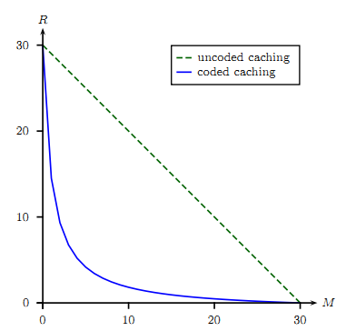
Page 8

Slide 9
In case of unknown users centralized : A1 , A2 decentralized : random MF/K bits
Decentralized
Page 9

Slide 10
Decentralized
we can’t get the number and identity of users in advance
Four subfiles
Asynchronous requests
Ai denotes the bits of ﬁle A that are stored in the cache memories of user i (i=1,2)
J is maximum tolerable delay
Split each file into J parts
Rate
Larger than ideal centralized situation
Page 10

Slide 11
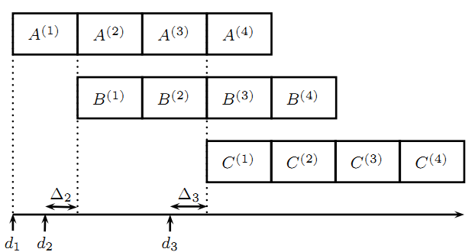
Asynchronous request
Page 11

Slide 12
Trace the popularity of files update popularity list
LRU vs. LRS
Dynamic
Page 12

Slide 13
E-BOOK A
GPA4.3！Nothing is impossible !
E-BOOK B
The way to a GOD! Everything is possible !
E-BOOK C
Believe me,GPA isn’t important :D
Page 13

Slide 14
Considered users’ habbits cluster analysis; fisher optimum partitioning
Non-uniform
Page 14

Slide 15
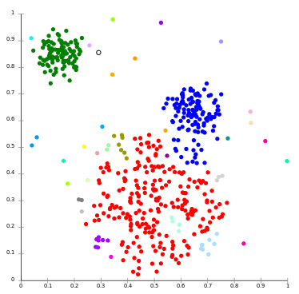
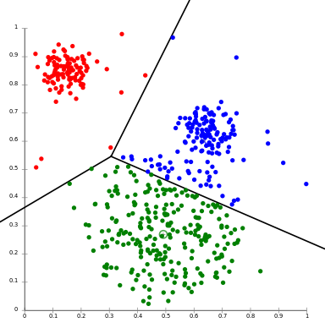
Page 15

Slide 16



THANK YOU !
Reference literature
Coded Caching with Nonuniform Demands
Decentralized Coded Caching Attains
Foundamental limits of caching
Online Coded Caching
Informed-Source Coding-On-Demand (ISCOD) over ]Broadcast Channels
Local Graph Coloring and Index Coding
Project 10
Brand new model
(server , shared link , caches)

