Slide 1
Communication Capacity in Social Situation
Guanjie Zheng, Xinbing Wang, Luoyi Fu

Slide 2
Outline
Introduction
Network Model
Analysis of No-jump Situation
Analysis of Jump Situation
Simulation
Conclusion and Future work
2

Slide 3
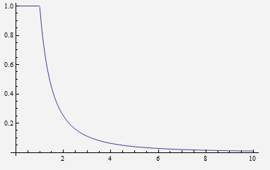
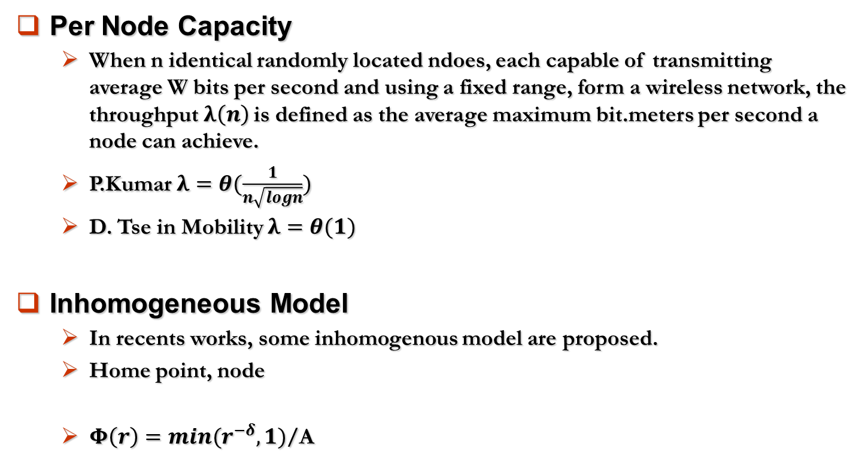
Background
Per Node Capacity
  When n identical randomly located ndoes, each capable of transmitting average W bits per second and using a fixed range, form a wireless network, the throughput$λ\left(n\right)$ is defined as the average maximum bit.meters per second a node can achieve.
  P.Kumar $λ=θ(\frac{1}{n\sqrt{logn}})$
  D. Tse in Mobility $λ=θ(1)$
Inhomogeneous Model
  In recents works, some inhomogenous model are proposed.
  Home point, node
  $Φ\left(r\right)=min(r^{−δ},1)$/A

Slide 4




Motivation
Inhomogeneity
  Prevalent in real life
  Fans, residents
Mobility
  i.i.d
  “jump” due to the “attraction”
Applications
  Dissemination of a disease
  Spread of a rumor
  Conversion of a fan
  Migration

Slide 5
Outline
Introduction
Network Model
Analysis of No-jump Situation
Analysis of Jump Situation
Simulation
Conclusion and Future work
5

Slide 6
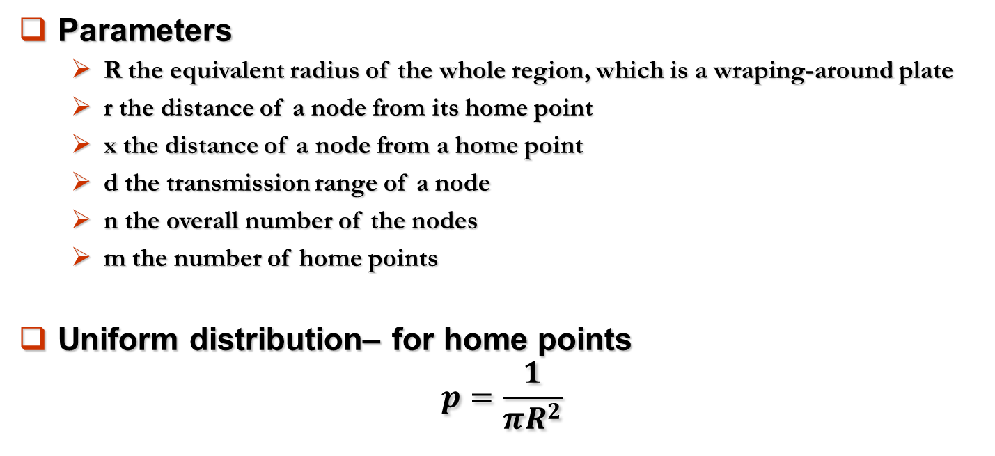
Network Model
Parameters
  R the equivalent radius of the whole region, which is a wraping-around plate
  r the distance of a node from its home point
  x the distance of a node from a home point
  d the transmission range of a node
  n the overall number of the nodes
  m the number of home points
Uniform distribution– for home points
$$p=\frac{1}{πR^{2}}$$

Slide 7
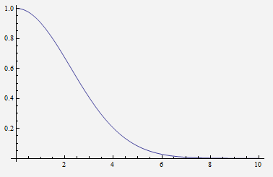
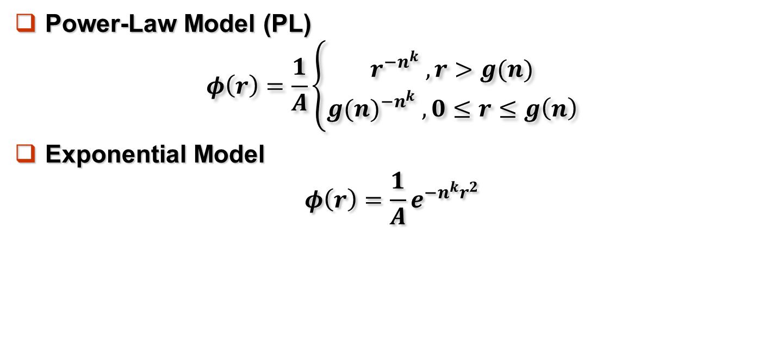
Network Model
Power-Law Model (PL)
$$φ\left(r\right)=\frac{1}{A}\left\{\begin{aligned}r^{−n^{k}} , r>g(n) \\ {g(n)}^{−n^{k}} ,0≤r≤g\left(n\right)\end{aligned}\right.$$
Exponential Model
$$φ\left(r\right)=\frac{1}{A}e^{−n^{k}r^{2}}$$

Slide 8
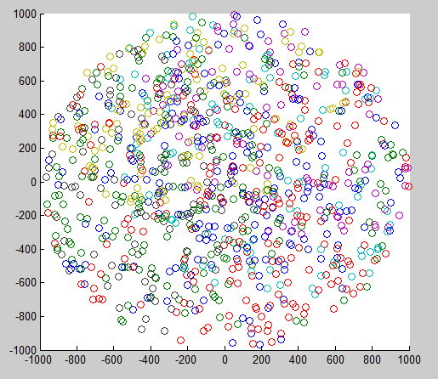
Figure Sample

Slide 9
Mobility Model
We devide the time into slots. At the beginning of every slot, the node move according to the model.
i.i.d + jump
i.i.d – for home points
  At the beginning of every slot, the home points are reshuffled.
Jump+i.i.d
  At the beginning of every slot, the node change their home point according to the “Attraction”.
  After the jump, every node are reshuffled within their new home points.

Slide 10
Outline
Introduction
Network Model
Analysis of No-jump Situation
Analysis of Jump Situation
Simulation
Conclusion and Future work
10

Slide 11
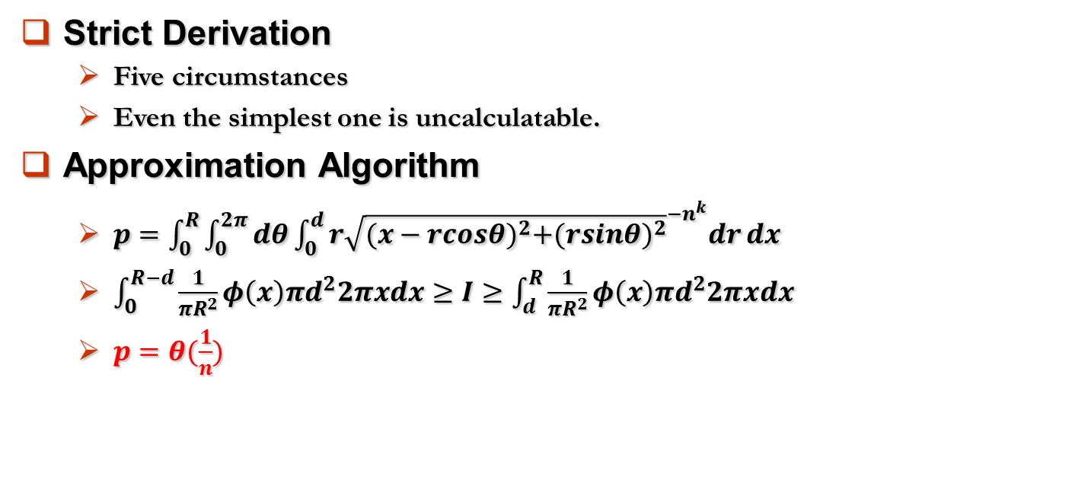
PL Model
Strict Derivation
  Five circumstances
  Even the simplest one is uncalculatable.
Approximation Algorithm
  $p=\int_{0}^{R}{\int_{0}^{2π}{dθ\int_{0}^{d}{r{\sqrt{{(x−rcosθ)}^{2}+{(rsinθ)}^{2}}}^{−n^{k}}dr}}dx}$
  $\int_{0}^{R−d}{\frac{1}{πR^{2}}φ\left(x\right)πd^{2}2πxdx}≥I≥\int_{d}^{R}{\frac{1}{πR^{2}}φ\left(x\right)πd^{2}2πxdx}$
  $p=θ(\frac{1}{n})$
d
R
x

Slide 12
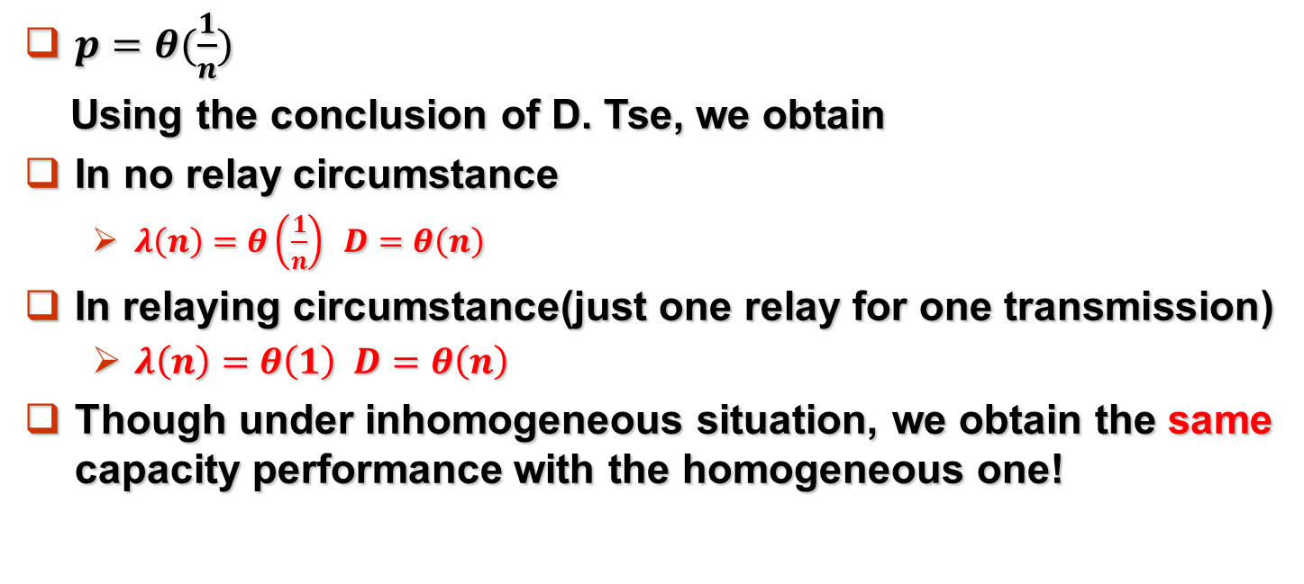
PL Model
$p=θ(\frac{1}{n})$
Using the conclusion of D. Tse, we obtain
In no relay circumstance
  $λ\left(n\right)=θ\left(\frac{1}{n}\right) D=θ\left(n\right)$
In relaying circumstance(just one relay for one transmission)
  $λ\left(n\right)=θ\left(1\right) D=θ\left(n\right)$
Though under inhomogeneous situation, we obtain the same capacity performance with the homogeneous one!
d
R
x

Slide 13
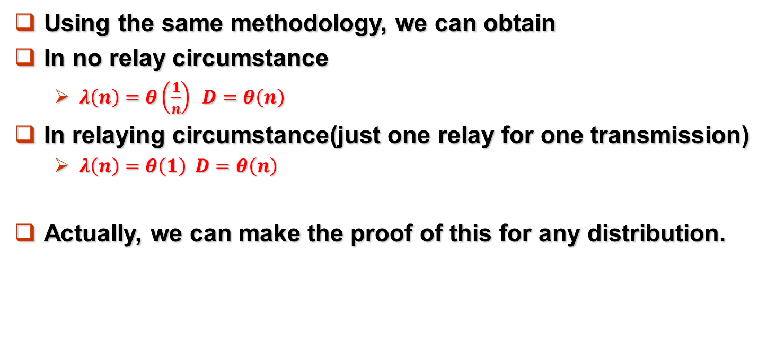
Exponential Model
Using the same methodology, we can obtain
In no relay circumstance
  $λ\left(n\right)=θ\left(\frac{1}{n}\right) D=θ\left(n\right)$
In relaying circumstance(just one relay for one transmission)
  $λ\left(n\right)=θ\left(1\right) D=θ\left(n\right)$
Actually, we can make the proof of this for any distribution.
d
R
x

Slide 14
Exponential Model
Using the same methodology, we can obtain
In no relay circumstance
  $λ\left(n\right)=θ\left(\frac{1}{n}\right) D=θ\left(n\right)$
In relaying circumstance(just one relay for one transmission)
  $λ\left(n\right)=θ\left(1\right) D=θ\left(n\right)$
Actually, we can make the proof of this for any distribution.
d
R
x

Slide 15
Outline
Introduction
Network Model
Analysis of No-jump Situation
Analysis of Jump Situation
Simulation
Conclusion and Future work
15

Slide 16
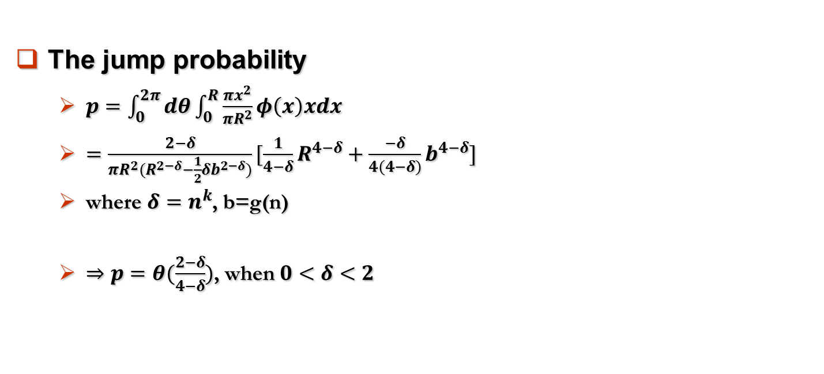
Analysis of Jump Situation
The jump probability
  $p=\int_{0}^{2π}{dθ\int_{0}^{R}{\frac{πx^{2}}{πR^{2}}}φ\left(x\right)xdx}$
  $=\frac{2−δ}{πR^{2}(R^{2−δ}−\frac{1}{2}δb^{2−δ})}[\frac{1}{4−δ}R^{4−δ}+\frac{−δ}{4(4−δ)}b^{4−δ}]$
  where $δ=n^{k}$, b=g(n)
  $⇒p=θ(\frac{2−δ}{4−δ})$, when $0<δ<2$
d2
d1

Slide 17
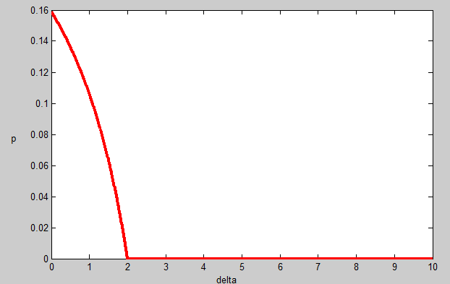
Analysis of Jump Situation

Slide 18
Outline
Introduction
Network Model
Analysis of No-jump Situation
Analysis of Jump Situation
Simulation
Conclusion and Future work
18

Slide 19
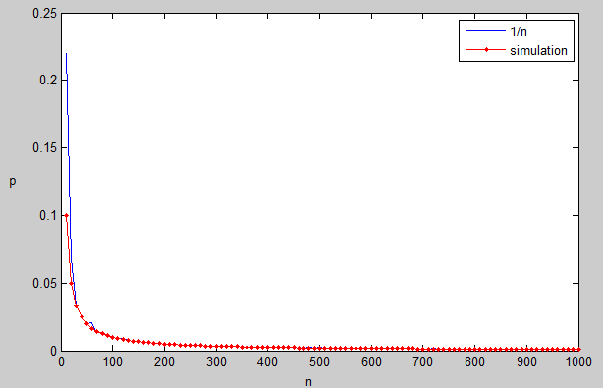
Simulation
Capacity of no-jump situation

Slide 20
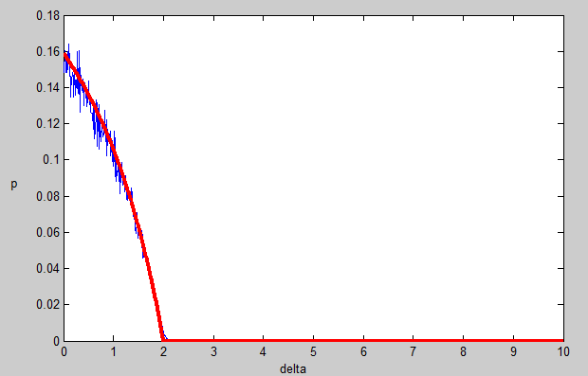
Simulation
Jump

Slide 21
Outline
Introduction
Network Model
Analysis of No-jump Situation
Analysis of Jump Situation
Simulation
Conclusion and Future work
21

Slide 22
Conclusion
The capacity and delay performance of inhomogeneous social ad hoc network is almost the same with the ones of homogeneous one
The inhomogeneity decrease the jump mobility, and may lead to the change of capacity.

Slide 23
Future Work
Derive the capacity and delay trade off in the inhomogeneous S-D chosen situation
Make the center inhomogeneous
Eg. Add some weight, change the range of each center
Investigate the control of this model in real life
Consider the multicast situation

Slide 24
References
[1] P. Gupta and P. Kumar, “The capacity of wireless networks,” IEEE Transactions on Information Theory, vol. 46, no. 2, pp. 388–404, 2000
[2] M. Grossglauser and D. Tse, “Mobility increases the capacity of ad hoc wireless networks,” IEEE/ACM Transactions on Networking, vol. 10, no. 4, pp. 477–486, 2002
[3] Garetto, M.; Leonardi, E., "Restricted Mobility Improves Delay-Throughput Tradeoffs in Mobile Ad Hoc Networks," Information Theory, IEEE Transactions on , vol.56, no.10, pp.5016,5029, Oct. 2010
[4] S Yao, X Wang, X Tian, Q Zhang, “Delay-Throughput Tradeoff with Correlated Mobility of Ad-Hoc Networks,” in Proc. IEEE INFOCOM, Toronto , Canada, April 2014.

Slide 25
Thank you!

