Slide 1
the Vehicle System for God's Eye View
Xie Jin
Notes:
(End) before I introduce my project, do you know what the God’s Eye View is?

Slide 2
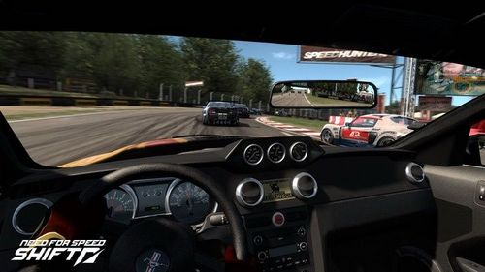
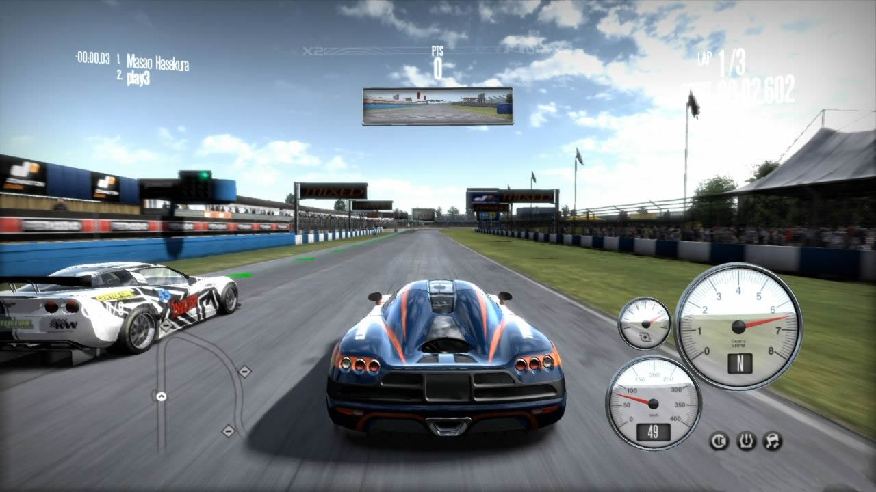
What is the God’s Eye View?
Notes:
Ok, look at this picture.
But players maybe prefer the this perspective, the third-person perspective, also named God’s eye view. You can find that, in this view, we can see something around us more clearly and have a wider view.

Slide 3
Outline
Overall Architecture
Three keywords
Android App
Notes:
Now, this is the outline of my project. I divide this presentation into three sections. In the first section, I will introduce the overall architecture of my project. And then, I will describe three keywords in my project. Finally, I will show you the android application.

Slide 4
Outline
Overall Architecture
Three keywords
Android App
Notes:
Ok, the first section.

Slide 5
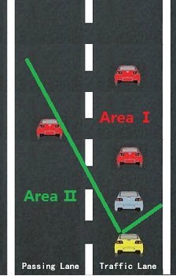
Overall Architecture
For the blue vehicle:
Recognizing the traffic condition about AreaⅠ.
Transmitting the data to yellow vehicle.
For the yellow vehicle:
Recovering the traffic condition on its screen, like IPad or Smartphone.
Notes:
Look at this picture.
(End). In the overall architecture, we can get the three keyword, R, T, R . So, let’s enter the second section

Slide 6
Outline
Overall Architecture
Three keywords
Recognizing
Transmitting
Recovering
Android App

Slide 7
Keyword-Recognizing
$$φ≈ \frac{α+β}{2}$$
Notes:
If we know the alpha and beta, we can determine this triangle and derive the S, delta v and phi easily.
Now we recognize the vehicle in front of us, the second work the system need to do is transmitting.

Slide 8
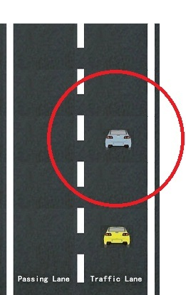
Keyword-Transmitting
For the blue vehicle:
Red circle:
Information-shared area.
Parameters of transmitting data
Velocity V
Angle$φ$
Distance S
Etc…
( All these parameters are about vehicles that are in front of blue vehicle )
Notes:
(Begin)Ok, the second keyword, transmitting. We should transmit the data when we recognized the vehicles.
(End) and then, something the yellow vehicle should do is recovering. It is the third keyword.

Slide 9
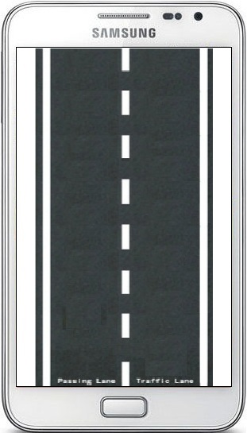
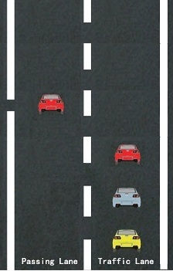
Keyword- Recovering
Notes:
Ok, this is a real traffic condition. In our mobile phone, maybe like this.
(End) thus far, I give you a brief introduction about my project. Let’s move to the third section. It’s the foremost section in this presentation.

Slide 10
Outline
Overall Architecture
Three keywords
Android App

Slide 11
Android App
Showtime
Notes:
in this application, I have achieved the first keyword, recognizing.

Slide 12
Thanks！

