Slide 1
Map matching technology in Indoor Localization
Presenter: Yi Dong

Slide 2
OUTLINE
Background
Difficulties
Map matching
Future work

Slide 3
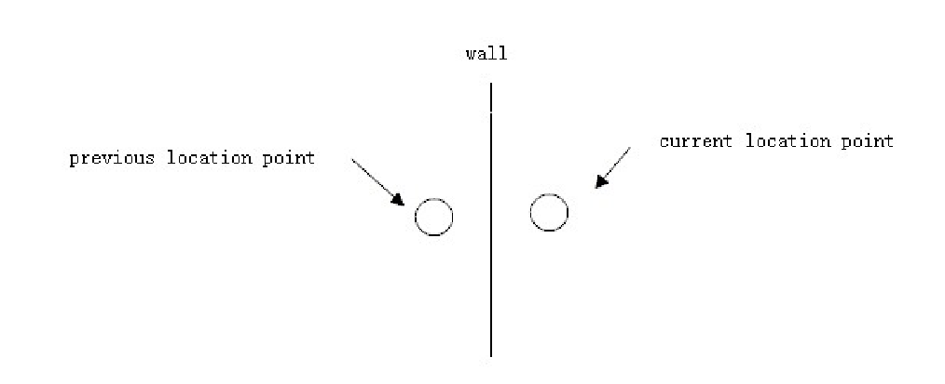
Wifi fingerprint based indoor localization systems
Set a fingerprint database
Compare user’s fingerprint to the database
Different room may have the similiar fingerprint
Indoor map should be take into consideration

Slide 4
Map matching is widely used in GPS location system
better result and reduce the error
Indoor environment has smaller area

Slide 5
DIfficulties
WIFI fingerprint do not have the speed information
WIFI fingerprint do not have the direction information

Slide 6
Map matching
Step1: get the location point and the candidate route
Step2:get the direction information
Step3:calculate the weight for each candidate
Step4:locate the point

Slide 7
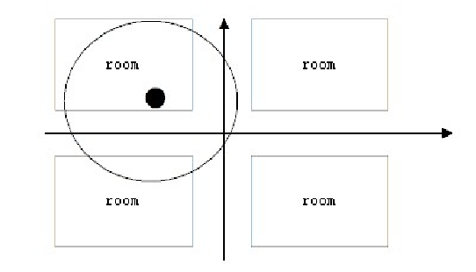
Step1: get the location point and the candidate route
Get the location point
Transfer it on the indoor map
Take all the routes in a short range as the candidate

Slide 8
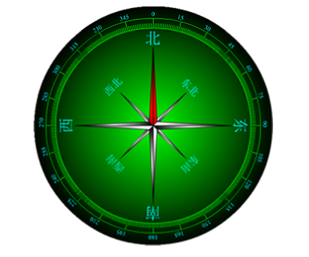
Step2:get the direction information
Get the direction of the indoor map
Get the direction by the compass on your phone

Slide 9
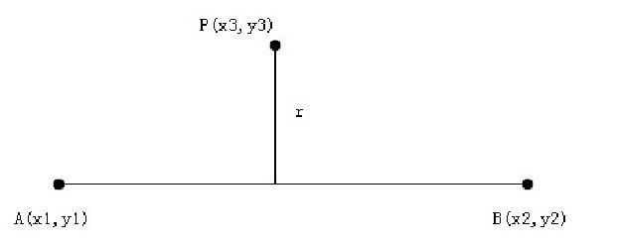
Step3:calculate the weight for each candidate
Calculate the projection distance r for each candidate route

Slide 10
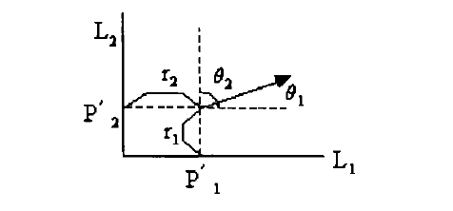
Step3:calculate the weight for each candidate
Calculate the angel between user and route

Slide 11
Step3:calculate the weight for each candidate
The total weight for each candidate is
$W=W_{θ}+W_{r}$
$W_{θ}=A_{θ}cos(θ)$
$W_{r}=A_{r}tan^{−1}\left(\frac{1}{r}\right)$

Slide 12
Step3:calculate the weight for each candidate
if difference of previous location point direction is larger than 45 degree or the weight is too large, keep the origin location point
Select the candidate with the maximum weight

Slide 13
Step4:locate the point
Use the Projection as the result

Slide 14
Future work
Do some simulation
Use more historical points to improve the algorithm
2D-3D

Slide 15
Thank you

