Slide 1
Answer Inference of the Crowdsourcing System in Scoring Problem
Presenter: Kaikai Sheng
Department of Electronic Engineering
Shanghai Jiao Tong University, China

Slide 2
Outline
Introduction
Background
Motivation
System Model
Main Results
Simulation Results
Conclusion

Slide 3
Background
What is Crowdsourcing ?
Outsource a task to a crowd of workers.
Use the wisdom of crowds to solve the task.
How Crowdsourcing system works ?
Notes:
Simply speaking
frankly speaking
Use human power and do what computers cannot do

Slide 4
Motivation
Scoring Problems
Quality estimation
Staff assessment
Features
Continuous: answers are continuous numbers
Correlative: answers are correlative with each other
Notes:
Extensive efforts have been put into the research for labeling problem.
Image classification, model categorization
This method used in labeling problems cannot work in scoring problems.
3. continuous: answer set is infinite.
Different from labeling problem, answers which are not exactly equal to the true answer can still provide inference information for algorithm.
The criterion to assess worker performance is also different. In labeling problem, if one worker’s answer is not exactly equal to the true answer,
he is wrong. However, for a certain scoring task, the true answer is 98 and one worker give his answer 97. If we regard it as labeling problem, this worker is wrong; If we regard it as scoring problem, this worker is almost correct.

Slide 5
Outline
Introduction
System Model
Problem Formulation
Task allocation
Evaluation Criterion
Main results
Simulation Results
Conclusion

Slide 6
Problem Formulation
tasks: , , ,…,
Task answer:
Correlation function:
workers: , , ,…,
p.d.f of worker’s answer:
Notes:
1. Correlation function: For the simplicity of mathematical analysis, we use the square form (・)^2 instead of the absolute value sign form
|・| to profile the correlation.
Intuitively, if the difference between x and y, the value of the correlation function is large, which indicates that they have high correlation with each other.
Apparently, the true score is the most correlative one with itself. If the difference between two scores is large enough, the value of the correlation function will be 0 since they are not correlative with each other.
2. If the true answer of a task is y, the probability density of worker j with submitted answer x is denoted by the probability density function.

Slide 7
Problem Formulation
Worker quality
Answer bias
Answer variance
Notes:
q can be interpreted as the mathematical expectation of correlation between the the task true answer y and the answer of worker j.
This definition is not convincing. workers who
Answer bias: intuitively, describe how strict the worker is. If strict, negative, their score tends to be lower than the true score; If loose, positive, their score tends to be higher than the true score. If very strict or very loose, the absolute value of answer bias is high and vice versa.
Answer variance: intuitively, describe how convergent the worker answer is. If convergent, smaller; If not convergent, large.

Slide 8
Task Allocation
Bipartite(二分图) for task allocation
Notes:
Bipartite: the edge in bipartite represents the task assignment. If there is an assignment, there will be an edge between node ti and node wj.
Each task is randomly assigned to l workers and each worker is assigned to r tasks.
Of course, it satisfy the constraint condition ml=nr.
Worker j answer for taks i is Aij. Become a answer matrix A.
The matrix entity Aij is null if task ti is not assigned to worker wj.

Slide 9
Evaluation Criterion
Average correlation
Correlation error
Notes:
average correlation: Generally, the average correlation can be very close to 1. In order to illustrate the accuracy of the system
more obviously, we define correlation error. It is very similar to the term bit error rate.
If the correlation error is smaller, the system is better.

Slide 10
Outline
Introduction
System Model
Main Results
Inference Algorithm
Performance Analysis
Simulation Results
Conclusion

Slide 11
Inference Algorithm
Example
MCE(Maximum Correlation Estimate) Algorithm
Choose what maximizes the sum of correlation function
Notes:
1. Before, show simple example
2. Choose the answer which maximizes the summary of correlation function with all submitted answers

Slide 12
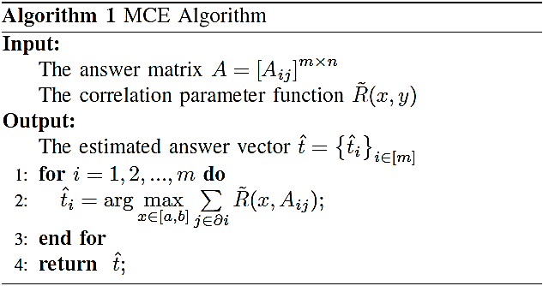
Inference Algorithm
Large estimation error
Notes:
MCE algorithm can easily make mistakes which means the estimated answer has large estimation error.
Why this happens ? Because w3 is low quality worker. He gives the house location randomly.

Slide 13
Inference Algorithm
One solution
Notes:
WMCE (Weighted Maximum Correlation Estimate),
contradiction
The MCE algorithm can make mistakes easily since it gives all the workers the same weight. There is no difference between high quality workers and low quality workers. So we have to give various weight to workers based on their quality. In this example,…
Choose the middle points of the line between two workers as the estimated position.
If we give them different weight, the position error is far smaller than before.
If we know the worker quality, we know the task answers. If we know the task answers, we know the worker quality.
Here is the challenge. Before the algorithm begins, we don’t know the task answers or worker quality.
So how ? That’s the amazing part of the WMCE algorithm.

Slide 14
Inference Algorithm
WMCE(Weighted Maximum Correlation Estimate) Algorithm
Iteratively update estimated quality and estimated task answers
Notes:
WMCE (Weighted Maximum Correlation Estimate),
If we know the worker quality, we know the task answers. If we know the task answers, we know the worker quality.
Here is the challenge. Before the algorithm begins, we don’t know the task answers or worker quality.
So how ? That’s

Slide 15
Inference Algorithm
Notes:
MCE algorithm can easily make mistakes which means the estimated answer has large estimation error.
Why this happens ? Because w3 is low quality worker. He gives the house location randomly.

Slide 16
Performance Analysis
can be expressed as
where is the normalized worker weight. For MCE algorithm . For WMCE algorithm,
can also be expressed as
when ,
Notes:
In order to get some intuitive understanding

Slide 17
Outline
Introduction
System Model
Main Results
Simulation Results
Performance Comparison
Robustness Test
Conclusion

Slide 18
Performance Comparison
Two types of workers
High quality worker: tend to give correct answers
Low quality worker: tend to give random answers
Parameters
 | High quality | Low quality
Ratio | 30% | 70%
Quality | 0.7684 | 0.0404

Slide 19
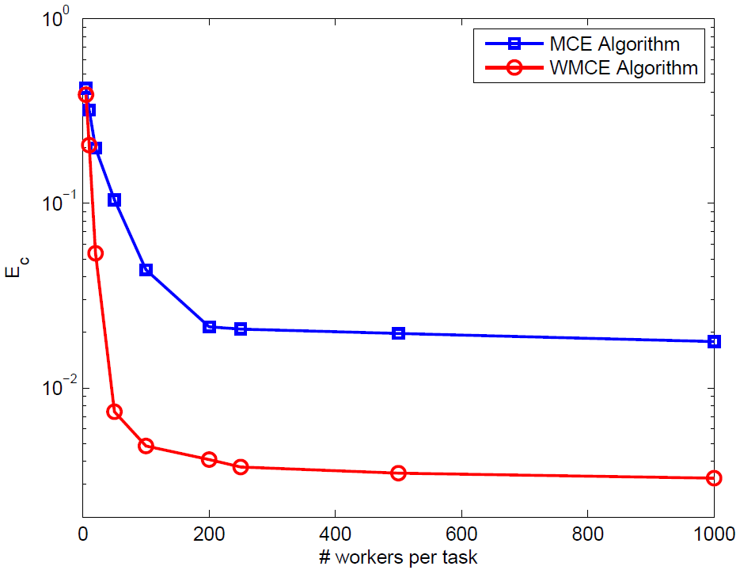
Performance Comparison
Comparison of two algorithms

Slide 20
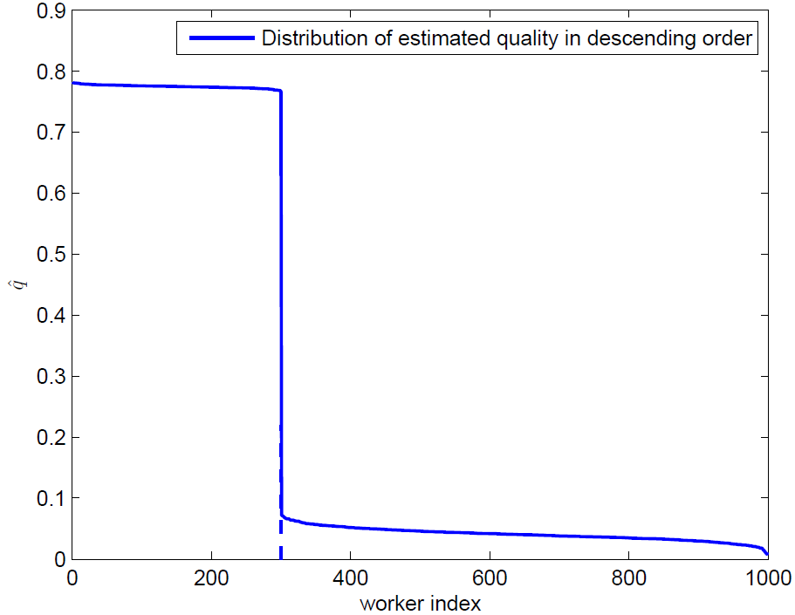
Performance Comparison
Distribution of estimated quality in WMCE algorithm

Slide 21
Robustness Test
Two types of workers
High quality worker: tend to give correct answers
Malicious worker: tend to give opposite answers
Parameters
 | High quality | Malicious
Ratio | 80% | 20%
Quality | 0.6788 | -0.3274

Slide 22
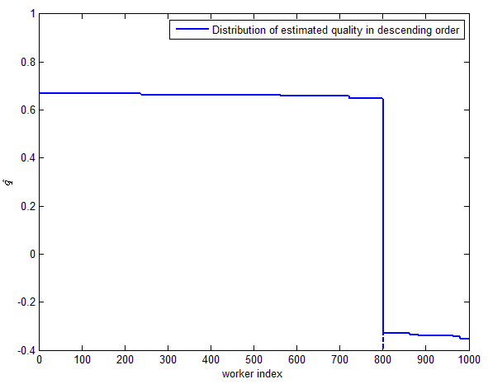
Robustness Test
Distribution of estimated quality

Slide 23
Outline
Introduction
System Model
Main Results
Simulation Results
Conclusion

Slide 24
Conclusion
We propose WMCE algorithm which can estimate worker quality and obtain task answers more accurately. The algorithm is proved to be efficient and robust.
We have proved that increase of redundancy can decrease correlation error but the correlation error cannot be smaller than the system bias.

Slide 25
Thank you !

