Slide 1
What I Learned From Mininet
Yulai Bi
2014.05.20

Slide 2
OUTLINE
Introduction
Basic Usage
Remote Controller
Future Work

Slide 3
INTRODUCTION
What is SDN?
  Software-Defined Networking (SDN) is an emerging architecture that decouples the network control and forwarding functions enabling the network control to become directly programmable and the under infrastructure to be abstracted from applications and network services.

Slide 4
INTRODUCTION
What is OpenFlow?
  OpenFlow is a communication protocol that gives access to the forwarding plane of a switch or router over the network.
  The OpenFlow protocol is a fundamental element for building SDN solutions.

Slide 5
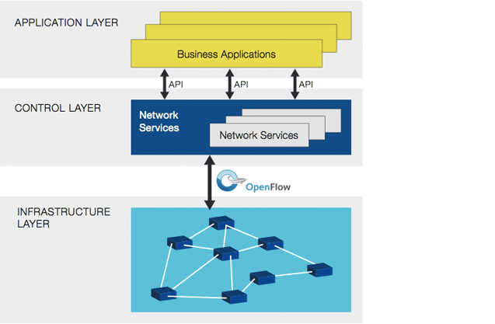
INTRODUCTION
Software-Defined Network Architecture

Slide 6
INTRODUCTION
What is Mininet?
  Mininet is a network emulator which creates a network of virtual hosts, switches, controller, and links.
  Mininet provides a simple network testbed for developing OpenFlow applications.

Slide 7
INTRODUCTION
What is Mininet?
  Mininet run real code including standard Linux network applications as well as the real Linux kernel.
  A design that works in Mininet can usually move directly to hardware switches.

Slide 8
Overview
Set up VM, learn tools, run provided hub.
Turn hub into an Ethernet switch.
Modify switch to push down flows.
Add multiple switch support.

Slide 9
Overview
Modify switch to handle IP forwarding.
Run switch on a real network.
Add firewall capabilities to switch.

Slide 10
OUTLINE
Introduction
Basic Usage
Remote Controller
Future Work

Slide 11
BASIC USAGE
Start Network
  1switch-3hosts topology
    sudo mn --topo single,3 --mac --switch ovsk --controller remote
    --topo single,3
    Set a network with 1 switch and 3 hosts.
    --mac
    Set the switch MAC, host MAC and IP address to small, unique and easy to read IDs.
    --switch ovsk
    Set a switch with a state of Open Vswitch(开放虚拟交换标准)
    --controller remote
    Set a controller running outside of the VM

Slide 12
BASIC USAGE
Start Network
  1switch-3hosts topology
    sudo mn --topo single,3 --mac --switch ovsk --controller remote
Controller
port 6633
c0
loopback
(127.0.0.1)
OpenFlow
Switch
s1
127.0.0.1:6634
dpctl
(user-space process)
s1-eth1
s1-eth2
s1-eth3
h1-eth0
h2-eth0
h3-eth0
h1
h2
h3
10.0.0.1
10.0.0.2
10.0.0.3

Slide 13
BASIC USAGE
Start Network
  Custom Topology
  eg. 2switch-3host topology
    # Add hosts and switches
    left1Host = self.addHost( 'h1' )
    left2Host = self.addHost( 'h2' )
    rightHost = self.addHost( 'h3' )
    leftSwitch = self.addSwitch( 's1' )
    rightSwitch = self.addSwitch( 's2' )
    # Add links
    self.addLink( left1Host, leftSwitch )
    self.addLink( left2Host, leftSwitch )
    self.addLink( leftSwitch, rightSwitch )
    self.addLink( rightSwitch, rightHost )

Slide 14
BASIC USAGE
Start Network
  2switch-3host topology
    sudo mn --custom mytopo.py --topo mytopo –mac –controller remote
_{c0}
_{h1}
h1-eth0
s1-eth1
s1
s1-eth3
s2
S2-eth2
_{h3}
s2-eth1
h3-eth0
s1-eth2
_{h2}
h2-eth0

Slide 15
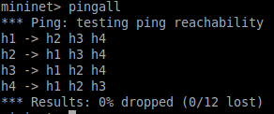
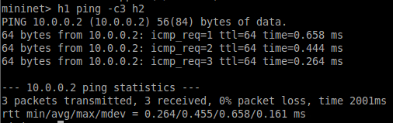
BASIC USAGE
Test Connectivity
  Ping test
    mininet > pingall
    mininet > h1 ping –c3 h2

Slide 16
OUTLINE
Introduction
Basic Usage
Remote Controller
Future Work

Slide 17
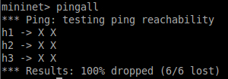
REMOTE CONTROLLER
Using a Remote Controller
    sudo mn --topo single,3 --mac --switch ovsk --controller remote
    mininet > pingall
  Why?
    Since, there is no controller connected to the switch and therefore the switch doesn't know what to do with incoming traffic, leading to ping failure.

Slide 18
REMOTE CONTROLLER
There are a handful of controllers available: such as POX, NOX, Beacon and Floodlight.
Beacon
  Beacon is a java-based SDN controller platform for research and education.

Slide 19
REMOTE CONTROLLER
Pox
  POX is a Python-based SDN controller platform geared towards research and education.

Slide 20
REMOTE CONTROLLER
Hub
  A network hub is a simple device in comparison with a switch or a router.
  A hub does not examine or manage any of the traffic that comes through it.
  Any input packet is rebroadcast on all the other ports.

Slide 21
REMOTE CONTROLLER
Hub
    OFAction action =
    new OFActionOutput(OFPort.OFPP_FLOOD.getValue());
    #OFPP_FLOOD - output all openflow ports except the input port.

Slide 22
REMOTE CONTROLLER
Verify Hub Behavior with tcpdump
    mininet > xterm h1 h2 h3 h4
    h1 > tcpdump –XX –n –i h1-eth0
    h2 > tcpdump –XX –n –i h2-eth0
    h3 > tcpdump –XX –n –i h3-eth0
    # tcpdump - a utility to print the packets seen by a host
    mininet > h1 ping –c1 h2

Slide 23

REMOTE CONTROLLER
Verify Hub Behavior with tcpdump

Slide 24
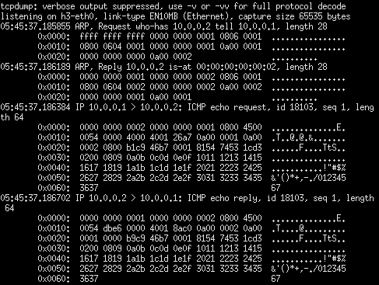
REMOTE CONTROLLER
Verify Hub Behavior with tcpdump
  The identical ARP and ICMP packets corresponding to the ping appear in all of the four xterms running tcpdump.

Slide 25
REMOTE CONTROLLER
L2_learning_switch
  When we see a packet, we'd like to output it on a port which will eventually lead to the destination. To accomplish this, I build a table that maps addresses to ports in L2_learning switch.

Slide 26
REMOTE CONTROLLER
L2_learning_switch
  The algorithm of l2_learning_switch
    For each packet from the switch:
    1) Use source address and switch port to update address/port table
    2) Is the port for destination address in our address/port table?
    Yes: Send the packet out appropriate port
    (Drop the packet whose outport is the same as inport)
    No: Act as a hub(Flood the packet)

Slide 27
REMOTE CONTROLLER
Verify Learning Switch Behavior with tcpdump
    mininet > xterm h2 h3
    h2 > tcpdump –XX –n –i h2-eth0
    h3 > tcpdump –XX –n –i h3-eth0
    mininet > h1 ping –c1 h2
    # for the first time

Slide 28
REMOTE CONTROLLER
Verify Learning Switch Behavior with tcpdump

Slide 29
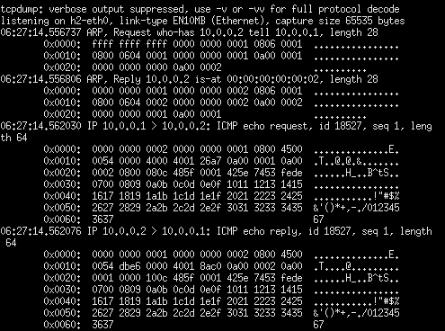
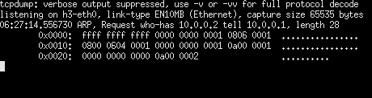
REMOTE CONTROLLER
Verify L2_Learning Behavior with tcpdump
h3-eth0
h2-eth0

Slide 30
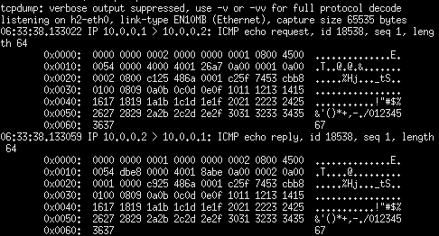

REMOTE CONTROLLER
Verify L2_Learning Behavior with tcpdump
    mininet > h1 ping –c1 h2
    # for the second time
h3-eth0
h2-eth0

Slide 31
REMOTE CONTROLLER
Multiple Learning Switch
  What is the difference between single learning switch controller and multiple learning switch controller?
    We need to create a address/port table for each switch rather than a single table for the whole network.

Slide 32
REMOTE CONTROLLER
Multiple Learning Switch
    protected Map<IOFSwitch, Map<Long,Short>> macTables =
    new HashMap<IOFSwitch, Map<Long,Short>>();
    # A Map of macTables, indexed by the switch.

Slide 33
REMOTE CONTROLLER
The Behavior of Multiple Learning Switch
  2switch-3host topology
    sudo mn --custom mytopo.py --topo mytopo –mac –controller remote
_{c0}
_{h1}
h1-eth0
s1-eth1
s1
s1-eth3
s2
S2-eth2
_{h3}
s2-eth1
h3-eth0
s1-eth2
_{h2}
h2-eth0

Slide 34
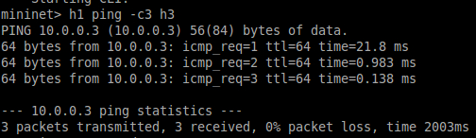
REMOTE CONTROLLER
The Behavior of Multiple Learning Switch
  2switch-3host topology
    sudo mn --custom mytopo.py --topo mytopo –mac –controller remote
    The host1 is connected to host3!

Slide 35
REMOTE CONTROLLER
L3_learning_switch
  How a l3 learning switch work?
    Keep a table that maps IP addresses to MAC addresses and switch ports. Update this table using information from ARP and IP packets.
    When you see an ARP request, try to answer it using information in the table.
    When you see an IP packet, if you know the destination port (because it‘s in the table), install a flow for it.

Slide 36
REMOTE CONTROLLER
L3_learning_switch
  The algorithm of l3_learning_switch
    For each packet from the switch:
    1) Is LLDP?
    Yes:
    1a) Drop packet -- don't forward link-local traffic (LLDP, 802.1x)
    2) Is IPv4 packet?
    Yes:
    2a) Learn or update port/MAC info
    2b) Try to forward
    (to be continued)

Slide 37
REMOTE CONTROLLER
L3_learning_switch
  The algorithm of l3_learning_switch
    2b) Try to forward
    If we have info about what port to send it out on?
    Yes:
    2bi) Is output port the same as input port?
    Yes: Drop the packet
    No: Install flow table entry in the switch
    No:
    2bii) track this buffer
    2biii) ARP for the destination

Slide 38
REMOTE CONTROLLER
L3_learning_switch
  The algorithm of l3_learning_switch
    3)Is ARP packet?
    Yes:
    3a) Learn or update port/MAC info
    3b)If we have an answer
    Yes: We use the MAC to answer ARP replies.
    No:flood

Slide 39
REMOTE CONTROLLER
L3_learning_switch
  Unfortunately, the controller can’t work as I expect.

Slide 40
OUTLINE
Introduction
Basic Usage
Remote Controller
Future Work

Slide 41
FUTURE WORK
Extend the learning switch to the learning router.
  Using ARP packets to learn the IP/MAC/port table.

Slide 42
Thank You

