Slide 1
Analysis of Node Localizability in Wireless Ad-hoc Networks
Presenter: Yang Gaoxiong
Thanks to Dr. Tian’s help
1
Notes:
Hello everyone! It is my honor here to give you presentation about my project about Analysis of Node Localizability
in Wireless Ad-hoc Networks. My name is Yang Gaoxiong. Thanks to Dr.Tian’s help.

Slide 2
Outline
Introduction
Analysis of graph model
Simulation results
Future work
2
2
Notes:
My presentation can be divided into 4 parts: the first one is the intruction,
The Second one is my main work: Analysis of graph model.
And then I will show you the Simulation results.
And the last part is our future work.

Slide 3
_{Introduction}
Two questions:
1. Given a network configuration, whether or not a single node is localizable?
2. How many nodes in a network can be located and which are them?
Priori conditions
Analysis
Network Configuration(Numbers of nodes, distance ranging, etc.)
Topology
Concept of node
localizability
Notes:
Ok, let’s come to the introduction part.
Location awareness is highly critical for wireless ad-hoc and sensor networks. Many efforts have been made to solve the problem of whether or not a network can be localized. But two fundamental questions remain unaddressed:
In this study, I will propose a novel concept of node localizability in mathematical topology method.

Slide 4
_{Analysis of graph model}
PRELIMINARY
u
_{Beacon}
Non-_{Beacon}
G(V,E) |V|>3
Rigidity and global rigidity
Notes:
The ground truth of a network can be modeled by a distance graph G. We assume G is connected and has at least 4 vertices in the following analysis.
In the graph, these white circle represent some special nodes knowing their global locations which is called beacons
if A graph cannot continuously deform its realizations while preserving distance constraints ,we called it generically rigid
if it is uniquely realizable, we called it globally rigid.

Slide 5
_{Analysis of graph model}
u
u
Rigidity but not global rigidity
Theorem 1.
A graph with n ≥4 vertices is globally rigid in 2 dimensions
if and only if it is 3-connected and redundantly rigid.
Network localizability
Node localizability
Notes:
In this graph, we can see that u can be this place by reflecting along the line of a pair of cut vertices
So this graph is rigid but not globally rigid.
There is a famous throrem:
However, how to judge whether a node is localizable.?

Slide 6
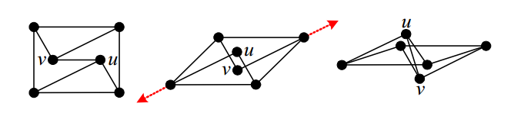
_{Analysis of graph model}
NECESSARY CONDITIONS
Necessity of 3 Vertex-disjoint Paths(3C)
Necessity of Redundant Rigidity(RR)
Not redundantly rigid
RR3C
Notes:
Based on previous studies on network localizability, we will explore these graph properties for node localizability.
The first means if a vertex is localizable, it has 3 vertex-disjoint paths to beacons. We denote such a condition as 3C for short.
Suppose a vertex has only 1 vertex-disjoint paths to beacons, it is even not rigid.
Suppose a vertex has only 2 vertex-disjoint paths to beacons. It definitely suffers from a potential flip ambiguity by reflecting along the line of a pair of cut vertices. So 3 paths can determine this node location.
this graph shows a 3-connected and rigid graph which becomes flexible upon removal of an edge. After the removal of the edge (u, v), a graph can swing into a different configuration in which the removed edge constraint is satisfied and then reinserted. This type of ambiguity can be avoided by redundant rigidity, this is s property of graph localizability.
In a graph with three beacons, if a vertex is localizable, it is included in the redundantly rigid component that contains these beacons, we denote it as RR for short.
Therefore, we can get a better necessary condition by combining 3C and RR, which we call RR3C.

Slide 7
_{Analysis of graph model}
SUFFICIENT CONDITIONS
A. If a vertex belongs to the globally rigid graph of G
that contains at least 3 beacons, it is uniquely
localizable(TRI)
Notes:
Based on Theorem 1, an obvious sufficient condition to node localizability we can get:
We denote this condition as TRI for short.

Slide 8
_{Analysis of graph model}
SUFFICIENT CONDITIONS
u
_{Implicit edge: e(u,v)}
G’=G+e
V
B. If a vertex belongs to a globally rigid graph of G’
that contains at least 3 beacons, it is uniquely
Localizable(RR3P).
Notes:
In this graph, it is clear that u is not in the 3-connected component of 3 beacon vertices. However u’s location can be uniquely determined under the configuration. The possible reason is the distance between u and v is actually fixed although no edge connects them.
So we call edge (u, v) implicit edge. And Let G’denote the extended distance graph of G.
So we achieve the following conclusion. We denote it RR3P for short.
Finally, because of limitation of time. I have to leave out strict and complex topology proof.

Slide 9
_{Simulation results}
C++
if a node satisfies the RR3P condition, it is localizable;
if a node, on the other hand, does not satisfy the RR3C
condition, it is non-localizable.
Notes:
I randomly generate networks of 400 nodes, uniformly deployed in a unit square. The unit disk model with a radius is adopted for communication and distance ranging.
and we have obtained the major result of this study

Slide 10
_{Simulation results}
Notes:
We can see, nodes above the curve of RR3P are non-localizable while those below the curve of RR3C are localizable.
Clearly, two curves are close to each other and the gap between them is always narrow, indicating a small number of nodes whose localizability cannot be determined

Slide 11
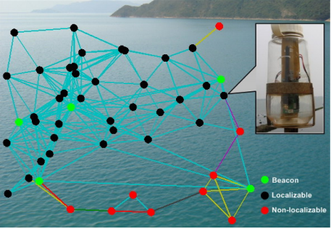
_{Future work}
Notes:
This is a data graph about the ongoing sea monitoring system in other’ research

Slide 12
_{Future work}
PERFORMANCE EVALUATIONS
1. data pre-processing: augmenting signal transmitting power
2. location computation: link reducing and energy saving
Notes:
The future work is that I am able to evaluate on experiment data to examine the effectiveness of above study. There are two stages:

Slide 13
Reference
1.B. Jackson and T. Jordan, "Connected rigidity matroids
and unique realizations of graphs," Journal of Combinatorial Theory Series B, vol. 94, no. 1, pp. 1-29, 2005.
2.Understanding Node Localizability of Wireless Ad-hoc Networks Zheng Yang and Yunhao Liu Hong Kong University of Science and Technology {yangzh, liu}@cse.ust.hk
3."OceanSense Project," in
http://www.cse.ust.hk/~liu/Ocean/index.html.

Slide 14
Thank you!

