Slide 1
Cooperative Relay with MIMO nodes
Zhu Yumeng
05/16/2014

Slide 2
Outline
Background : cooperative relay
MIMO relays
Future Work

Slide 3
Cooperative Relay
In a cognitive radio network, when the traffic demand and spectrum resource availability are largely mismatched, it cannot fully utilize spectrum resource and fulfill secondary users’ demands.
Data rate:100Kbps
AP
[1,3,4]
AP
150Kbps
50Kbps
[1]
[3]
S1
[1,2]
S2
[2,3,4]
S1
S2
Notes:
Two secondary end users S1 and S2 want to receive data from the AP. The numbers on the dashed lines indicate the average traffic demand of the users from AP. We assume that each common channel between any pair of nodes can provide 100Kbps date rate.
In the traditional transmission,S1 uses up the channel one and receives 100 Kbps while S2 receives 50Kbps because of its small traffic demand.

Slide 4
Cooperative Relay
Cooperative relay scheme
CH1
CH2
CH3
CH4
AP
AP
data for S1
own data
[1]
[3,4]
S2
S1
S2
S1
Notes:
Improvement is possible if we introduce cooperative relay
Scheme including two time slots with equal time interval

Slide 5
Cooperative Relay
Cooperative relay scheme
CH1
CH2
CH3
CH4
AP
AP
data for S1
own data
[1]
S2
S1
[2]
S2
S1
Notes:
Both of the demands are fulfilled.

Slide 6
Outline
Background : cooperative relay
MIMO relays
Future Work
Notes:
Nowadays, most of mobile devices, which usually function as secondary end users have more than one antenna, so we introduce MIMO relays.

Slide 7
MIMO
Compared to single-input single-output(SISO), multiple-input multiple-output(MIMO) techniques can provide high spectral efficiency and increase channel capacity substantially through multiple spatial channels without need of the additional spectrum.
  spatial multiplexing
  A high rate signal is split into multiple lower rate streams and each stream is transmitted from a different transmit antenna in the same frequency channel.

Slide 8
MIMO Relays
Cooperative relay topology
Constraints:
  One node can have only one relay;
  One relay can serve only one node;
  When one node is served by a relay, this node cannot be the relay node of another node.
AP
One relay can serve more than one node;
D1
R
D2
Notes:
Depend on the number of antennas

Slide 9
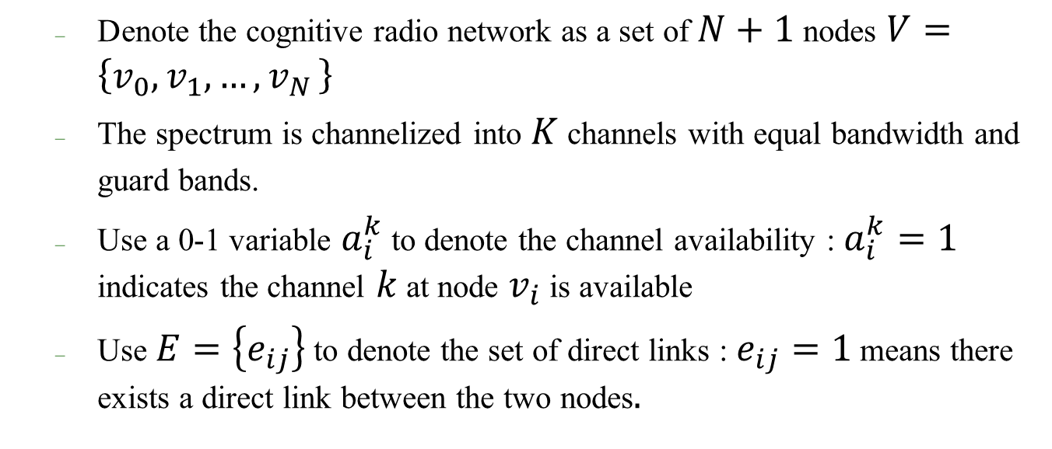
MIMO Relays
Problem formulation
  Denote the cognitive radio network as a set of $N+1$ nodes $V=\left\{v_{0},v_{1},…,v_{N }\right\}$
  The spectrum is channelized into $K$ channels with equal bandwidth and guard bands.
  Use a 0-1 variable $a_{i}^{k}$to denote the channel availability : $a_{i}^{k}=1$ indicates the channel $k$ at node $v_{i}$ is available
  Use $E=\left\{e_{ij}\right\}$ to denote the set of direct links : $e_{ij}=1$ means there exists a direct link between the two nodes$.$
Notes:
V0 the secondary AP node
Ui MIMO nodes
Divide channels into two parts
K1 used by regular nodes
K2 used by MIMO nodes

Slide 10
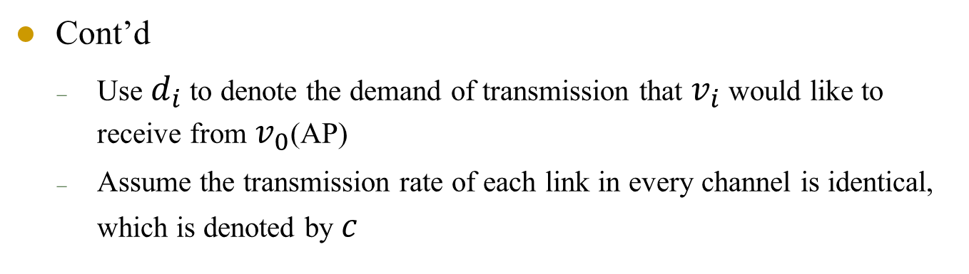
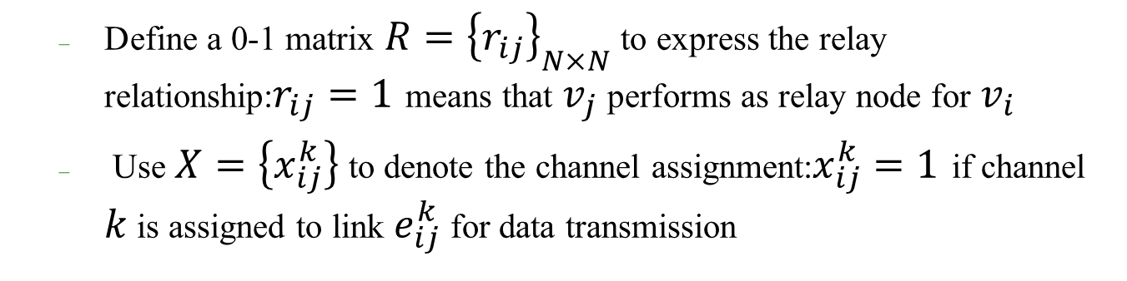
MIMO Relays
Cont’d
    Use $d_{i}$ to denote the demand of transmission that $v_{i}$ would like to receive from $v_{0}$(AP)
    Assume the transmission rate of each link in every channel is identical, which is denoted by $c$
  Define a 0-1 matrix $R={\left\{r_{ij}\right\}}_{N×N}$ to express the relay relationship:$r_{ij}=1$ means that $v_{j}$ performs as relay node for $v_{i}$
  Use $X=\left\{x_{ij}^{k}\right\}$ to denote the channel assignment:$x_{ij}^{k}=1$ if channel $k$ is assigned to link $e_{ij}^{k}$ for data transmission
Notes:
X=1 if channel k is assigned to link eij

Slide 11
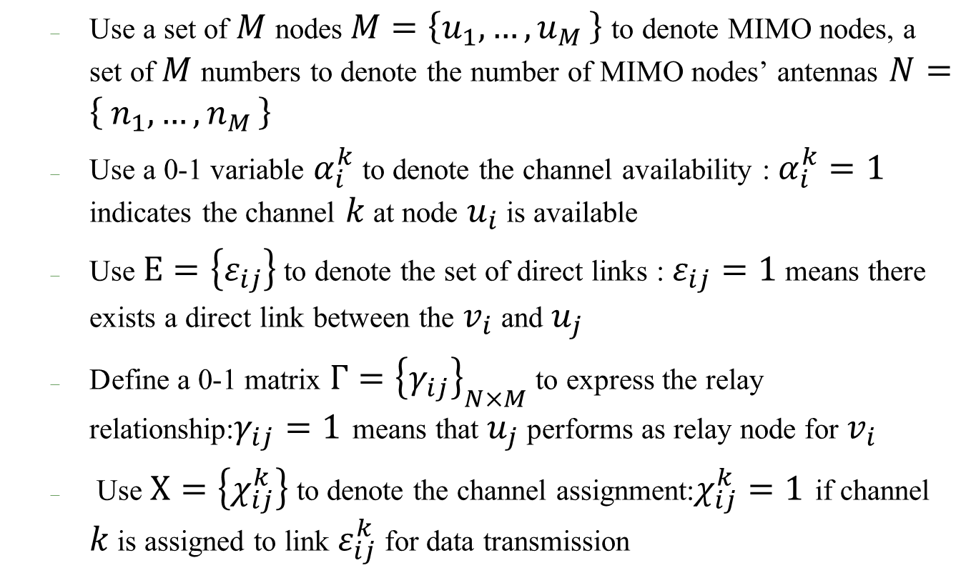
MIMO Relays
Additional denotations
  Use a set of $M$ nodes$M=\left\{u_{1},{…,u}_{M}\right\}$ to denote MIMO nodes, a set of $M$numbers to denote the number of MIMO nodes’ antennas $N=\left\{ n_{1},{…,n}_{M}\right\}$
  Use a 0-1 variable $α_{i}^{k}$to denote the channel availability : $α_{i}^{k}=1$ indicates the channel $k$ at node $u_{i}$ is available
  Use $Ε=\left\{ε_{ij}\right\}$ to denote the set of direct links : $ε_{ij}=1$ means there exists a direct link between the $v_{i}$ and $u_{j}$
  Define a 0-1 matrix $Γ={\left\{γ_{ij}\right\}}_{N×M}$ to express the relay relationship:$γ_{ij}=1$ means that $u_{j}$ performs as relay node for $v_{i}$
  Use $Χ=\left\{χ_{ij}^{k}\right\}$ to denote the channel assignment:$χ_{ij}^{k}=1$ if channel $k$ is assigned to link $ε_{ij}^{k}$ for data transmission
Notes:
V0 the secondary AP node
Ui MIMO nodes
Divide channels into two parts
K1 used by regular nodes
K2 used by MIMO nodes

Slide 12
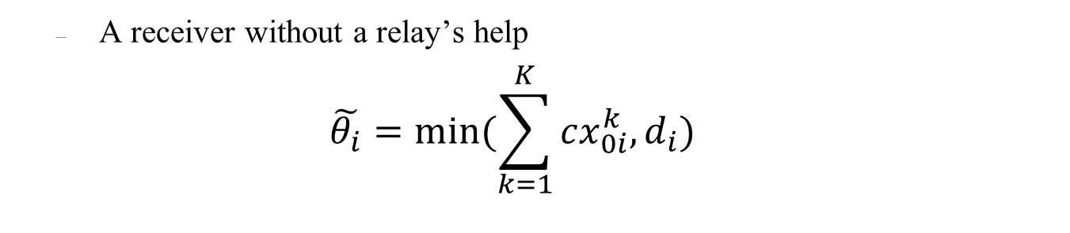
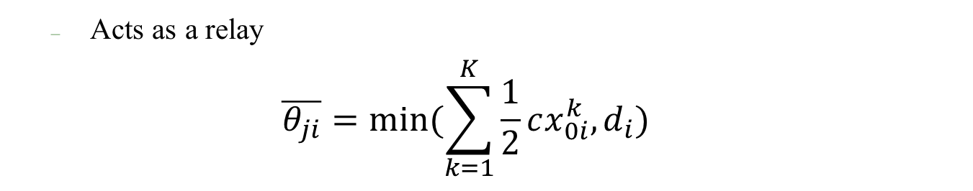
MIMO Relays
Four categories:
  A receiver without a relay’s help
  $$\tilde{θ_{i}}=min⁡(\sum_{k=1}^{K}{cx_{0i}^{k},d_{i}})$$
  Acts as a relay
  $$\overline{θ_{ji}}=min⁡(\sum_{k=1}^{K}{\frac{1}{2}cx_{0i}^{k},d_{i}})$$
Notes:
Remaining nodes make up a conditional cooperative

Slide 13
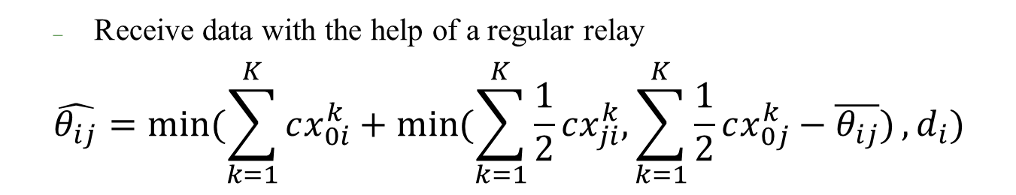

MIMO Relays
Cont’d
  Receive data with the help of a regular relay
  $$\hat{θ_{ij}}=min⁡(\sum_{k=1}^{K}{cx_{0i}^{k}+\min{(\sum_{k=1}^{K}{\frac{1}{2}}cx_{ji}^{k},\sum_{k=1}^{K}{\frac{1}{2}cx_{0j}^{k}−\overline{θ_{ij}}})},d_{i}})$$
  Receive data with the help of a MIMO relay
  $$\overline{θ_{i}}=min⁡(\sum_{k=1}^{K}{cx_{0i}^{k}+\sum_{k=1}^{K}{\frac{1}{2}}n_{j}cχ_{ij}^{k} ,d_{i}})$$
Notes:
Remaining nodes make up a conditional cooperative

Slide 14
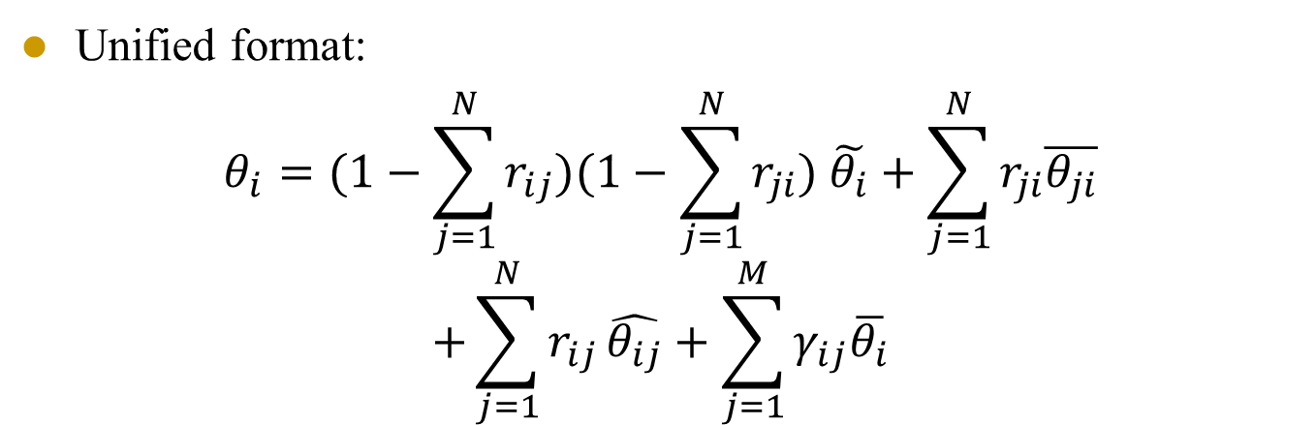
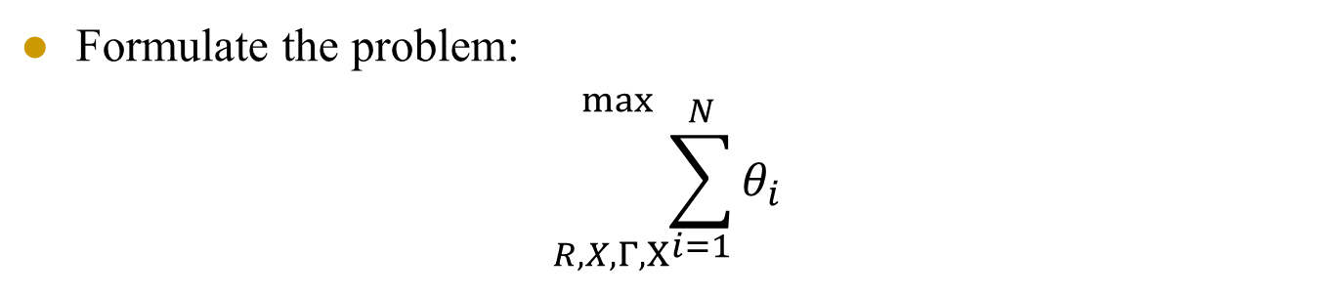
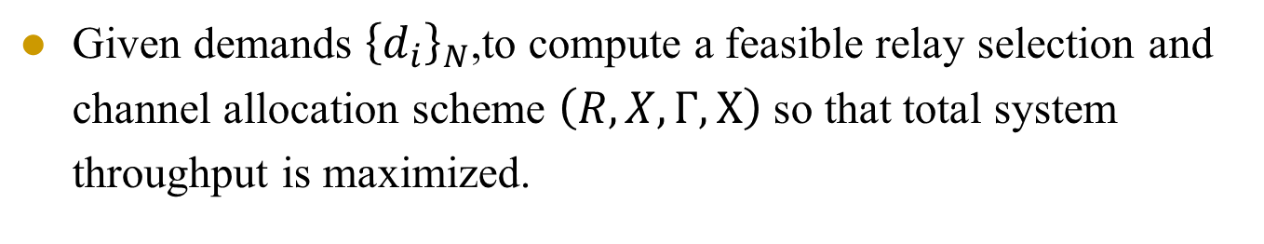
MIMO Relays
Unified format:
$$θ_{i}=(1−\sum_{j=1}^{N}{r_{ij}})(1−\sum_{j=1}^{N}{r_{ji}}) \tilde{θ_{i}}+\sum_{j=1}^{N}{r_{ji}\overline{θ_{ji}}}$$
$$+\sum_{j=1}^{N}{r_{ij}}\hat{θ_{ij}}+\sum_{j=1}^{M}{γ_{ij}\overline{θ_{i}}}$$
Given demands ${\left\{d_{i}\right\}}_{N}$,to compute a feasible relay selection and channel allocation scheme $\left(R,X,Γ,Χ\right)$ so that total system throughput is maximized.
Formulate the problem:
$${}_{R,X,Γ,Χ}^{\max{ }}{\sum_{i=1}^{N}{θ_{i}}}$$

Slide 15
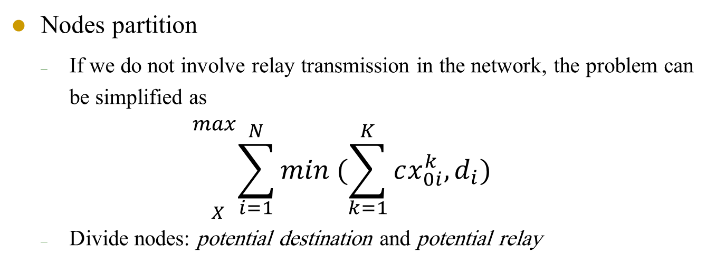
MIMO Relays
Proposition
  If one user’s demand is not fulfilled, it will not act as a relay to help others because this will definitely decrease the total throughput of the whole system.
  Nodes partition
  If we do not involve relay transmission in the network, the problem can be simplified as
  $${}_{X }^{max}{\sum_{i=1}^{N}{min (\sum_{k=1}^{K}{cx_{0i}^{k},d_{i})}}}$$
  Divide nodes: potential destination and potential relay
Notes:
A max flow problem can be solved in polynomial time

Slide 16
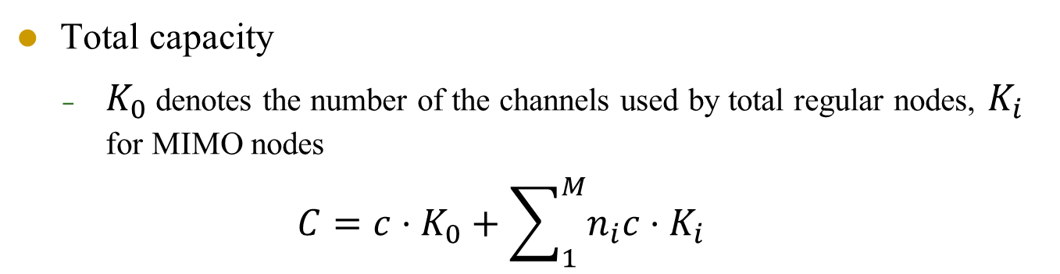



MIMO Relays
  Total capacity
    $K_{0}$ denotes the number of the channels used by total regular nodes, $K_{i}$ for MIMO nodes
    $$C=c⋅K_{0}+\sum_{1}^{M}{n_{i}c⋅K_{i} }$$
subsystem
$$v_{0}$$
$$v_{i}$$
Secondary AP node
MIMO node
Potential destination
Potential relay
$$u_{i}$$
Notes:
Explain the expression in detail
Different colors to represent different kinds of nodes
The algorithm aims to make full use of channel capacity ,so the total capacity in some way determines the throughput.
That means the channels will satisfy MIMO relays’ demand first, which makes C as large as possible.

Slide 17
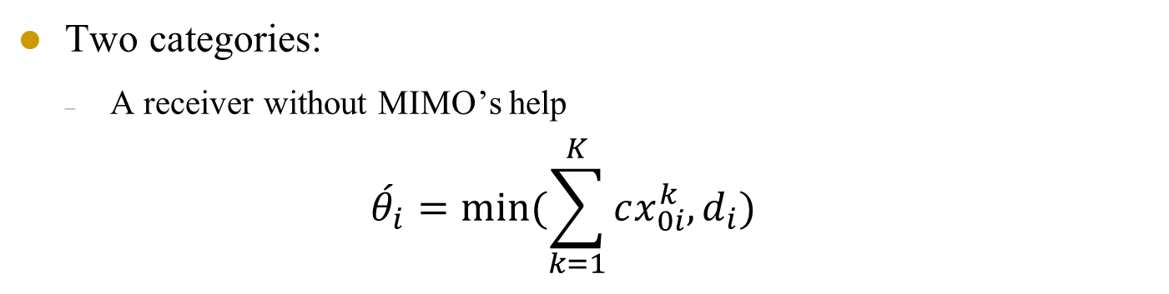
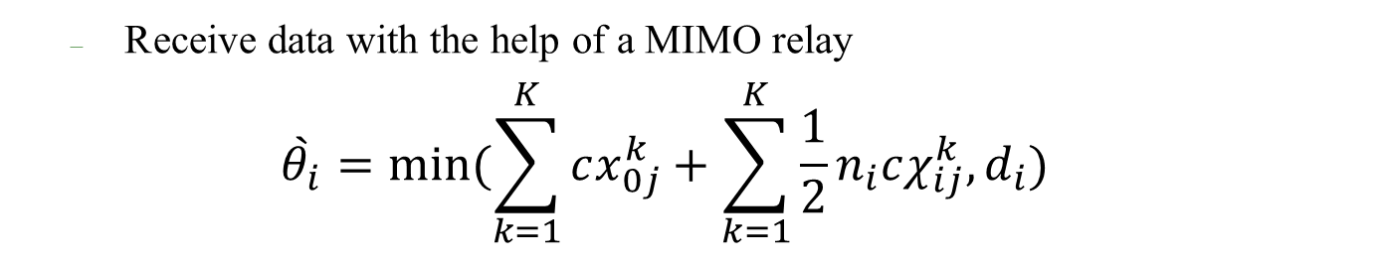
MIMO Relays
Subsystem
  How to choose nodes from potential destination to be served by MIMO relays?
Two categories:
  A receiver without MIMO’s help
  $$\acute{θ_{i}}=min⁡(\sum_{k=1}^{K}{cx_{0i}^{k},d_{i}})$$
  Receive data with the help of a MIMO relay
  $$\grave{θ_{i}}=min⁡(\sum_{k=1}^{K}{cx_{0j}^{k}+\sum_{k=1}^{K}{\frac{1}{2}}n_{i}cχ_{ij}^{k},d_{i}})$$
Notes:
X=1 if channel k is assigned to link eij

Slide 18
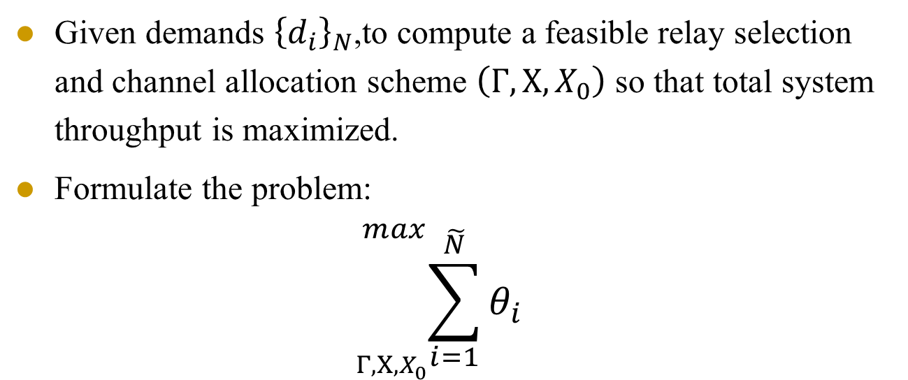
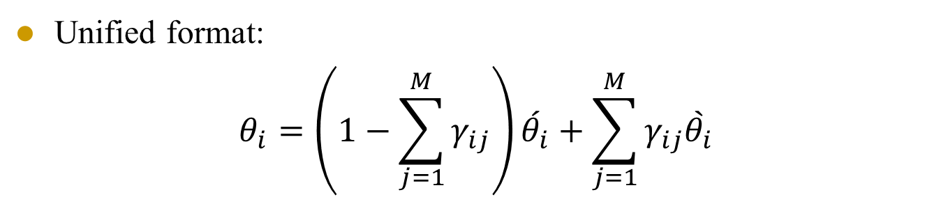
MIMO Relays
Unified format:
$$θ_{i}=\left(1−\sum_{j=1}^{M}{γ_{ij}}\right)\acute{θ_{i}}+\sum_{j=1}^{M}{γ_{ij}\grave{θ_{i}}}$$
Given demands ${\left\{d_{i}\right\}}_{N}$,to compute a feasible relay selection and channel allocation scheme $\left(Γ,Χ,X_{0}\right)$ so that total system throughput is maximized.
Formulate the problem:
$${}_{Γ,Χ,X_{0}}^{max}{\sum_{i=1}^{\tilde{N}}{θ_{i}}}⁡$$
Notes:
Subject to 受约束

Slide 19
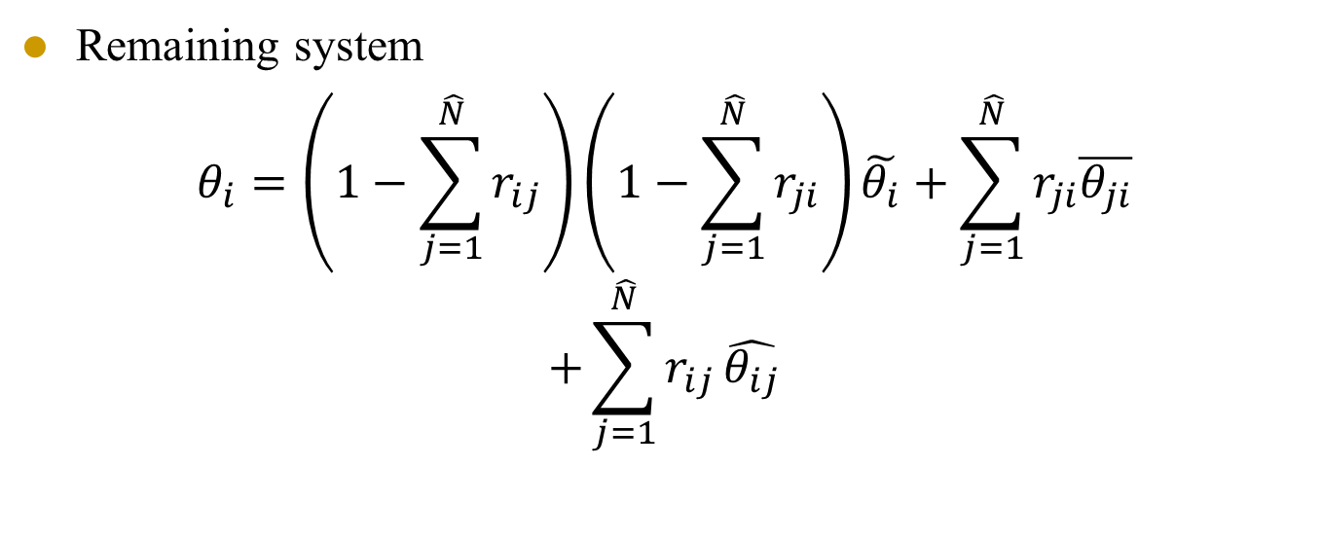

MIMO Relays
Remaining system
$$θ_{i}=\left(1−\sum_{j=1}^{\hat{N}}{r_{ij}}\right)\left(1−\sum_{j=1}^{\hat{N}}{r_{ji}}\right)\tilde{θ_{i}}+\sum_{j=1}^{\hat{N}}{r_{ji}\overline{θ_{ji}}}$$
$$+\sum_{j=1}^{\hat{N}}{r_{ij}}\hat{θ_{ij}}$$
Formulate the problem:
$${}_{R,X }^{max}{\sum_{i=1}^{\hat{N}}{θ_{i}}}$$
Notes:
Subject to 受约束

Slide 20
Outline
Background : cooperative relay
MIMO relays
Future Work

Slide 21
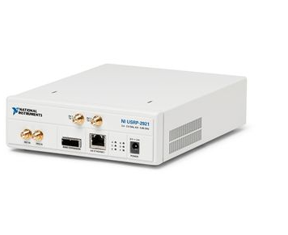
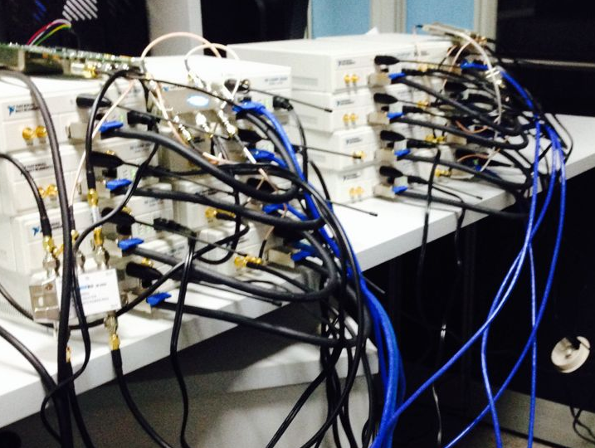
Future Work
Build a MIMO-OFDM system acting as MIMO relays
USRP 2920
Notes:
Relay-assisted D-OFDM

Slide 22
Thank you !

