Slide 1
Anti DDoS Bloom Filter in SDN & MiniNet POX Simulation
徐玉含
ens@sjtu.edu.cn
2014/5/27

Slide 2
Outline
Basic Concept: SDN, Open Flow, MiniNet
An Example to explain the advantage of SDN
Introduction of Bloom Filter and Analysis
MiniNet POX Experiment
Future Work

Slide 3
What is SDN? OpenFlow? MiniNet?
Software-Defined Networking (SDN)
Decouples the network control and forwarding functions
Directly programmable
OpenFlow
Enables the Controller to interact with the forwarding plane
Make adjustments to the network
MiniNet
creates a network of virtual hosts, switches, controller, and links
provides a simple network testbed
REFERENCE：http://www.sdncentral.com/what-is-openflow/.
http://ethancbanks.com/2014/05/15/what-sdn-could-mean-for-networking-careers-in-one-picture/

Slide 4
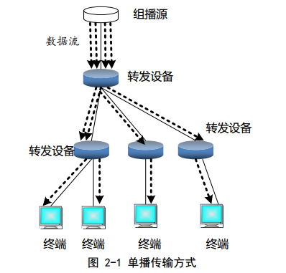
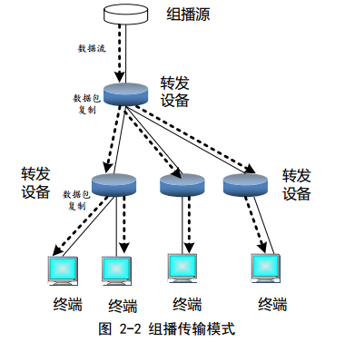
SDN in Multicast
REFERENCE：申罕骥. 基于 SDN/OpenFlow 的组播技术研究[J]. 2013.

Slide 5
Outline
Basic Concept: SDN, Open Flow, MiniNet
An Example to explain the advantage of SDN
Introduction of Bloom Filter and Analysis
MiniNet POX Experiment
Future Work

Slide 6
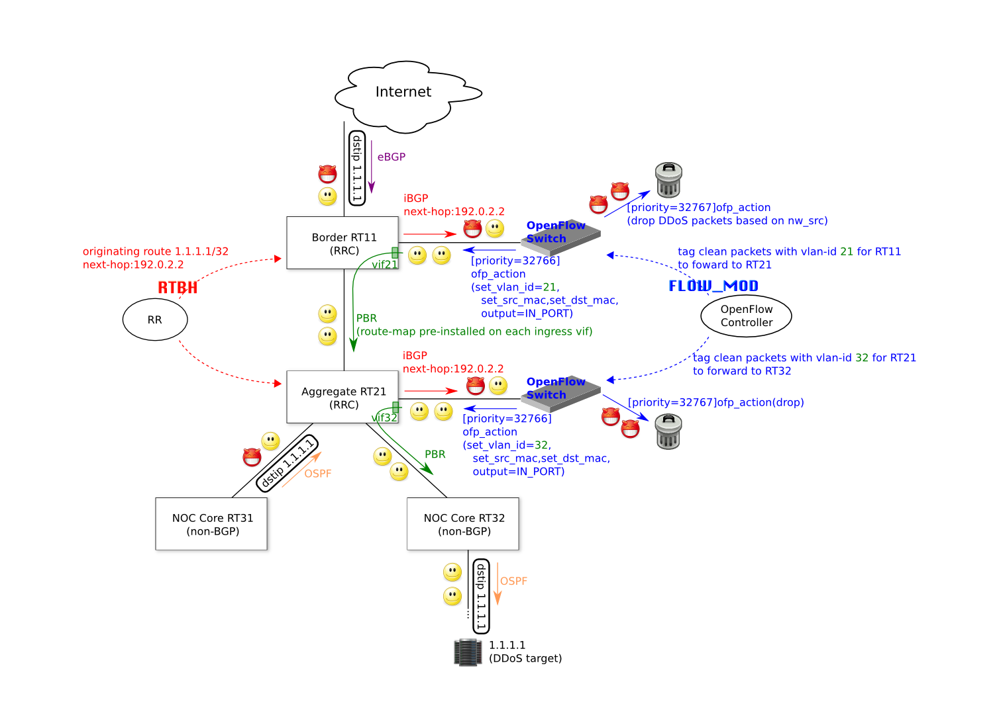
An successful example
RRC:Radio Resource Control
RTBH：Remote trigger black hole
DDoS:Distributed Denial of Service
2013, Sakura Internet’s DDoS detection and mitigation app
REFERENCE：张卫峰. 深度解析SDN 利益、战略、技术、实践.2014.1
Notes:
In short, all we would do ahead of time with the existing backbone routers is simply configure one interface plus a few other small things.

Slide 7
Outline
Basic Concept: SDN, Open Flow, MiniNet
An Example to explain the advantage of SDN
Introduction of Bloom Filter and Analysis
MiniNet POX Experiment
Future Work

Slide 8
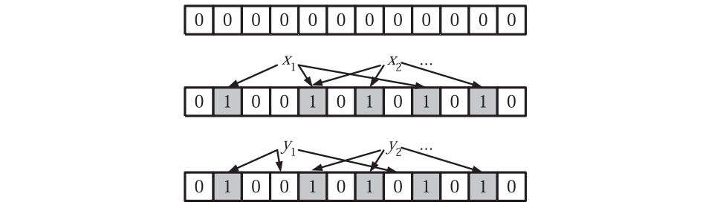
Single Bloom Filter
Hash function
False positive
False positive rate :
F minimizing，when
$$f={\left(1−e^{−kn/m}\right)}^{k}={\left(1−p\right)}^{k}$$
$$k=\frac{m}{n}ln2$$
REFERENCE：A. Broder and M. Mitzenmacher. Network applications of bloom filters: A survey. Internet Mathematics, 1(4):485–509, 2005.
Notes:
An example of n element is described by an array of m bits, initially all set to 0.
A Bloom filter uses k independent hash functions.
Assume that hash functions map each item randomly.

Slide 9
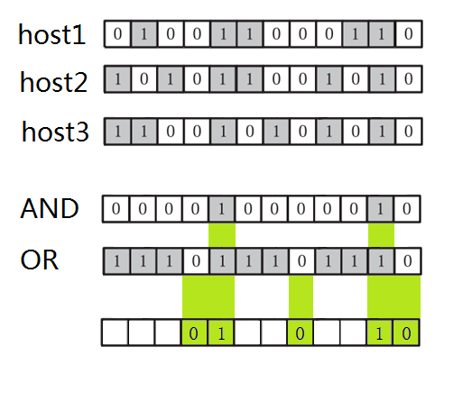
Double Bloom Filter
Bloom Filter AND
Bloom Filter OR
h1
h2
h3
False positive rate declines.

Slide 10
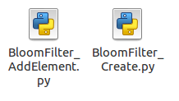
Bloom Filter Simulation with Python
Random Attempts
Switch (m=32*4)
h1
h2
......
hn
Host number from 2 to 13
Attempt Number=800
MD5 hash function

Slide 11
Outline
Basic Concept: SDN, Open Flow, MiniNet
An Example to explain the advantage of SDN
Introduction of Bloom Filter and Analysis
MiniNet POX Experiment
Future Work

Slide 12
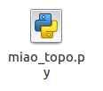
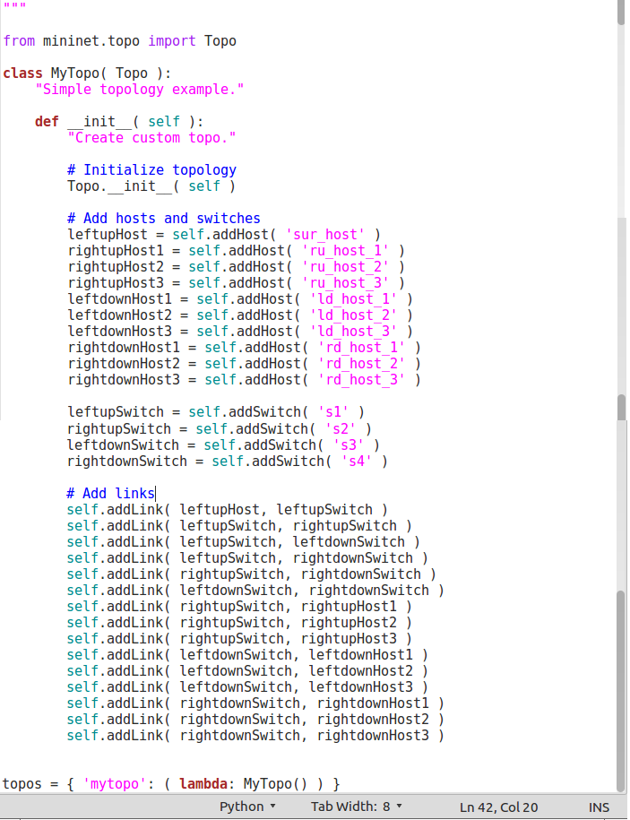
OpenFlow POX + Mininet
Multicast Data Flow
Source Host
SWITCH1
Host1
Controller
SWITCH2
Host2
SWITCH3
Host3
SWITCH4
Host4
Host5
Host6
Host7
Host8

Slide 13
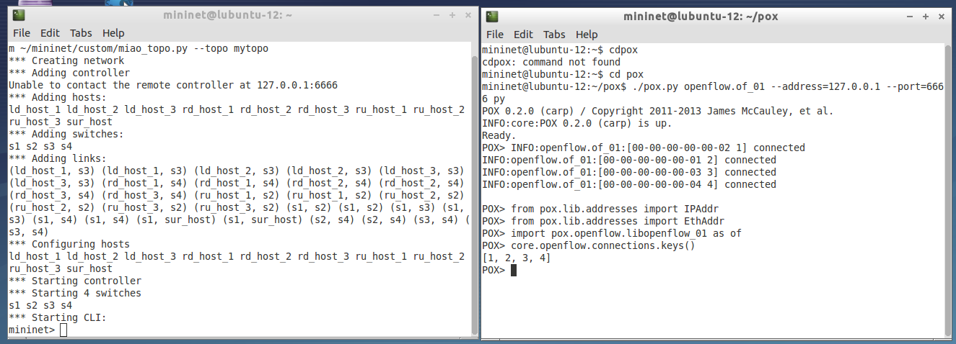
OpenFlow POX + Mininet

Slide 14
Outline
Basic Concept: SDN, Open Flow, MiniNet
An Example to explain the advantage of SDN
Introduction of Bloom Filter and Analysis
MiniNet POX Experiment
Future Work

Slide 15
Thank you for Listening！
Q&A

