Slide 1
Dynamic TDMA-MAC for Multi-Hop
Wi-Fi Networks
XINGMIN ZHUANG
May 13, 2014

Slide 2
Outline
Introduction
Backgrounds
Protocol Design
Future Work

Slide 3
Introduction
Most 802.11 networks use the DCF to arbitrate access to the shared wireless medium, which is designed for networks where stations are near each other. For very long distances the time required to wait for each frame to be acknowledged can dramatically affect performance. TDMA is a good way to handle media access in long distance networks. No arbitration is required once a slot is assigned to a station.
3
Notes:
3

Slide 4
Backgrounds
TDMA
Time Division Multiple Access
TDMA works with principle of dividing time frame in dedicated time slots.
Synchronization is one of the key factors while applying TDMA.
TDMA uses less energy than others due to less collision and no idle listening.
4
Notes:
4

Slide 5
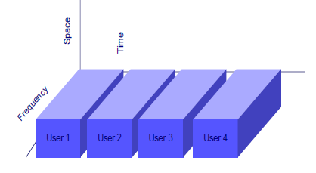
Backgrounds
Timing diagram of TDMA
TDMA requires a slot assignment protocol and a synchronization algorithm to ensure time slots do not collide as the clocks drift.
5
Notes:
5

Slide 6
Protocol Design
Proposed network
R
… …
R
: Root node
: Hop-1 nodes
: Hop-2 nodes
6
Notes:
6

Slide 7
Protocol Design
Step 1
Listening for a while and choose a proper node to connect.
(with upper stage and fewer children nodes)
7
Notes:
7

Slide 8
Protocol Design
Step 1
R : root node
H : hop-1 nodes
G : hop-2 nodes
N : new node
H3
R
H2
H1
N
G1
8
Notes:
8

Slide 9
Protocol Design
Step 1
Listening for a while and choose a proper node to connect.
(with upper stage and fewer children nodes)
Step 2
The root node assigns a proper time slot for the new node.
(time slot reusing and collision avoiding )
9
Notes:
9

Slide 10
Protocol Design
Step 2
R : root node
H : hop-1 nodes
G : hop-2 nodes
N : new node
H3
R
H4
H2
G3
H1
N
G2
G1
10
Notes:
10

Slide 11
Protocol Design
Step 1
Listening for a while and choose a proper node to connect.
(with upper stage and fewer children nodes)
Step 2
The root node assigns a proper time slot for the new node.
(time slot reusing and collision avoiding )
Step 3
  If a node disconnects from the network, the root node will retain the time slots for its children nodes to reconnect.
11
Notes:
11

Slide 12
Protocol Design
Step 3
R : root node
H : hop-1 nodes
G : hop-2 nodes
H3
R
H4
H2
G3
H1
G2
G1
12
Notes:
12

Slide 13
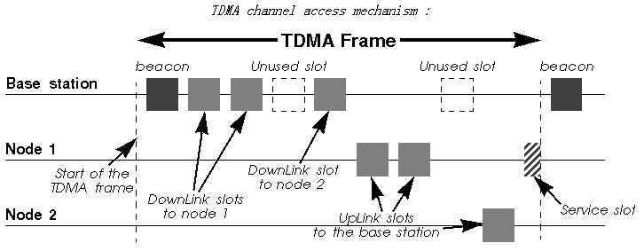
Protocol Design
H3
R
H2
H1
G2
R : root node
H : hop-1 nodes
G : hop-2 nodes
G1
13
Notes:
13

Slide 14
Future Work
Simulation in MATLAB
Implementation on test bed
14
Notes:
14

Slide 15
Thank you !

