Slide 1
Localization Accuracy of CrowdSourcing based Indoor Localization
Cheng Wu 5110309335
Reference：Zee: Zero-Effort Crowdsourcing for Indoor Localization

Slide 2
Related work
Infrastructure-Based Localization Systems
infrared
acoustic
visual
RF transmitters
sniffers
RFID

Slide 3
RF Fingerprinting based Localization
RF Fingerprinting
inertial sensors
accelerometer
compass
WiFi or cellular signals
gyroscope

Slide 4
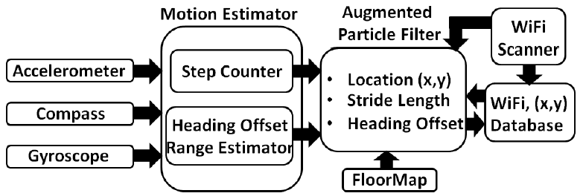
Modeling instead of Calibration
The whole Structure picture

Slide 5
Modeling Steps
1.Placement Independent Motion Estimator (PIME).
2.Augmented Particle Filter(APF).
3.Creating the WiFi Database
4.WiFi-based initialization in APF.
5.Refinement of the WiFi database

Slide 6
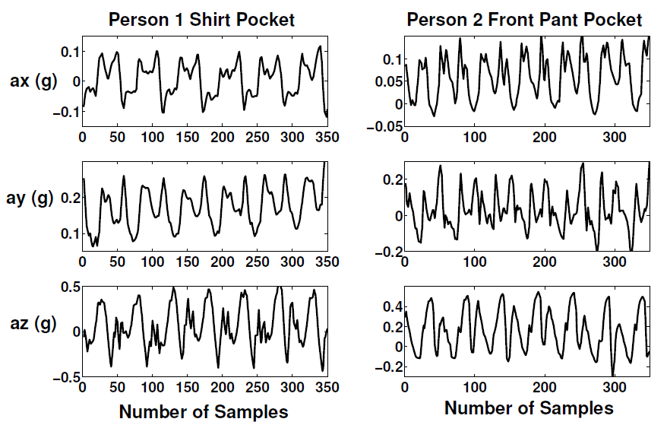
COUNTING STEPS
Typical mobile phone placement scenarios：
men{shirt pockets or rear pant pockets}
women{in handbags and sometimes in pant pockets}

Slide 7
Normalized Auto-correlation based Step Counting (NASC).

Slide 8
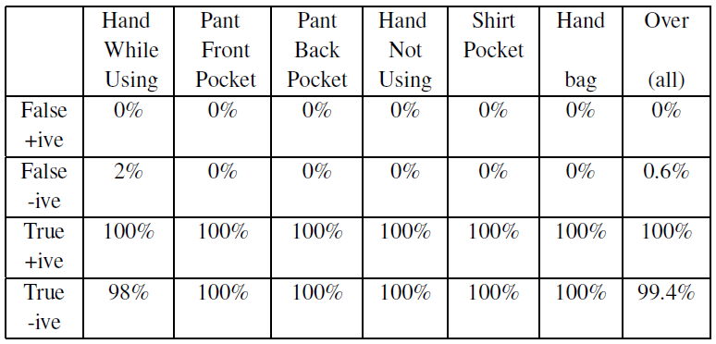
Performance of step counting

Slide 9
Estimatimg heading offset range
Heading Offset:
Magnetic Offset:
Placement Offset:

Slide 10
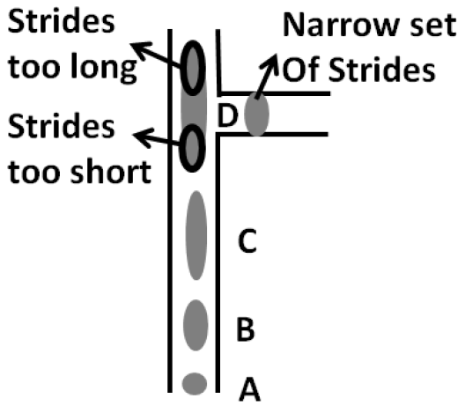
Tracking using augmented particle filter(APF )
stride length estimation

Slide 11
Put it all together : crowdsourcing
Using existing measurement database for subsequent crowdsourcing.
We can determine where in the floor a certain WiFi measurement was taken and generate location-annotated WiFi measurements of the form (location, WiFi RSS). This database of measurements can then be used to locate new users using existing WiFi localization techniques.

Slide 12
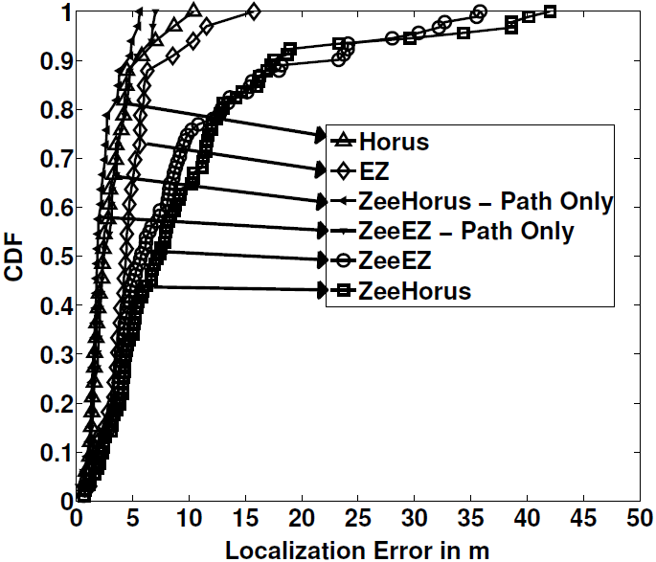
Performance of WiFi localization using crowdsourcing
error distributions

Slide 13
Q&A
Thank you for listening！

