Slide 1
Rounting protocols for wireless sensor networks
SEIEE_EE 丁舟奕海
E-mail : dingdingyihai@sina.com
2014/5/6

Slide 2
introduction of 3 protocols I refered
the model of my protocol so far
simulation result
future work

Slide 3
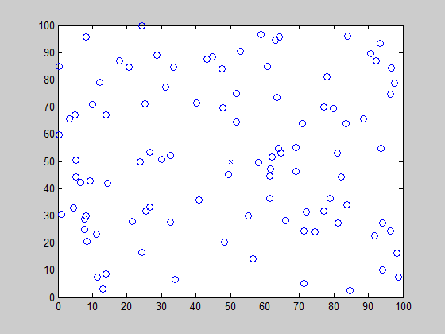
Rounting protocols for wirelee sensor networks
  every node transmits packets to the
  basestation
  each node have limited power
X: Base Station
O: Node

Slide 4
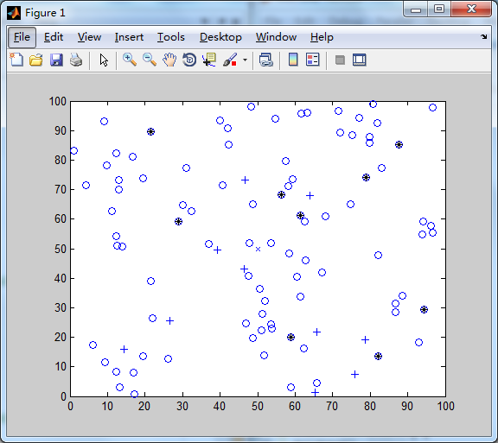
LEACH
  Every node transmits packets to the
  nearest cluster.
  Using cluster gathers packet and send
  to the base station.
  Nodes will save energy. Cluster will loss
  energy.
LEACH-energy
  Give nodes which has more energy
  more propobility to be chosen as cluster.
X: Base Station
O: Node
* : Cluster

Slide 5
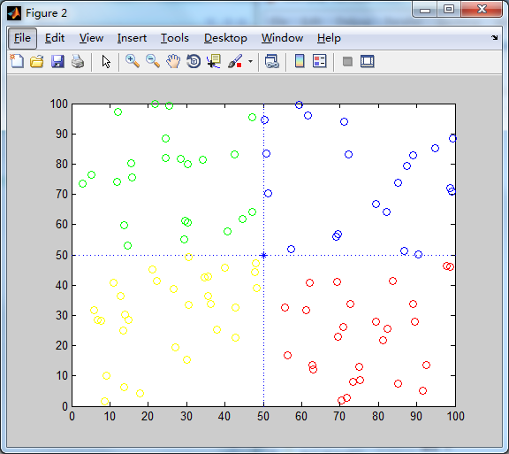
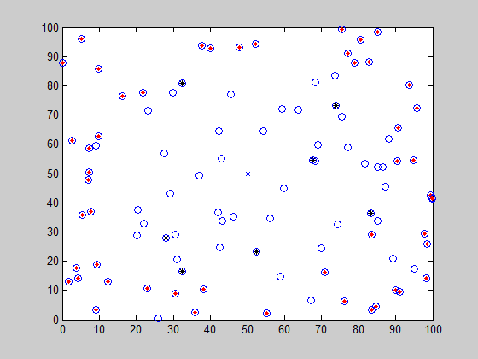
GAF
  Divide the network into 4 parts.
  Every part chooses their cluster
  independently.
  How to divide the network more
  efficiently?
X: Base Station
O: Node

Slide 6
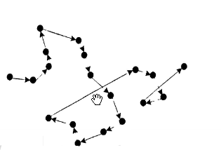
PEGASIS
Started at the most far nodes, mark it as
‘head’.
Using greedy algorithm, find the nearst
node of the ‘head’, connect them,
and pass the ‘head’ to the new one.
Repeat until all the nodes join the queue.
It is one of the second-best solution, not optimal solution.

Slide 7
My simulation model
Calculate the weight:
  Calsulate the weight of every node. Not using energy directly, but divide it by the energy cost if it is a cluster, which is the maximun time it can become a cluster.
  Create 5 chains using the weight above.

Slide 8
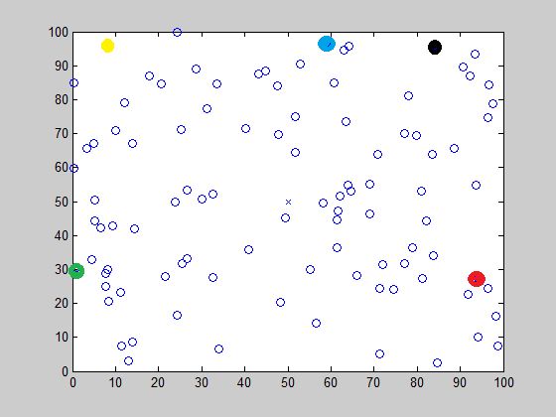
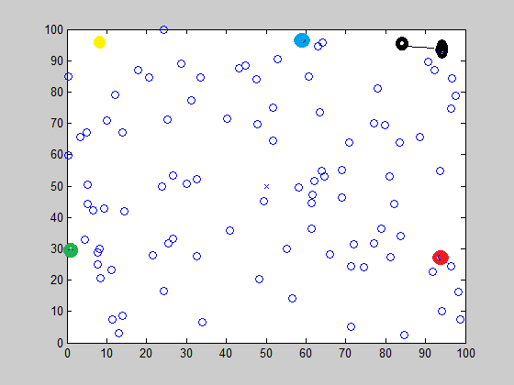
My simulation model
Create a stable network:
  First, choose 5 of the least weight as ‘head’, they can communicate with each other.
  The least of 5 of them start to find the nearest node and (1) pass the ‘head’ to it and (2) add their weight as new weight.
  Repeat.

Slide 9
My simulation model
Energy cost formulation used:
Amplify energy cost:
Data fusion cost:
Transmit and receive cost:
How many clusters I choose:
  Clusters(on average):
  Nodes (on average):
  Total energy cost/round(on average):
K=5

Slide 10
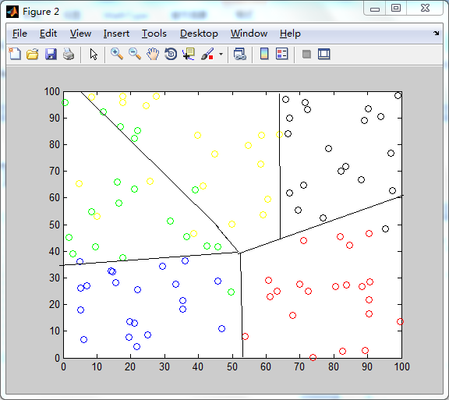
My simulation model
  As shown in the figure, nodes
  are divided into 5 parts.
  Every part has a similat
  total weight of the maximun
  times this chain can work.
  Using weight instead of energy
  to choose cluster.

Slide 11
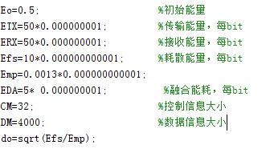
My simulation model
Parameters in simulation:

Slide 12
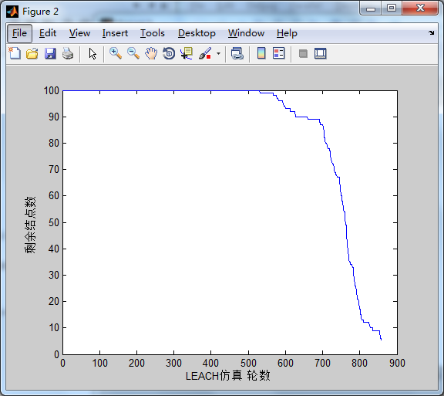
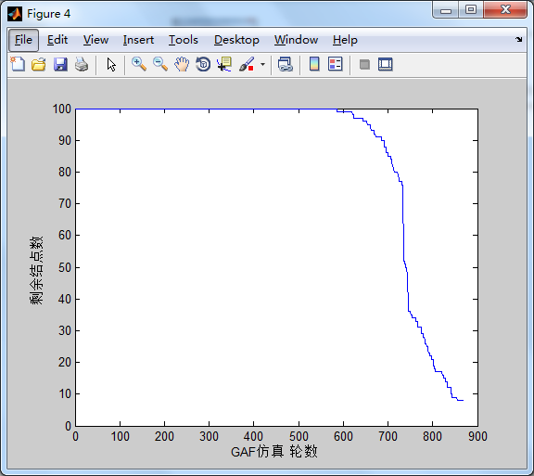
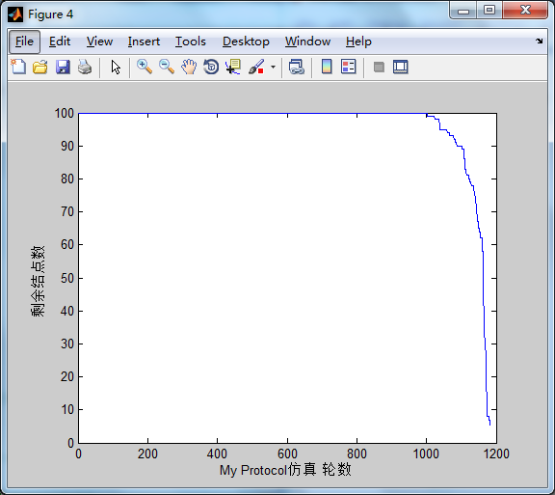
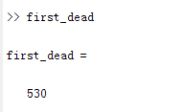
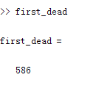
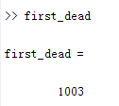
My simulation result

Slide 13
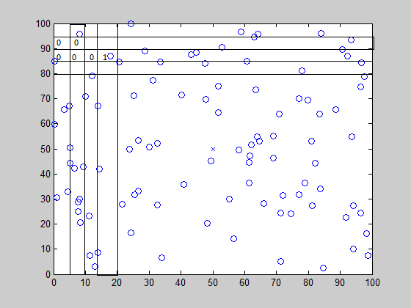
Future work
Review my protocol code and correct
some details .
I want to try if I can divide the area
by using the density and gradient. Use
what I learned in ‘Image Processing’.

Slide 14
Q and A?

