Slide 1
ClassWorld
– Android app
Chen Jiawei
Li Xinhui
Wang Keyu
Zhu YiDa

Slide 2


Some questions in wireless class have not been solved, but tomorrow is due day ! !
I do not want to attend the microwave class tomorrow, but what if Prof Zhou check the attendance
Notes:
They are thinking about the way to solve their problem, and they both find that social network application may be a possible solution.

Slide 3



It has been blocked !
Most people I know do not know me！
It is not deserve to pay for it, since wireless network in school is free.
Notes:
人人网找个理由，屏蔽掉

Slide 4

ClassWorld
Problem Solved ！
Notes:
One day an application named ClassWorld attract the attention of these two guys, and after they used this application they found that they have solved the problem.

Slide 5




Notes:
The brief overview is like this

Slide 6
ClassWorld
Notes:
我们的界面

Slide 7
Function & UI
Technology review
Feature utilization
Function &
UI

Slide 8
courses
students
Database
Notes:
Two basic elements in our app is courses and the students, all the information will be stored in a remote database, I will introduce later.

Slide 9
Sign up
Add Class
Student
Login
Check
syllabus
Delete Class
Find Classmates
Contact
Add Class 1
Add Student A
Database
Add Student B
Add Class 2
Add Student C

Slide 10
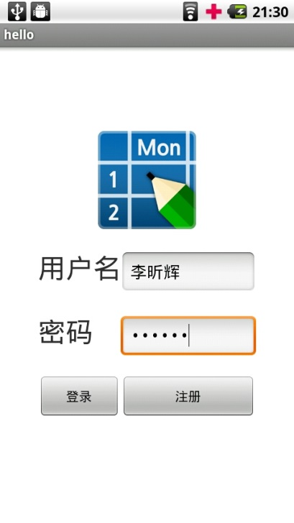
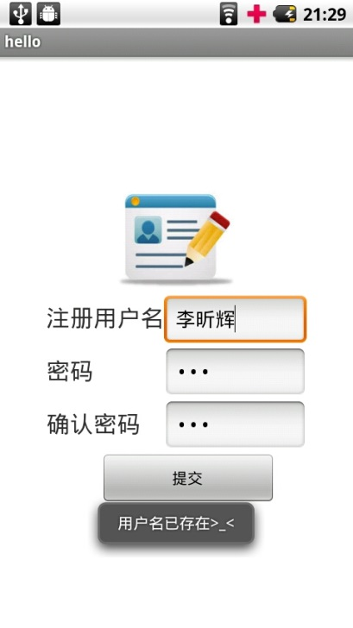
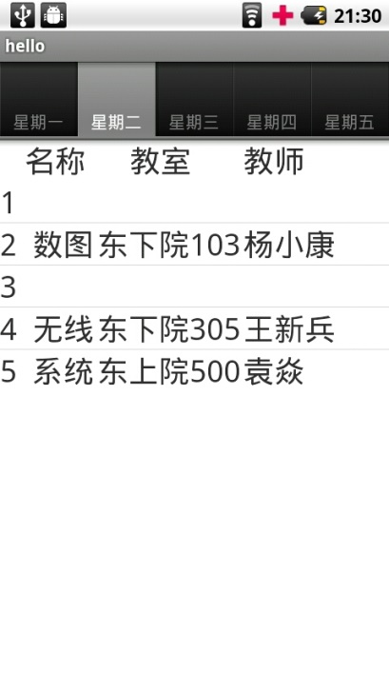
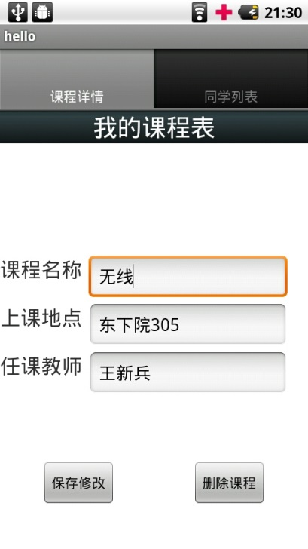
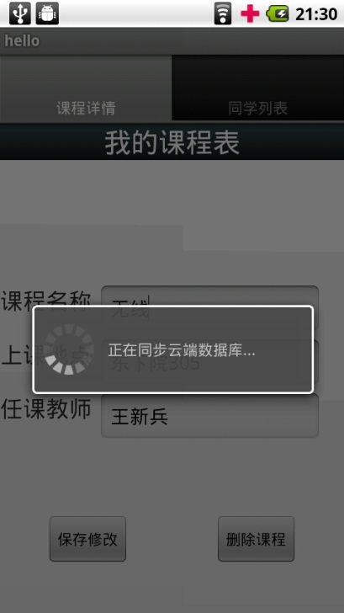
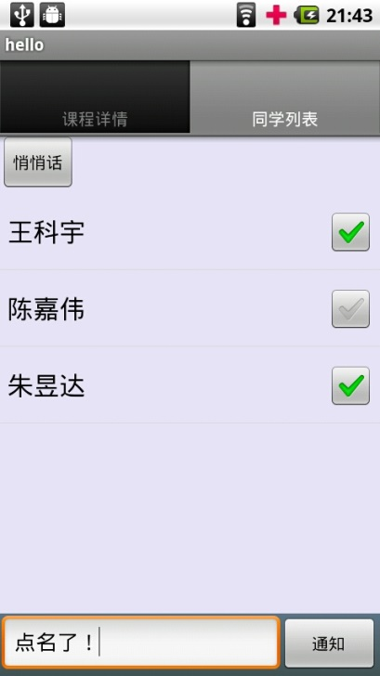
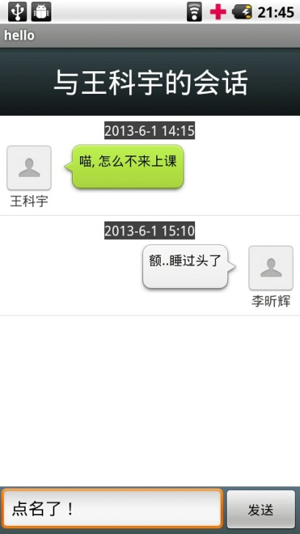
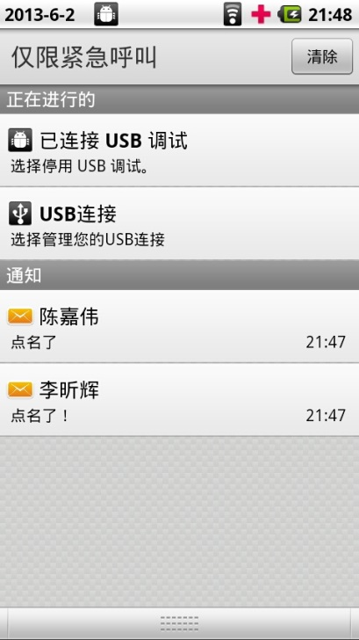

Slide 11
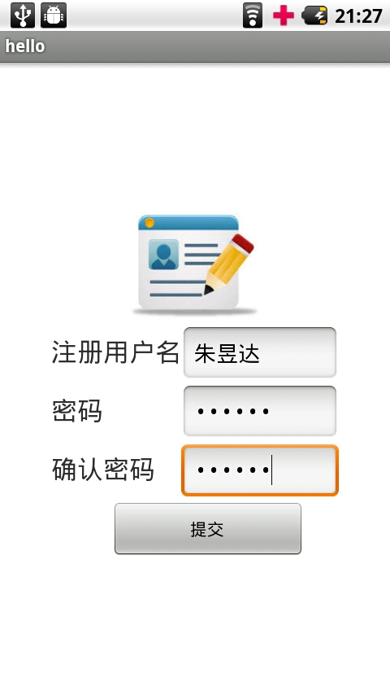
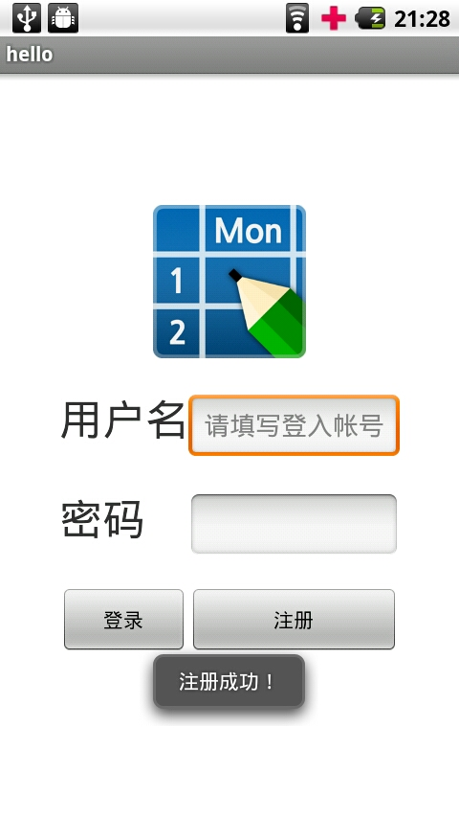
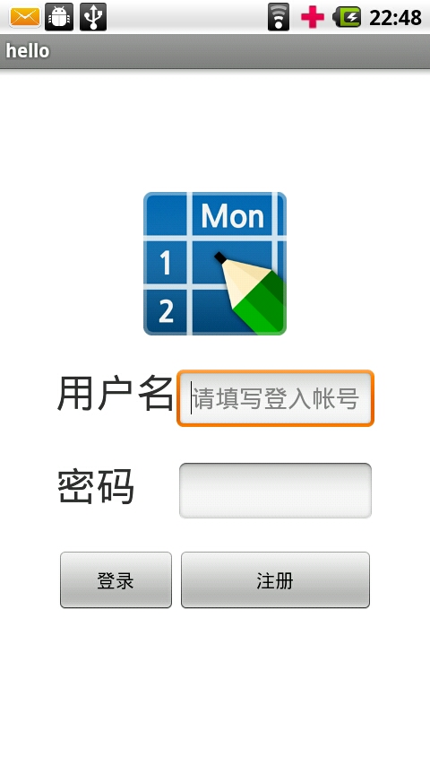

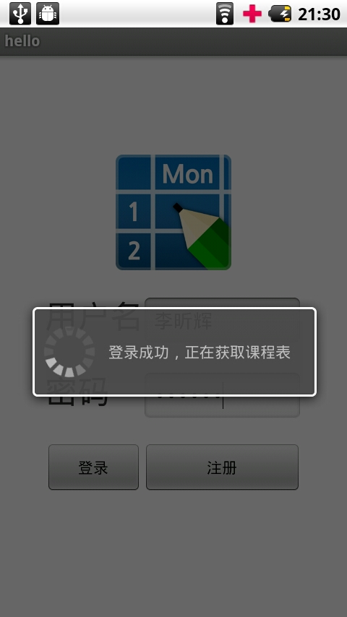
Login and Sign up
Sign up
Log in

Slide 12
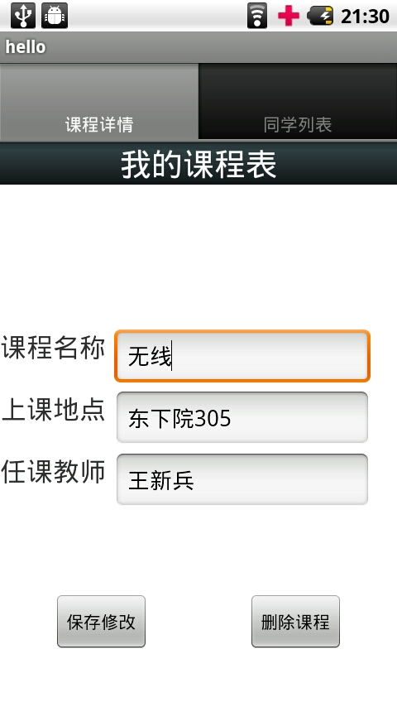
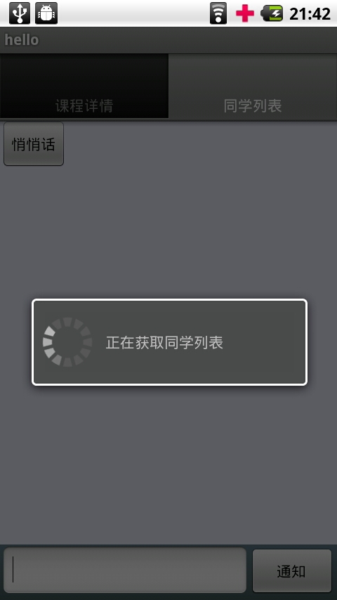
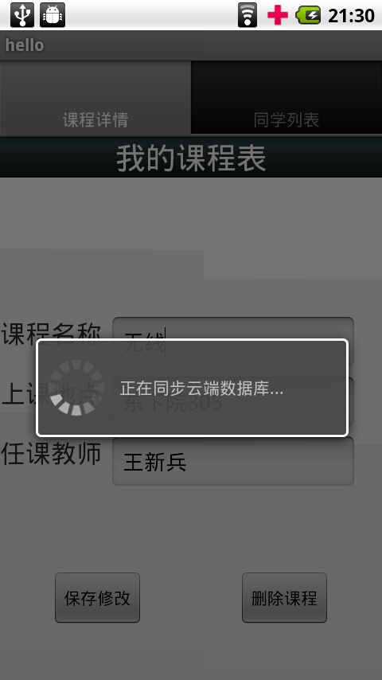

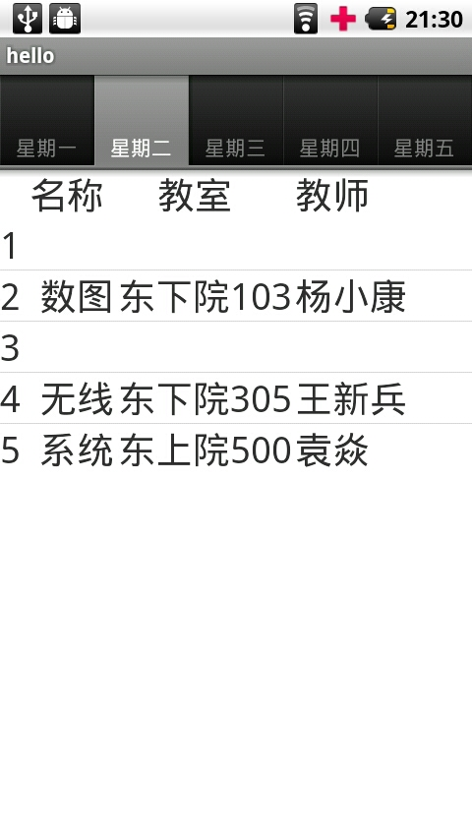
Class Management
Edit class

Slide 13
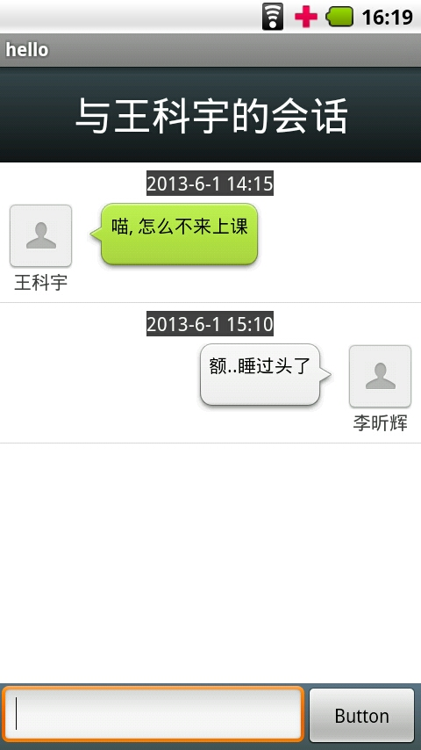
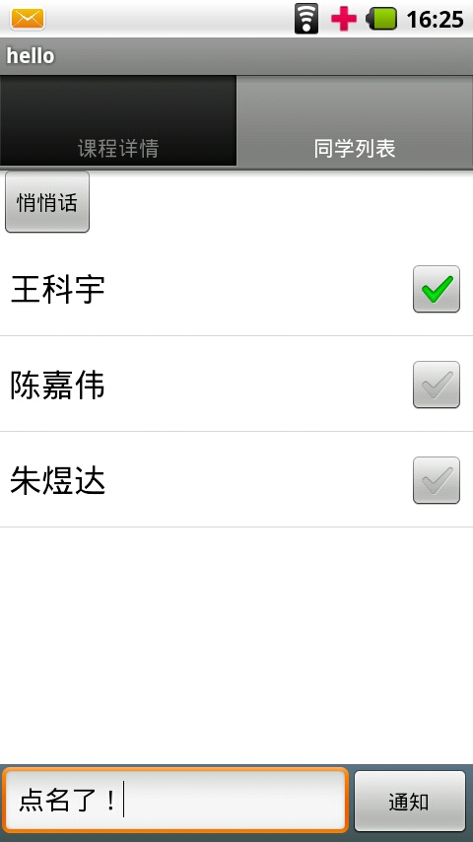
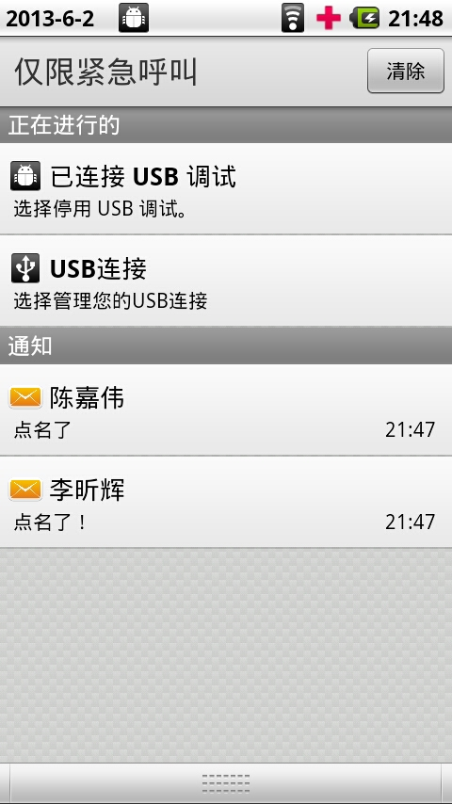
Chatting
Online Chatting
Offline Notification

Slide 14
UI & Function
Technology review
Feature utilization
Technology review

Slide 15
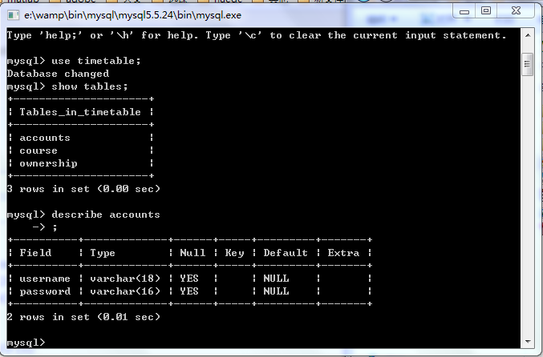
Database Architecture
MySQL
Notes:
截一张sql表格图

Slide 16

Database Architecture
MySQL
Accounts
Courses
Ownerships
JDBC
HTTP Server
Notes:
JDBC：JavaDataBaseConnectivity

Slide 17


SQLite
HTTP Protocol
SQLite
Notes:
The cloud
Icloud include http server and database

Slide 18



Implement of Offline Notification
Message Queue for Phone B
Polling
Background Service
Phone A
Phone B
Notes:
每隔一分钟进行一次查询，流量很少，但有一定延时
如果加快查询速度，则流量会增加，引起网络拥塞，所以需要其他方法
解决矛盾需要后面介绍的持久连接（Keep-alive connection）

Slide 19
Implement of Online Chatting
IP TABLE
IP Address of A
IP Address of B
Log in
REQ for chatting
Log in
REQ for chatting
ACK for chatting
IP Address of B
IP Address of A
TCP Keep-alive connection
(Transferring Chat Messages)
Phone A
Phone B

Slide 20
Why Keep-alive connection?
Low CPU and Memory consumption
Reduced network congestion
Faster response
Minimized handshaking
Notes:
持久连接（keep-alive/ persistent connection）是使用同一个TCP连接来发送和接收多个请求/应答，而不是为每一个新的请求/应答打开新的连接的方法。
长连接的优点：
1、减少CPU及内存的使用，因为不需要经常的建立及关闭连接；
2、减少网络的堵塞，因为减少了TCP请求；
3、减少后续请求的响应时间，因为不需要需要反复的TCP握手等过程；

Slide 21
UI & Function
Technology review
Feature utilization
Feature utilization

Slide 22
Offline Notification
Chatting Log
HTTP Server
Online Chatting
MySQL
Social connection graph

Slide 23
Future utilization
Recommendation products in a more specific social group
Why the producer wants to advertise this app
Why users want to use this application

Slide 24
Thank you !
Q&A

