Slide 1
Wireless Communication Project
——Qin Xiaosong
5100109073

Slide 2
Spread Spectrum

Slide 3
Contents
Spread Spectrum Theory Introduction
Labview Simulation
USRP Manipulation
Background and Objective
Application and Advance

Slide 4
Project Background
Originally military used
Broaden application
Computer Network
Wireless Communication （3G ）
Reliability
Security

Slide 5
Project Process
Explore the theory
Use the software and hardware to experiment and simulate
Application and Advance
Digital Communication
Labview
USRP
Dynamic spectrum access
Tamed spread spectrum
Application

Slide 7
Theory Basis
Shannon Theorem
When S/N is very small （≤0.1）

Slide 8
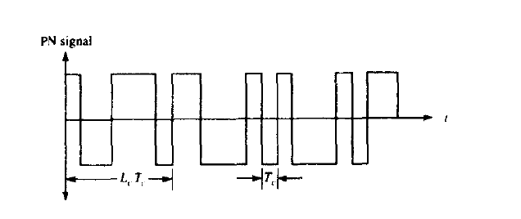
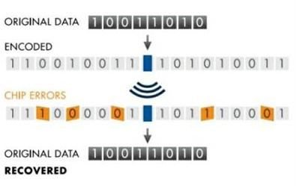
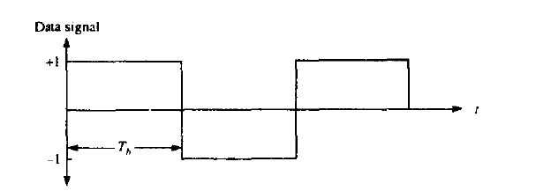
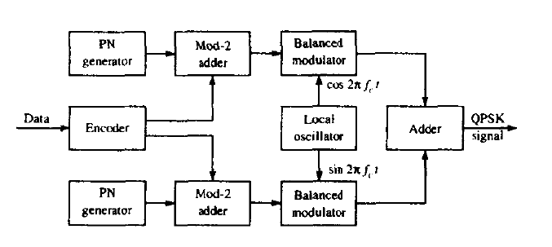
Direct Sequence Spread Spectrum

Slide 9
Labview Programming With USRP Manipulation
Labview：Graphic programming software developed by NI.
USRP: A hardware to make PC work as software radio with large bandwidth

Slide 10
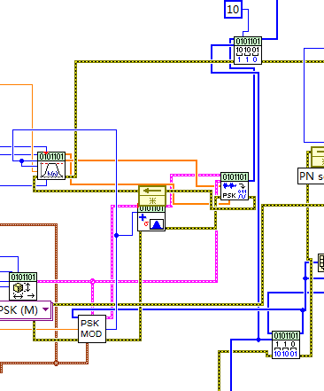
解扩频
PSK解调
AWGN噪声信道
PSK调制模块
扩频模块

Slide 12
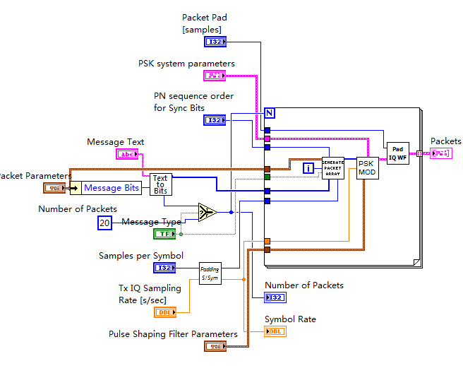
The real transmission
ASCII码转换
Message transform
Packet form
Synchronization and checkout
Modulation and spread
扩频模块
扩频模块
扩频模块
冗余位以及校验位添加
PSK调制
数据转换
产生PN序列
产生PN序列
包序号

Slide 13
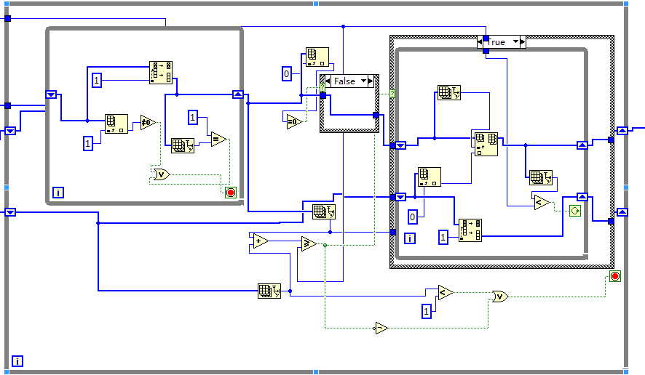
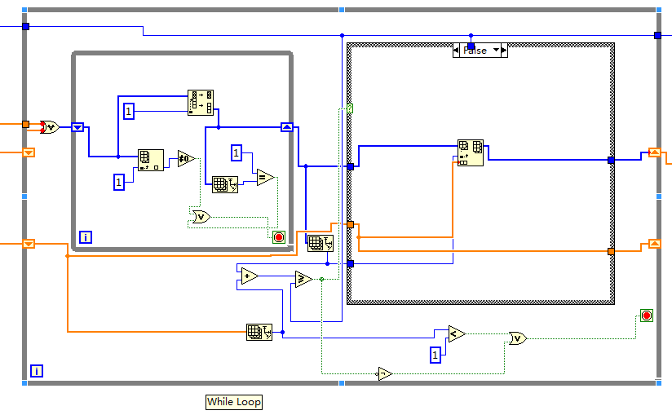
Checkout

Slide 14
Evaluation Model
Transmission Gain
$G={\frac{s_{o}}{n_{o}}}/{\frac{s_{i}}{n_{i}}}$
Error rate

Slide 15
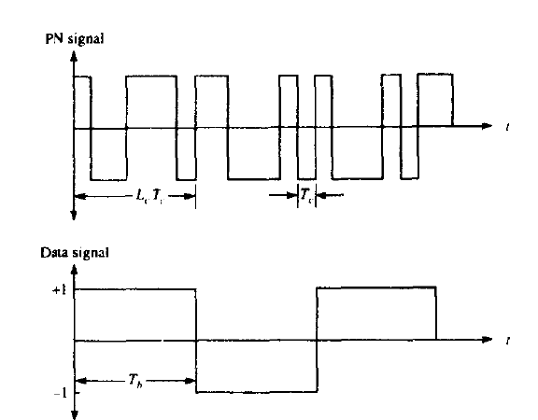
The evolution
System bandwidth make the increase in the number of jamming signal in the front-end of receiver
Dynamic spectrum access
The channel capacity is limited
Tamed spread spectrum

Slide 16
Thank You!

