Slide 1
A Transport Protocol for
Mobile Ad Hoc Network
MATP
Wei Wang

Slide 2
TCP a Brief Review
User Application
Email WWW Voice...
SMTP HTTP RTP...
TCP UDP
IP
Ethernet PPP…
MultiAccess async sync...
copper fiber radio...
Application Protocol
Transport Protocol
Internet Protocol
Media Access Protocol
Media Sharing Principles
Physical System

Slide 3
TCP mechanisms
Slow start
Window Based Transmission
Dependence on ACK’s
Reliance on Reverse Path

Slide 4
MANET Characteristics
Mobility
Distance
Noise
……
node1
node3
node2

Slide 5
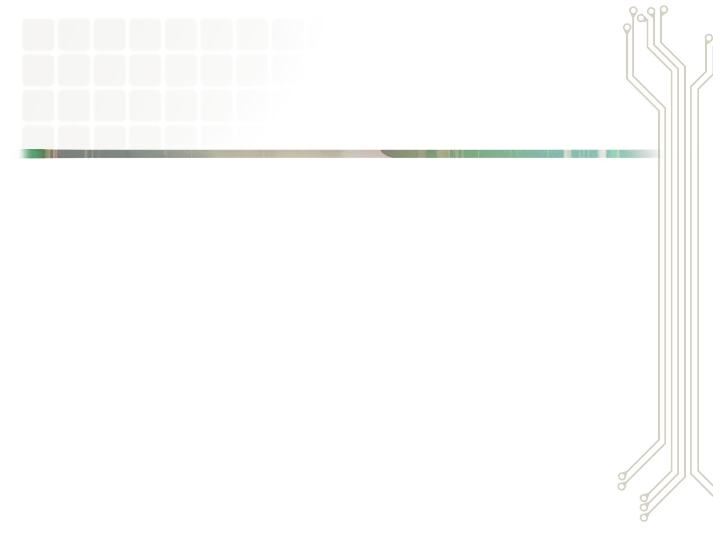
TCP in Mobile ad hoc Network
TCP interprets
Route failure
congestion
Wireless errors
congestion
Delay Spike
Not received by receiver
N nodes to one node
Not Designed to handle this

Slide 6
Methods to Improve Performance
TCP Variants
  Estimate the available bandwidth
  Determine Route Failure & Wireless Error
  Reduce Contention
  Many more …
Non TCP Variants
  Rate Based instead of Window Based

Slide 7
ATP :a Non TCP Variant
Window Based Transmission
NO
Rate Based Transmission
?
Queuing Delay and Transmission Delay recorded as a judge of the status of the network

Slide 8

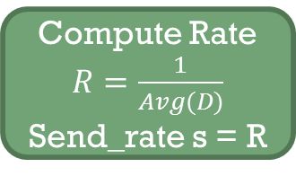
ATP Quick Start ¹
S:Sender;I:Intermediate Node; R:Receiver;
Qt: queuing time of a packet;
Tt:Transmission delay of a packet.
D:largest of sum of Qt and Tt of the I node
Compute Rate $R=\frac{1}{Avg(D)}$
Send_rate s = R
S
I
R
S
D
Avg(D)

Slide 9
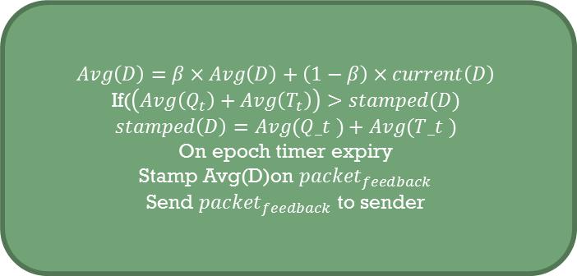
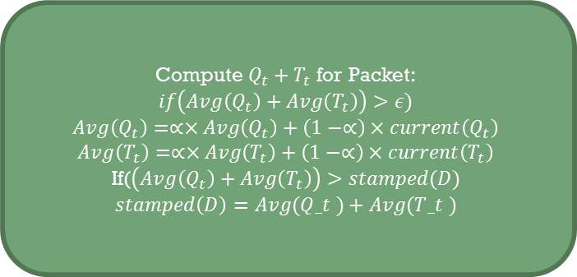
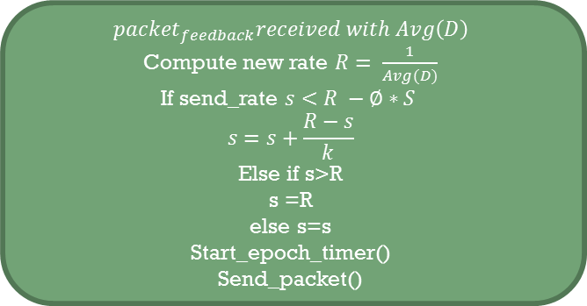
ATP Normal Operation¹
$$Avg\left(D\right)=β×Avg\left(D\right)+\left(1−β\right)×current\left(D\right)$$
If($\left(Avg\left(Q_{t}\right)+Avg\left(T_{t}\right)\right)>stamped(D)$
$$stamped\left(D\right)=Avg(Q_t )+Avg(T_t )$$
On epoch timer expiry
Stamp Avg(D)on ${packet}_{feedback}$
Send ${packet}_{feedback}$ to sender
I
R
S
D
Avg(D)
$${packet}_{feedback}received with Avg\left(D\right)$$
Compute new rate $R= \frac{1}{Avg(D)}$
If send_rate $s<R −∅∗S$
$$s=s+\frac{R−s}{k}$$
Else if s>R
s =R
else s=s
Start_epoch_timer()
Send_packet()
Compute $Q_{t}+T_{t}$ for Packet:
$$if\left(Avg\left(Q_{t}\right)+Avg\left(T_{t}\right)\right)>ε)$$
$$Avg\left(Q_{t}\right)=∝×Avg\left(Q_{t}\right)+\left(1−∝\right)×current\left(Q_{t}\right)$$
$$Avg\left(T_{t}\right)=∝×Avg\left(T_{t}\right)+\left(1−∝\right)×current\left(T_{t}\right)$$
If($\left(Avg\left(Q_{t}\right)+Avg\left(T_{t}\right)\right)>stamped(D)$
$$stamped\left(D\right)=Avg(Q_t )+Avg(T_t )$$

Slide 10
Shortcomings of ATP
  require the assistance of intermediate node
  Incompatibility problem
  It takes about 1 second to detect and recover a packet

Slide 11
MATP
  Add some modification in ATP protocol
  Direct link between sender and receiver considered

Slide 12
Simulations
Currently I am still working on this step
Create a transport protocol in ns-2
Choose Mobility Models
Running Simulation

Slide 13
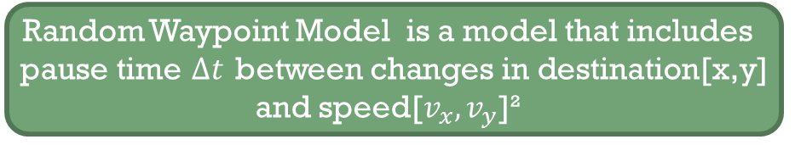
Mobility Models
To create a realistic topology for the simulations of transport protocols
Random Waypoint Model is chosen in Ref 1 to simulate the performance of ATP
Random Waypoint Model is a model that includes pause time $∆t$ between changes in destination[x,y] and speed[$v_{x},v_{y}$]²

Slide 14
References
¹ Karthikeyan Sundaresan,Vaidyanathan Anantharaman,Hung-Yun Hsieh, and Raghupathy Sivakumar,”ATP :A Reliable Transport Protocol for Ad –hoc Networks”
²Tracy Camp, Jeff Boleng and Vanessa Davies,”A survey of Mobility Models for Ad Hoc Network Research”.10 Sep. 2002
³Google

Slide 15
Any Questions?

Slide 16

Thank You!

