Slide 1






Connectivity of Mobile k-Hop Wireless Network
Qi Wang

Slide 2




Wireless Network Structure
BS
BS
MN
MN
MN
MN
Notes:
An infrastructure-based network has a structure like this. It has base stations connected by wired lines and mobile nodes which connect to the network through wireless connections.

Slide 3
r
cluster member
cluster head
transmission range
Notes:
When analyzing the network theoretically, we usually use graph to represent the network, like this picture. The white nodes are cluster members, just like the mobile nodes in the previous picture. And the black nodes are cluster heads, just as the base stations. Each cluster head has a transmission range, which is a circle with radius r centered at the head.

Slide 4
Mobility Model——I.I.D model
At the beginning of each time slot, each cluster member node randomly and uniformly choose a position within the region and remain static for the rest of the time slot.
Notes:
First I will introduce the mobility model used here. There are two frequently used models, the random walk model and the I.I.D model. Here we use the I.I.D model. The model is described as follows. And the region here is usually assumed to be a unit square.

Slide 5
Explanation of k-Hop in mobile network
Data transmission is divided into k time slots.
For each cluster member node, if it can reach the transmission of a certain cluster head in k time slots, then it is connected. Otherwise it is disconnected.
If all the member nodes is connected, then the network is fully connected.
Notes:
Here I would like to give some explanation on the concept k-hop. In network analysis, time is usually divided into slots, and so does data transmission. For a mobile node, if it can reach the transmission range of a head, then we say it is connected to the network. And if all the nodes in the network is connected, the network is fully connected.

Slide 6
2
I
II
III
IV
1
Connectivity illustration
Notes:
Here I give an illustration of connection. Under the I.I.D model, assume the trace of node 1 is depicted as the blue lines and the trace of node 2 is the yellow lines. We see at time slot 1 and 3, node 1 is in the transmission range of head IV and head III, respectively, but node 2 is not in the transmission range of any heads. So if k=4, node 1 is connected while node 2 is disconnected. Obviously, at time slot 2 and 4, node 1 is not within the transmission range of any heads, so why do we still define node 1 a connected node? This has something to do with the transmission scheme.

Slide 7
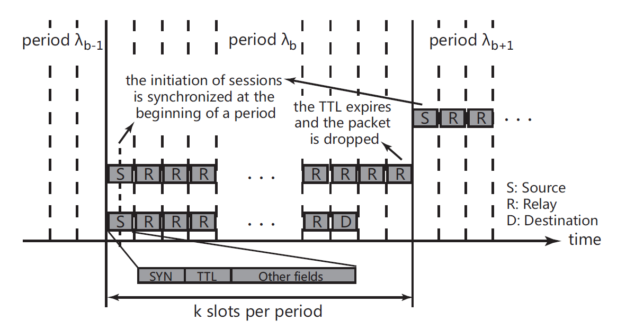
Transmission Scheme Illustration
Notes:
In the data transmission process, the node will send the packet as soon as it reaches a head. During 1 period (k-slots), only one packet will be sent. So if the node can reach a node within k time slots, the data will be sent successfully and if not, the transmission is failed. We see in the picture that the first packet is failed because the node does not reach any head during k time slots. And the second packet reaches the destination after k-2 slots, so we say the node is connected.

Slide 8
Network Deployment
Cluster head nodes are initially distributed randomly and uniformly within the unit square and always remain static. There is a path that connects all the cluster heads in the initial graph G.
Cluster member nodes are initially distributed randomly and uniformly within the unit square and move according to the I.I.D model. If at time slot d, member node i is within the transmission range of head j , an edge e_{ij} is added the G.
The number of cluster member nodes is n.
The number of cluster head is n^{α} ,where α is called the cluster head exponent , and 1/k< α≤1.
Notes:
The network deployment is described as follows. The cluster heads are static, since they serve as the base stations. An edge is added to the graph if a node is connected.

Slide 9
Critical Transmission Range
Let E denote the event that the network is fully connected, then r_{c} is the critical transmission range if
if r ≥ br_{c} and b>1
if r ≤ b’r_{c} and b’<1
(Asymptotic Connectivity)
Notes:
The critical transmission range for a mobile k-hop network is defined as follows. This definition is what we call asymptotic connectivity. That is to say, we consider large-scale network and let the number of nodes goes to infinity, then we calculate the probability of full connectivity. Intuitively, when r is larger, the probability for full connectivity is greater.

Slide 10
Notes:
After a series of complicated proof, we got this result.

Slide 11
Improvement
I.I.D
Correlated Mobility
Cluster Scalability
Notes:
The previous model is practical to some extent, but actually it does not take cluster into consideration. So two improvement can be made, the modification from I.I.D to correlated mobility and the cluster scalability.

Slide 12
Correlated Mobility Model
1.The movement of home point. At the beginning of each time slot, each home point will randomly and independently choose a position within the unit square.
2.The relative movement of cluster member. Each cluster member will uniformly and independently choose its location in its corresponding cluster region.
Notes:
First let’s talk about the correlated mobility model. This model is based on an assumption, that is, members in the same always stay closer and to some extent, move in the same way, while members in different clusters stay further and move differently. So the model here takes this into consideration and separate the movement into two steps, the movement of the home point, which is the center of the cluster and the relative movement of the cluster member.

Slide 13
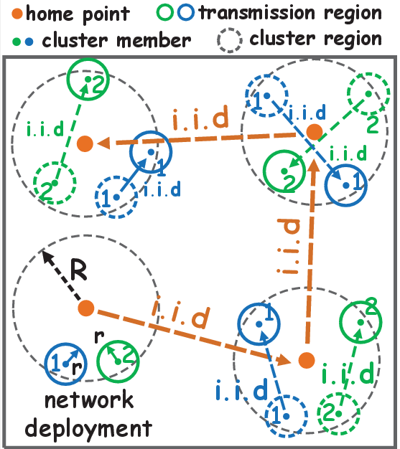
Notes:
This picture shows the correlated mobility model

Slide 14
Cluster Scalability
：The radius of each cluster
m=n^{γ}(0<γ≤1)：The number of clusters
：The number of nodes in each cluster
Notes:
For cluster scalability, we bring in some additional parameters. We call β the cluster radius exponent and γ the cluster exponent.

Slide 15
State Transition
：cluster-sparse (member-dense) state
：cluster-critical (member-critical) state
：cluster-dense (member-sparse) state
Notes:
With the parameter α and β, we can classify the network state into three categories.

Slide 16
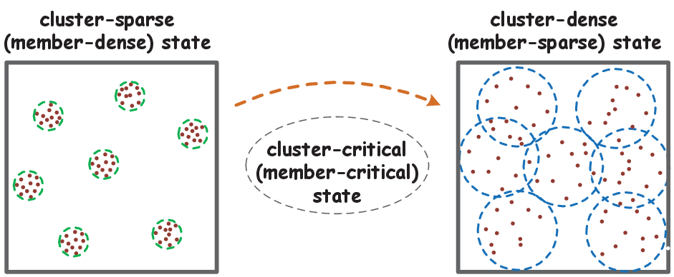
Illustration of state transition
Notes:
The cluster state transition is shown in this picture.

Slide 17
Cluster-sparse state (α+2β<0)：
Cluster-critical state (α+2β=0)：
Cluster-dense state (α+2β>0)：
Notes:
After another series of complicated proof, the critical transmission range for cluster sparse state is this, and for the other two cases, the result is still under processing and here I can just put a question mark.

Slide 18
Thank You

