Slide 1
Release Conference
Liu Wang
Chi Jia
Huang Shuo
Notes:
学号：刘驰煌5100719070 王嘉硕5100309436

Slide 2
IMAGINE
Notes:
imagine the hardware specifications of future electronic products. When we choose which cellphone to buy maybe we would consider its hardware at first, because higher level of hardware may bring us better experience. So we discuss it first.

Slide 3
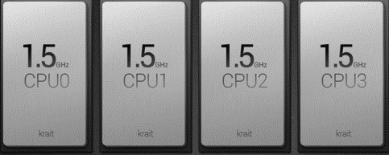
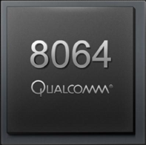
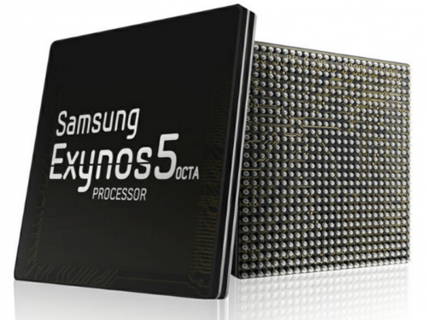
100 Core
Samsung 8-core
Qualcomm quad-core
Notes:
Would a Qualcomm quad-core processor satisfy you? You may say it is outdated and cannot play large scale 3D games.
How about Samsung 8-core processor? Some would think it will die out in several years and there must be some more powerful CPUs.
So I think only this can satiate your appetite. But our attitude to these answer is NO!

Slide 4
NO
Notes:
Because we do not need powerful processors any more, what we need is just this.

Slide 5
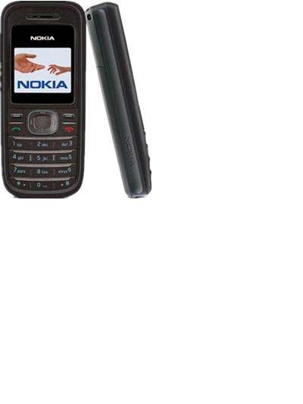
Notes:
I do not mean that this kind of mobile phone will be popular in the future, but the phone at that time only need to have hardware such as CPU and GPU of this level. Why?

Slide 6
@Cloud
Notes:
because the most of calculating and rendering job are finished at cloud. The only task of a mobile terminal is to show you what you want, to display pictures received from the cloud. It need not to have good hardware to process your command.

Slide 7
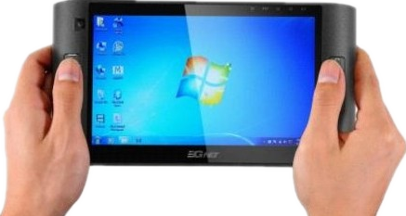
Notes:
That is, when you want to use your mobile terminal to finish a job, you just tell the cloud what you want by touching the screen or speaking to your terminal, and the cloud will know how to achieve your goal and manage to do that.
After it has finished the cloud send you back some packed pictures and the only thing for your terminal to do is to display these pictures. And thus your terminal need not to have powerful CPU or GPU at all, because all these complex and consuming jobs have been already done at cloud.

Slide 8
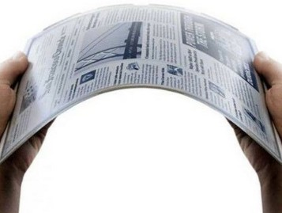
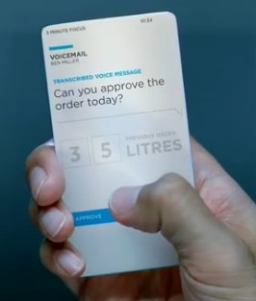
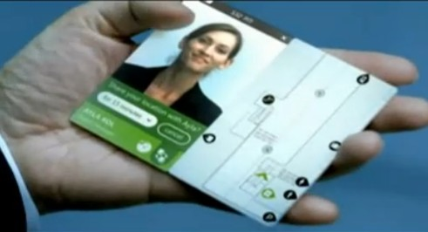
Portable
Notes:
This will lead to many benefits. First of all your handheld device could be very portable. because there is no much calculation and render, so powerful CPU? NO! Strong GPU? NO! 4 gigabytes ram? NO! 64 Gigabytes rom? NO! So the device will be more power saving and the battery can be smaller.

Slide 9
Notes:
And secondly the concept of “download an app” would disappear, because you never need any app to be stored in your terminal any more, all of your information is saved in the cloud and no data need to be stored in your device. If you want to use some specified function, you can just get it directly from the cloud. What you need is just kind of license, to enable you to access some data. Another benefit is to provide developer with easy control over their app, he can simply update his app in the cloud and all users could use the new version of app in the same time. Now let’s welcome CTO Wang Jiashuo to give us some details for developers.

Slide 10
Enter “app”
New thread
Initial layout
Notes:
Now please allow me to introduce about how our developers design their app on our @cloud. When the user enters the app,
the device will send an enter request to @cloud. And an associated thread will be created, which is used to deal with operations of this user.
Then the initial layout will be rendered and compressed and sent to the user device to decompress and let the user see the interface of the app.

Slide 11
Command
Refresh
New layout
Notes:
When the user do something with this app, for example, a game, he will control andthe device will send the command to @cloud automatically.
The thread on @cloud will execute and generate the new layout, which will be sent to the user by rendering and compressing.

Slide 12
Dynamic
Image
New layout
Notes:
When the game UI has lots of dynamic images, the layout will be refreshed automatically with some interval, which is defined by the predicted speed of the dynamic image.

Slide 13
Exit “app”
Kill thread
Notes:
When the user exit the app, a command will be sent to @cloud to kill the associated thread. But if the app is not terminated but runs in background, the associated thread will only be suspended.
Next I will show you the demo program. We mainly implemented the communications between the phone and our @cloud, which is PC here, so the UI is not that nice. Now let’s see the game first.

Slide 14
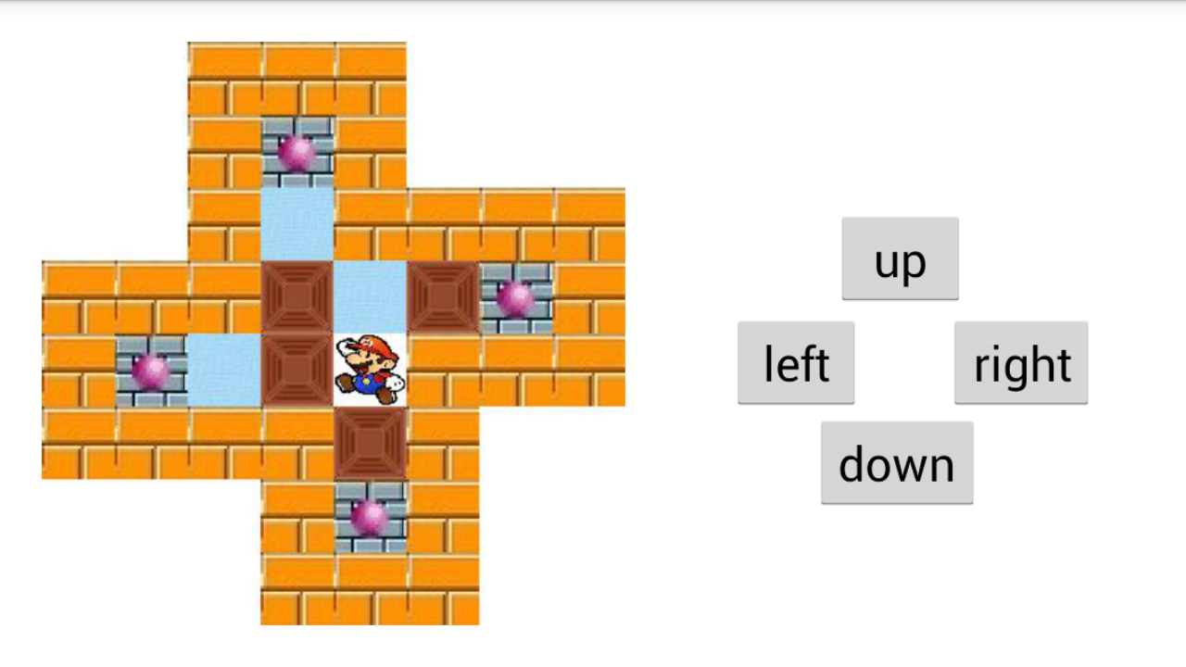
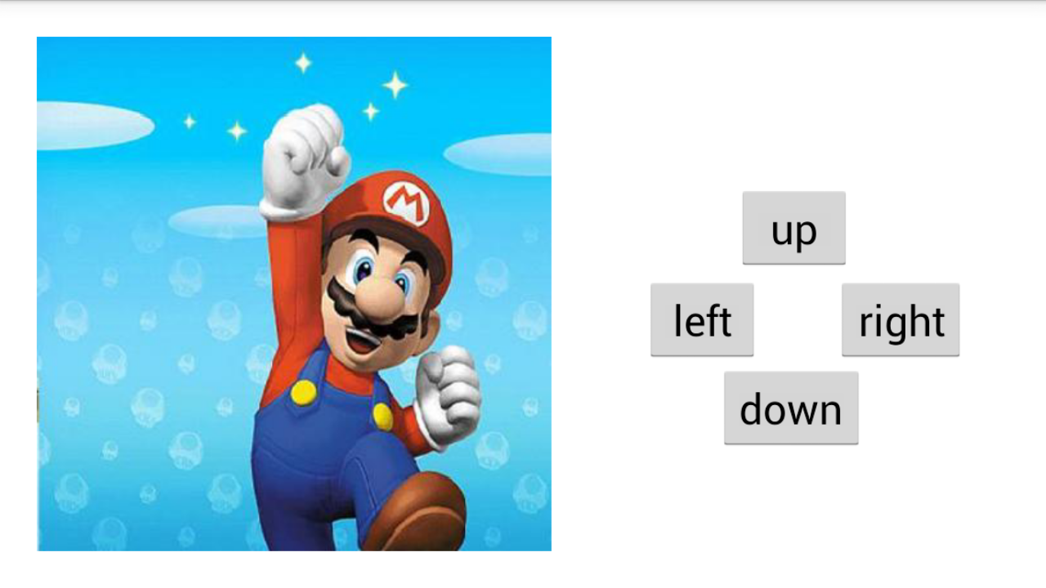
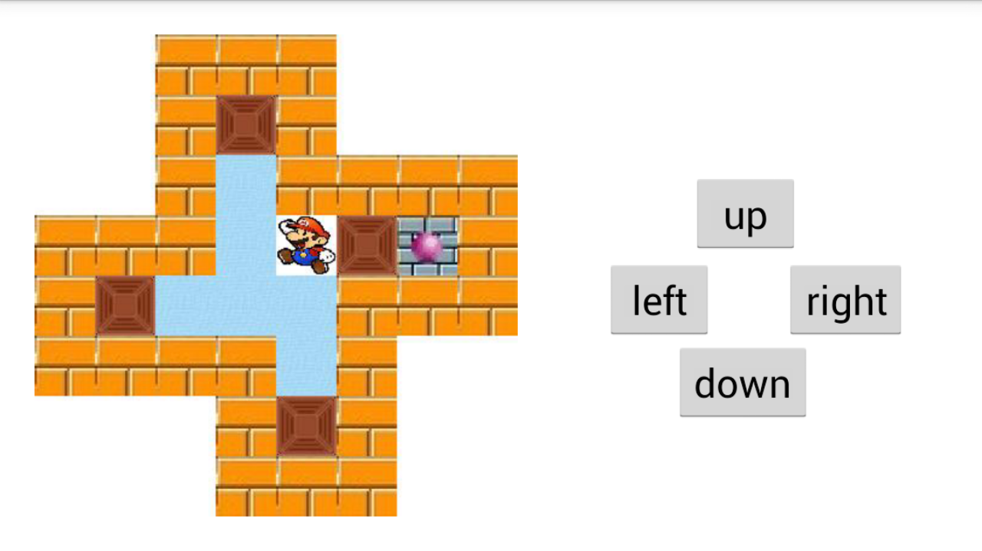
Notes:
This is the enter layout of the game, which is sent by PC via Wifi.
This is how this works. If the speed of Wifi is good, the game will perform really fluently. The higher speed of the Internet, the better.
When you pass the game, Mario will be very happy!

Slide 15
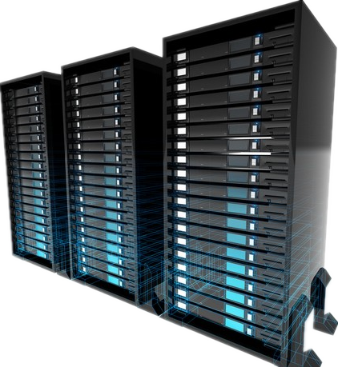
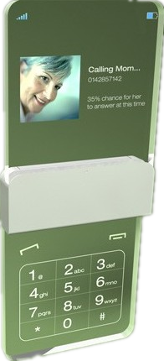
Wi-Fi
Socket
Server
Socket
Notes:
We use Java to make these programs. And socket is used when communicating between @cloud and devices. @cloud will receive the request and decide what will happen next by executing the program of the associated app. With this way, most of calculation will be done on @cloud, whose CPU is very very powerful, and the device doesn’t need to have a strong CPU.

Slide 16
