Slide 1
Android Application: Smart Stop Watch
Fuxing Liu
Meidan Zhao

Slide 3
What is necessary in a distance race?
0. Dependable timing system
1. Proper racetrack
2. Numerous racers
3. Enthusiastic audience

Slide 4
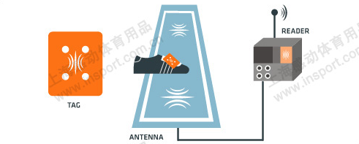
RFID Timing carpet
$ ?????
Accurate
Manipulation-free
Dependable

Slide 5
What about a relay race…

Slide 6
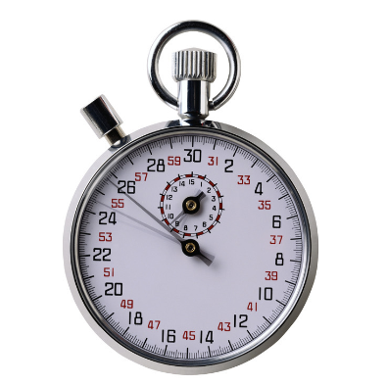
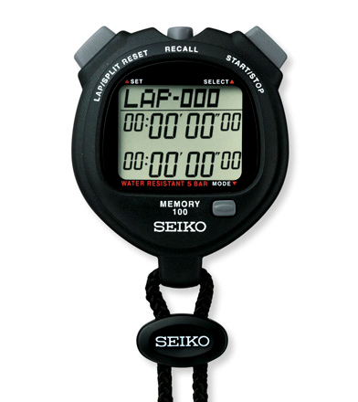
What about a relay race…
Every racer`s result should be recorded
A final result is also required
It should be easy to compare horizontally and vertically

Slide 7
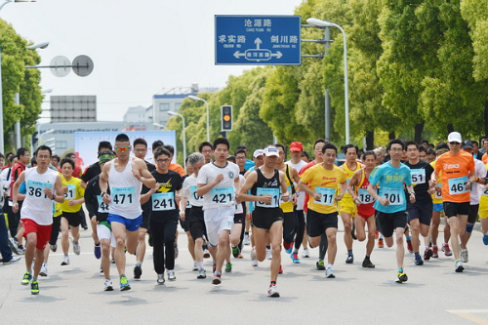
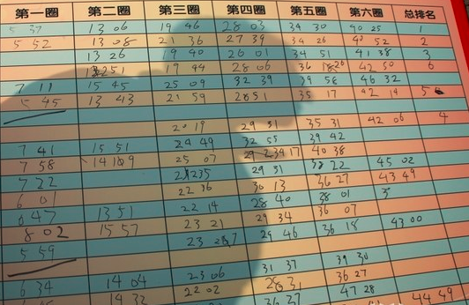

Slide 8
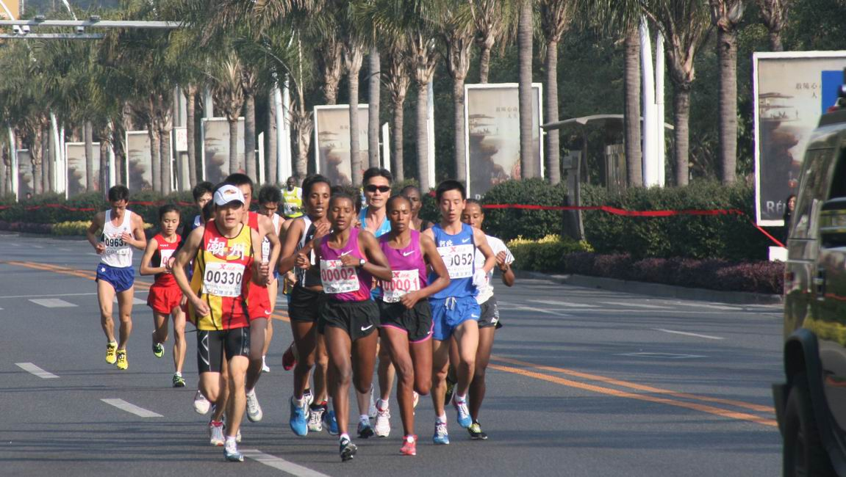
Traditional stop watch & Result board
Cumbersome
Easy to make mistake

Slide 9
Smart Stop Watch

Slide 10
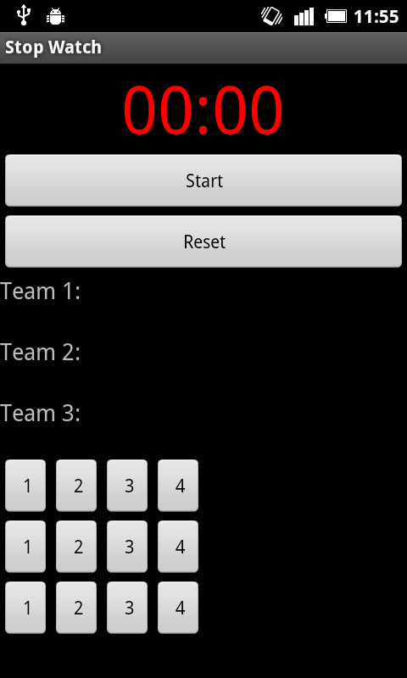
Interface

Slide 11
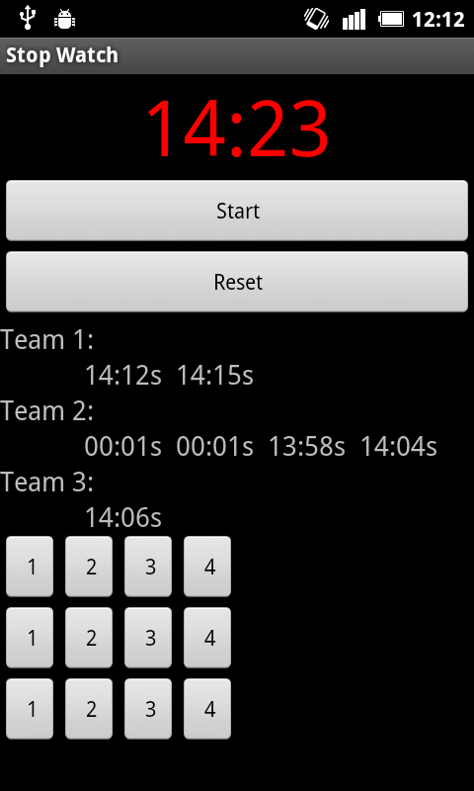
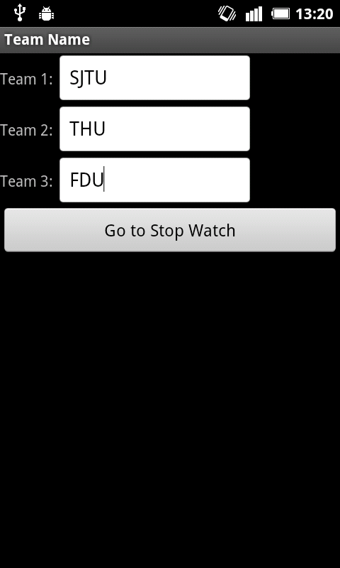
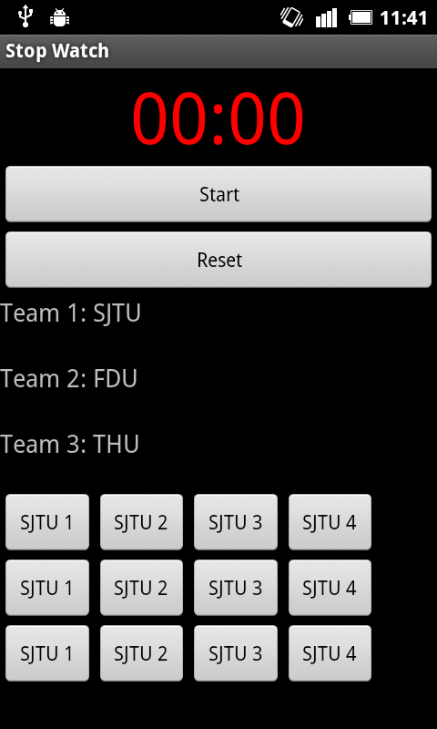
Interface

Slide 12
The idea of smart stop watch
Easy to manipulate
Calculate everyone`s result automatically
Directly perceived
Can be customized

Slide 13
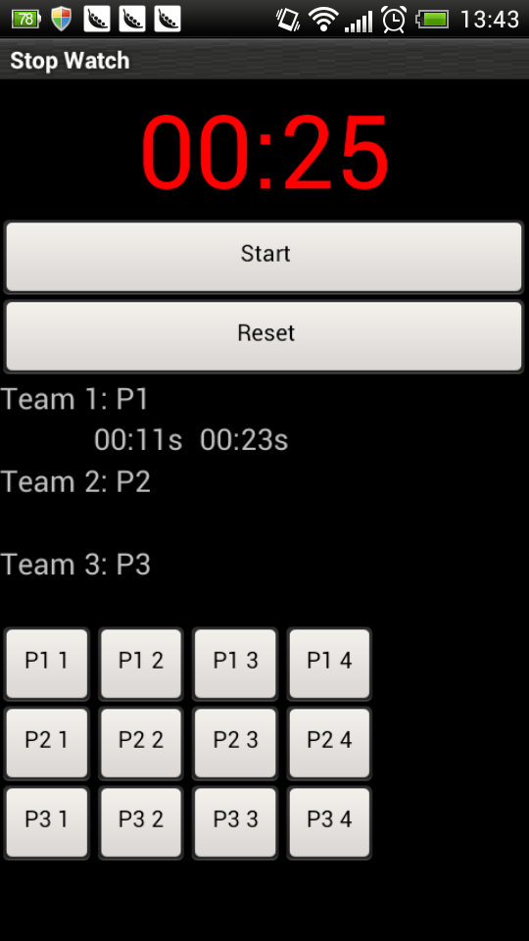
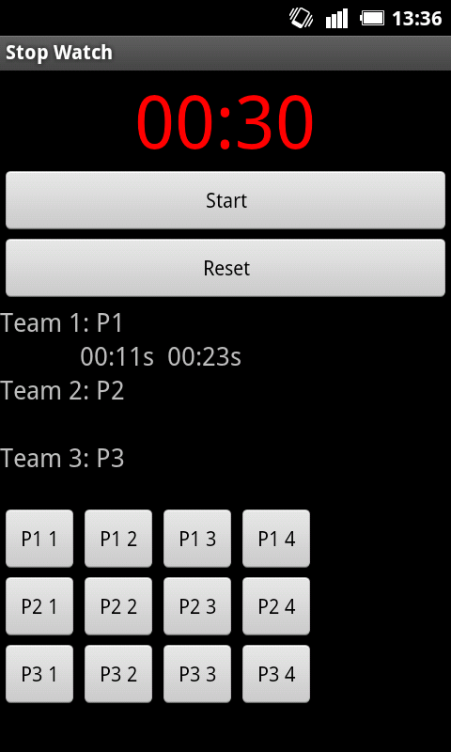
Share results between two terminals

Slide 14
Thank you!

