Slide 1
Android Development
陆俊敏 F0903030 5090309114

Slide 2
Outline
Development Environment
Eclipse
My project DIY Computer Assistant

Slide 3
Outline
Development Environment
Eclipse
My project DIY Computer Assistant

Slide 4
Development Environment
Java SE Development Kit
Eclipse
Android SDK

Slide 5
Java SE Development Kit
Java Platform, Standard Edition (Java SE) lets you develop and deploy Java applications on desktops and servers, as well as in today's demanding embedded environments. Java offers the rich user interface, performance, versatility, portability, and security that today’s applications require.
From www.oracle.com

Slide 6
Eclipse
Eclipse is a multi-language software development environment comprising an integrated development environment (IDE) and an extensible plug-in system. It is written mostly in Java. It can be used to develop applications in Java and, by means of various plug-ins, other programming languages.

Slide 7
Android SDK
Android SDK is Android development package. Today, we have Android SDK 4.0 which provides emulator of Android 4.0 system.

Slide 8
Outline
Development Environment
Eclipse
My project DIY Computer Assistant

Slide 9
Eclipse

Slide 10
Eclipse

Slide 11
Eclipse

Slide 12
Eclipse

Slide 13
Outline
Development Environment
Eclipse
My project DIY Computer Assistant

Slide 14
My project DIY Computer Assistant
Introduction
Function
This is a application that can generate a DIY List for those who are going to buy a DIY computer.
Input: your budget、your requirement
Output: DIY list

Slide 15
My project DIY Computer Assistant

Slide 16
My project DIY Computer Assistant

Slide 17
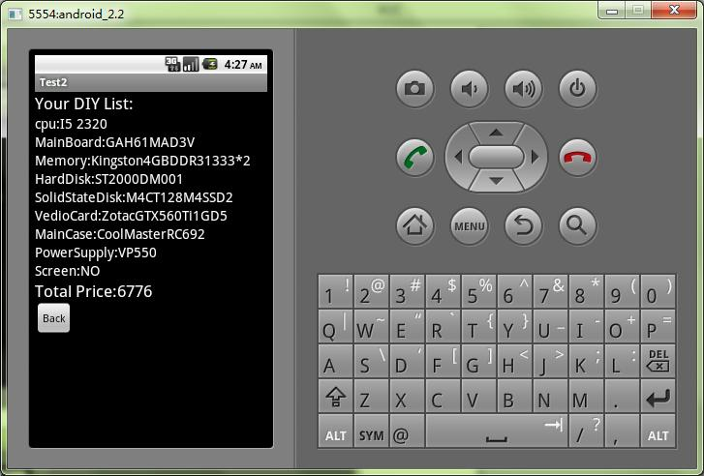
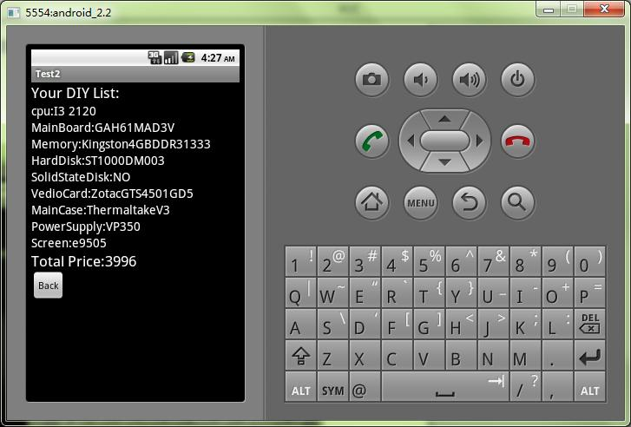
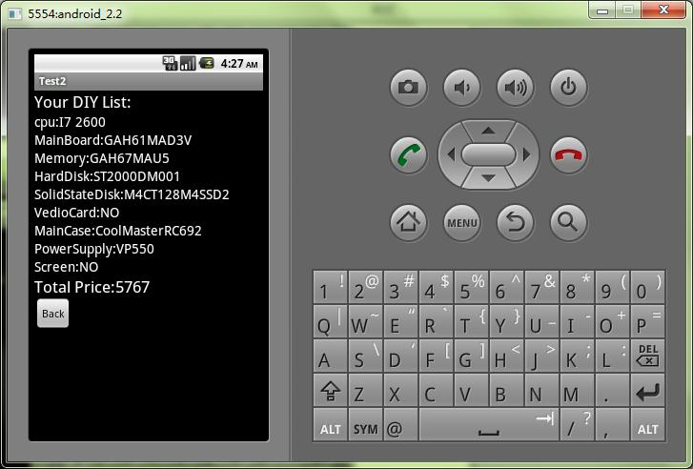
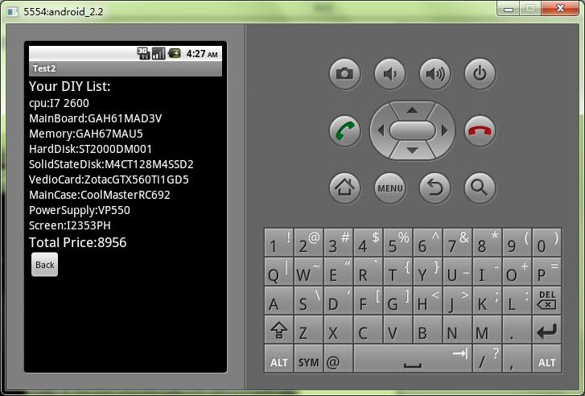
My project DIY Computer Assistant

Slide 18
Thank You!
Q & A time.

