Slide 1
Research on Throughput-Optimal Control in Multi-Radio Multi-Channel Wireless Networks
Huang Xin, Qiu Hang
Zhuang Weixu, Shi Qi

Slide 2
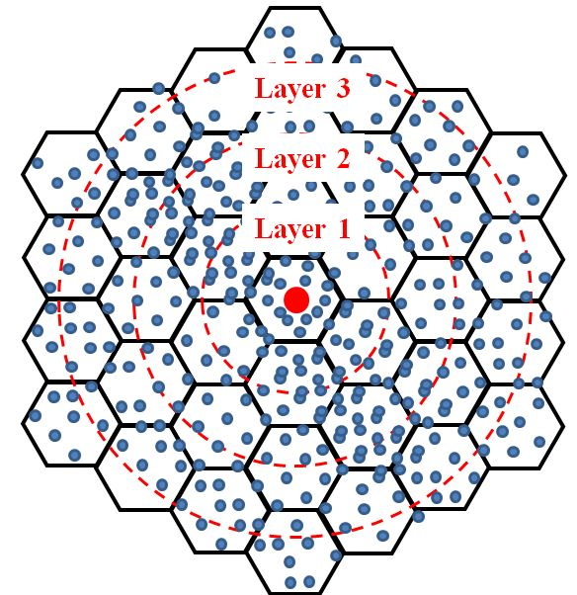
Introduction
Basic Architecture of Network
Sink Node
Assumption
Many to one architecture
3 channels for each node
Dynamic channel allocation
2
Notes:
项目的要求和网络场景

Slide 3
Related work
L. Tassiulas in [1] developed a back pressure algorithm to achieve the optimal capacity region in SR-SC networks.
NP-hard problem;
Unnecessarily large delay.
C. Joo in [2] designed a greedy maximal scheduling (GMS) to achieve a constant fraction of the maximum system capacity in multi-hop SR-SC networks.
About $\frac{1}{6} \sim \frac{1}{3}$ .
[1] L. Tassiulas and A. Ephremides, “Stability properties of constrained queueing systems and scheduling policies for maximum throughput in multihop radio networks,” IEEE Trans. automat. Contr., vol. 4, pp. 1936-1948, December 1992.
[2] C. Joo, X. Lin, and N. B. Shroff, “Understanding the capacity region of the greedy maximal scheduling algorithm in mult-ihop wireless networks,” IEEE/ACM Trans. Netw., vol. 17, no. 4, pp. 1132–1145, Aug. 2009.
Notes:
Here are some related work on these topics. First of all, I’ll introduce some work on SR-SC networks. This is the basis of the MR-MC networks.
[1] It is throughput optimal algorithm, but also leads to some problems
I’d like to say something more about this algorithm, because it’s a very important reference of Hongkun Li’s paper.
Especially in networks with small burden.
Because of these problems, lots of effort has been delivered to design a distributed algorithm with low complexity.

Slide 4
Related work
M. Alicherry in [3] proposed a centralized polynomial complexity sub-optimal algorithm for MR-MC networks.
The multi-dimensional resource space in MR-MC networks by nature leads to a mixed integer programming (which is NP-hard);
It guarantees a constant fraction of the maximum system capacity.
X. Lin in [4] proposed a distributed joint channel-assignment, scheduling and routing algorithm for MR-MC networks.
Straight-forward extensions of single-channel distributed scheduling algorithms to multi-channel networks may lead to very poor performance;
Also guarantees a fraction of the maximum system capacity, but is better than that in [3].
[3] M. Alicherry, R. Bhatia, and L. Li, “Joint channel assignment and routing for throughput optimization in multi-radio wireless mesh networks,” in Proc. ACM MobiCom, Aug. 2005, pp. 58–72.
[4] X. Lin and S. Rasool, “A distributed joint channel-assignment, scheduling and routing algorithm for multi-channel ad hoc wireless networks,” in Proc. IEEE INFOCOM, May 2007, pp. 1118–1126.
Notes:
[3] centralized algorithm
this is the first constant fraction approximate algorithm of this problem
In the paper I’ll present, the author gives another model, and conclude that in their model we may directly extend the SR-SC algorithm.

Slide 5
Goal & Motivation
Considering the contention of radio and channel, we intend to design a distributed scheduling algorithm by introducing game theory into MR-MC wireless network.
$\text{Game} \text{theory} \text{is} \text{an} \text{appropriate} \text{tool}$
$\text{To} \text{analyz}\text{e} \text{the} \text{interaction} \text{of} \text{decision} \text{makers} \text{with} \text{conflicting} \text{objectives}$.
To deal primarily with distributed optimization individual users, who make their own decisions instead of being controlled by a central authority.

Slide 6
System Model
A system with is the set of sink nodes and
is the set of transmission nodes. Besides,
is the set of channels.
Each transmitting node chooses one proper channel to maximize its revenue.
An example of the network scenario with 1 sink node and 6 transmission nodes. Besides, the channels set is{c₁ ,c₂ , c₃}.

Slide 7
System Model
We have three channels in our network and every node may have a different SNR for different channel.
We use the concept of interference range to model the potential interference among nodes.
T1 and T2 interfere each other because T1 lies in the interference range of T2 and they both choose the same channel C2 to transmit data
Notes:
Basic assumption of system model

Slide 8
System Model
Game Model
Players: the transmission nodes set T = {1,2,…,N }.
Strategies (or actions) of player: selecting a channel, i.e., ¹,
Utility function: defined in latter slide.
Basic Assumption for Model
Nodes make decision turn by turn. The order of the decision making process is determined by a random number.
Nodes in our network are selfish and rational which means they all want to get the maximum revenue in the network and when their utility is less than zero, they will give up the opportunity to use the channel.
¹ Note : The strategies of node i also include C₀, which means the node decides not to transmit in this round.
Notes:
Illustrate the problem using game theory model

Slide 9
Problem formulation
Key notations
----The utility function of node i for channel k
----The ability of node i for channel k
----The choice of node i for channel k
----The strategy of node i
----The bandwidth of channel k
----The buffer length of node i

Slide 10
Problem formulation
The definition of some notations
The choice of node i for channel k is got from the following equation
Then, the object is to find an optimal strategy, which means
Node i chooses channel k
Node i does not choose channel k

Slide 11
Problem formulation
From the definition of and , we can get the strategy set
Node i gives up the transmitting opportunity
Node i chooses channel 1
Node i chooses channel 2
Node i chooses channel 3
An illustration of strategy in the system model

Slide 12
Problem formulation
Ability of node i in channel k is defined as follow
Guarantee a better throughput
Buffer Length of Node :
Avoid data congestion

Slide 13
Problem formulation
We further define utility function of node i
represents the revenue i can get from channel k while the second part of the above equation is about the harm i brings to other users in the network when it decides to transmit.
is a set of nodes included in the interference range of node i

Slide 14
Problem formulation
Game process
In our network, every node will make its own decision which maximizes its utility function
When the decisions of all nodes during this turn t are the same as those in former turn t-1, which means
Then , nodes begin to transmit their data based on the decisions

Slide 15
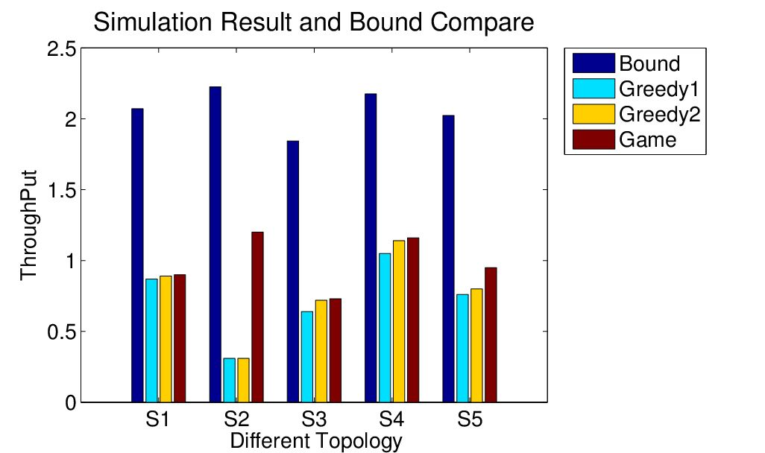
Simulation Result
Performance of Algorithms in Different Topologies
We use the average data amount that each node generates during one second to evaluate the throughput of each algorithm.
From this picture, we can see that compared with the other two greedy algorithms, our algorithm is much better especially in some specific network topologies.
Compared with the upper bound result, we still have a long way to go, which means that our algorithm is a subprime one, and we can do a lot to improve our algorithm and its application method.
15
Notes:
贪心算法一是：先在第一个信道上依次选择传输链路，直到无法再选。然后在第二个信道上依次选择传输链路，最后在第三个信道上选。
贪心算法二是：先在第一个信道上选择一个传输链路，然后在第二个信道上选择一个传输链路，接着是第三个信道。然后再从第一个信道开始选。

Slide 16
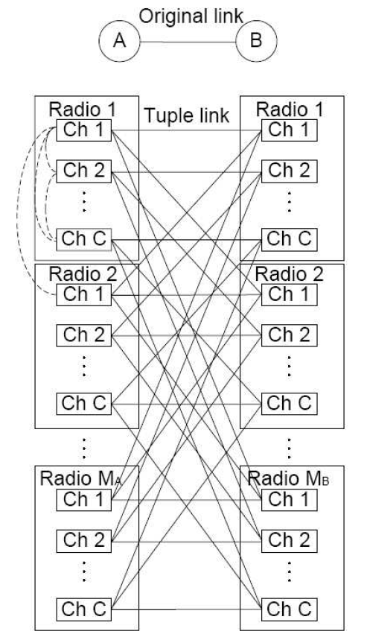
Future work – System model
Generating Tuple-Based Network
Node $n$ is transformed to multiple node-radio-channel (NRC) tuples, denoted as $(n,m_{n},c)$.
The tuple $(n,m_{n},c)$. means that the $m_{n}$th radio of node $n$ is working on the channel $c$.
Node $n$ is mapped to $M_{n}× C$ tuples.
Two tuples form a tuple link if their associated nodes form an original link and they are working on the same channel, denoted by $l_{p}$ or $(p,p′)$.
Notes:
我们模型的conflict graph
Cross layer

Slide 17
Future work – System model
Interference Model
It defines the following events to determine the interference relation between any two tuple links, denoted as $(p_{1},p_{2})$ and $(p_{3},p_{4})$
Radio interface contention:
Any two tuples in the pair $(p_{1},p_{3})$, $(p_{1},p_{4})$, $(p_{2},p_{3})$, or $\left(p_{2},p_{4}\right)$ share a common radio interface.
Co-channel transmissions within interference range:
The original links $l(p_{1},p_{2})$ and $l(p_{3},p_{4})$ interfere with each other according to the protocol model, and the two tuple links work on the same channel.

Slide 18
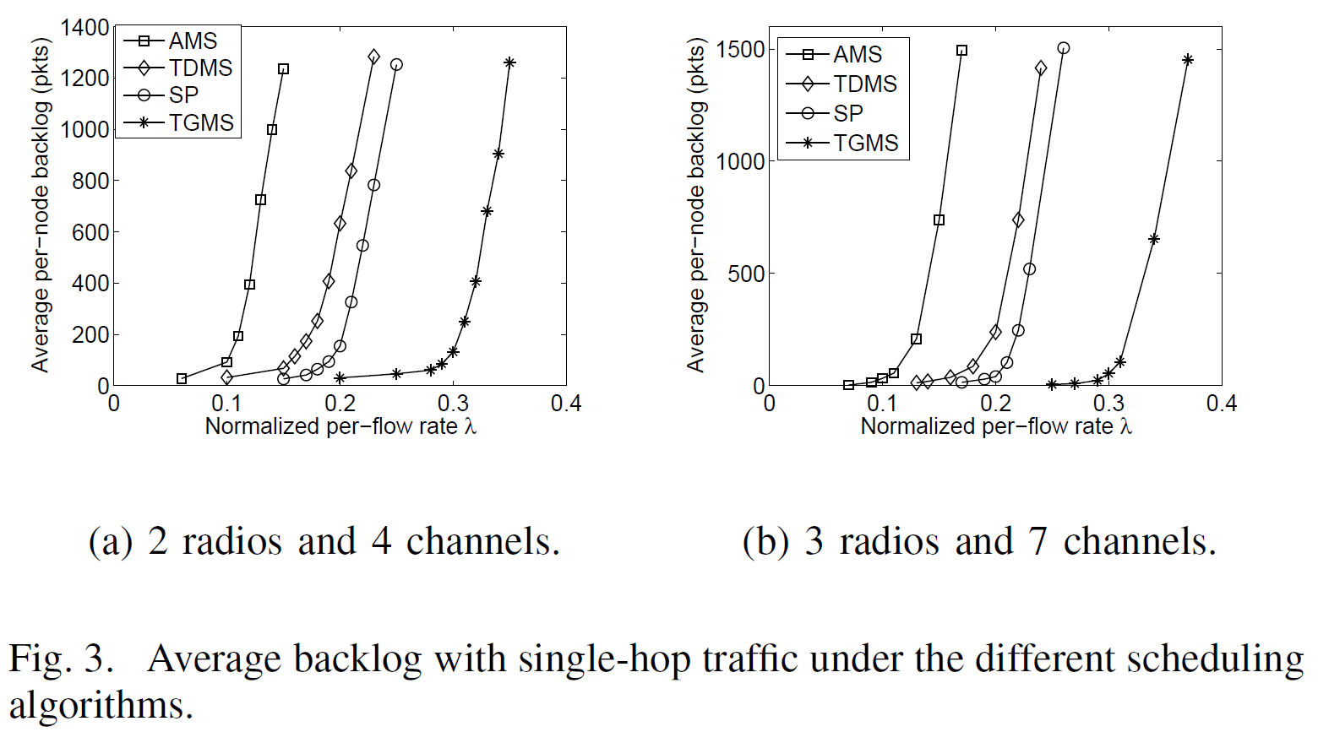
Future work – Evaluation
Comparison of Scheduling Algorithms
Our schemes in [5]
[5] Hongkun Li, Yu Cheng, Xiaohua Tian and Xinbing Wang, “A Generic Framework for Throughput-Optimal Control in MR-MC Wireless Networks,” in Proc. of IEEE INFOCOM March, Orlando, 2012.
Notes:
AMS：aggregated maximal scheduling
TDMS：tuple-based distributed maximal scheduling
SP：single path (SP) algorithm
TGMS：tuple-based greedy maximal scheduling；
TDMS比SP略差
SP long waiting time, small transmission time
Though the logical queue assignment procedure in SP algorithm may lead to longer waiting time based on the
output queue information, it could utilize those high capacity channels.
We may close the gap!

Slide 19
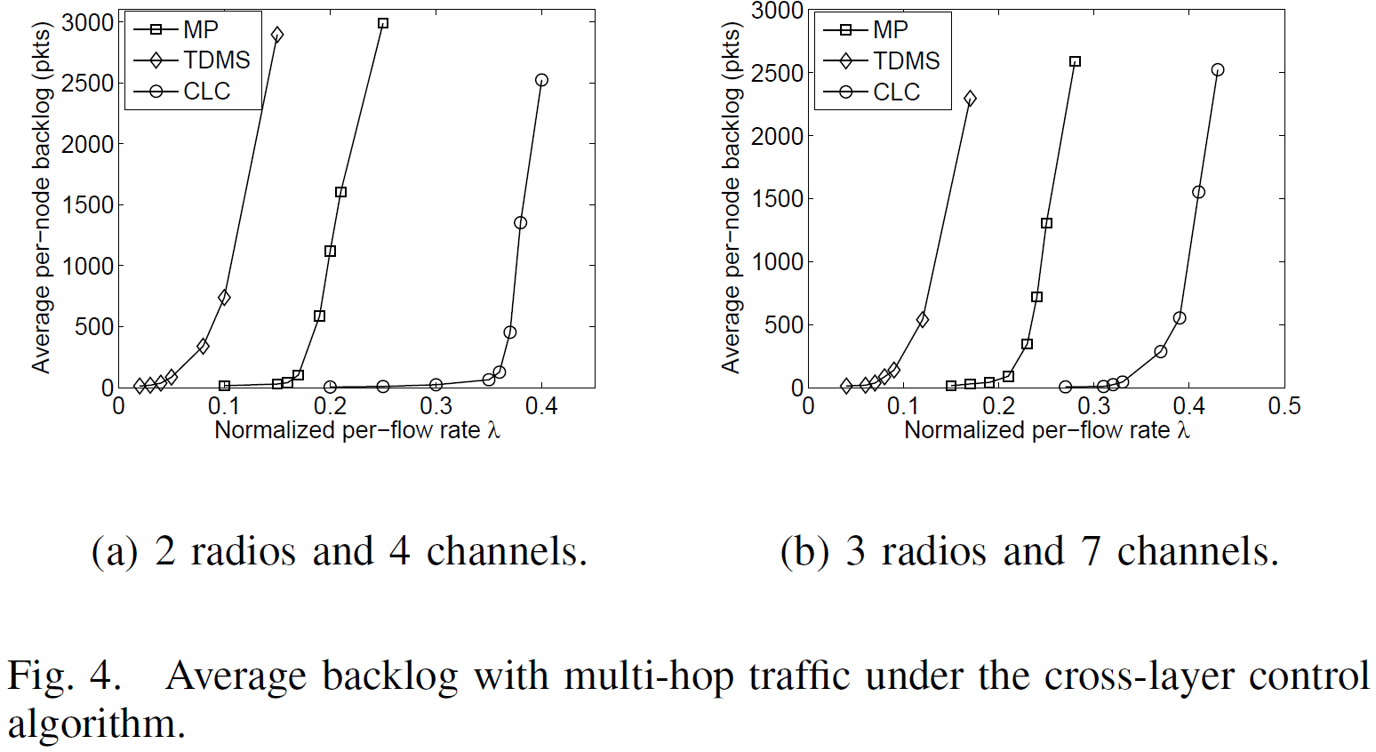
Future work – Evaluation
Delay Enhancement by Cross-layer Control
[5] Hongkun Li, Yu Cheng, Xiaohua Tian and Xinbing Wang, “A Generic Framework for Throughput-Optimal Control in MR-MC Wireless Networks,” in Proc. of IEEE INFOCOM March, Orlando, 2012.
Notes:
MP：multi-path algorithm
TDMS：tuple-based distributed maximal scheduling
CLC：cross-layer control (CLC) algorithm

Slide 20
Thank you !

