Slide 1
Location Transmission
My first android app
袁苏鑫 5090309502

Slide 2
Motivation
One function of google map:
Google Latitude
Share the location with
your family and
Friends.
But, there are disadvantage:
No Privacy!

Slide 3
Motivation
Another way to call the police:
SMS
But, police can not get
your accurate location.
Not Efficient.

Slide 4
The Idea
You can share your location with specific person, e.g. girlfriend, parents, not all your friends on the network.
Be more efficient, do not need to register and log in.
Let the receiver to know your specific location .
Easy to operate.

Slide 5
How to Achieve(1)
Google Map Service
used to achieve the specific location accurately.
GSM or 3G Network and WIFI
used to achieve the location quickly.
SMS
can send and receive the location data safely, easily.

Slide 6
How to Achieve(2)
Sender side
Receiver side
download the location
Determine the location
SMS
Send the data
Receive the data

Slide 7
UI of sender

Slide 8
receiver

Slide 9
Determine(1)
Use your phone’s google map
to determine the location

Slide 10
Determine(2)
PC’s google map

Slide 11
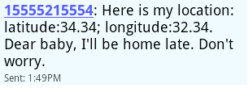
What I Think is Shining Point(1)
Attached text (SMS)
It’s for help
It’s to your parents
To tell different situations.

Slide 12
What I Think is Shining Point(2)
Use different resources to balance the power consumption, accuracy and speed.

Slide 13
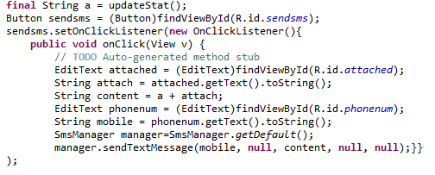
Problem I faced
The parameter passing is not stable.
Crash sometime.

Slide 14
How I Solve It

Slide 15
Need to Do Further
More efficient:
don’t need to type in the number every time, fill it from the contact list.
More functions:
the easiest way is embedded in the google map or baidu map.

Slide 16
Thank You!

