Slide 1
Near-Optimal Spectrum Allocation for Cognitive Radios:
A Frequency-Time Auction Perspective
Xinyu Wang
Department of Electronic Engineering Shanghai Jiao Tong University, China

Slide 2
Outline
Introduction
Spectrum Auction
Analysis
Simulation Results
Conclusion
2

Slide 3
Outline
Introduction
  Motivations
  Background
  Related Works
  Objectives
Spectrum Auction
Analysis
Simulation Results
Conclusion
3

Slide 4
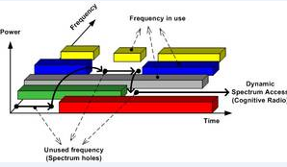
Motivations
Former studies [1] [2] show that from a time-spatial view, there are a large number of underutilized spectrum holes in the current wireless networks.
[1] T. Rappaport, Wireless communications. Prentice Hall, 2002.
[2] F. Force, “Report of the spectrum efficiency working group ,” Washington DC, noviembre de, 2002.

Slide 5
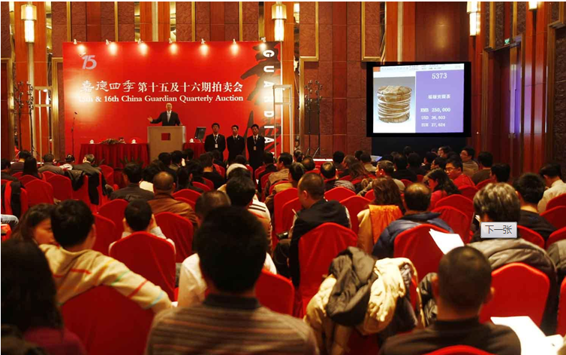
Background
Cognitive radio network (CRN) is a promising technology for the efficient utilization of spectrum resource. The core problem is how to allocate the limited spectrum to lots of users.
Auction theory is a strong tool to solve this prolem for its fairness, efficiency and valuation independence [3].
[3] V. Krishna, Auction theory. Academic press, 2009.

Slide 6
Background
There are many kinds of auctions:
  First-Price Auctions
  Second-Price Auctions
  English Auctions
  Dutch Auctions
  VCG Auctions
Here, we consider the auction that the bidders give their bids to the auctioneer, and the auctioneer determines the winners and then charge them.
But we cannot use this model directly to solve the spectrum allocation problem, considering the unique characteristics of spectrum allocation.

Slide 7
Background
So we have to invent a new mechanism based on the current economic auction tools.
An auction mechanism should achieve some of the following goals:
  Maximize the social welfare
  Maximize the generated revenue.
  Guarantee the truthfulness, in order to make it practical.
  Make the efficiency acceptable.

Slide 8
Related Works
Gandhi [4] maximized the generated revenue, but the mechanism is not truthful.
Kasbekar [5] proposed algorithms to maximize the social welfare while ignored the truthfulness.
J. Jia [6] came up with a truthful auction mechanism, but the spectrum utilization is not so high.
X. Li [7] considered the online auction and figured out the competitive ratio, while the mechanism is semi-truthful.
[4] S. Gandhi et al., “A General Framework for Clearing Auction of Wireless Spectrum,” in Proc. IEEE DySPAN, Dublin, Ireland 2007.
[5] Kasbekar, G.S. and Sarkar, S., “Spectrum Auction Framework for Access Allocation in Cognitive Radio Networks,” Networking, IEEE/ACM Transactions on, vol. 18, no. 6, pp. 1841 - 1854, 2010.
[6] J. Jia et al., “Revenue Generation for Truthful Spectrum Auction in Dynamic Spectrum Access,” in MobiHoc, 2009.
[7] P. Xu and X. Li, “TOFU: Semi-truthful Online Frequency Allocation Mechanism for Wireless Networks,” IEEE/ACM Transactions on Networking, vol. 19, no. 2, pp.433C446, Apirl 2011.

Slide 9
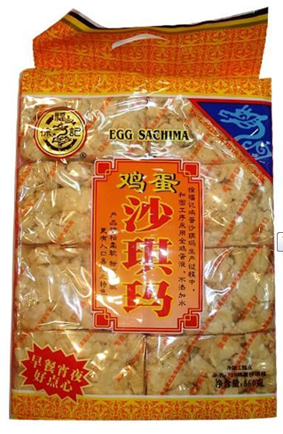
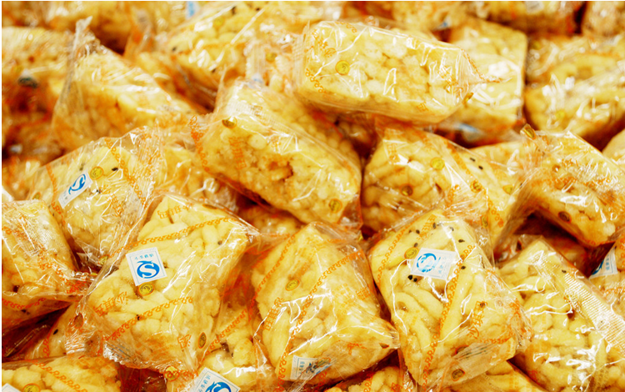
Related Works
DongMo [8] views the idle spectrum from a frequency-time perspective, and allocate the frequency-time slot to the users.
U
S
R
2
U
S
R
1
3
2
channel
Combinatorial Auction
Knapsack Problem
[4] DongMo. “Combinatorial Auction with Time-Frequency Flexibility in Cognitive Radio Networks.” INFOCOM 2012.

Slide 10
Objective
We focus on devising a truthful auction mechanism to maximize the network social welfare, as well as enhance the spectrum utilization ratio.
Modeling the spectrum opportunity from the frequency-time perspective, we consider the different SU’s requirements, and derive the lower bound of the social welfare.
To allocate the spectrum opportunity efficiently.

Slide 11
Outline
Introduction
Spectrum Auction Game
  System Model
  SWMP & TMDP
  Norm-based Greedy Scheme
Analysis
Simulation Results
Conclusion
11

Slide 12
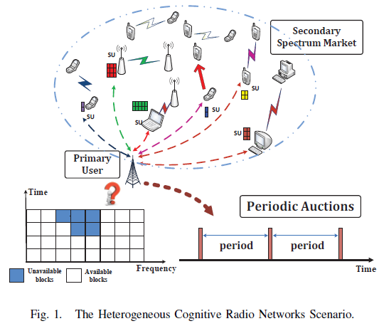
System Model
N SUs: U={1,2,……,N}, one PU.
PU divides it spectrum by frequency and time into F homogeneous channels and T time slots. Each unit is called a frequency-time block.
PU will occupy some
blocks, the remaining L
blocks will be sold to SUs.
L blocks:

Slide 13

System Model
SU’s requirement: denotes its requested number of blocks, and is the valuation of these blocks.
Auction game process:
PU broadcasts L available blocks
SUs submit their bids to PU
PU determines the winners, allocates the blocks, and charges the winners
Winners get the allocated blocks and transmit data to the co-located receivers

Slide 14


System Model
SU’s utility function:
the price that SU i is charged

Slide 15

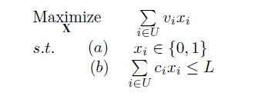

SWMP & TMDP
: allocation scheme
SWMP is similar to knapsack problem, and we can prove that SWMP is an NP-hard problem. To realize the fast spectrum allocation, we need to find an scheme to approximate the optimal social welfare.
Heterogeneity Increases Multicast Capacity in Clustered Network

Slide 16
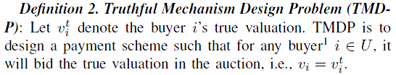
SWMP & TMDP
Only a truthful auction mechanism is useful in the real network.
Heterogeneity Increases Multicast Capacity in Clustered Network

Slide 17
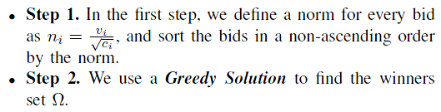
Norm-based Greedy Scheme
We propose an algorithm, named Norm-based Greedy Scheme, to approximate the optimal solution of SWMP. It consists of two steps:
Interestingly, this greedy algorithm can lead to a approximate ratio, and the simulation results show its perfect approximation to the optimal solution.

Slide 18
Outline
Introduction
Spectrum Auction Game
Analysis
  Computation Efficiency
  Approximation Ratio
  Truthfulness
Simulation Results
Conclusion
18

Slide 19
Computation Efficiency
Theorem 1. The Norm-based Greedy Algorithm is computationally efficient, i.e., it has polynomial computational complexity.
Proof: The computation complexity of Norm-based Greedy Algorithm is O(nlogn).

Slide 20
Approximation Ratio
Theorem 2. The approximation ratio of Norm-based Greedy
Algorithm for SWMP is .
Proof: Using Cauchy-Schwarz inequality and combinatorial mathematics, we can proof the approximation ratio to be .
Here, we omit the details.

Slide 21
Truthfulness
Theorem 3. NGS is truthful.
Proof: Because we use the greedy solution to select the winners, and the critical payment scheme to charge them, it is easy to guarantee the Monotonicity and Critical Value rule. In addition, we assume the buyers to be rational, so the Ex-post Budget Balance rule is satisfied.
Observing these, NGS is truthful.

Slide 22

Introduction
Spectrum Auction
Analysis
Simulation Results
Conclusion
22

Slide 23
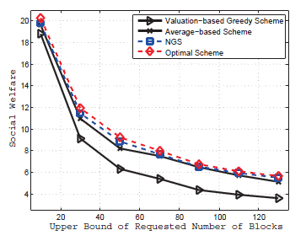
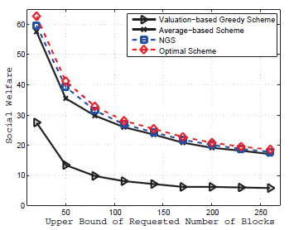
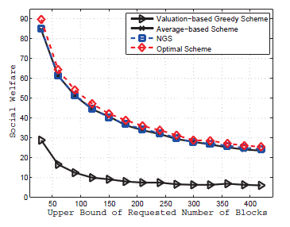
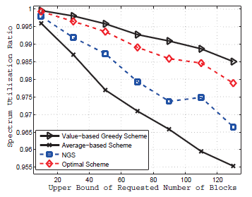
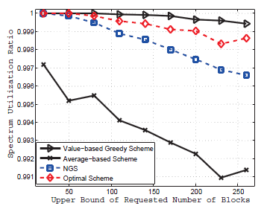
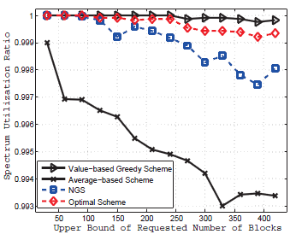
Simulation Results
N=50, L=144
N=500, L=288
N=1000, L=432

Slide 24
Introduction
Spectrum Auction
Analysis
Simulation Results
Conclusion
24

Slide 25
Conclusion
We investigate DSA in a frequency-time perspective, which will satisfy the SUs’ flexible requirements.
We design a truthful auction mechanism to approximate the maximum social welfare. And we prove the approximation ratio.
Numerical results show that our scheme approximates the optimal social welfare perfectly and enhances the spectrum utilization ratio dramatically.

Slide 26
Thank you for listening

Slide 27
Conclusion
Q&A???

