Slide 1
Group Multicast Capacity in Large Scale Wireless Networks
Xican Yang
Shanghai Jiao Tong University, China

Slide 2
Outline
Introduction
Backgrounds
Motivations
Network Model
Capacity of Regular Distribution Group Multicast
Capacity of Random Distribution Group Multicast
Conclusion
2

Slide 3
Background
Capacity of large scale wireless networks
Scaling laws (Gupta & Kumar [1])
2-hop relaying (Grossglauser & Tse [2])
Multicast (X. -Y. Li[9])
[1] P. Gupta, P. R. Kumar, “The Capacity of Wireless Network,” IEEE Trans. on Inf. Theory, vol. 46, no. 2, pp. 388-404, Mar. 2000.
[2] M. Grossglauser and D. N. C. Tse, “Mobility increases the capacity of ad-hoc wireless networks,” in Proc. IEEE/ACM Transactions on Networking, vol. 10, pp. 477-486, August 2002..
[9] X. -Y. Li, “Multicast Capacity of Wireless Ad Hoc Networks,” in IEEE/ACM Trans. on Networking, vol.17, no.3, pp.950-961, June 2009.
3
Notes:
Since the seminal work by Kumar [1] et al., who showed that the optimal unicast per-node capacity is O(1/n), the fundamental
capacity research about wireless ad hoc networks has drawn tremendous interest. Later on, Grossglauser and Tse [2] proposed a
2-hop relaying algorithm in which nodes are allowed to move, and they demonstrated that Θ(1) capacity per source-destination is
achievable but packets have to endure a larger delay of Ω(n). Multicast capacity for large-scale wireless ad hoc network was first analyzed in [9].

Slide 4
Motivation
While unicast and multicast traffic pattern have been extensively studied in previous work, group multicast is still a relatively new concept and under active research
Destinations are originazed in a multicast group.
Data is delivered from a source to a multicast group.
Such as School message, Stadium TV.
4
Notes:
While unicast and multicast traffic pattern have been extensively studied in previous work, group multicast is still a relatively
new concept and under active research. Group multicast refers to a traffic pattern in which data is delivered from a source to
multiple destinations originazed in a multicast group, which differs from multicast in that its destinations are located in a more
centralized area. Recently, there appeared many new applications such as Introstate Television (TV), Stadium TV that impose
stringent broadband services on group multicast. In this paper, we give a general analysis on group multicast capacity of wireless ad hoc networks

Slide 5
Outline
Introduction
Backgrounds
Motivations
Network Model
Capacity of Regular Distribution Group Multicast
Capacity of Random Distribution Group Multicast
Conclusion
5

Slide 6
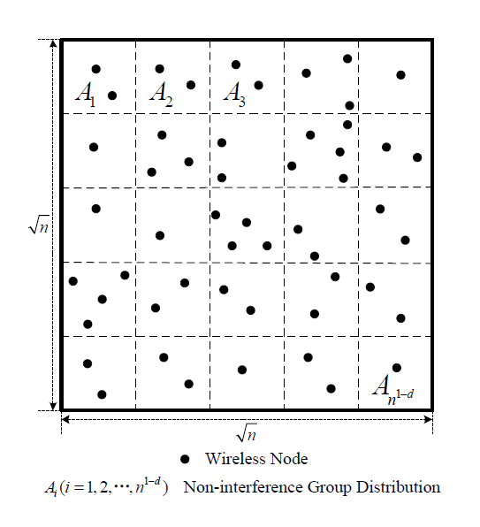
Network Models
Network Architecture
6
Notes:
We employ the extended network model.We assume that there is a set of n normal wireless nodes uniformly
deployed in a square region with side length. among which ns nodes are selected as sources and nd destined nodes are
chosen for each. Thus, ns multicast sessions are formed. Furthermore, we assume that there are a set of n1−d multicast groups. We study two kinds of common transmission scenarios, i.e., regular distribution scenario and random distribution scenario. The first type represents that n1−d groups are regularly distributed in the network and each group covers the whole cell without intersections. While in the latter pattern these groups are randomly distributed in the network, there will inevitably be interferences due to the intersections between groups.

Slide 7
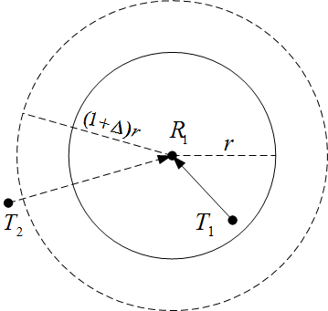
Network Models
Interference Model
Protocol Model:
is the guard range.
The distance between T₁ and R₁ is no more than r, |T₁ – R₁| ≤ r
For every other node T_{k} simultaneously transmitting,
|T_{k} – R₁| ≥ (1+∆)r
7
Notes:
We employ the traditional protocol model as the interference model All nodes employ a common range r for all their
transmissions. When node Vi transmits to a node Vj , this transmission is successfully received by Vj if

Slide 8
Outline
Introduction
Backgrounds
Motivations
Network Model
Capacity of Regular Distribution Group Multicast
Capacity of Random Distribution Group Multicast
Conclusion
8

Slide 9
Regular Distribution
Any group A_{i} will be chosen by a certain source node as a destination with the probability
Let N_{i} be the number of times when the group A_{i} is chosen as a destination.
The expected value of N_{i} is
9
Notes:
hus we will employ different approaches to investigate the network
capacity, according to the various circumstances of s + d.

Slide 10
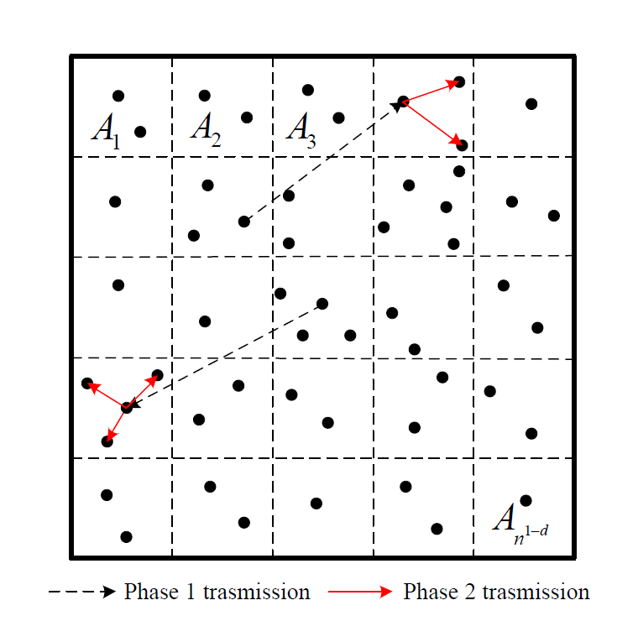
Regular Distribution: s+d<1
Upper Bound
Capacity of Phase One Transmission:
Capacity of Phase Two Transmission:
Upper bound:
10
Notes:
We can randomly choose only one node inside a group as the destination node, thus the destination nodes are less than
or included in the original group nodes. We define the procedure that source nodes transmit packets to destination nodes as
phase one transmission. When the number of destination nodes increases, just like original situation, network performance will be inevitably worse compared to phase one.We define the process that packets are transmitted from the destination node to the whole group as phase two transmission, and We cam easily know that the network capacity
is upper-bounded both by the per-flow unicast capacity and the per-flow broadcast capacity. Thus, combining the two phases,
we can get the upper bound of wireless network capacity

Slide 11
Regular Distribution: s+d<1
To achieve the upper bound, we design a schedule that satisfies the following two propositions.
In phase one, packets are transmitted from each source node to any node V_{i,d} in the destination group A_{i}, adopting percolation theory in routing by Franceschetti et al. [12].
In phase two, V_{i,d} transmits the packets to all other nodes in the group A_{i}, using flooding algorithm.
Lower Bound
11

Slide 12
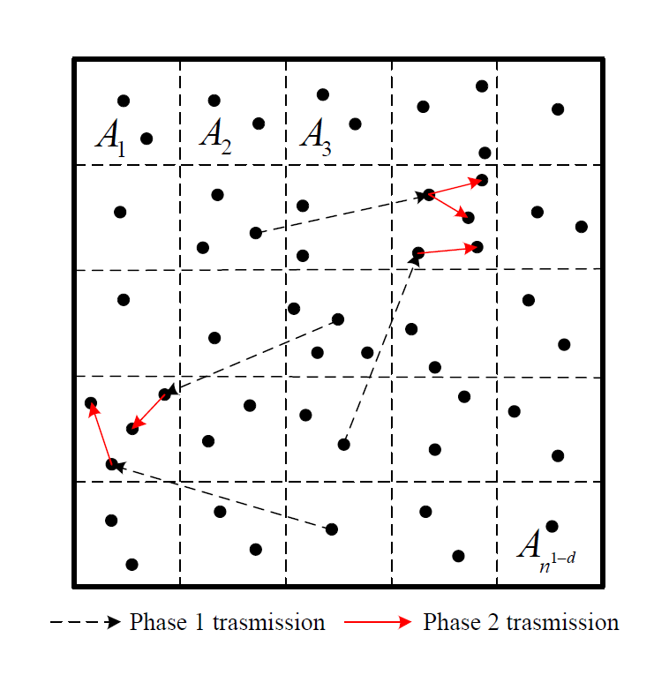
Regular Distribution: s+d>1
Upper Bound
Capacity of Phase One Transmission:
Capacity of Phase Two Transmission:
Upper bound:
12
Notes:
Since the expected value of Ni goes to infinity when the number of nodes increases, the methods above is not applicable anymore
we choose ns+d−1 nodes in each group as representatives. Firstly
packets are transmitted from each source node to any representative node in a randomly selected group, and then representative
nodes employ a celluar TDMA transmission scheme, broadcasting the packets to all other nodes in
the group.

Slide 13
Regular Distribution: s+d>1
We choose n^{s+d-1} nodes in each group as representatives.
Firstly packets are transmitted from each source node to any representative node in a randomly selected group, adopting percolation theory in routing by Franceschetti et al. [12].
Representative nodes employ the flooding scheme, broadcasting the packets to all other nodes in the group.
Lower Bound
13

Slide 14
Regular Distribution: s+d=1
Since E[N_{i}] = n^{s+d−1} = 1, clearly N_{i} follows the Poisson distribution with parameters λ = 1 as the number of nodes goes to infinity.
The number of times when any group is appointed as a destination is at most log n^{s}.
Similarly, we have
14

Slide 15
Outline
Introduction
Backgrounds
Motivations
Network Model
Capacity of Regular Distribution Group Multicast
Capacity of Random Distribution Group Multicast
Conclusion
15

Slide 16
Random Distribution
When groups are randomly distributed in the network, there will inevitably be interferences between the groups, making it difficult to schedule the model.
Any node V_{i} will be chosen by a certain source node as its destination node with the probability
Let N_{i} be the number of times when the node V_{i} is chosen as a destination node.
The expected value of N_{i} is
16
Notes:
Unlike previous analysis, we mainly discuss the random scenario capacity from the perspective of
destination nodes.
Similarly according to the various circumstances of s+d, we will employ
different approaches to investigate the network capacity.

Slide 17
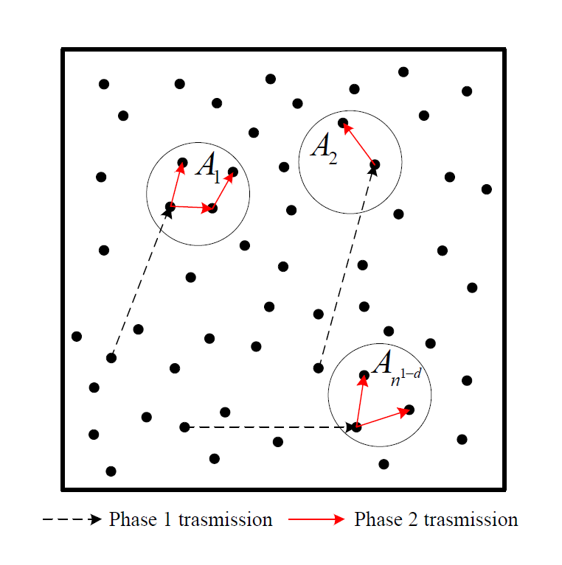
Random Distribution: s+d<1
Upper Bound
Capacity of Phase One Transmission:
Capacity of Phase Two Transmission:
Upper bound:
17
Notes:
The number of times when any node is appointed as a destination node under random distribution scenario is also at
most constant

Slide 18
Random Distribution: s+d<1
To achieve the upper bound, we design a schedule that satisfies the following two propositions.
In phase one, packets are transmitted from each source node to any node V_{i,d} in the destination group A_{i}, adopting percolation theory in routing by Franceschetti et al. [12].
In phase two, V_{i,d} transmits the packets to all other nodes in the group A_{i}, using flooding algorithm.
The lower bound is then obtained by performing pairwise coding and decoding, and using a TDMA scheme. All nodes will be able to transmit at least once in every time.
Lower Bound
18

Slide 19
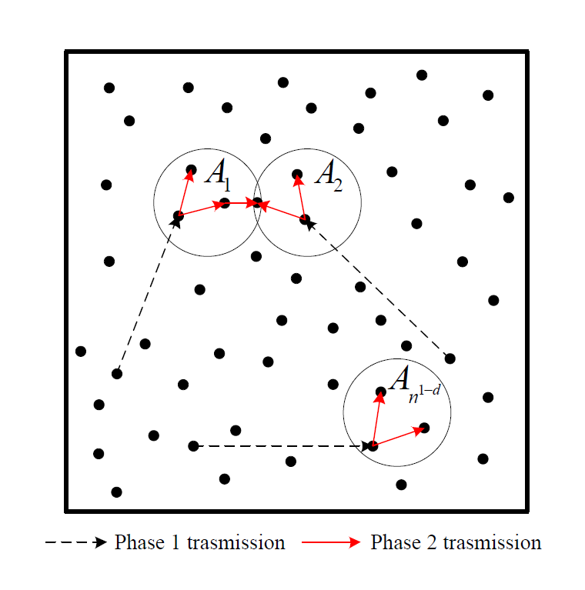
Random Distribution: s+d>1
Upper Bound
Capacity of Phase One Transmission:
Capacity of Phase Two Transmission:
Upper bound:
19
Notes:
The number of times when any node is appointed as a destination node under random distribution scenario is at most
2ns+d−1 when s + d > 1.

Slide 20
Random Distribution: s+d>1
We choose n^{s+d-1} nodes in each group as representatives.
Firstly packets are transmitted from each source node to any representative node in a randomly selected group, adopting percolation theory in routing by Franceschetti et al. [12].
Representative nodes employ the flooding scheme, broadcasting the packets to all other nodes in the group.
The lower bound is then obtained by performing pairwise coding and decoding, and using a TDMA scheme. All nodes will be able to transmit at least once in every time.
Lower Bound
20

Slide 21
Random Distribution: s+d=1
Since E[N_{i}] = n^{s+d−1} = 1, clearly N_{i} follows the Poisson distribution with parameters λ = 1 as the number of nodes goes to infinity.
The number of times when any group is appointed as a destination is at most log n^{s}.
Similarly, we have
21
Notes:
This is identical to the situation when s + d = 1 under regular distribution scenario, and we need to establish the maximum flow of
the network.

Slide 22
Conclusion
Under both the regular and random distribution scenario with group multicast
The capacity is when s+d ≤ 1.
The capacity is when s+d > 1.
To our best knowledge, this is the first work that characterizes the impact of group multicast on network capacity from a theoretical perspective.
22
Notes:
In this project, we have studied the theoretical group multicast capacity of wireless ad hoc network. In particular, we have investigated
wireless networks using both regular distribution and random distribution models. Our results can well unify the previous multicast
results in wireless ad hoc networks. What’s more, our study is the first attempt to understand how group multicast may impact on
network capacity from a theoretical perspective

Slide 23
Thank you !

