Slide 1
Downlink Resource Allocation for Video Streaming over Femtocell Networks
Yong Yang
Electronic Engineering
Shanghai Jiaotong University
May 20,2012

Slide 2
Agenda
Background
System Model
Problem Definition
Optimization Algorithm
Simulation Results
Conclusions

Slide 3
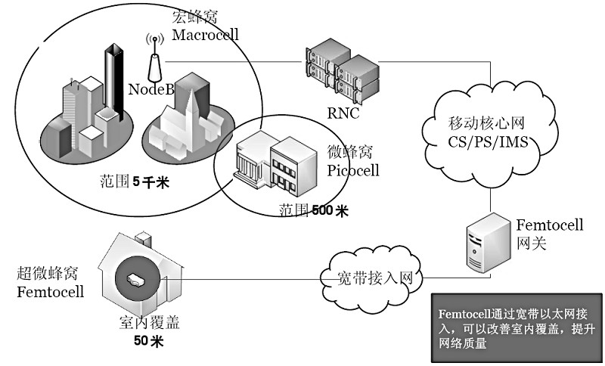
Femtocell Networks

Slide 4
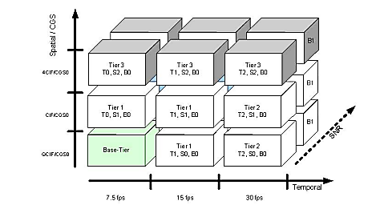
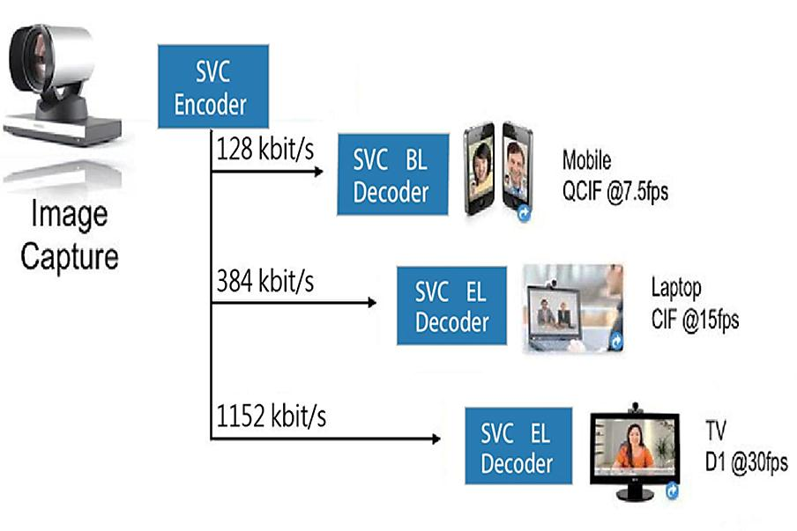
SVC video

Slide 5
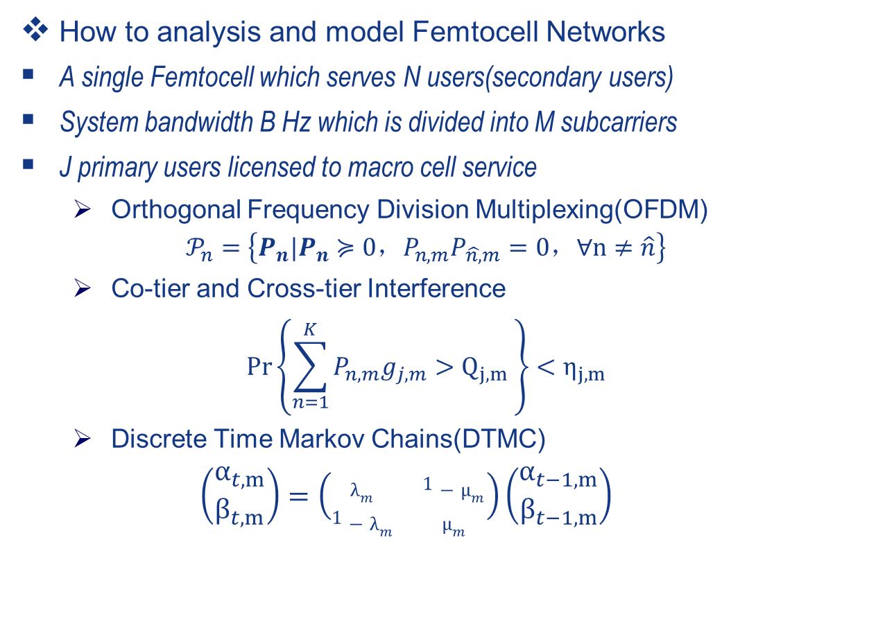
System Model-1
How to analysis and model Femtocell Networks
A single Femtocell which serves N users(secondary users)
System bandwidth B Hz which is divided into M subcarriers
J primary users licensed to macro cell service
  Orthogonal Frequency Division Multiplexing(OFDM)
  $$𝒫_{n}=\left\{P_{n}|P_{n}≽0，P_{n,m}P_{\hat{n,}m}=0，∀n≠\hat{n}\right\}$$
  Co-tier and Cross-tier Interference
  $$\operatorname{Pr}\left\{\sum_{n=1}^{K}{P_{n,m}g_{j,m}}>Q_{j,m} \right\}<η_{j,m}$$
  Discrete Time Markov Chains(DTMC)
$$\left(\begin{matrix}α_{t,m} \\ β_{t,m}\end{matrix}\right)=\left(\begin{matrix}λ_{m} & 1−μ_{m} \\ 1−λ_{m} & μ_{m}\end{matrix}\right)\left(\begin{matrix}α_{t−1,m} \\ β_{t−1,m}\end{matrix}\right)$$

Slide 6
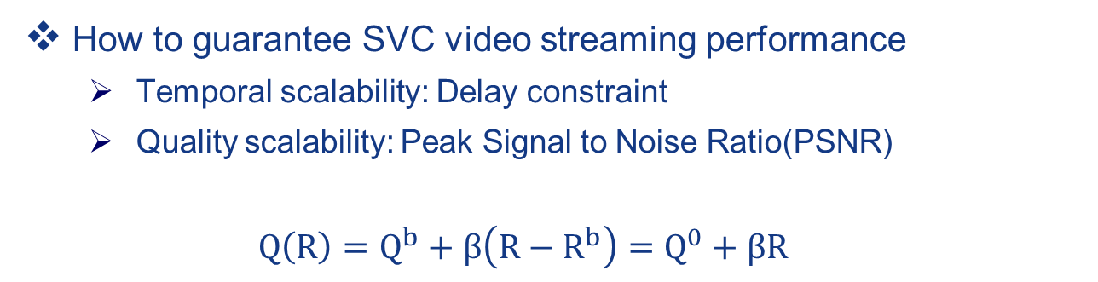
System Model-2
How to guarantee SVC video streaming performance
  Temporal scalability: Delay constraint
  Quality scalability: Peak Signal to Noise Ratio(PSNR)
  $$Q\left(R\right)=Q_{}^{b}+β\left(R−R_{}^{b}\right)=Q^{0}+βR$$

Slide 7
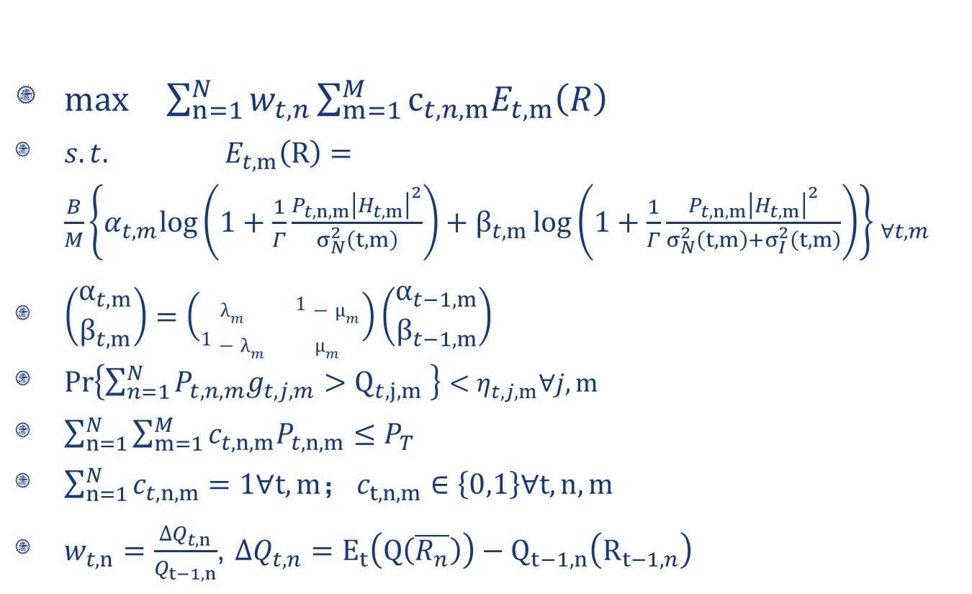

Problem Definition-1
$max \sum_{n=1}^{N}{w_{t,n}\sum_{m=1}^{M}{c_{t,n,m}E_{t,m}\left(R\right)}}$
$s.t. E_{t,m}（R）={\frac{B}{M}\left\{α_{t,m}log\left(1+\frac{1}{Γ}\frac{P_{t,n,m}{\left|H_{t,m}\right|}^{2}}{σ_{N}^{2}（t,m）}\right)+β_{t,m}\log\left(1+\frac{1}{Γ}\frac{P_{t,n,m}{\left|H_{t,m}\right|}^{2}}{σ_{N}^{2}（t,m）+σ_{I}^{2}（t,m）}\right)\right\} }_{∀t,m}$
$\left(\begin{matrix}α_{t,m} \\ β_{t,m}\end{matrix}\right)=\left(\begin{matrix}λ_{m} & 1−μ_{m} \\ 1−λ_{m} & μ_{m}\end{matrix}\right)\left(\begin{matrix}α_{t−1,m} \\ β_{t−1,m}\end{matrix}\right)$
$\operatorname{Pr}\left\{\sum_{n=1}^{N}{P_{t,n,m}g_{t,j,m}}>Q_{t,j,m} \right\}<η_{t,j,m}∀j,m$
$\sum_{n=1}^{N}{\sum_{m=1}^{M}{{c_{t,n,m}P}_{t,n,m}≤P_{T}}}$
${\sum_{n=1}^{N}{c_{t,n,m}=1∀t,m；}c}_{t,n,m}∈\left\{0,1\right\}∀t,n,m$
  $w_{t,n}=\frac{∆Q_{t,n}}{Q_{t−1,n}}$, $ΔQ_{t,n}=E_{t}\left(Q\left(\overline{R_{n}}\right)\right)−Q_{t−1,n}\left(R_{t−1,n}\right)$
Markovian interference model
System transition
Interference to primary users
Weight based on temporal and quality

Slide 8
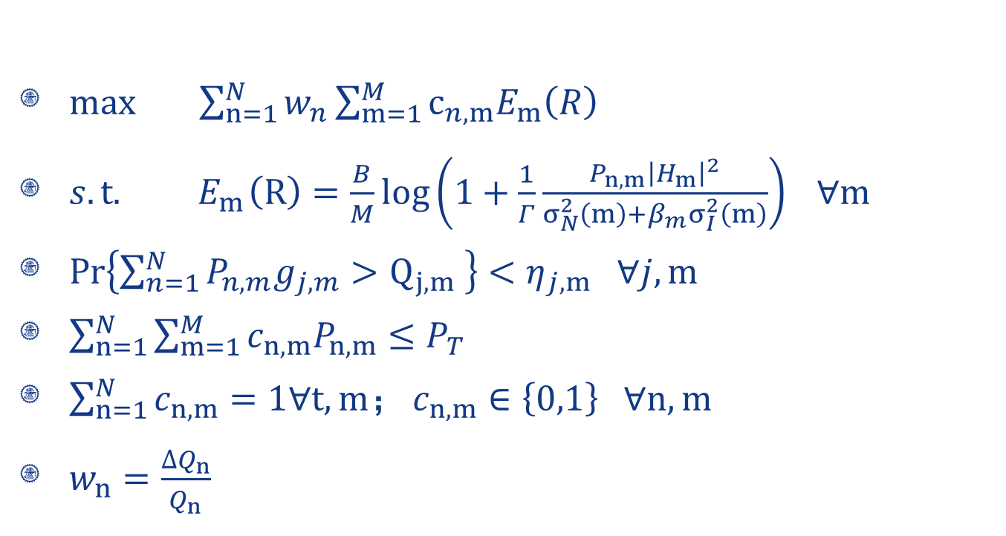
Problem Definition-2
$max \sum_{n=1}^{N}{w_{n}\sum_{m=1}^{M}{c_{n,m}E_{m}\left(R\right)}}$
$s.t.{ E}_{m}（R）=\frac{B}{M}log\left(1+\frac{1}{Γ}\frac{P_{n,m}{\left|H_{m}\right|}^{2}}{σ_{N}^{2}（m）+β_{m}σ_{I}^{2}（m）}\right) ∀m$
$\operatorname{Pr}\left\{\sum_{n=1}^{N}{P_{n,m}g_{j,m}}>Q_{j,m} \right\}<η_{j,m} ∀j,m$
$\sum_{n=1}^{N}{\sum_{m=1}^{M}{{c_{n,m}P}_{n,m}≤P_{T}}}$
${\sum_{n=1}^{N}{c_{n,m}=1∀t,m；}c}_{n,m}∈\left\{0,1\right\} ∀n,m$
$w_{n}=\frac{∆Q_{n}}{Q_{n}}$
Jensen's inequality

Slide 9
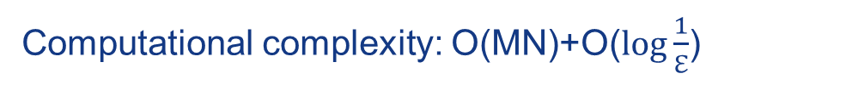
Optimization algorithm
Dual Decomposition
Inner loop
  Construct the Lagrange dual function
  Solve numerically based on fixed Lagrange factor
  Search one-dimensionally for best pairs
Outer loop
  Update the Lagrange factor using the subgradient method
Computational complexity: О(MN)+О($\log{\frac{1}{ℇ}}$)

Slide 10
Simulation Setup-1
Parameter | Value
Wireless Channel Model | Nakagami Fading
Average SNR | 20 dB
Required BER | 1e-3
System Bandwidth | 4 MHz
Number of Subchannel | 128
Total Power | 20 dBm
Time Slots | 2 Msec
Primary/Secondary Users | 6/4
GOP Size | 8

Slide 11
Simulation Setup-2
Four different video sequence is used in the simulation:
We define the weight with three different method:
  Pure-blind(W1)
  Deadline-blind(W2)
  Deadline-aware(W3)
Sequence | Bitrate(kbps) | Deadline(ms)
1 | 500 | 250
2 | 1000 | 250
3 | 1500 | 250
4 | 2000 | 250

Slide 12
Simulation Results-1
  The above figure show the urgent user in our suggested algorithm has been allocated more resource due to the higher rate and deadline requirement.

Slide 13
Simulation Results-2
  From the figure, we see that our proposed algorithm has actually decreased the system performance, however the deterioration is slight since users can reach the deadline as well as possible.

Slide 14

Simulation Results-3
  Raj Jain's equation rates the fairness of a set of values where there are n users and xi is the throughput for the i-th connection. Then , we can find that our algorithm has the best fairness property.
Video Quality Fairness
W1 | W2 | W3
0.6352 | 0.7030 | 0.7399

Slide 15
Conclusion and Future Work
  A joint design approach
OFDM channels with cross-tier interference
Requirements of video quality and deadline
  Effective performance
  Higher average video quality at the cost of tolerable loss
  Better fairness property
  Future work
  Multi-Femtocell
  Femtocell Cache
  Diverse multimedia traffic

Slide 16
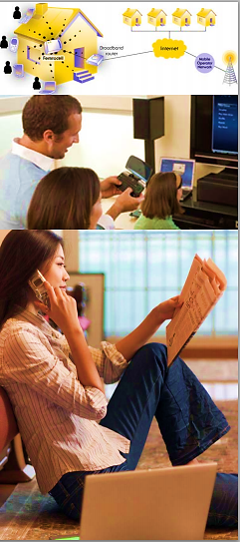
Many thanks to
Prof. Xinbing Wang and Xiaohua Tian
Thank you very much for your comments!
Yang Yong
Email: sheldonyoung@126.com
Department of Electronic Engineering

