Slide 1
An Enhancement of WirelessHART Protocol
李颢

Slide 2
Outline
Background
WirelessHART
Channel Hop Strategy
Cooperative Relay Strategy
Future Work

Slide 3
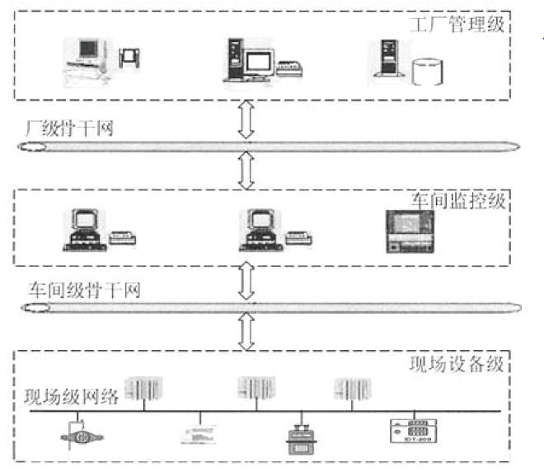
Industrial Wireless Communication
Environment: complicated, full of interferences
Advantages: less cost, flexibility, easy to set, safety

Slide 4
Target and Methods
Target: To enhance an industrial wireless communication protocol ━━ WirelessHART
Major concerns: Improve the anti-interference ability of industrial wireless network
Methods: Channel Hop & Cooperative Relay

Slide 5
WirelessHART
The protocol utilizes a time synchronized, self-organizing, and self-healing mesh architecture. The protocol supports operation in the 2.4 GHz ISM band using IEEE 802.15.4 standard radios. And TDMA is used to enhance the efficiency. Most widely applied in industry environment.
Weakness: blind channel hop ( with a white list ), none-cooperative relays

Slide 6
Frequency Hopping
Frequency Hopping Spread Spectrum:
1. Spread-spectrum signals are highly resistant to narrowband interference.
2. Spread-spectrum signals are difficult to intercept.
3. Spread-spectrum transmissions can share a frequency band with many types of conventional transmissions with minimal interference.

Slide 7
Cooperative Communication & MIMO
MIMO: In radio, Multiple-Input and Multiple-Output, or MIMO, is the use of multiple antennas at both the transmitter and receiver to improve communication performance. It is one of several forms of smart antenna technology.
Cooperative Comm. : Use the singular antenna of multiple different users to realize MIMO.

Slide 8
Frequency Hopping Strategy
The number of nodes and channels are N and C. And the slots number should be within S.
……
…
…
…
…
…
…
……

Slide 9
Frequency Hopping Strategy
Set the reliability matrix of a data link between source and destination with several sublinks in it.
stands for the reliability of sublink j using channel i.
We can get the data from historical success rate of transmission.
…
…

Slide 10
Frequency Hopping Strategy
Reliability of Sub. P_{i}: Reliability of the Link： is the set of the chosen channel(s) for subchannel j.
In this method, we get the distribution of slots as well as

Slide 11
Frequency Hopping Strategy
……
得到
P1,D1
Initiialize：
2nd：add to make P1
increases the most
得到
P2,D1
……
……
……
Repeat until the slots are used up.
得到
P,D

Slide 12
Frequency Hopping Strategy
Sub | 1 | 2 | 3 | 4 | 5 | 6 | 7 | 8 | 9
Reliab. | 0.8644 | 0.9420 | 0.9164 | 0.9860 | 0.7706 | 0.8307 | 0.9532 | 0.7099 | 0.9745
Slot | 1 | 1 | 1 | 1 | 1 | 1 | 1 | 2 | 1
Sub | 1 | 2 | 3 | 4 | 5 | 6 | 7 | 8 | 9
Reliab. | 0.8644 | 0.9420 | 0.9164 | 0.9860 | 0.7706 | 0.8307 | 0.9532 | 0.9078 | 0.9745
Slot | 1 | 1 | 1 | 1 | 2 | 1 | 1 | 2 | 1
Sub | 1 | 2 | 3 | 4 | 5 | 6 | 7 | 8 | 9
Reliab. | 0.8644 | 0.9420 | 0.9164 | 0.9860 | 0.9458 | 0.8307 | 0.9532 | 0.9078 | 0.9745
Slot | 1 | 1 | 1 | 1 | 2 | 2 | 1 | 2 | 1

Slide 13
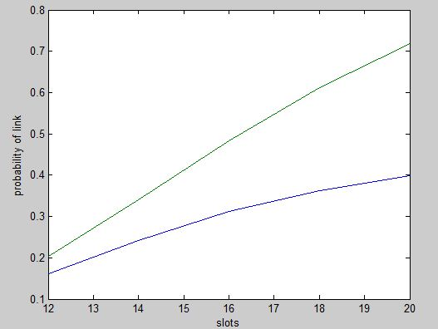
Frequency Hopping Strategy

Slide 14
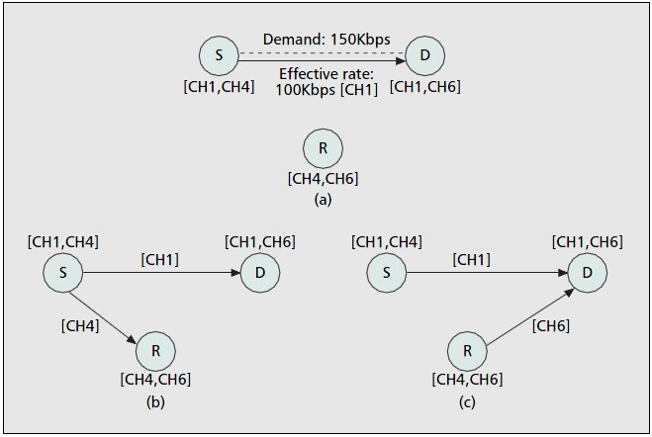
Cooperative Relay Strategy
One of the advantages: To enhance data rate
Not what we want

Slide 15
Cooperative Relay Strategy
Decrease the error rate：
R
1
2
S
D
1
When S is transmitting to D, R monitors.
In the case that S failed, R would transmit again.

Slide 16
Cooperative Relay Strategy
Improvement:
R
2
1
S
1
D
2
S will transmit to D for the second time as R transmit to D.
However, here comes a problem that D will probably receive two overlapping
messages.

Slide 17
Cooperative Relay Strategy
Differential demodulation:
C1 = A1
C2 = A2 + B1
C3 = A3 + B2
C4 = A4 + B3
C5 = B4;
Iterative subtraction
Detect the beginning by sensing the energy excess

Slide 18
Future Work
Simulation based on hardware(USRP2)
Deeper insight of WirelessHART

