Slide 1
Iclass android class assistent
Dai Ji & Zhiyi Zhou
Notes:
apple

Slide 4
What is iClass?

Slide 5
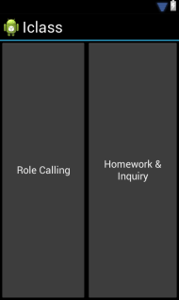
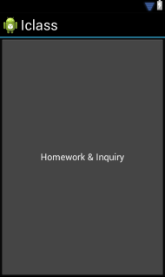
Server
Client

Slide 6
Why iClass?
Easy to be built
Free!

Slide 7
Prerequisite
Only Classroom wifi!

Slide 8
Role Calling

Slide 9
Procedure
Connect to class WIFI
Log into server with server’s IP
Provide client message
Server check its database(vector)
Light the icon for the student

Slide 11
Assignment
Upload
homework

Slide 12
Upload
Each student hands in homework(quiz) after logged in

Slide 13
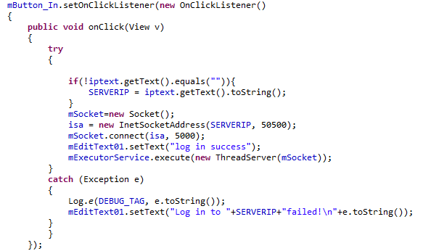
Upload
1.Log in through socket.

Slide 14
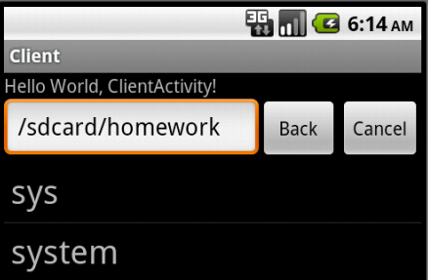
Upload
2.Hand in homework.

Slide 15
Assignment
Professor transmits the homework to each student.

Slide 16
Use screenshot to send current screen to professor
Chat with professor for inquiry
Inquiry

Slide 17
Inquiry
Use screenshot to send current screen to server
1. obtain the screen shot of the specific activity

Slide 18
Inquiry
2. claim view as the screen shot
3. obtain the width and height of the screen shot

Slide 19
Inquiry
4.Teacher get the screen shot of the student.

Slide 20
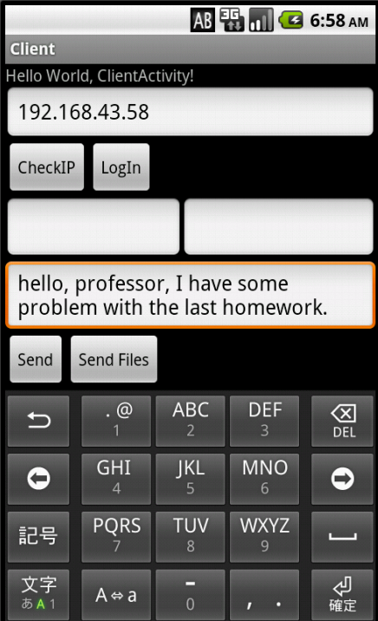
Inquiry
Chat with professor for inquiry

Slide 21
Future work
Group send
Large file
Expand to various OS device

Slide 22
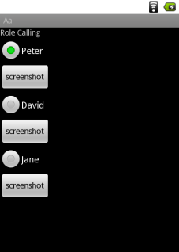
Demo

Slide 23
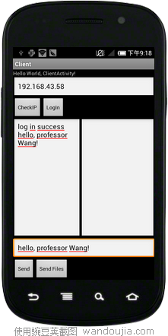
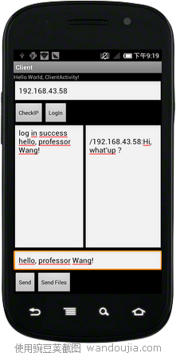
Demo

Slide 24
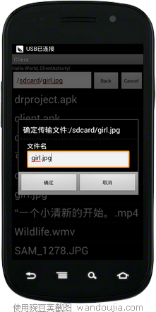
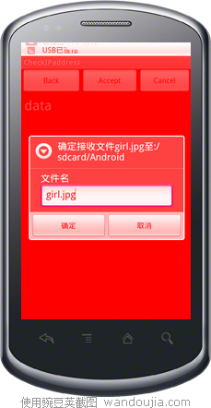
Demo

Slide 25
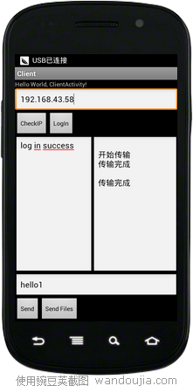
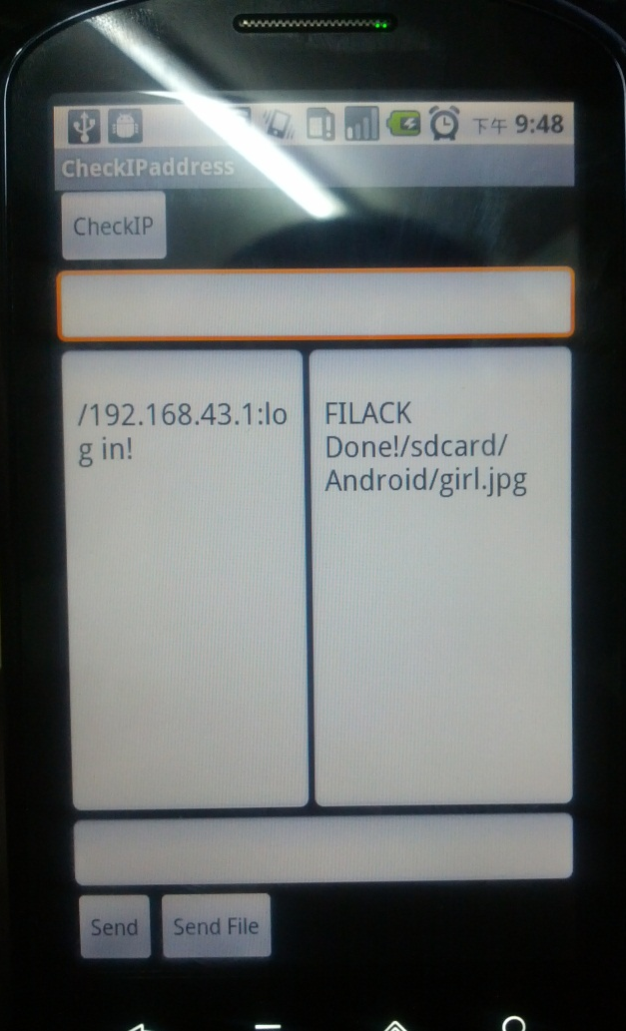
Demo

