Slide 1
One Problem of Reliability In Collaborative Communication System
----------the recovery of aliased signals

Slide 2
Outline
Researching background
Problem introduction:
A solution to the problem
Simulation results

Slide 3
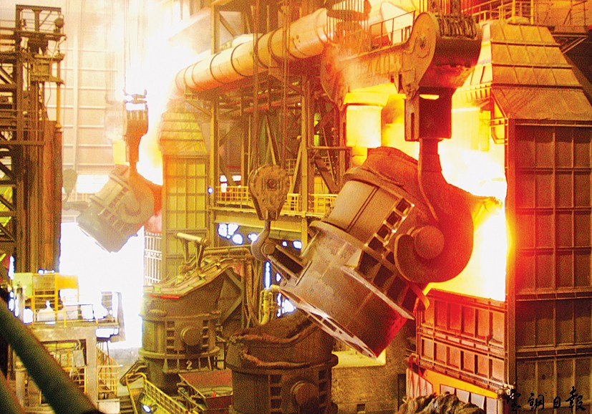
Harsh for wireless communication
Reflecting, scattering, refraction and shadowing introduced by metal.
Moving obstacles
Scorching temperature , high-energy consumption
Demanding for high reliability.

Slide 4
Outline
Researching background
Problem introduction
A solution to the problem
Simulation results

Slide 5
collaboration
The communication reliability is very low for two nodes far away from each other or with obstacles between them.
Then we can introduce some nodes working as relays to deliver the messages from the source to the destination.
Then one-hop communication between two nodes becomes two-hopping along the link.

Slide 6
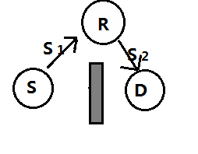
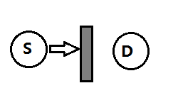
Circumvention introduced by the relay
Blocked by obstacles
S to R and then R to D

Slide 7
Flaw of this model
However, remember that the environment is not stable, so the obstacles, the interference are not fixed.
Then the obstacle can occur between the source and the relay or between the relay and the destination.
Thus the simple introduction of one relay can not enhance but reduce the reliability :
  the possibility of blocking is larger from one hop to two hops.

Slide 8
Multiple paths
R1
spatial and path diversity
To add more relays enable the messages being delivered from the source to the node in different ways and the possibility that all ways are blocked is low
Superposition will enhance the signal.
S2
S1
D
S
S1
R2
S2

Slide 9
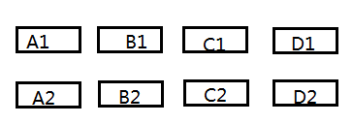
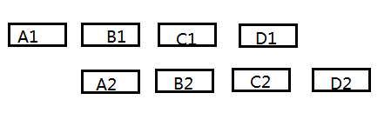
A new problem
However, more relays will introduce another problem, signals from different relays will interfere with each other.
In ideal situation, we want them to enhance the SNR by superposition, where Synchronization must be ensured.

Slide 10
BER vs delay

Slide 11
Outline
Researching background
Problem introduction
A solution to the problem
Simulation results

Slide 12
Channel Model
S = c*M + n
S : received signal
c : channel coefficient
M : modulated signal from the digit signal
n : white noise

Slide 13
Iteration method for offset-overlapping messages
The messages contain purified part: A1.
We know that the information contained in A2 is the same as A1, then we can get B1 by subtracting A2 from the second segment information. In the same way, all information can be recovered.
S1 = c1 * M + n1
S2 = c2 * M + n2
ci :the channel coefficient
M: modulated signals
ni : white noise

Slide 14
Channel coefficients
The signal is always disturbed by the environment.
S = c*m + n
  Where S is the received signal
  m is the transmitted signal from the source and n is noise.
Time delay
You should know exactly the position where the latter signal begins.

Slide 15
Channel coefficient
If R = c*S + N, then c is estimated as
Results:

Slide 16
Time delay
The Gaussian filtering parameters in GMSK:
  J_g_1=[0.0000 0.0000 0.0000 0.0000 0.0000 0.0001 0.0002 0.0006];
  J_g_2=[0.0013 0.0028 0.0056 0.0105 0.0185 0.0308 0.0485 0.0725];
  J_g_3=[0.1030 0.1397 0.1816 0.2268 0.2732 0.3184 0.3603 0.3970];
  J_g_4=[0.4275 0.4515 0.4692 0.4815 0.4895 0.4944 0.4972 0.4987];
  J_g_5=[0.4994 0.4998 0.4999 0.5000 0.5000 0.5000 0.5000 0.5000];
When the sample rate is 8, the phase between two modulated bits will not change much and so the amplitude will not change much. Then, when we detect that there is a sharp change in the amplitude of the signal, we can assume that that is the place where overlapping begins.

Slide 17
In my simulation, the Energy detection method have a rate of about 70% to succeed.
Note that when the unsynchronized number of samples is less than two, the BER is also very small. This is a point relaxing the demand for the delay time estimation accuracy.
Maybe the time delay estimation method needs to be improved when BER is required to be very low.

Slide 18
Outline
Researching background
Problem introduction
A solution to the problem
Simulation results

Slide 19
Simulation environment
Matlab2009
GMSK modulation and demodulation
Sample rate : 8 samples per symbol
Channel coefficients : randomly set
  C = random + j*random
Number of symbols in each experiment: 2*10^12

Slide 20
Simulation system
modulation
Add carrier wave and noise
Sample and remove carrier wave
Filtering and decimation
demodulation
Interpolation
&
filtering

Slide 21
Experiment One
+++++++++++++++++++++++++++++++++
Coefficient of channel One : 0.68106+0.99664i
Coefficient of channel Two : 0.80936+0.17889i
Bit Error Rate of the direct demodulation: 6.38%
Bit Error Rate of demodulation after iteration: 0.1963%
+++++++++++++++++++++++++++++++++

Slide 22
Experiment Two
+++++++++++++++++++++++++++++++++
Coefficient of channel one: 0.11059+0.061394i
Coefficient of channel two: 0.99201+0.85213i
Bit Error Rate of the direct demodulation: 45.731%
Bit Error Rate of demodulation after iteration: 0.196%
+++++++++++++++++++++++++++++++++

Slide 23
Experiment Three
+++++++++++++++++++++++++++++++++
Coefficient of Channel One : 0.81472+0.90579i
Coefficient of Channel Two0.12699+0.91338i
Bit Error Rate of the direct demodulation : 10.108%
Bit Error Rate of demodulation after iteration : 0.196%
+++++++++++++++++++++++++++++++++

Slide 24
The previous iteration method relies heavily on the accuracy of the first signal.
However, when the signal arriving early is weak or is overwhelmed by the strong noise, the demodulation result is also disappointing.
This situation occurs in my experiments when one channel coefficient is very little.

Slide 25
Obviously, in this situation you can apply the iteration in the reverse direction if the latter signal is stronger.
To make full use of multiple-path signals, you can recover the two series of signals and then use the summation of them to demodulate.
Then BER should be lower than not only the offset-superposed signal but also the one-way signal.

Slide 26
Experiment Four(increase noise)
+++++++++++++++++++++++++++++++++
Coefficient of channel One : 0.63236+0.09754i
Coefficient of channel Two : 0.2785+0.54688i
Bit Error Rate of one-way signal : 3.0769%
Bit Error Rate of demodulation after two-way iteration and summation:1.5385%
+++++++++++++++++++++++++++++++++

Slide 27
Reference
Cooperative Relay for Cognitive Radio Networks
  IEEE Infocom 2009
“Timing Synchronization in Decode-and-Forward Cooperative Communication Systems “
  IEEE TRANSACTIONS on signal processing, April, 2009
DAC : Distributed Asynchronous Cooperation for Wireless Relay Networks
  Xinyu Zhang and Kang G.Shin from the University of Michigan

Slide 28
Thanks

