Slide 1
Research on Channel allocation in Multi-hop Network
Weixu Zhuang, Xinbing Wang
Department of Electronic Engineering
Shanghai Jiao Tong University, China

Slide 2
Outline
Introduction
Background
Related work
Contributions
System Model and Problem Formulation
Simulation Results
Conclusions
2
Notes:
This is the outline of my presentation. First of all, I’ll introduce the Background of this paper, including a brief view of MR-MC wireless networks and some related works. Then, I’ll show you the system model and some definitions in this paper. After that, I’d like present the algorithms given in this paper. I’ll also show you the simulation results of these algorithms in the evaluation section. Finally, I’ll talk about our future work. This future work is mainly about the FUJISU project.

Slide 3
Background
Multi-hop network has been studied a lot since it is the only feasible mean of communication in some environment such as large sensor network. It is really close to reality since in large space, source nodes are always far away from their destination. In multi-hop network, if selfish nodes arbitrarily access the channel, serious interference problem will be caused. As a result, an efficient method to efficiently allocate the channel is needed to help all nodes in the network use the channel wisely and let most data arrive its destination.
Spectrum is reusable among bidders subjecting to the spatial, interference constraints. Because interference is only a local effect. Nodes close to each other cannot use the same spectrum frequency simultaneously but well-separated bidders can.
Notes:
First of all, I’d like to give some brief introduce of the MR-MC networks. In the very beginning, our wireless network is Single-radio Single-channel. Later, people say, we need more capacity, so they introduced Single-radio Multiple-channel wireless networks. Users are enabled to access to several channels to reduce network interference. However, later, people say again, we need more and more capacity. Then they developed Multi-radio Multi-channel wireless network by equipping each user multi radio interfaces, such as Bluetooth, Zigzag and wifi. Since in the Single-radio Multiple-channel wireless networks each user can access to only one channel at the same time, but in MR-MC networks, they can access to several channel through different radio interfaces simultaneously, network capacity could be improved significantly. In Practice, the dropping of the wireless interface cards’ price and some IEEE standards also support this trend of developing MR-MC network.
On the other hand, such MR-MC networks also pose some topics on resource allocation, such as channel assignment, scheduling and routing

Slide 4
Background
There are two different methods to solve this channel allocation problem in multi-hop network
A distributed algorithm without a central node.
A centralize method with a central node to allocate the channel wisely.
Notes:
First of all, I’d like to give some brief introduce of the MR-MC networks. In the very beginning, our wireless network is Single-radio Single-channel. Later, people say, we need more capacity, so they introduced Single-radio Multiple-channel wireless networks. Users are enabled to access to several channels to reduce network interference. However, later, people say again, we need more and more capacity. Then they developed Multi-radio Multi-channel wireless network by equipping each user multi radio interfaces, such as Bluetooth, Zigzag and wifi. Since in the Single-radio Multiple-channel wireless networks each user can access to only one channel at the same time, but in MR-MC networks, they can access to several channel through different radio interfaces simultaneously, network capacity could be improved significantly. In Practice, the dropping of the wireless interface cards’ price and some IEEE standards also support this trend of developing MR-MC network.
On the other hand, such MR-MC networks also pose some topics on resource allocation, such as channel assignment, scheduling and routing

Slide 5
Background
The centralize method:
It may be more efficient than the distributed method if the central node has all the information of the network and nodes in the network can have simple application in their hands.
The central node has difficulty in collect the true information of all nodes in the network.
The distributed method:
It can save a lot of overhead because it doesn’t need a central node.
It may suffer a relatively low efficiency and each node in the network have to equip some application with the computation ability because they must make sure the decision they make will help they to get more benefit
Notes:
First of all, I’d like to give some brief introduce of the MR-MC networks. In the very beginning, our wireless network is Single-radio Single-channel. Later, people say, we need more capacity, so they introduced Single-radio Multiple-channel wireless networks. Users are enabled to access to several channels to reduce network interference. However, later, people say again, we need more and more capacity. Then they developed Multi-radio Multi-channel wireless network by equipping each user multi radio interfaces, such as Bluetooth, Zigzag and wifi. Since in the Single-radio Multiple-channel wireless networks each user can access to only one channel at the same time, but in MR-MC networks, they can access to several channel through different radio interfaces simultaneously, network capacity could be improved significantly. In Practice, the dropping of the wireless interface cards’ price and some IEEE standards also support this trend of developing MR-MC network.
On the other hand, such MR-MC networks also pose some topics on resource allocation, such as channel assignment, scheduling and routing

Slide 6
Related work
Xia Zhou, Sorabh Gandhi in [3] proposed an truthful auction framework to allocate the channel to nodes in the network which allowed spectrum reuse among well-separated nodes.
It just discusses the problem in single-hop network.
Bo-Ruei Kao, Liang-Ku Lee in [1] discusses the problem of channel allocation in multi-hop network using auction.
It doesn’t propose a truthful auction to solve the problem which means the auction in its paper cannot avoid manipulation of bidders in the network.
Jain et al. [4] has proved that the channel allocation problem in multi-hop network is an NP-hard problem.
It doesn’t give out efficient methods to solve it.
[3] Xia Zhou, Sorabh Gandhi, Subhash Suri and Haitao Zheng. “eBay in the Sky: Strategy-Proof Wireless Spectrum Auctions,” In IEEE Mobicom, San Francisco, California, USA, Sep. 2008.
[4]Jain, K., Padhye, J., Padmanabhan, V. N., and Qiu, L. “Impact of interference on multi-hop wireless network performance,” In Proc. of MobiCom, San Diego, CA, USA, Sep. 2003.
[1] Bo-Ruei Kao, Liang-Ku Lee, Lai, K.R. “Multi-hop Auction-Based Bandwidth Allocation in Wireless Ad Hoc Networks,” In Advanced Information Networking and Applications(AINA), pp. 772 - 778, Mar. 2011.
Notes:
[3] centralized algorithm
this is the first constant fraction approximate algorithm of this problem
In the paper I’ll present, the author gives another model, and conclude that in their model we may directly extend the SR-SC algorithm.

Slide 7
Contributions
We propose an auction in the multi-hop network which can ensure the truthfulness.
We introduce a mechanism for the auctioneer(or owner of the spectrum) which can not only ensure the revenue of the network but also consider the fairness among nodes in our multi-hop network.
We introduce some algorithms to efficiently allocate the channel. Then, by comparing the performance of the algorithms, we can figure out which algorithm perform best in our network in different circumstances.

Slide 8
Outline
Introduction
System Model and Problem Formulation
System Model
Problem Formulation
Simulation Results
Conclusions
Notes:
30 seconds
I will start the motivations and objectives of this work.
Then, I will describe the mobility pattern of our designed SMS model followed by its steady state properties.
After that, I will talk about the simulation results which is to validate our theoretical analysis and to demonstrate its impacts on performance evaluation of MANETs.
Finally, I will conclude this paper.
Let’s begin with the introduction part first.
→Next slide

Slide 9
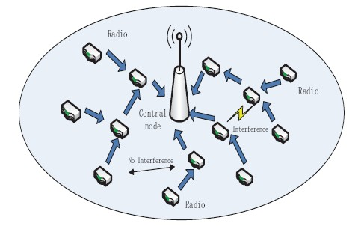
System Model
We have a set of nodes in the network. Besides, all nodes want to transmit their data to the central node. In addition, nodes laying far away can reuse the channel.
When a node use the channel to transmit data, other receiving nodes lay in the interference zone of this node cannot use the channel simultaneously.
An example of the network scenario with a central node and several transmission nodes.
We have only one channel in the network
Notes:
Figure is not clear.
You may want to use Viso figure, rather than the figure from PDF file.
60sec
As we know, node mobility induces unpredictable dynamic topology changes in MANETs. Let’s look a an example. The current network contains 5 ad hoc nodes:,A, B,C D and E. Because only node B is within the transmission range of node A, node A can only communicate with node D, C, E via the relaying node of B. Once node B moves outside node A’s transmission zone, at this moment, node A loses the connections with all other nodes. That means all these four nodes are isolated and the network is disconnected.
In addition, node mobility has a significant impact on the network performance as well. Therefore, we are strongly motivated to investigate the nature of node moving behaviors in the MANETs.
[Click]
However, different types of ad hoc nodes have different moving behaviors.
For example, pedestrians may move slowly while a bus may move faster, but they follow different routes.
[Click] Then, how to specify a typical node mobility in MANETs ?.
[Click] People use mobility models to capture different node moving behaviors.

Slide 10
System Model
Basic Assumption for Model
Every node in the network knows the routing to the destination which means they know whom they should transmit data to.
We call a transit node and a receiving node as a data-link. Every data link has its own interference zoom and the auctioneer knows the interference relation among these data-links. Finally, we let the transit node to represent the data-link as a bidder in the auction.
Notes:
Illustrate the problem using game theory model

Slide 11
Problem formulation
Key notations
----The bid of node i for the channel
----The price auctioneer charges node i for using channel
----The true value of node i for the channel
----The weight of vertex i or node i
---- The buffer length of node i

Slide 12
Problem formulation
The definition of some notations
The weight of bidder i
We charge the winner i of the auction the boundary bid which means if i bids higher than , he can win the auction, otherwise, he will lose.
is the highest weight belonging to a node which lays in
the interference zone of i.

Slide 13
Problem formulation
The auctioneer uses some algorithms(such as greedy algorithm or linear programming) to allocate the channel.
We charge the node i who uses the channel
Then, the auctioneer redistribute these revenue of the network by allocate the revenue of the winners of our auction.
is the highest weight belonging to a node which lays in
the interference zone of i but do not interfere with the other nodes which are selected to use the channel
D = (d1, d2...) denotes the winners of the auction

Slide 14
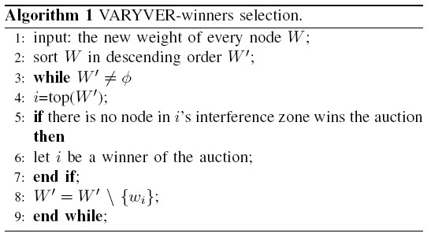
Problem formulation
The algorithm we use to select to winners of the auction
Notes:
这个不记得是那篇paper提到的。。。麻烦问一下杨森学长，因为是他上次在会上提到的这篇reference的

Slide 15
Problem formulation
Main Theorem

Slide 16
Problem formulation
Then, we present our solutions to efficiently allocate the channel, given the location of every node and the weight of every node. The channel allocation problem can be converted to a weighted vertex cover problem.
The algorithms include LP algorithm, N-LP algorithm and greedy algorithm. We will introduce the algorithms and compare the results of these algorithms.

Slide 17
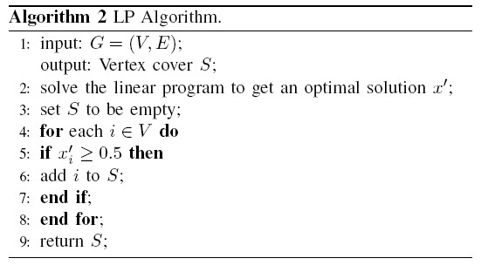
Problem formulation

Slide 18
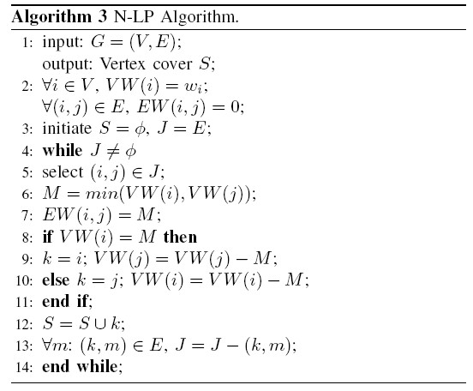
Problem formulation

Slide 19
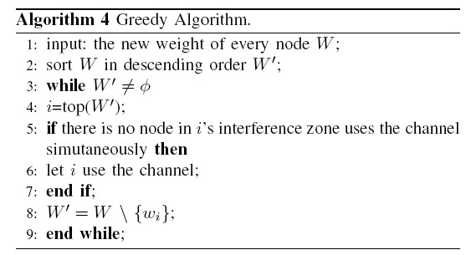
Problem formulation

Slide 20
Outline
Introduction
System Model and Problem Formulation
Simulation Results
Conclusions
20

Slide 21
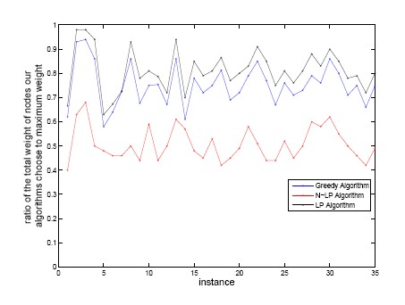
Comparison of Algorithms
The comparison of the total weight of chosen nodes in one time slot among the three different algorithms
21
Notes:
贪心算法一是：先在第一个信道上依次选择传输链路，直到无法再选。然后在第二个信道上依次选择传输链路，最后在第三个信道上选。
贪心算法二是：先在第一个信道上选择一个传输链路，然后在第二个信道上选择一个传输链路，接着是第三个信道。然后再从第一个信道开始选。

Slide 22
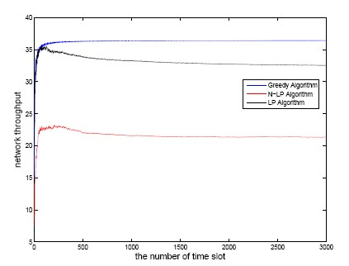
Comparison of Algorithms
The network throughput in three thousand time slots
22
Notes:
贪心算法一是：先在第一个信道上依次选择传输链路，直到无法再选。然后在第二个信道上依次选择传输链路，最后在第三个信道上选。
贪心算法二是：先在第一个信道上选择一个传输链路，然后在第二个信道上选择一个传输链路，接着是第三个信道。然后再从第一个信道开始选。

Slide 23
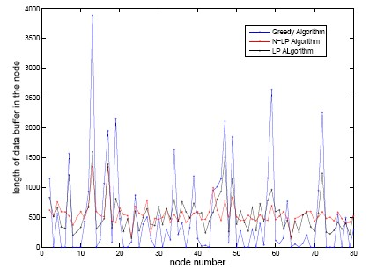
Comparison of Algorithms
The buffer status of nodes in the network
23
Notes:
贪心算法一是：先在第一个信道上依次选择传输链路，直到无法再选。然后在第二个信道上依次选择传输链路，最后在第三个信道上选。
贪心算法二是：先在第一个信道上选择一个传输链路，然后在第二个信道上选择一个传输链路，接着是第三个信道。然后再从第一个信道开始选。

Slide 24
Outline
Introduction
System Model and Problem Formulation
Simulation Results
Conclusions and Future work
24

Slide 25
Conclusions
In our paper, we develop a new kind of auction called VARYVER to discuss the channel allocation problem in multi-hop network.
The mechanism of this VARYVER action not only ensure the truthfulness of every bidders’ bids but also consider the fairness among nodes in our network.
In addition, we introduce several algorithms to help auctioneer to efficiently solve the channel allocation problem.
By comparing the behaviors of these algorithms in simulation results, we find that Greedy Algorithm is better to get a high throughput of the network, while LP Algorithm is a better choice when we consider both the throughput and the fairness among cognitive nodes of the network.
25

